Slide 1
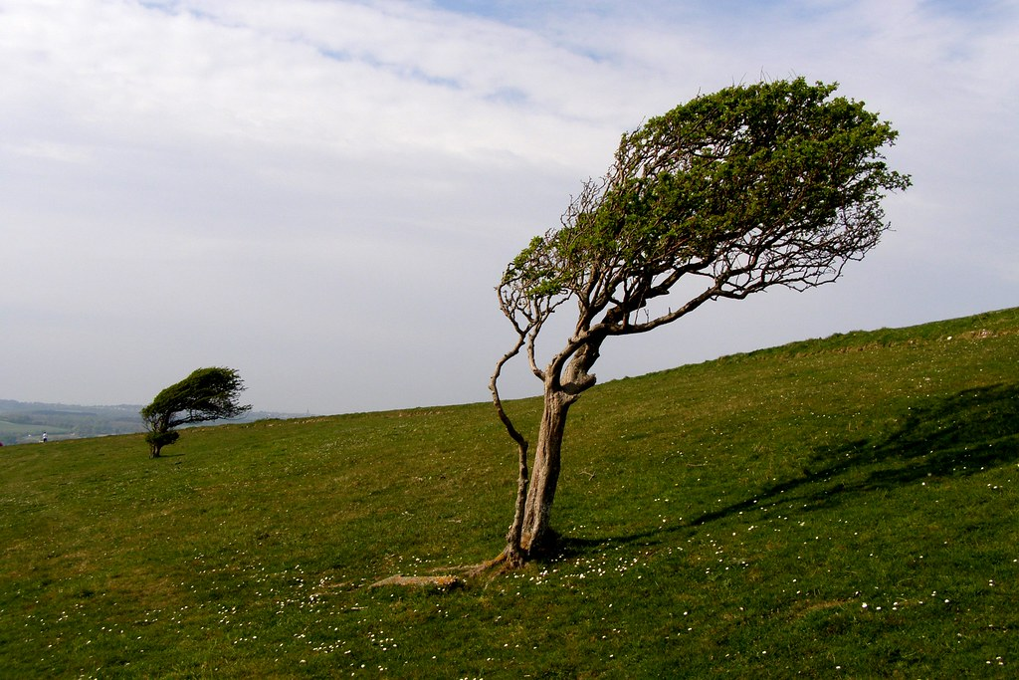
windswept
Exposed to and swept by the wind
This Photo by Unknown Author is licensed under CC BY-SA-NC

Slide 2
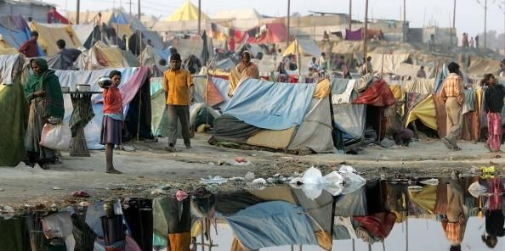
impoverished
This Photo by Unknown Author is licensed under CC BY
Characterized by poverty

Slide 3
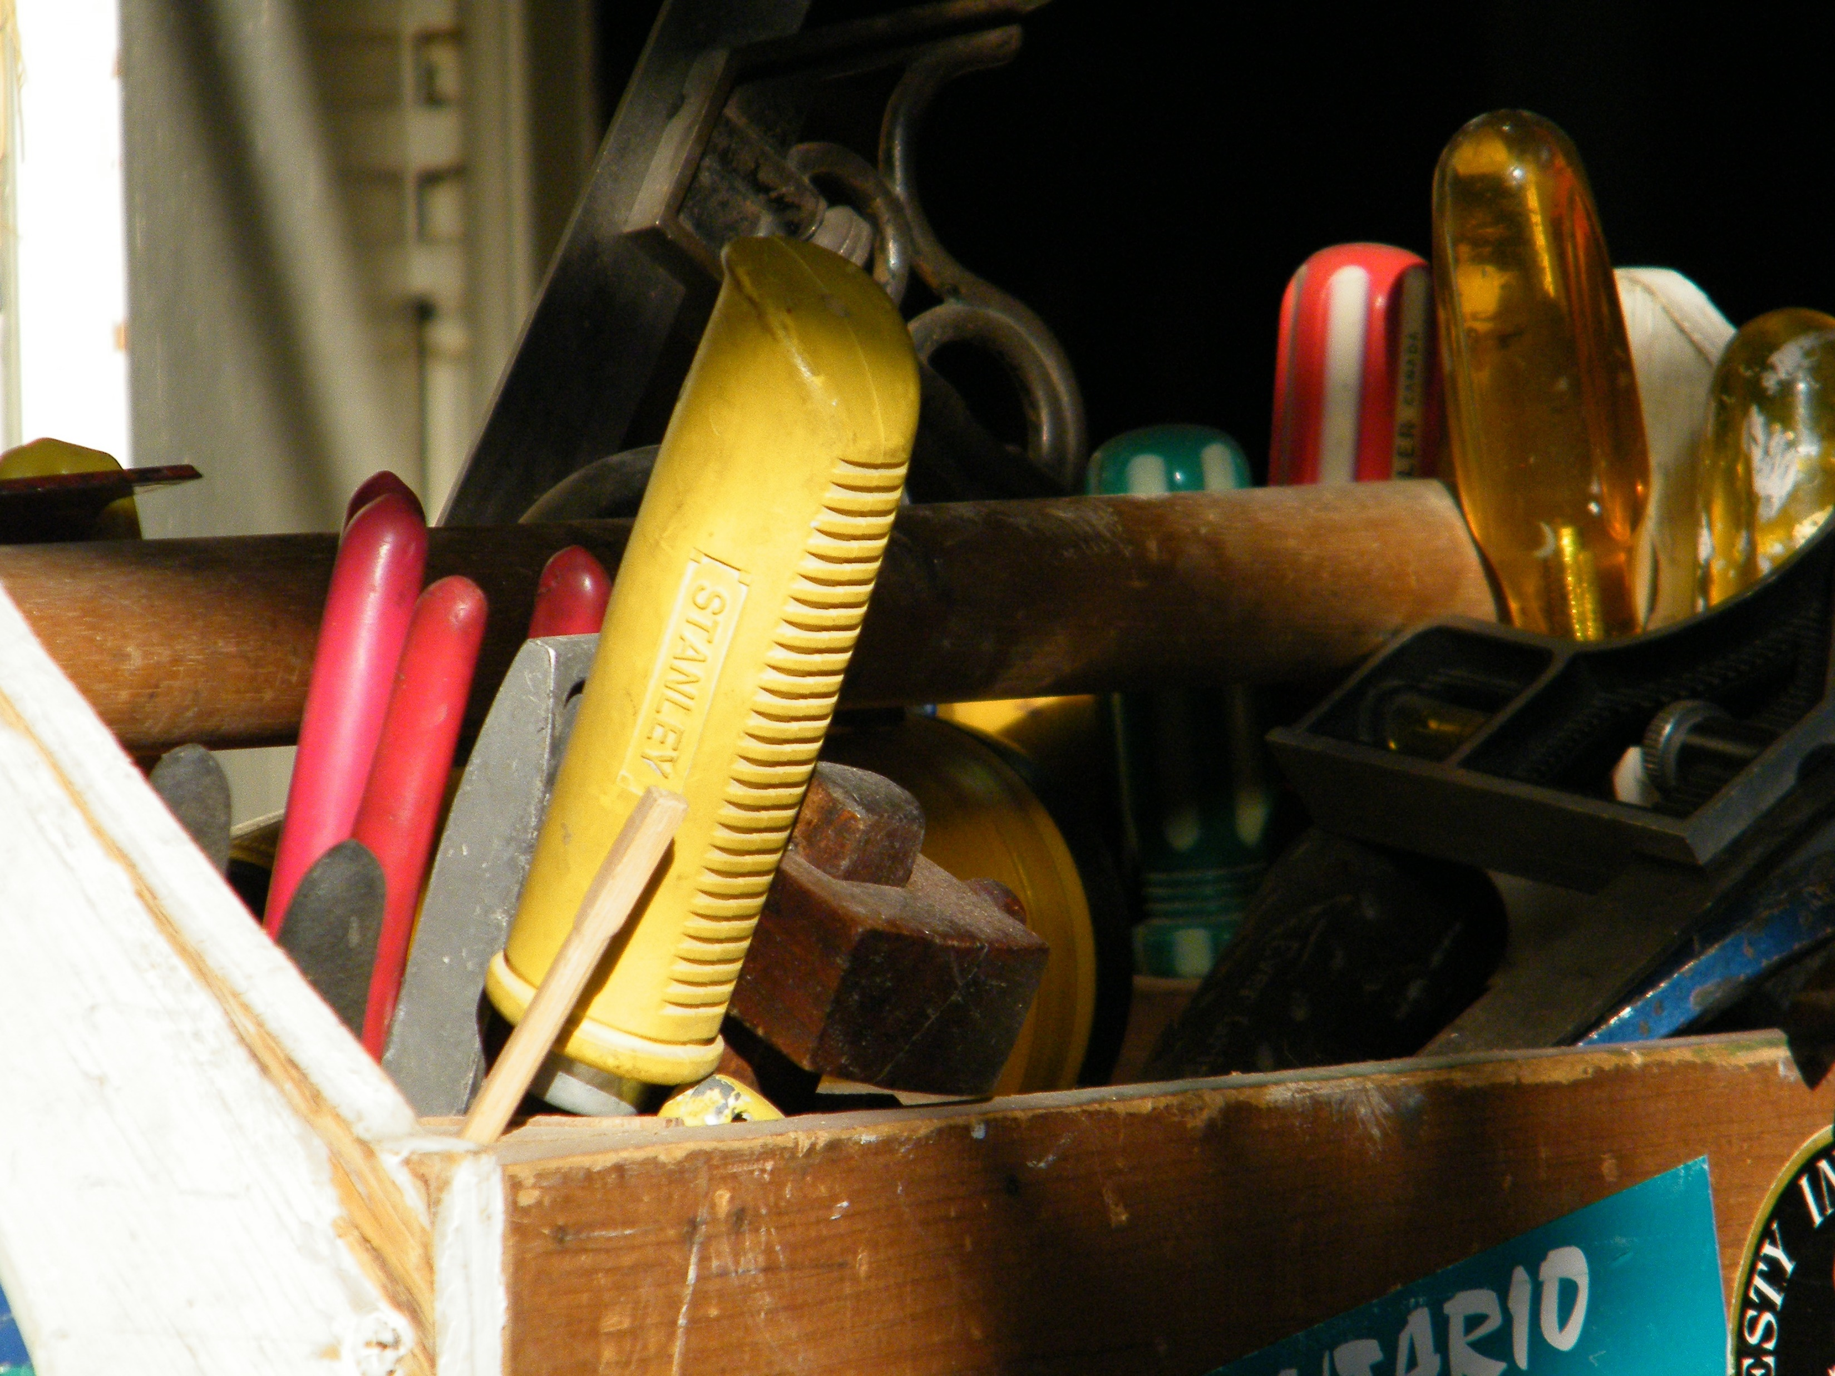
fashioned
To make or give shape to
This Photo by Unknown Author is licensed under CC BY-SA-NC

Slide 4
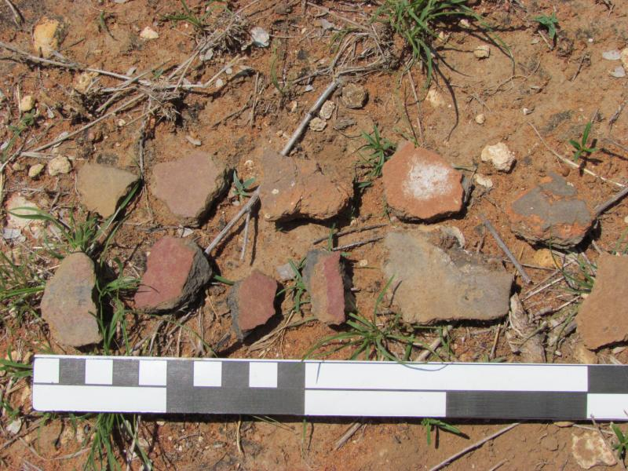
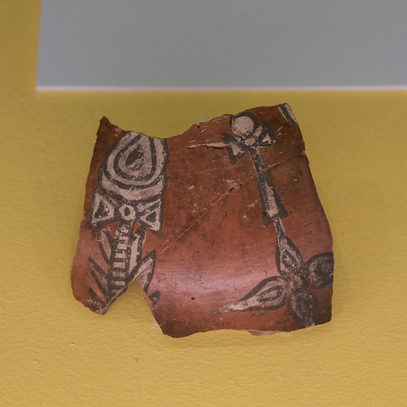
potsherds
A broken piece of ceramic often found at archaeological sites

Slide 5
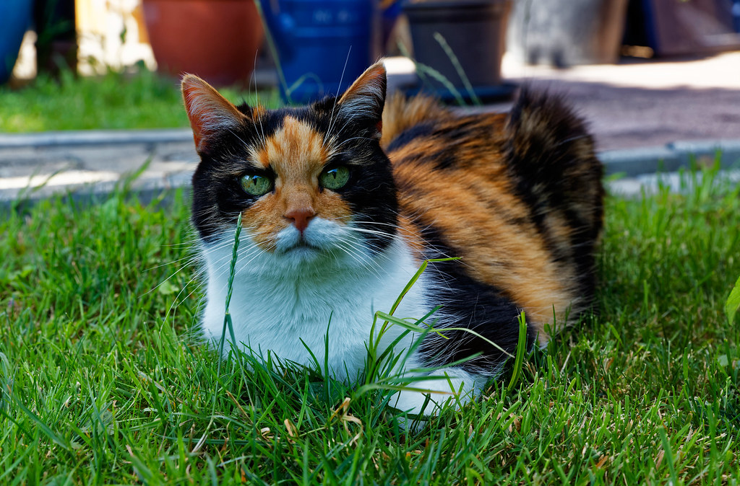
calico
Having spots or blotches of different color
This Photo by Unknown Author is licensed under CC BY-NC-ND

Slide 6
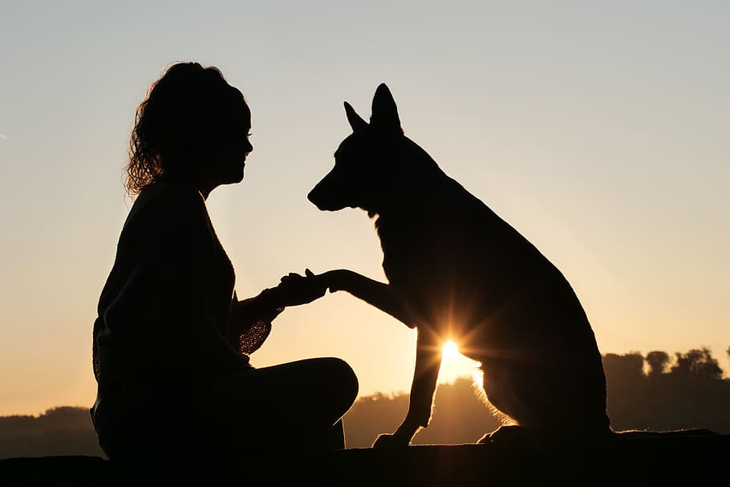
cherishes
to love or care for

Slide 7
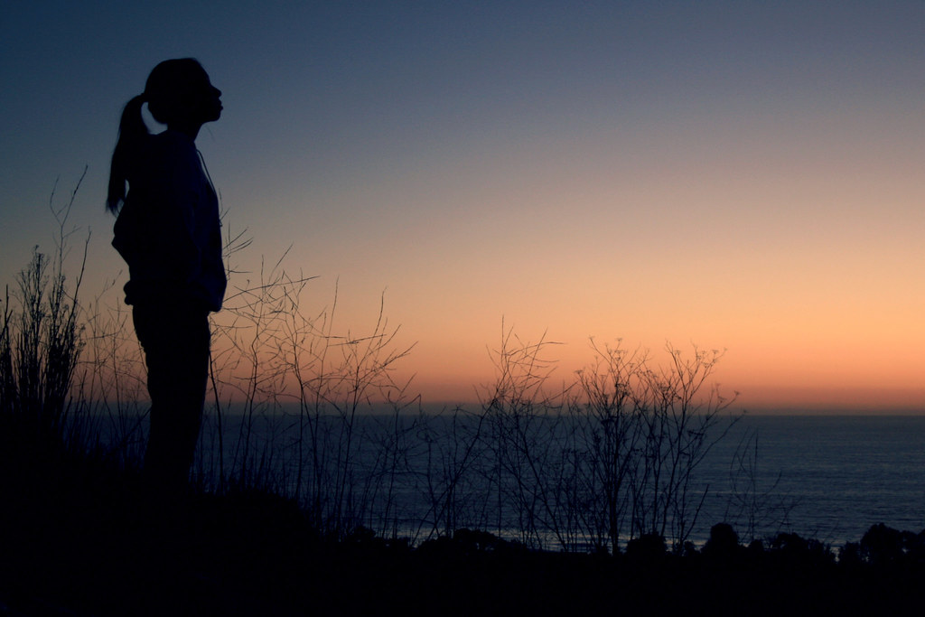
solitude
A state of being by oneself
This Photo by Unknown Author is licensed under CC BY

Slide 8
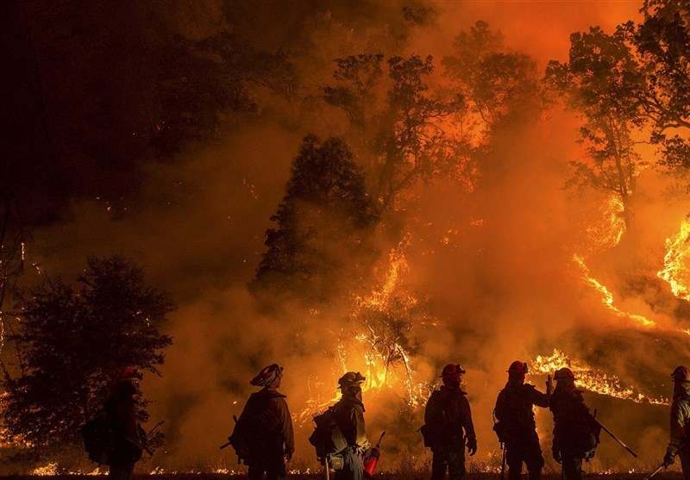
battled
To fight
This Photo by Unknown Author is licensed under CC BY

Slide 9
supplemented
This Photo by Unknown Author is licensed under CC BY-NC-ND
to add to

Slide 10
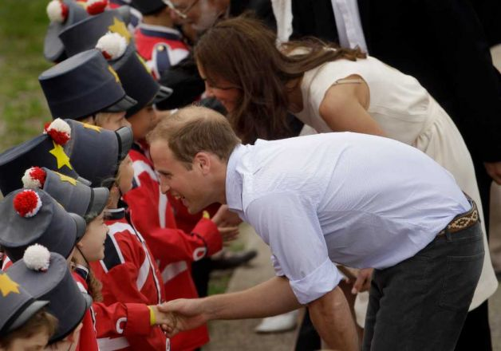
patrons
A person, especially one who is rich or powerful, who supports another person…
This Photo by Unknown Author is licensed under CC BY-NC-ND

Slide 11
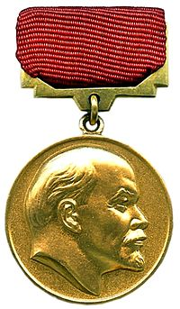
prize
This Photo by Unknown Author is licensed under CC BY-SA
to think something is important or valuable

Slide 12
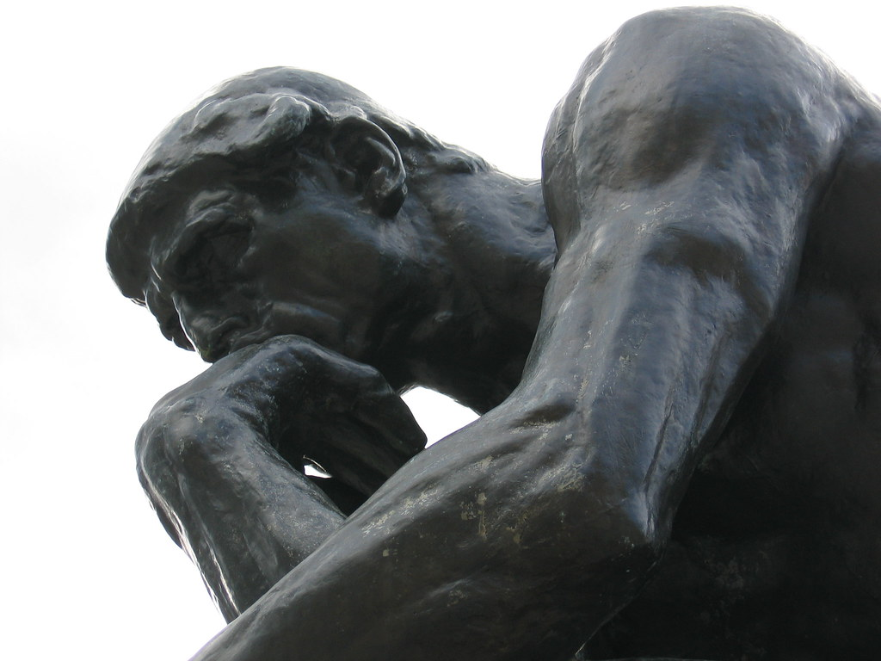
reflect
to think seriously about something that has occurred
This Photo by Unknown Author is licensed under CC BY-SA-NC

