Slide 1
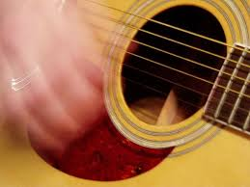
strummed
to play an instrument in a gentle or unskilled way

Slide 2
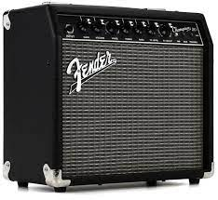
amplifier
an electronic device used to increase the sound
of an instrument

Slide 3
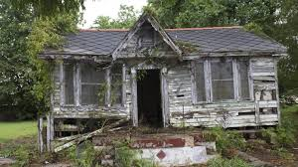
dilapidated
fallen into ruin; broken down

Slide 4
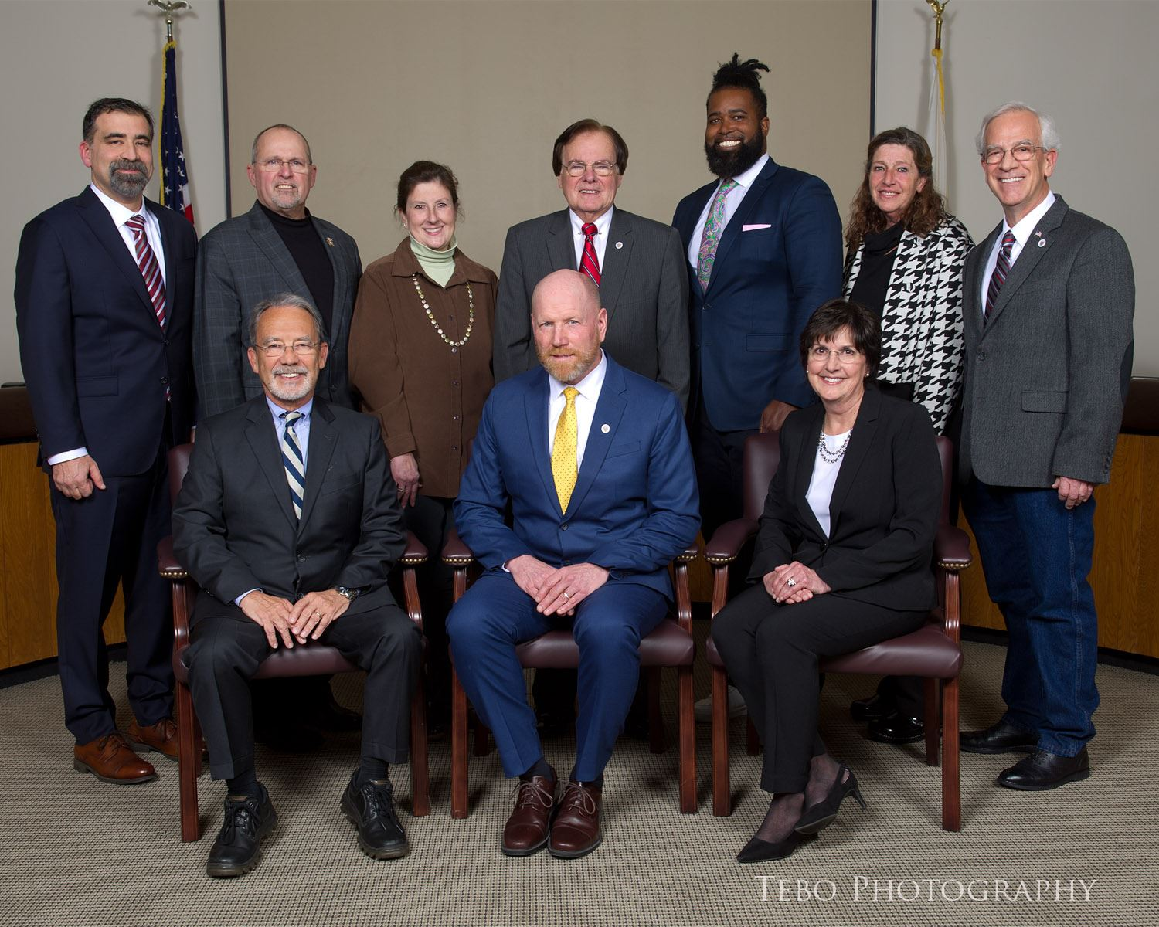
town council
a group of elected officials that make decisions

Slide 5
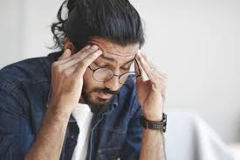
slight
not much or not important; small

Slide 6
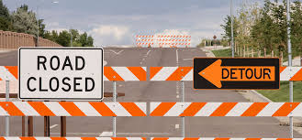
detour
a different route to a location,
often taken to avoid something

Slide 7
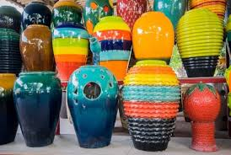
ceramics
art made of baked clay

Slide 8
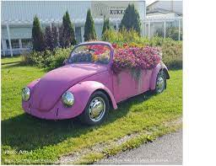
eyesore
something that is unpleasant based on their point of view

Slide 9
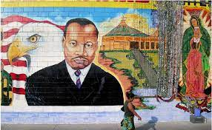
mural
an illustration painted on a wall or ceiling

Slide 10
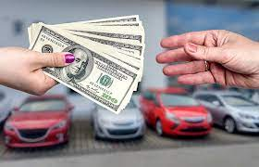
funds
an amount of money set aside for a purpose

Slide 11
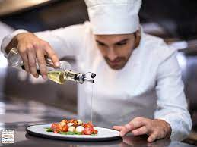
culinary
the art of cooking

Slide 12
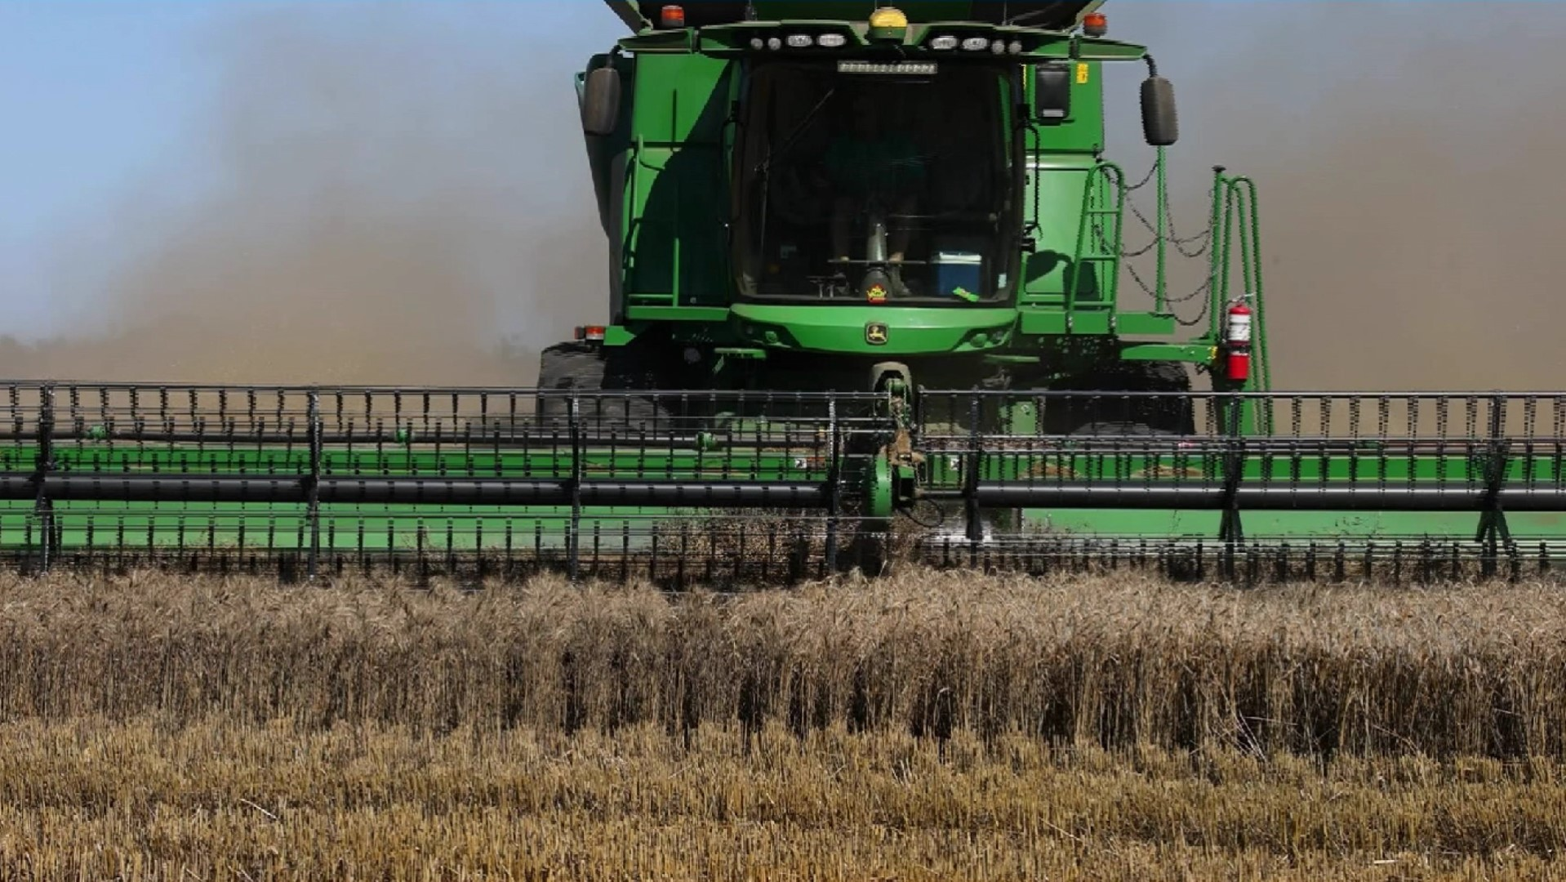
essential
very important and necessary

Slide 13
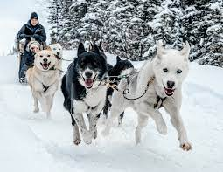
diligently
steady and determined

Slide 14
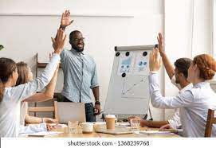
unanimously
everyone agrees

Slide 15
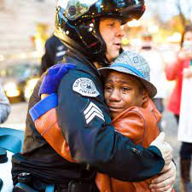
gratitude
a feeling of being thankful

