Slide 1
t________
a message sent by telegraph

Slide 2
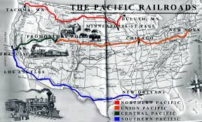
t___________
crossing a continent

Slide 3
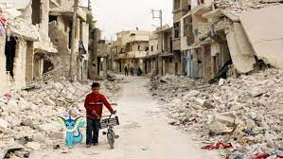
h______
rough or unpleasant to hear, see, taste, or touch

Slide 4
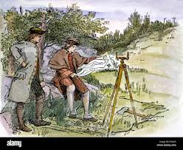
s_________
someone who examines something to make decisions;
a land surveyor splits land into boundaries (maps)

Slide 5
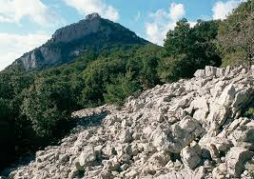
r_______
rough and uneven

Slide 6
g_______ c________
a special event marking the start of something new

Slide 7
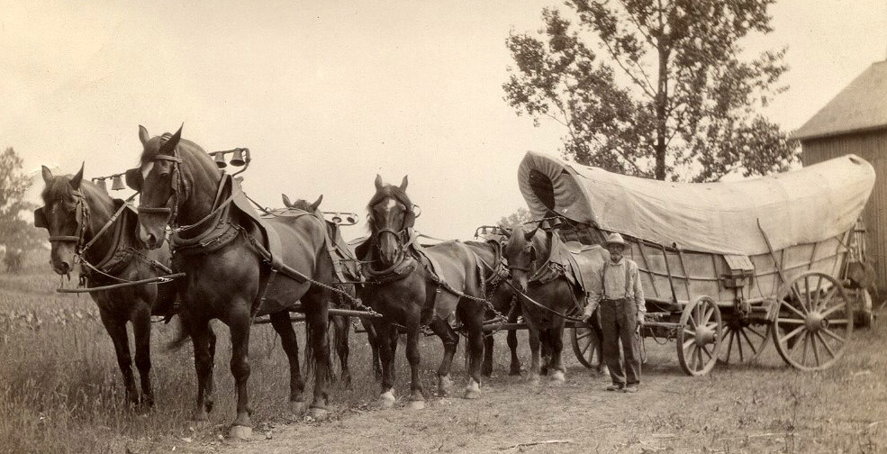
h______
to pull something or to move something
from one place to another

Slide 8
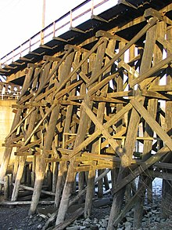
t________
the structure that holds up a railroad bridge

Slide 9
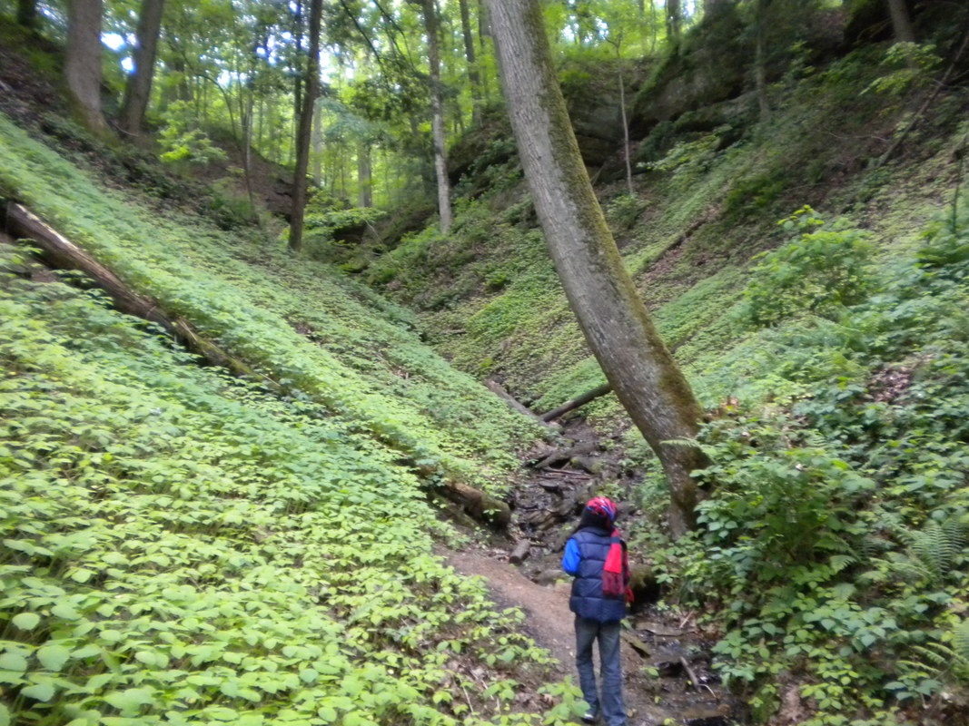
r________
deep, narrow valleys

Slide 10
w______
thin twigs and branches woven
to create frames or baskets

Slide 11
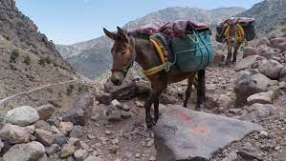
t________
to move across or through something

Slide 12
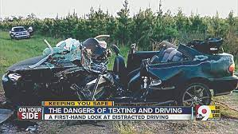
f______
causing death

Slide 13
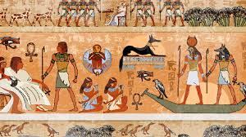
c_________
the creation of government, culture, and economy by humans

