Slide 1
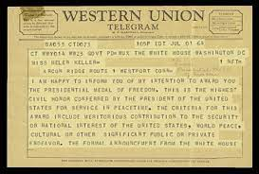
telegram
a message sent by telegraph

Slide 2
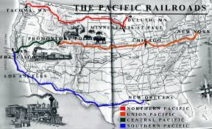
transcontinental
crossing a continent

Slide 3
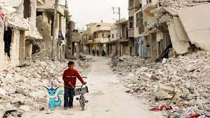
harsh
rough or unpleasant to hear, see, taste, or touch

Slide 4
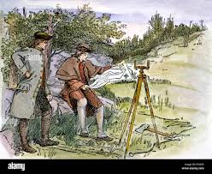
surveyors
someone who examines something to make decisions;
a land surveyor splits land into boundaries (maps)

Slide 5
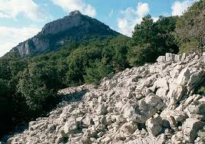
rugged
rough and uneven

Slide 6
groundbreaking ceremony
a special event marking the start of something new

Slide 7
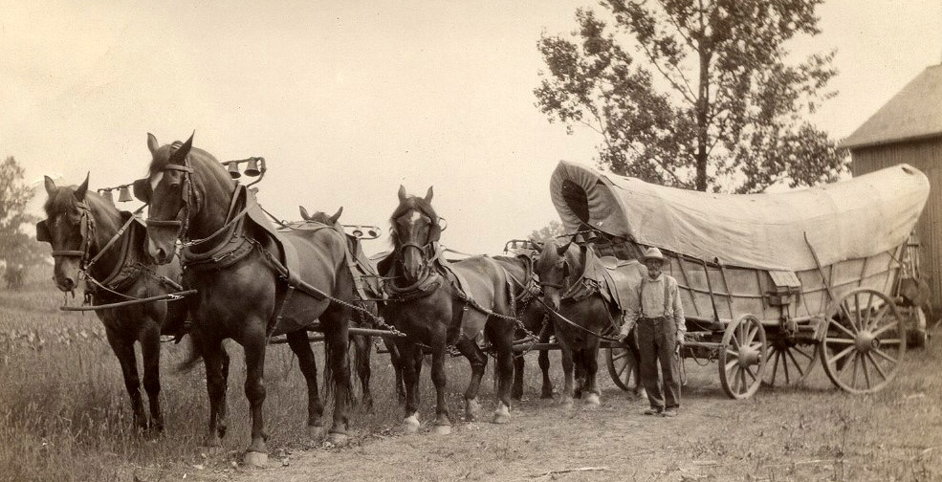
haul
to pull something or to move something
from one place to another

Slide 8
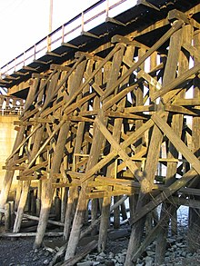
trestles
the structure that holds up a railroad bridge

Slide 9
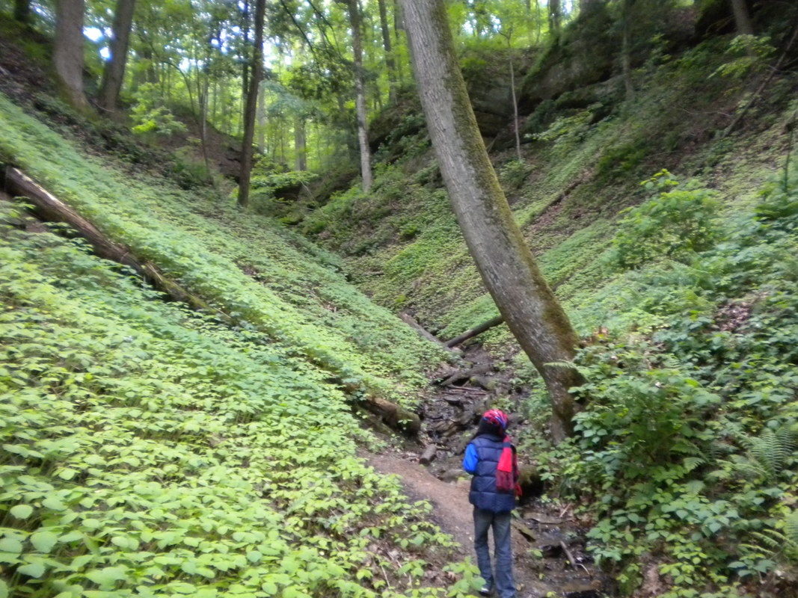
ravines
deep, narrow valleys

Slide 10
wicker
thin twigs and branches woven
to create frames or baskets

Slide 11
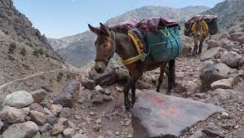
traverse
to move across or through something

Slide 12
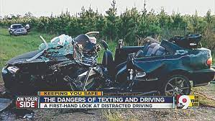
fatal
causing death

Slide 13
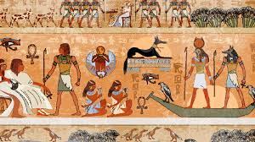
civilization
the creation of government, culture, and economy by humans

