Slide 1
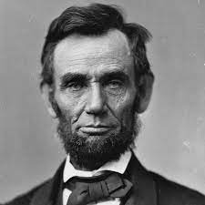
a_______
a person in favor of ending slavery

Slide 2
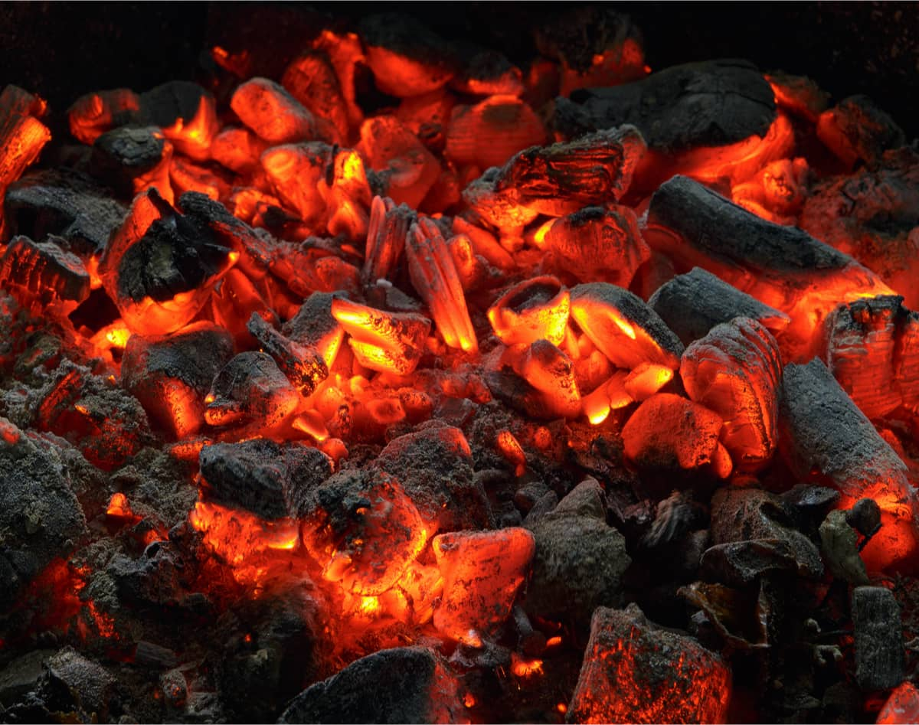
s_________
to burn slowly and smoke with little or no flame

Slide 3
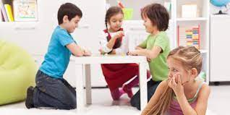
a________
to make someone feel uncomfortable or alone

Slide 4
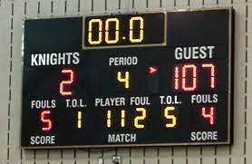
d_______
a quick and final conclusion

Slide 5
r________
in favor of extreme changes or reforms

Slide 6
e________
to leave one’s own place or country
to live in another

Slide 7
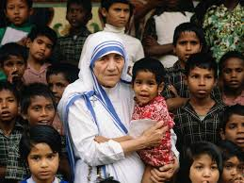
r_______
good moral character, virtuous

Slide 8
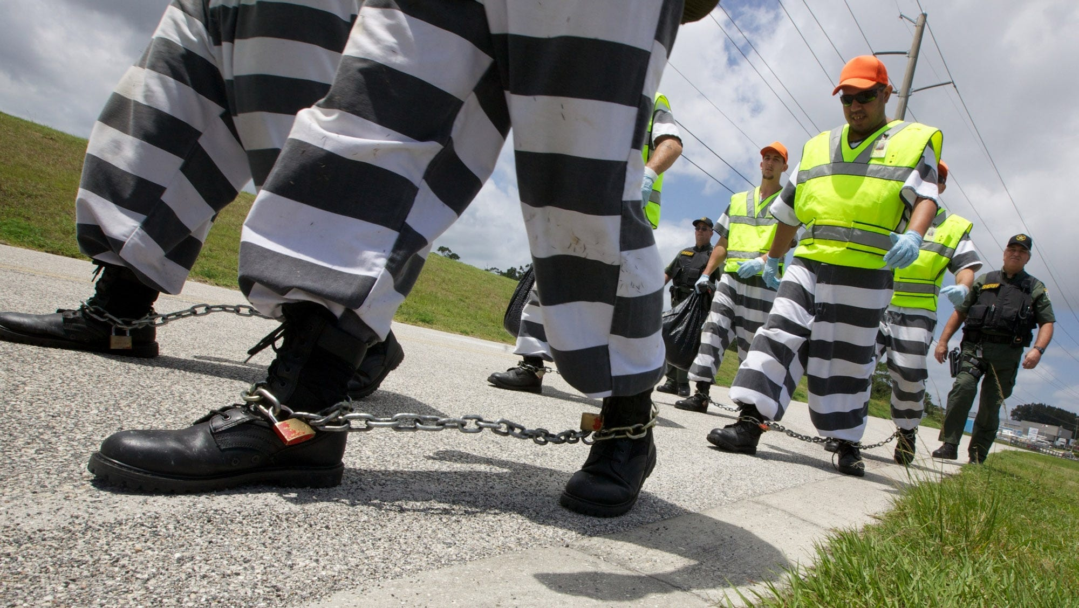
s_______
metal cuffs and chains used to prevent movement

Slide 9
e________
a strong felling of excitement and interest about something

Slide 10
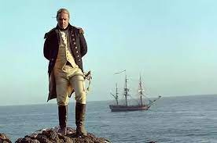
m_______
a person who sails or navigates a ship

Slide 11
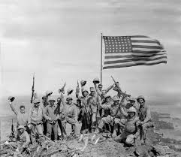
a______
spirit, passion, loyalty for something

Slide 12
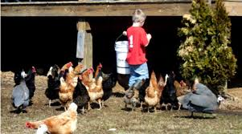
m______
in the middle of something like a crowd of people or
an activity like a video game, project, or chore

Slide 13
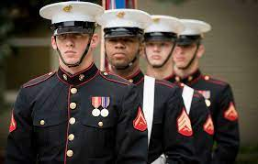
b______
an old way to say brother or fellow member of a group

