Slide 1
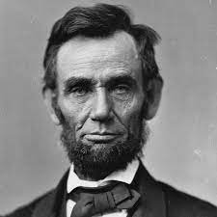
abolitionist
a person in favor of ending slavery

Slide 2
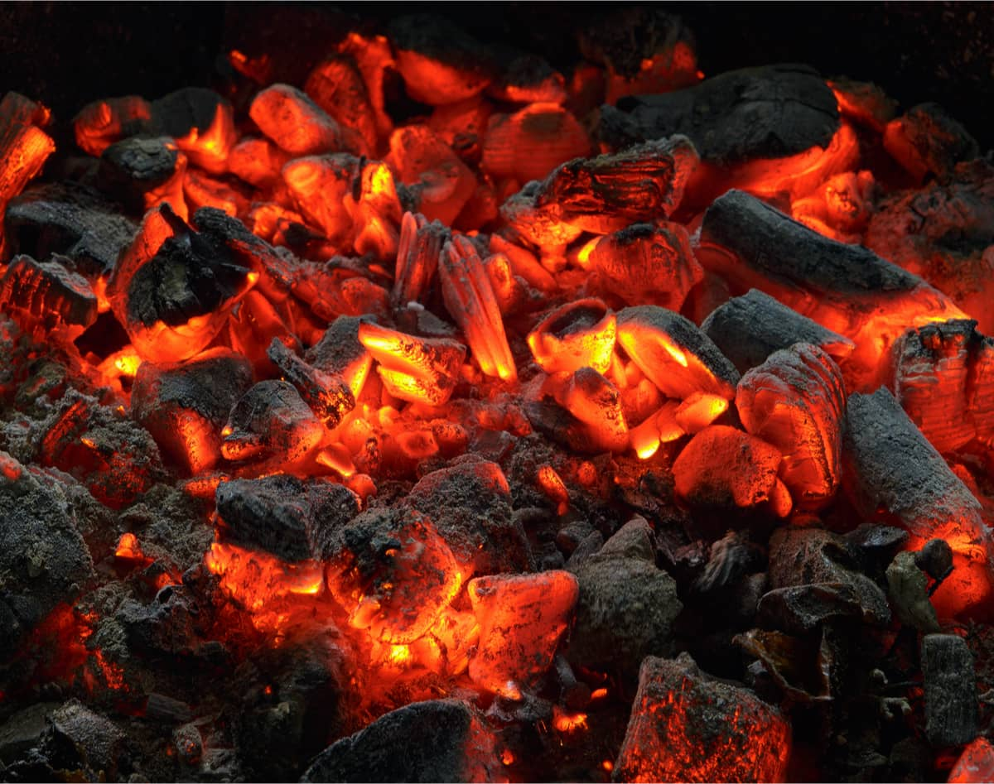
smoldering
to burn slowly and smoke with little or no flame

Slide 3
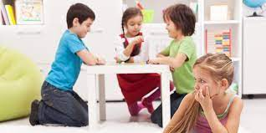
alienate
to make someone feel uncomfortable or alone

Slide 4
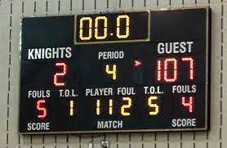
decisive
a quick and final conclusion

Slide 5
radical
in favor of extreme changes or reforms

Slide 6
emigrating
to leave one’s own place or country
to live in another

Slide 7
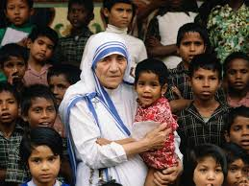
righteous
good moral character, virtuous

Slide 8
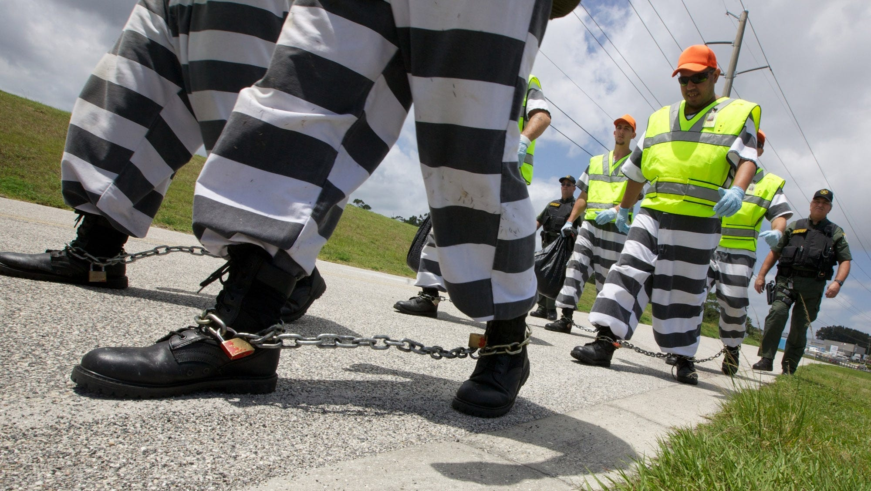
shackles
metal cuffs and chains used to prevent movement

Slide 9
enthusiasm
a strong felling of excitement and interest about something

Slide 10
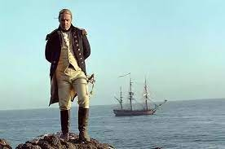
mariner
a person who sails or navigates a ship

Slide 11
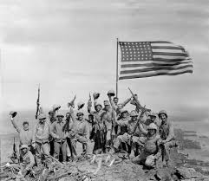
ardor
spirit, passion, loyalty for something

Slide 12
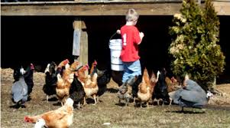
midst
in the middle of something like a crowd of people or
an activity like a video game, project, or chore

Slide 13
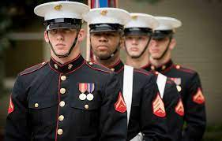
brethren
an old way to say brother or fellow member of a group

