Slide 1
b______
quick and lively; refreshing

Slide 2
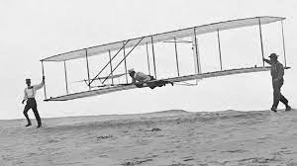
e_________
to imagine

Slide 3
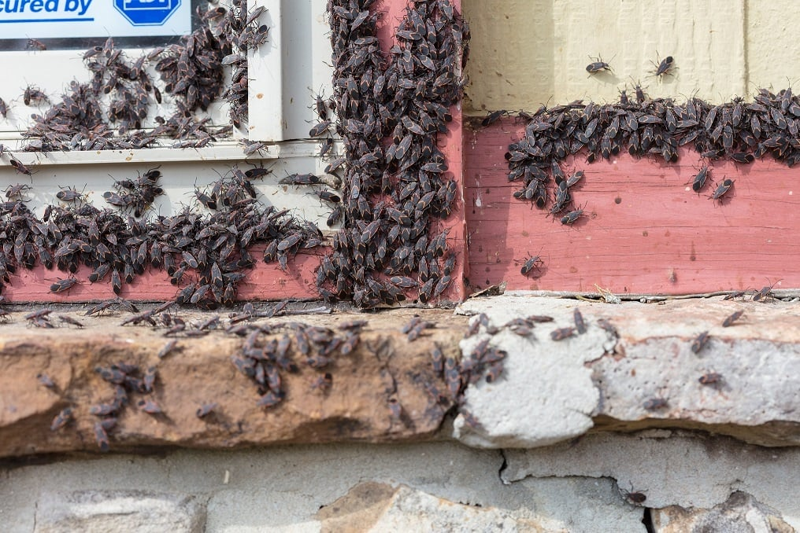
i_________
invaded or overrun by pests or parasites

Slide 4
u________
lawyer
to expose or draw out

Slide 5
b________
to provide evidence for

Slide 6
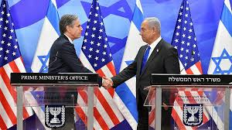
m________
a person that represents his or her government in a foreign country

Slide 7
c_________
the buying and selling of goods

Slide 8
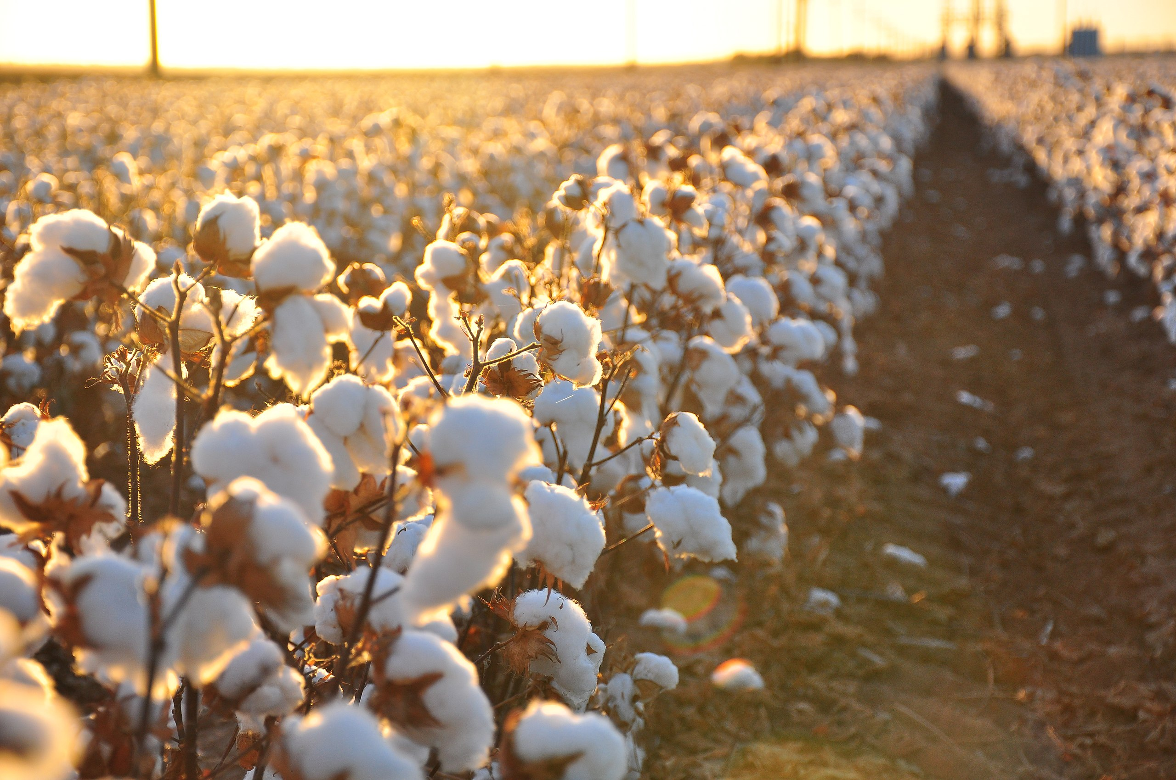
c____ c____
a crop that is grown to be sold to others

Slide 9
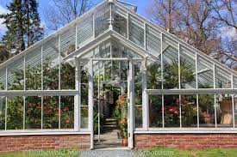
h________
a place that encourages the quick
development of something

Slide 10
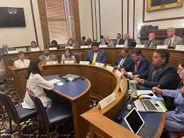
c_________
a group of people brought together to make
a decision or evaluate a situation

Slide 11
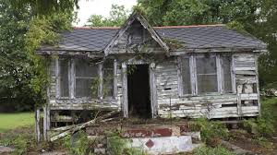
d__________
the condition or process of falling apart

Slide 12
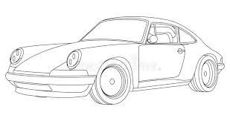
c_______
the exterior shape of something

Slide 13
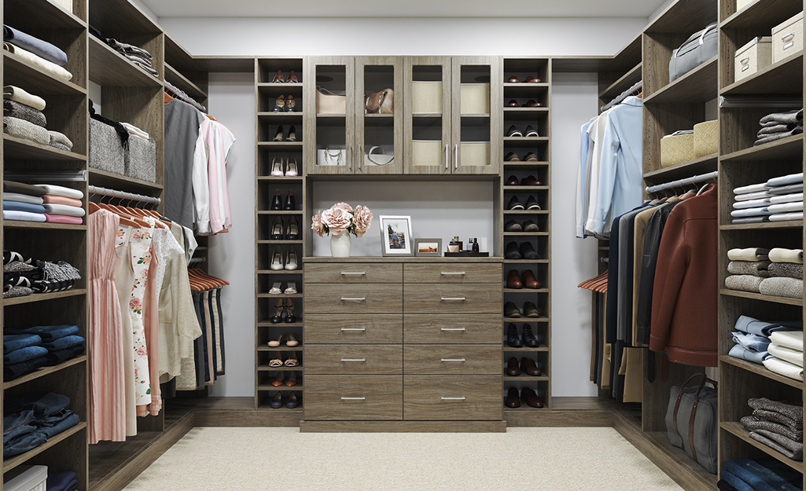
a______
clothing, especially fine or formal ones

Slide 14
m______
a way of doing something

Slide 15
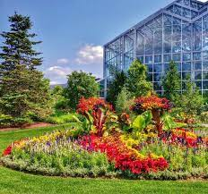
b_____ g______
a garden where plants are grown for
scientific learning and public display

Slide 16
p
a simple, straight-forward,
honest way of speaking

