Slide 1
brisk
quick and lively; refreshing

Slide 2
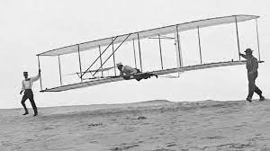
envisioned
to imagine

Slide 3
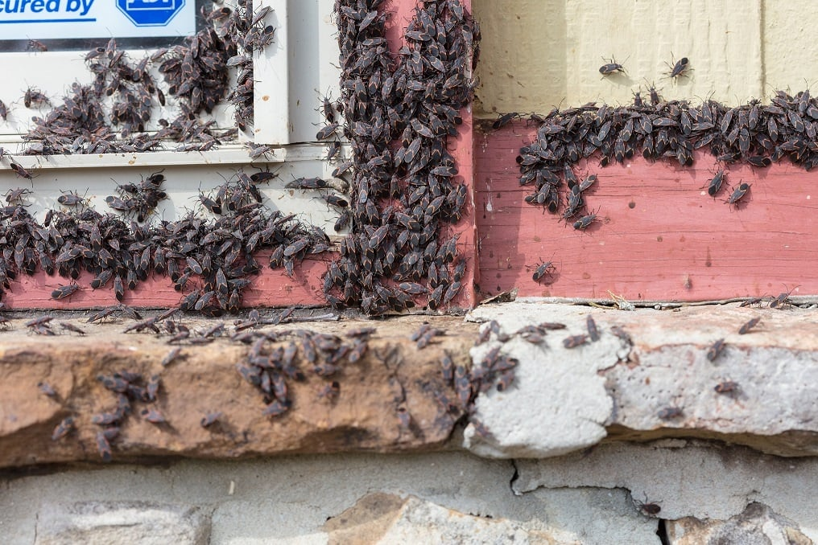
infestation
invaded or overrun by pests or parasites

Slide 4
uprooted
lawyer
to expose or draw out

Slide 5
bespeaks
to provide evidence for

Slide 6
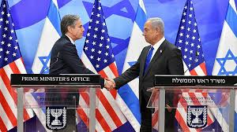
minister
a person that represents his or her government in a foreign country

Slide 7
commerce
the buying and selling of goods

Slide 8
cash crop
a crop that is grown to be sold to others

Slide 9
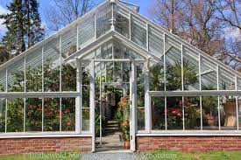
hothouse
a place that encourages the quick
development of something

Slide 10
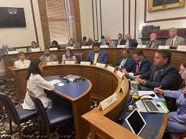
committee
a group of people brought together to make
a decision or evaluate a situation

Slide 11
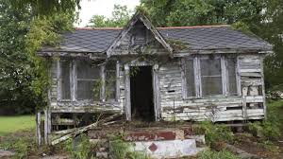
degradation
the condition or process of falling apart

Slide 12
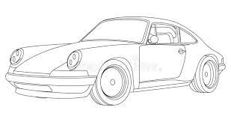
contours
the exterior shape of something

Slide 13
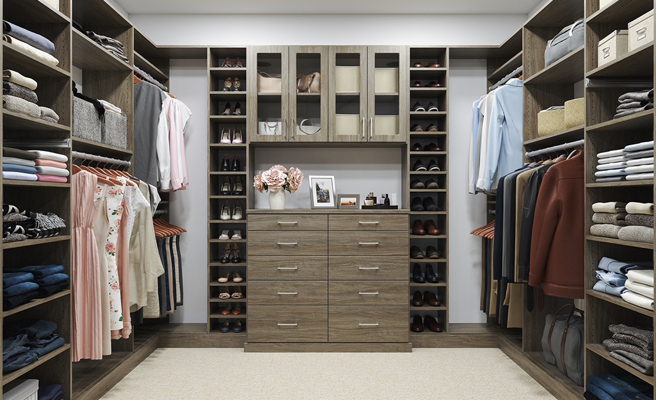
attire
clothing, especially fine or formal ones

Slide 14
mode
a way of doing something

Slide 15
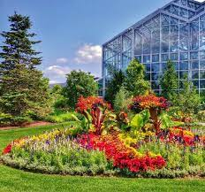
botanical gardens
a garden where plants are grown for
scientific learning and public display

Slide 16
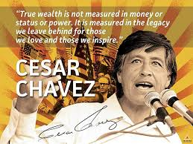
plainspoken
a simple, straight-forward,
honest way of speaking

