Slide 1
intently
with great effort, attention, or concentration

Slide 2
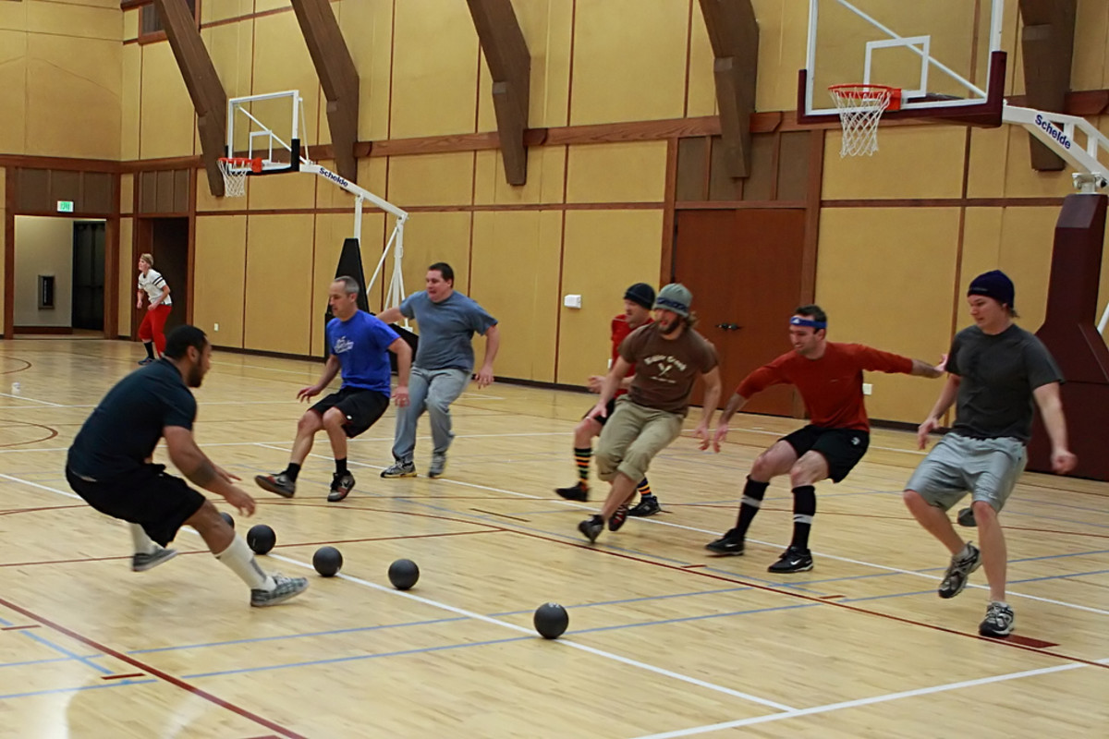
cede
to release or yield

Slide 3
bothersome
something that is troubling or annoying

Slide 4
divulge
to release unknown information

Slide 5
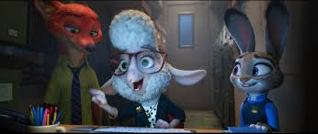
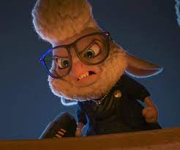
scandal
actions that are perceived as wrong
and cause anger

Slide 6
staunch
loyal and committed in attitude

Slide 7
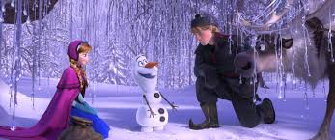
mere
nothing more than expected; simple

Slide 8
hunch
a guess or feeling about what will happen

Slide 9
considerable
large in amount or impact on something

Slide 10
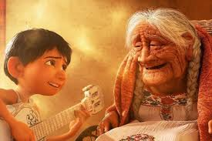
in the nick of time
just before it is too late

Slide 11
ruffian
a villain or troublemaker

Slide 12
respects
to honor someone with your presence

