Slide 1
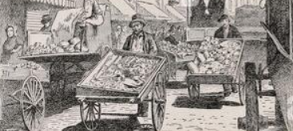
p
a small cart that is pushed by hand; a wheelbarrow

Slide 2
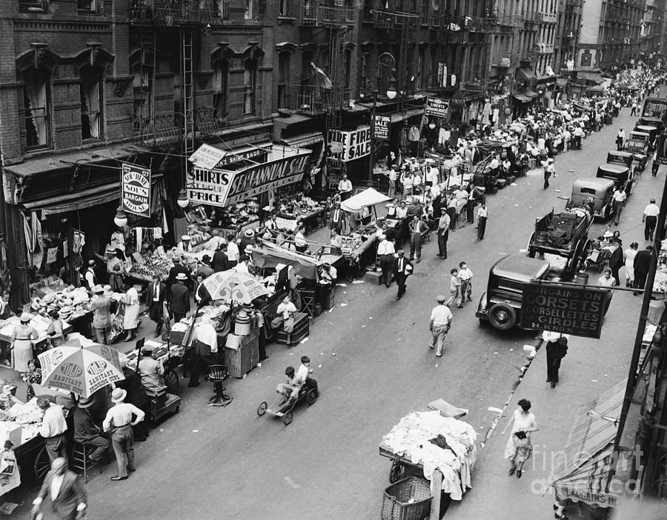
m____ s_____
an area in a town or city where merchants sell goods from stalls

Slide 3
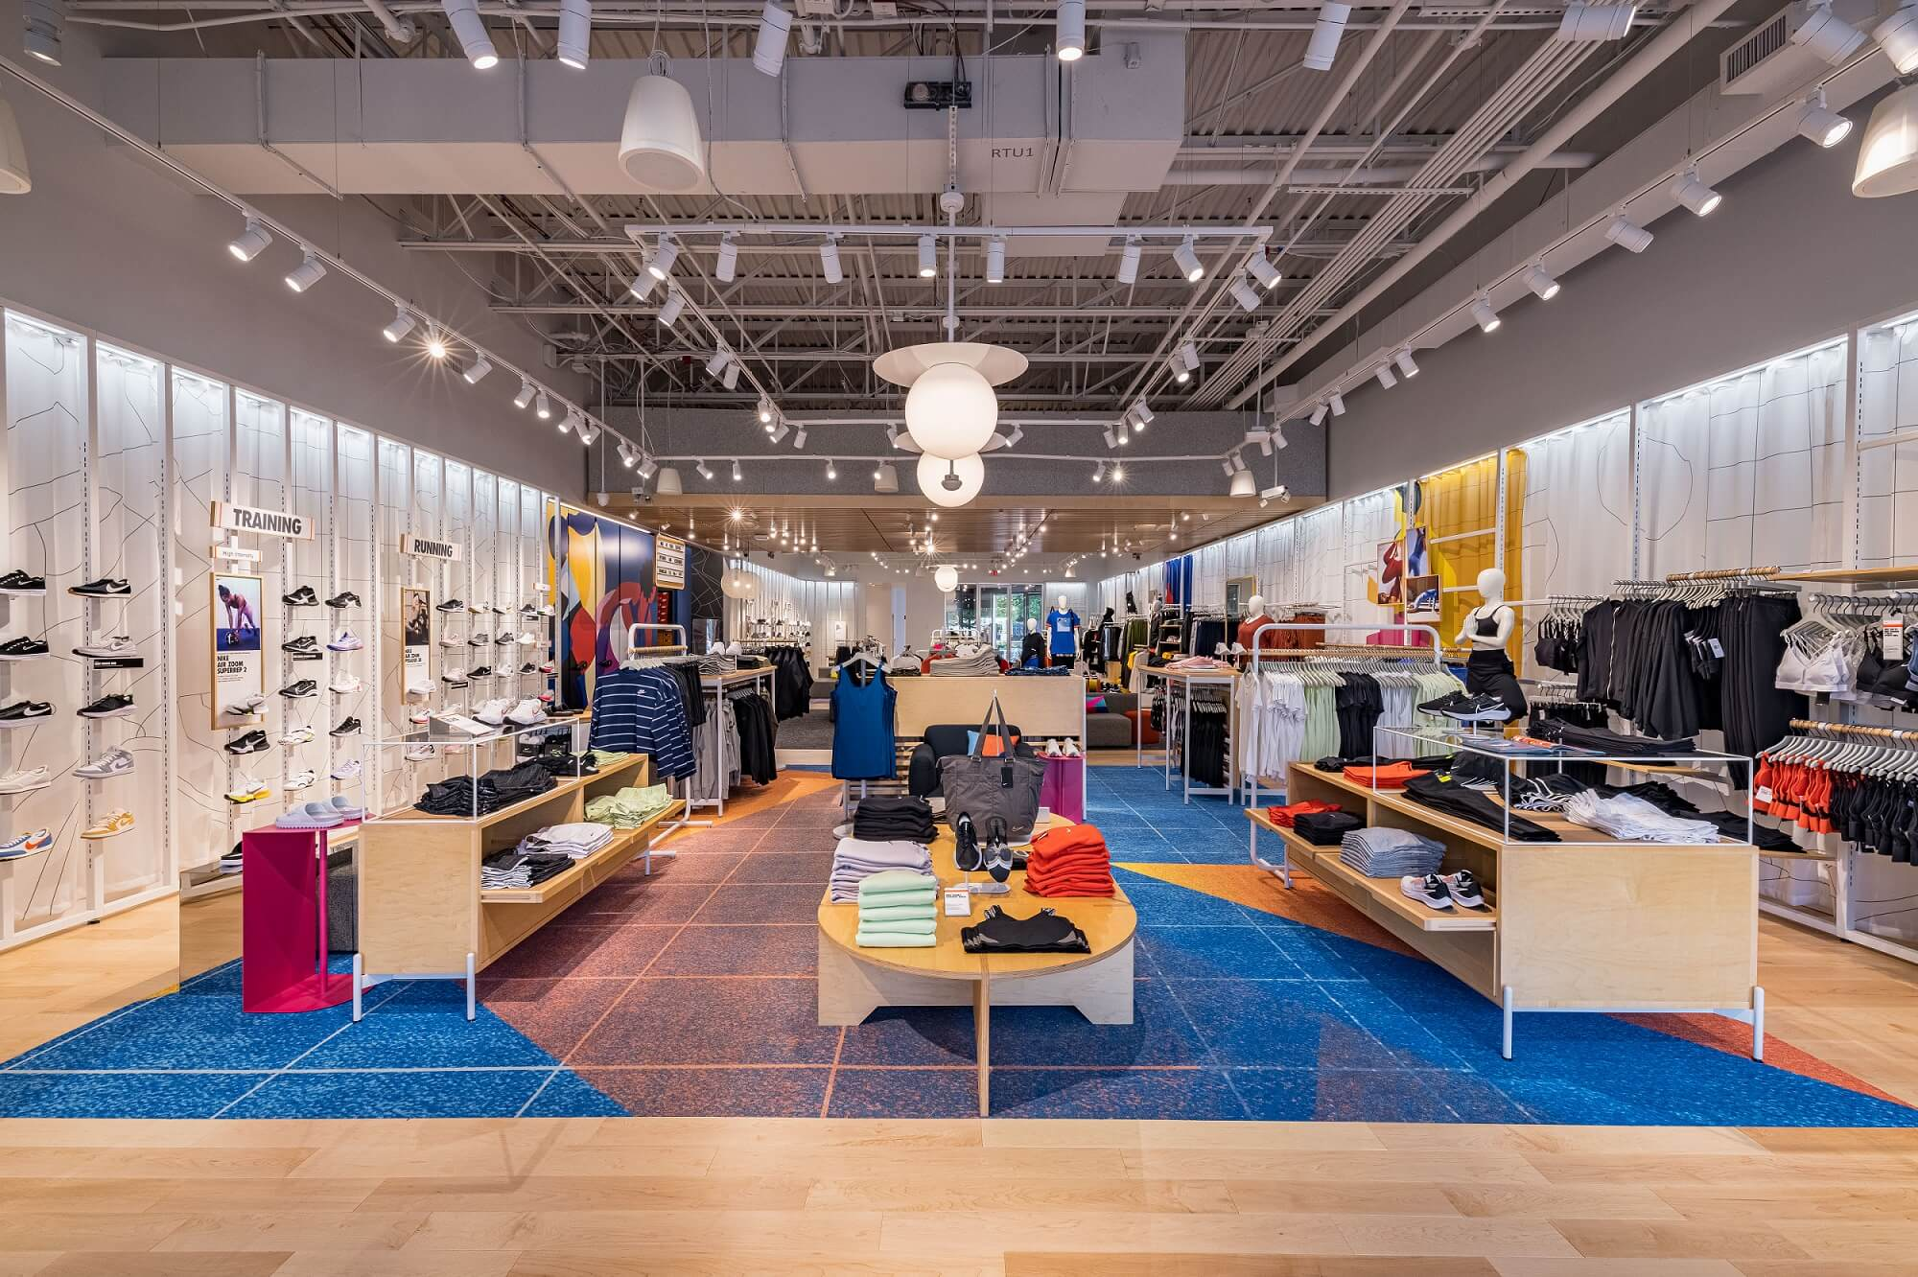
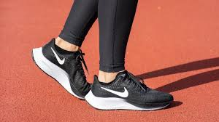
e
Now
At first, only sold running shoes
something that a person strives to do, often referring to business

Slide 4
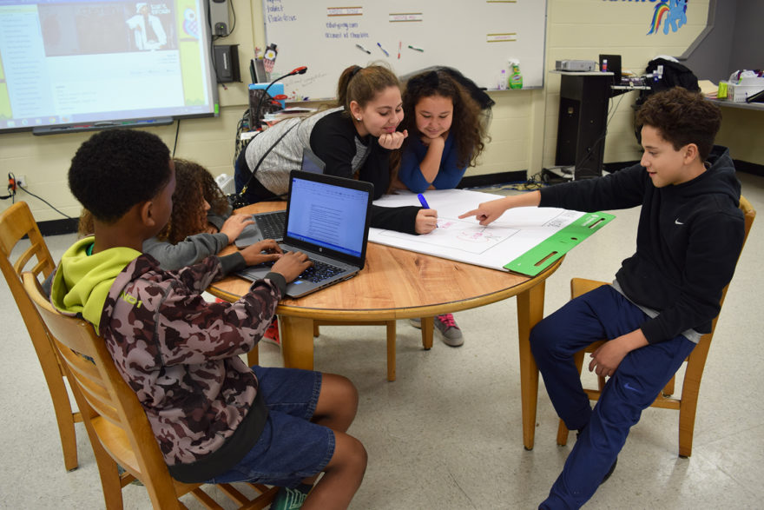
k
eager or interested in

Slide 5
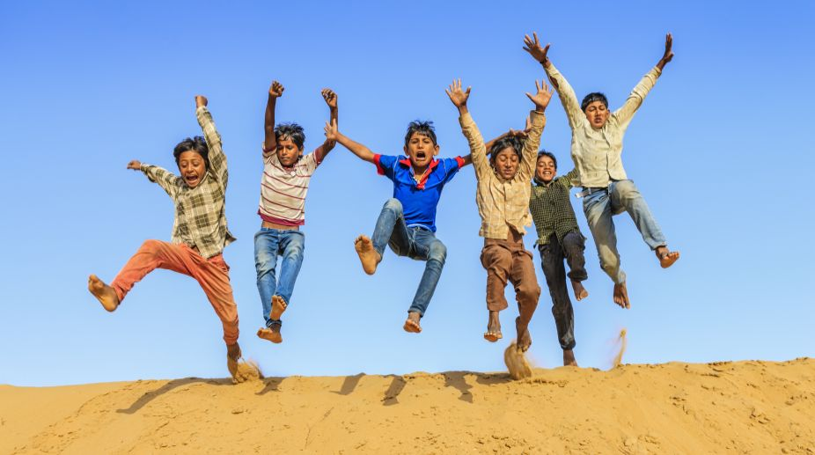
c
friendship

Slide 6
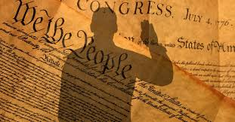
o
a promise that what someone says is true

Slide 7
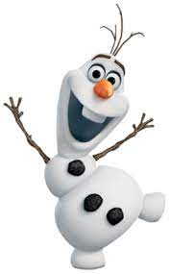
o
eager to meet others; talkative

Slide 8
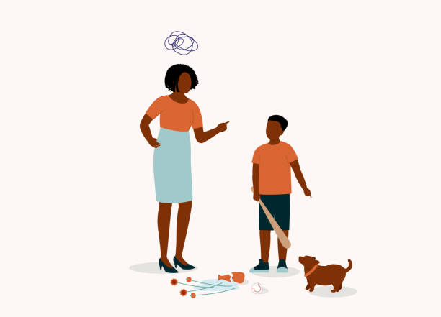
s
doubt about a person or thing

Slide 9
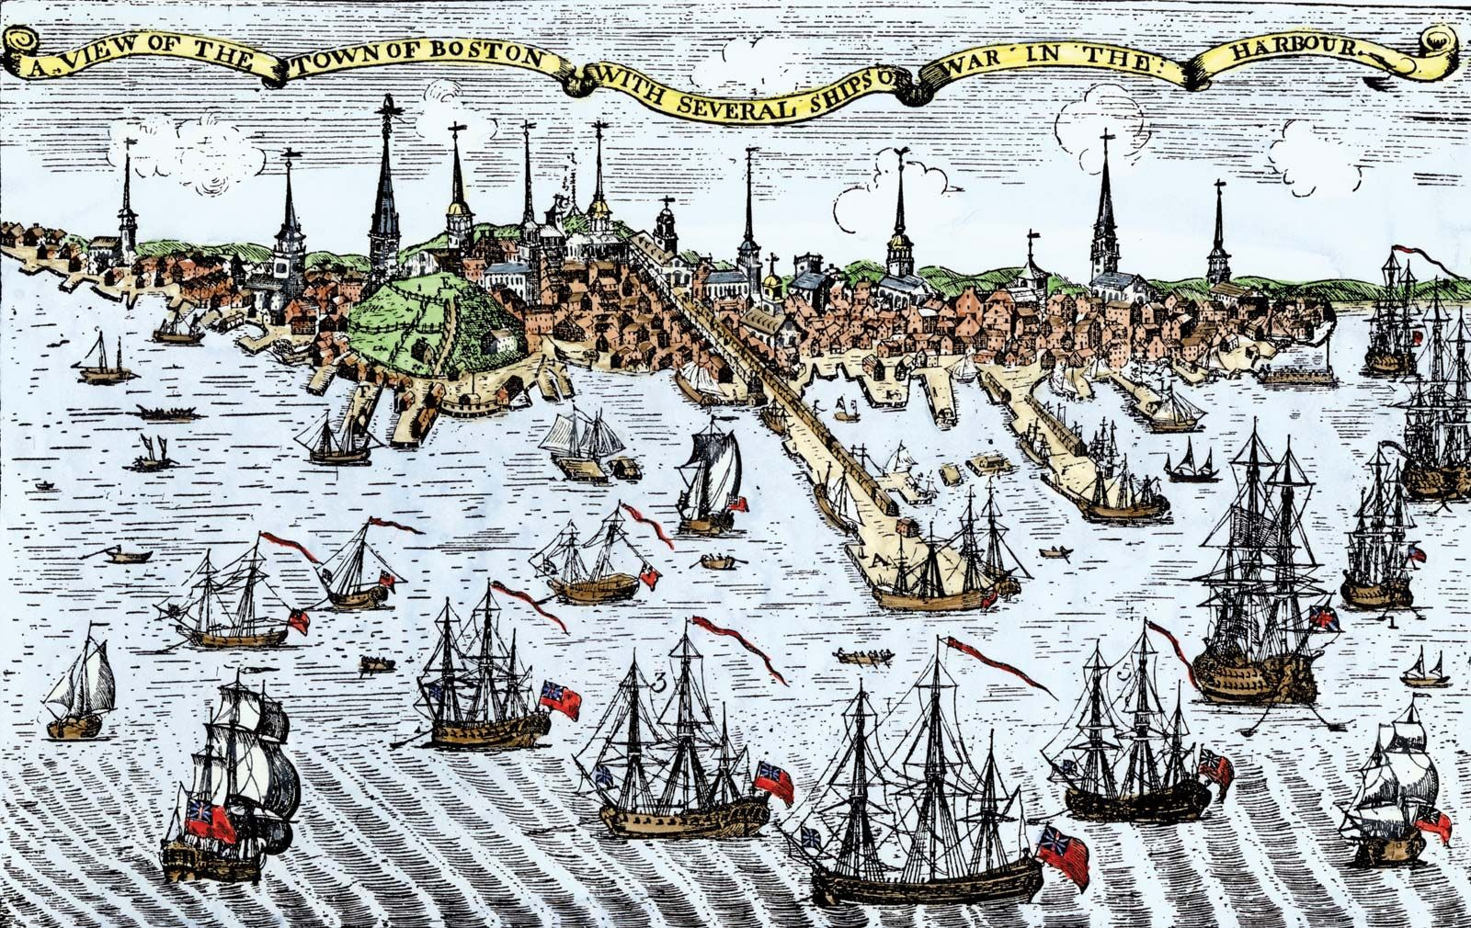
b
to shut off an area to keep people or supplies from coming in or going out

Slide 10
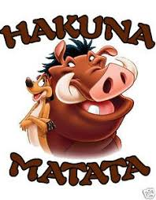
f
done without concern or worry

Slide 11
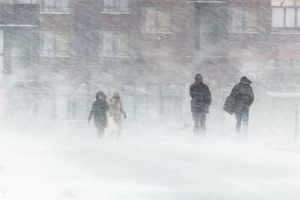
f
very cold

Slide 12
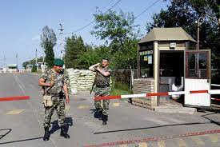
c
a barrier along a route that is guarded

Slide 13
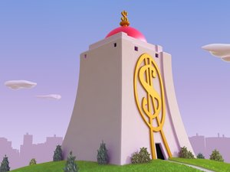
u___ l___ and k__
kept safe and secure

Slide 14
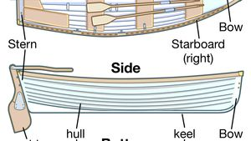
h
the sides and bottom of a boat

Slide 15
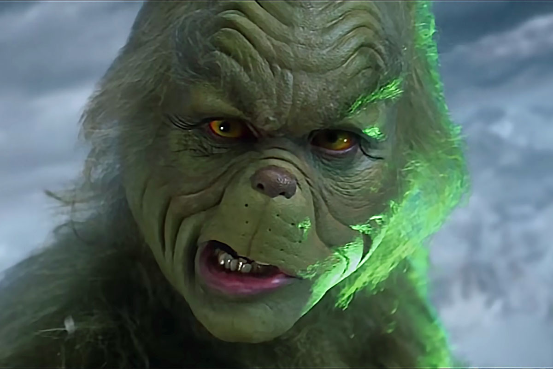
g
not friendly or polite

Slide 16
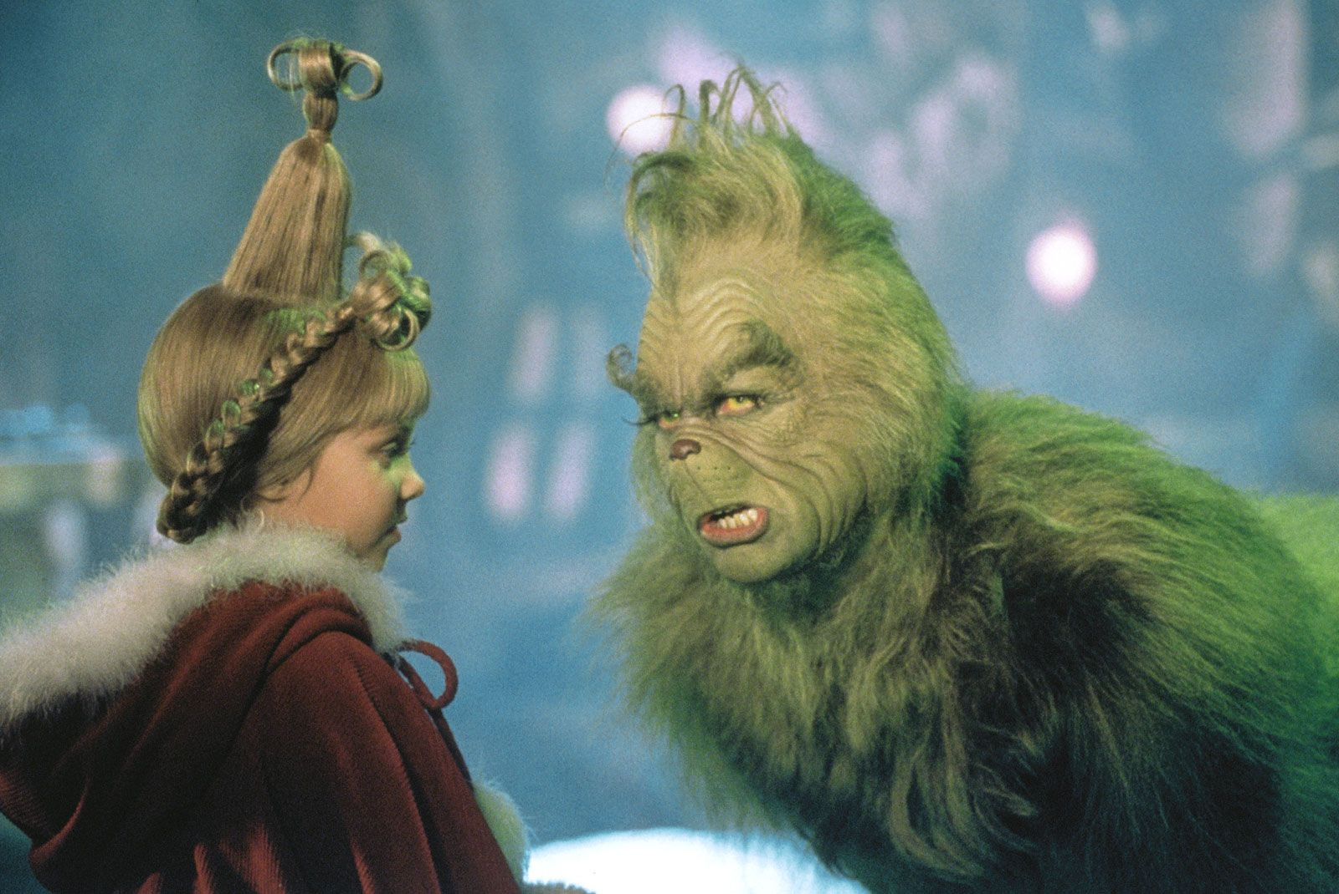
b
to make a friend of someone or an animal

