Slide 1
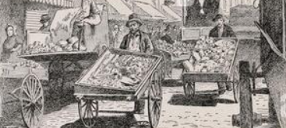
pushcart
a small cart that is pushed by hand; a wheelbarrow

Slide 2
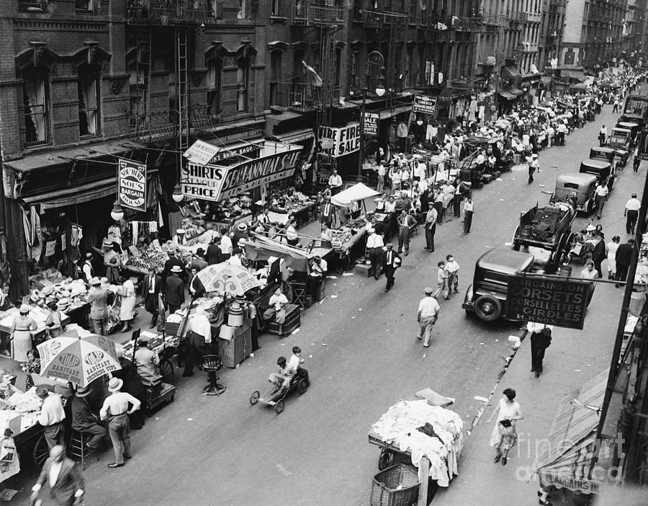
market square
an area in a town or city where merchants sell goods from stalls

Slide 3
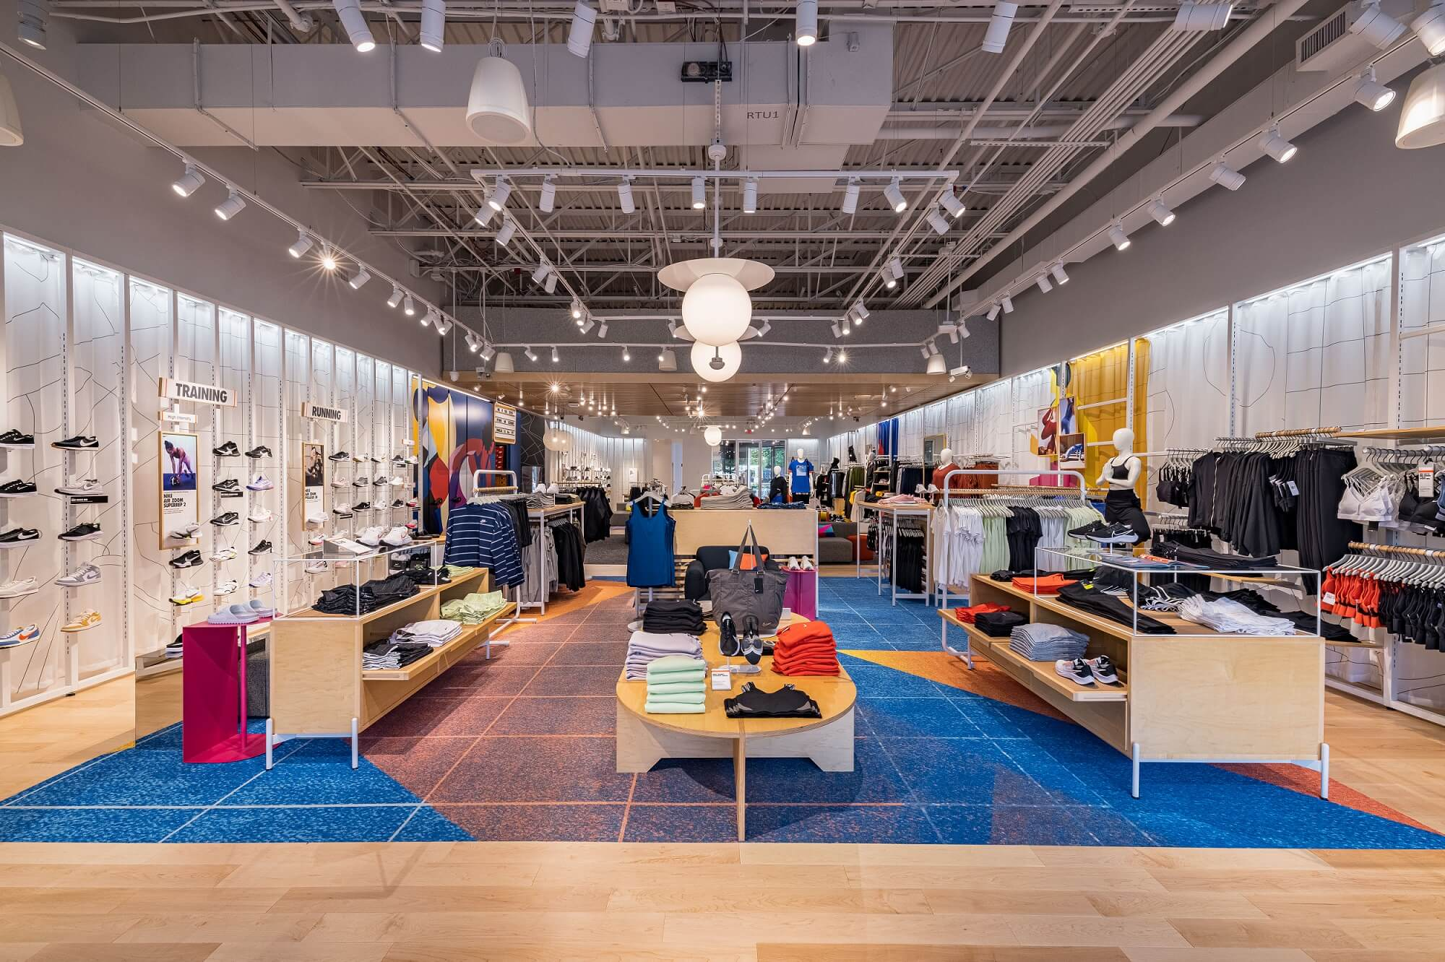
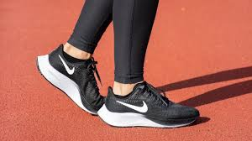
enterprise
Now
At first, only sold running shoes
something that a person strives to do, often referring to business

Slide 4
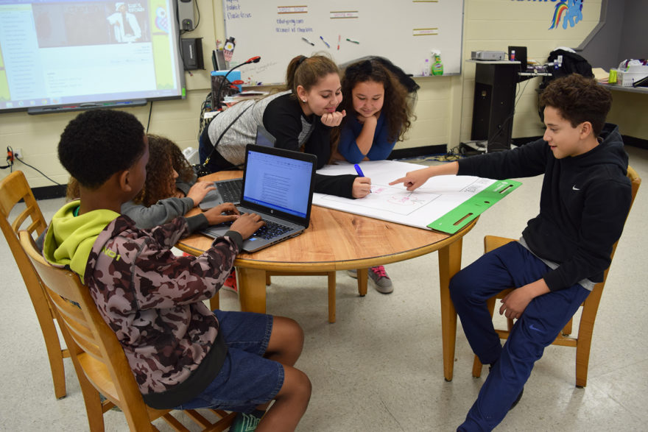
keen
eager or interested in

Slide 5
camaraderie
friendship

Slide 6
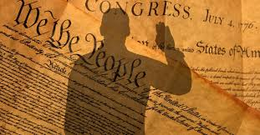
oath
a promise that what someone says is true

Slide 7
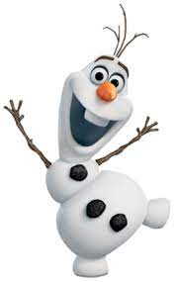
outgoing
eager to meet others; talkative

Slide 8
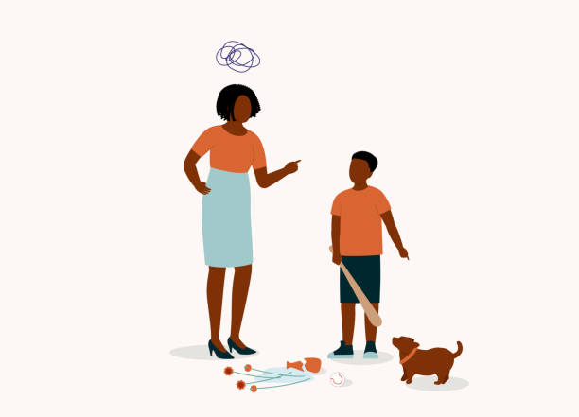
suspicions
doubt about a person or thing

Slide 9
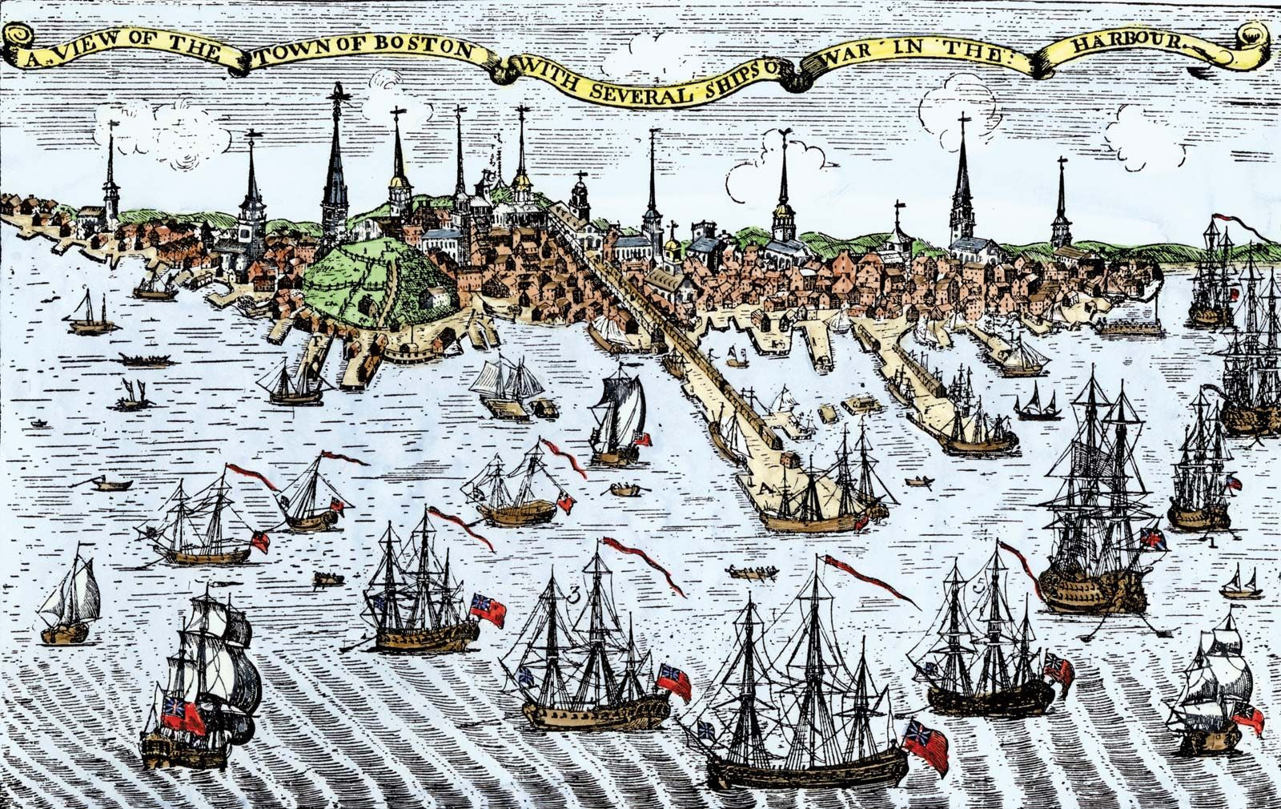
blockade
to shut off an area to keep people or supplies from coming in or going out

Slide 10
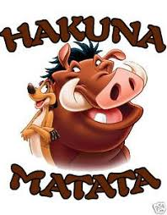
freely
done without concern or worry

Slide 11
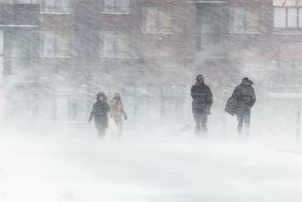
frigid
very cold

Slide 12
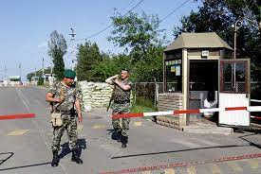
checkpoints
a barrier along a route that is guarded

Slide 13
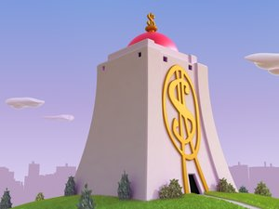
under lock and key
kept safe and secure

Slide 14
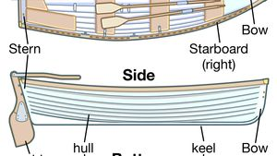
hull
the sides and bottom of a boat

Slide 15
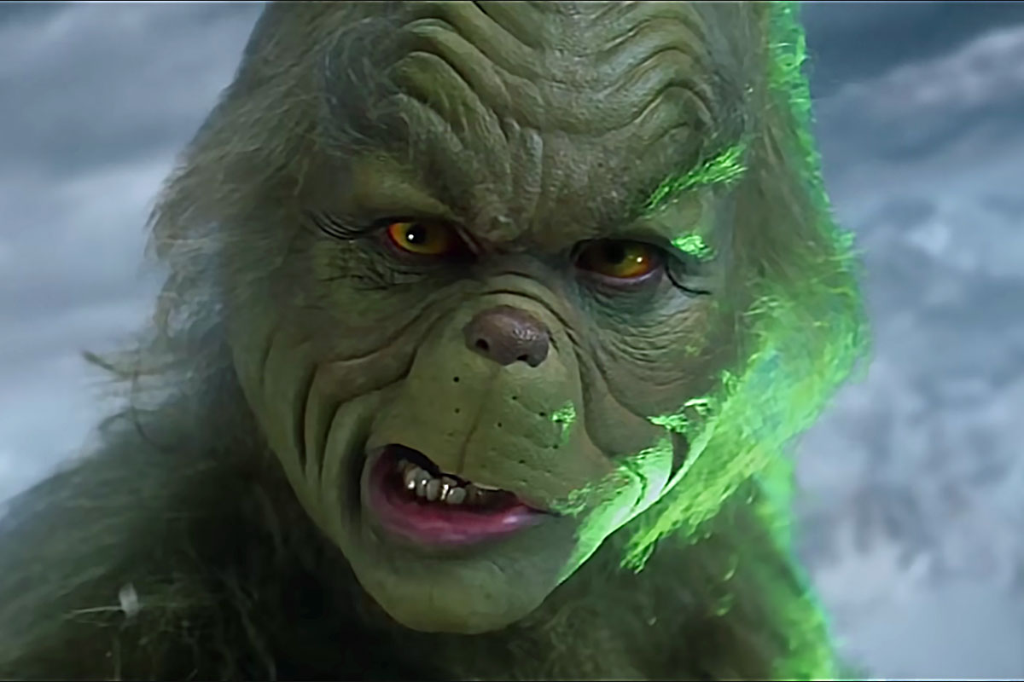
gruffer
not friendly or polite

Slide 16
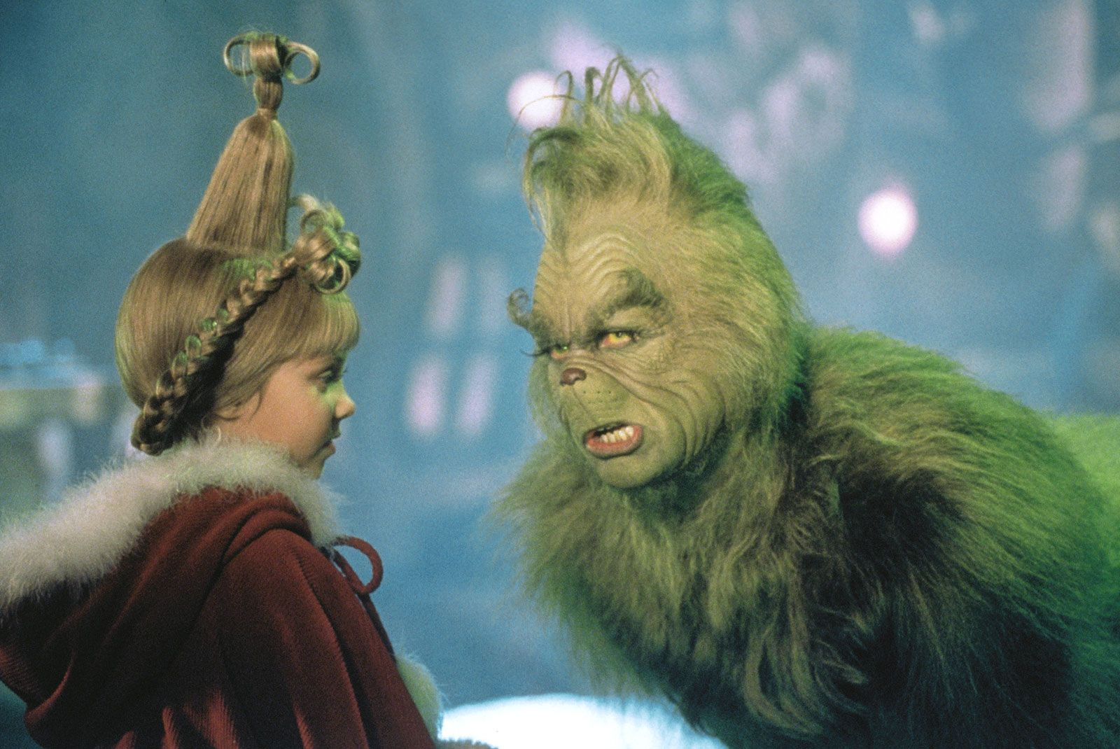
befriend
to make a friend of someone or an animal

