Slide 1
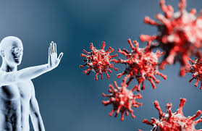
i
the ability of the body to resist a disease

Slide 2
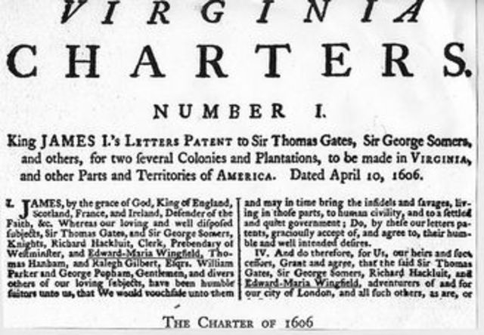
c
to create an official document to set up rights and expectations for a person, group , or company

Slide 3
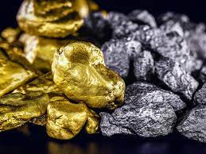
p_____ m_____
a rare metal that has a high value, such as gold, silver, and platinum

Slide 4
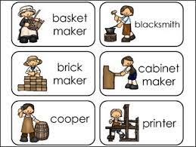
a
a person skilled in a specific craft or trade

Slide 5
n
the science of figuring out the position and course of a boat or vehicle

Slide 6
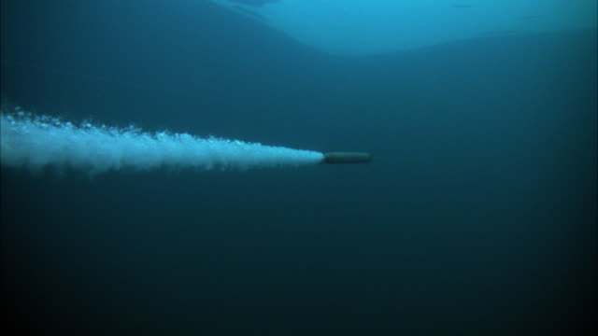
p
the force that moves something forward

Slide 7
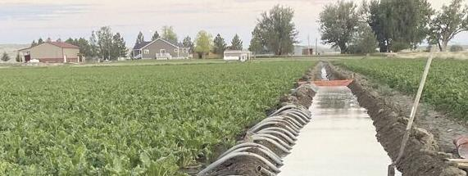
i
to supply land with water using streams, channels, pipes or sprinklers

Slide 8
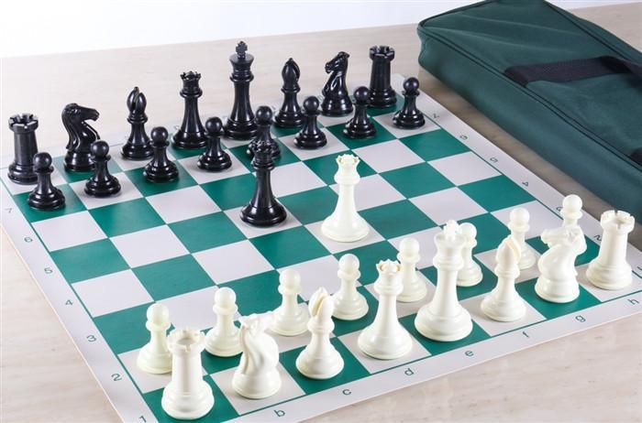
s
create a plan to achieve a goal

Slide 9
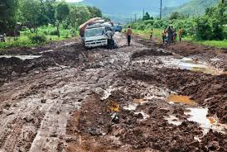
h
to get in the way of action or progress

Slide 10
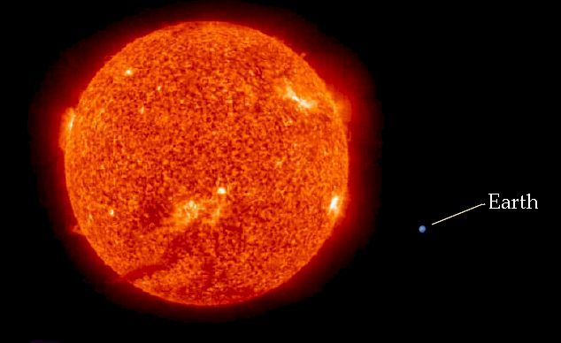
m
of great size or extent; very big

Slide 11
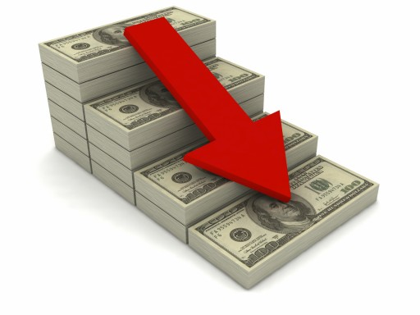
d
to become less or smaller, shrink slowly

Slide 12
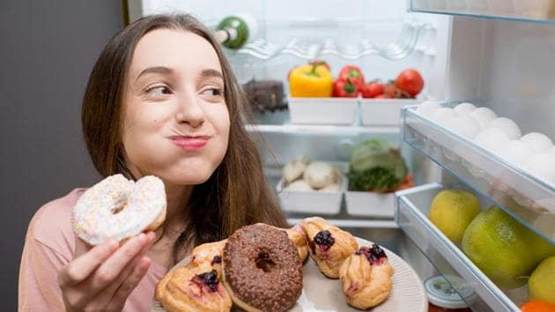
s
to be overcome or yield

Slide 13
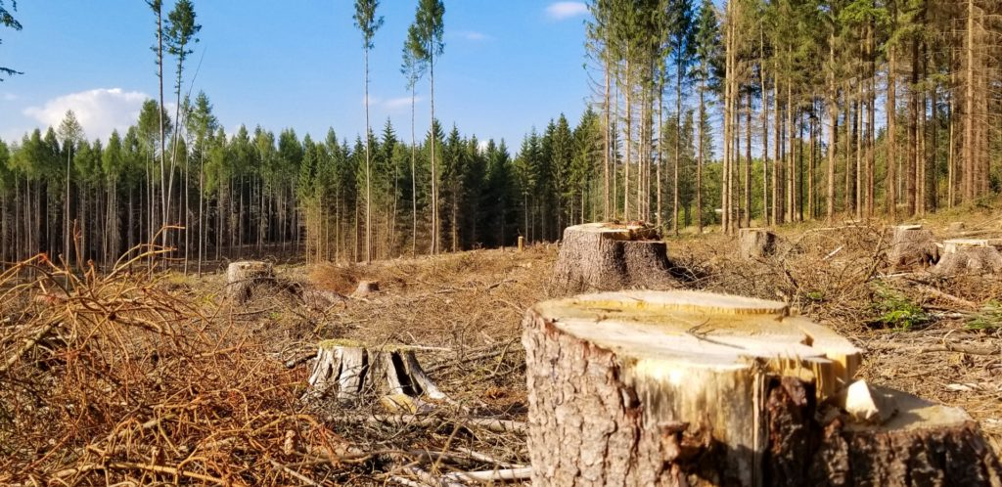
d
reduction in the number or quantity

Slide 14
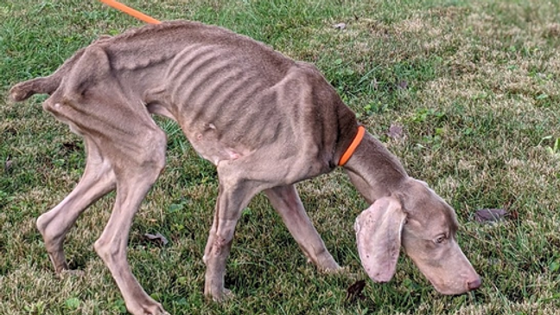
e
very thin due to a lack of nourishment

Slide 15
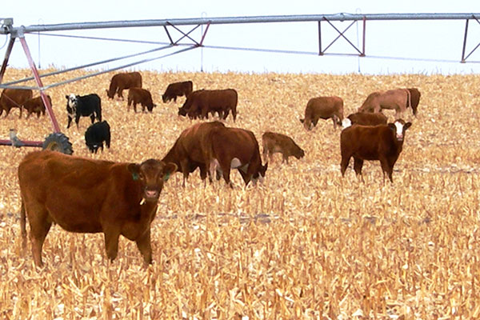
a
having to do with growing crops and
raising livestock

Slide 16
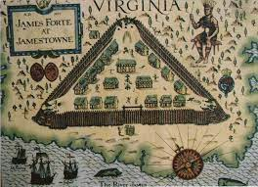
p
lasting or remaining unchanged for a long time

