Slide 1
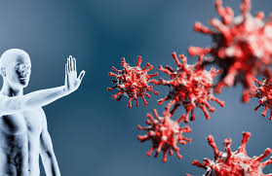
immunity
the ability of the body to resist a disease

Slide 2
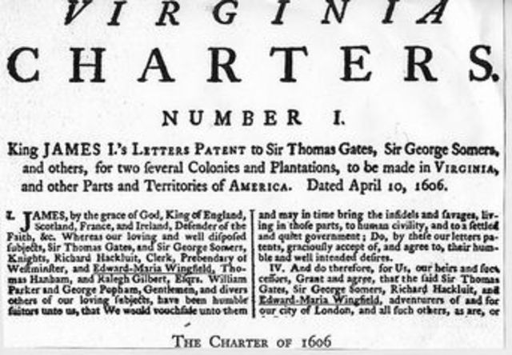
charter
to create an official document to set up rights and expectations for a person, group , or company

Slide 3
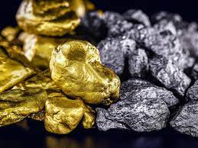
precious metals
a rare metal that has a high value, such as gold, silver, and platinum

Slide 4
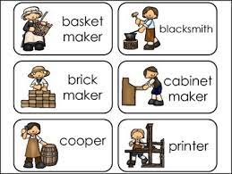
artisans
a person skilled in a specific craft or trade

Slide 5
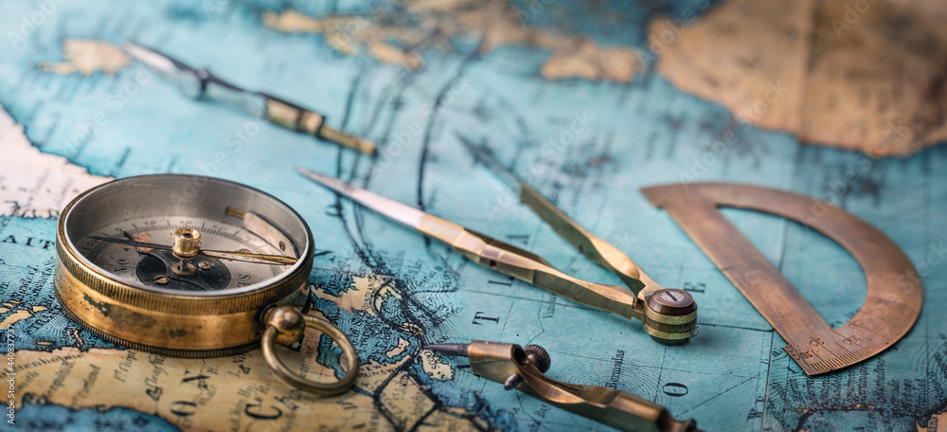
navigational
the science of figuring out the position and course of a boat or vehicle

Slide 6
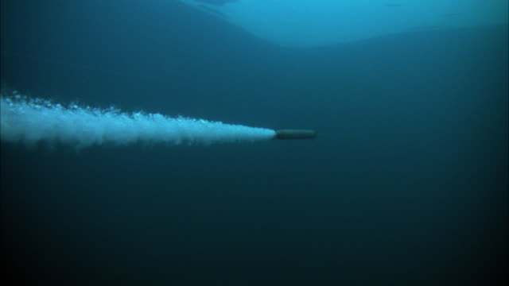
propulsion
the force that moves something forward

Slide 7
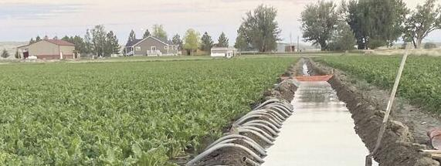
irrigate
to supply land with water using streams, channels, pipes or sprinklers

Slide 8
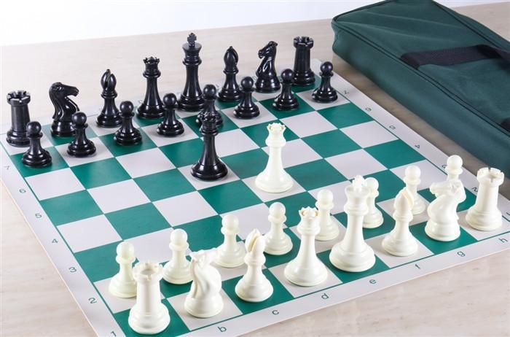
strategic
create a plan to achieve a goal

Slide 9
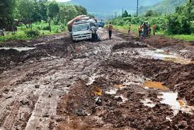
hampered
to get in the way of action or progress

Slide 10
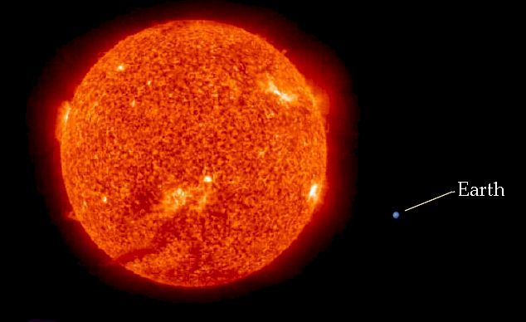
massive
of great size or extent; very big

Slide 11
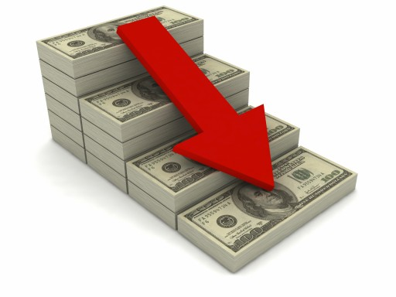
dwindling
to become less or smaller, shrink slowly

Slide 12
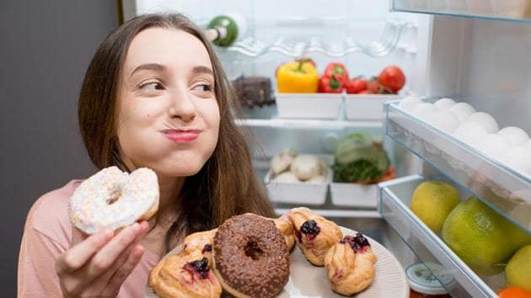
succumbing
to be overcome or yield

Slide 13
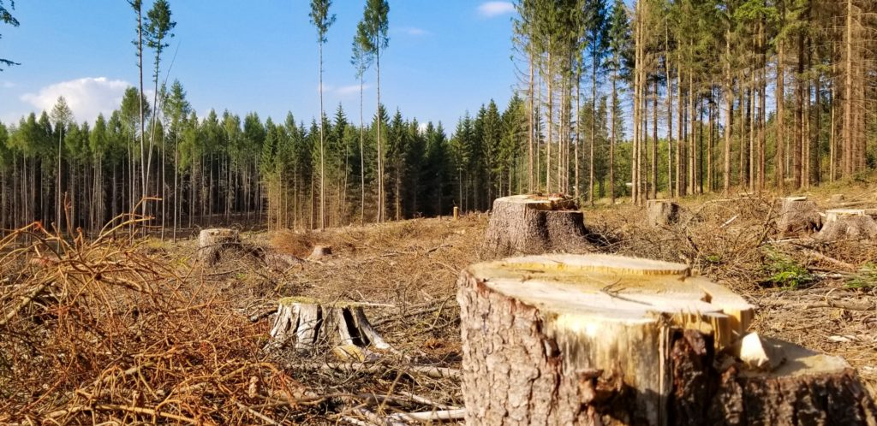
depletion
reduction in the number or quantity

Slide 14
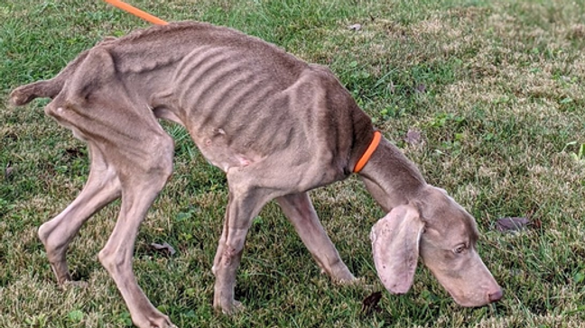
emaciated
very thin due to a lack of nourishment

Slide 15
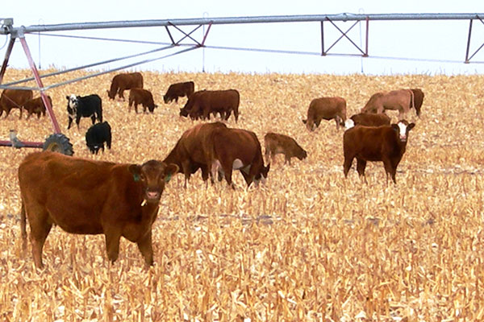
agricultural
having to do with growing crops and
raising livestock

Slide 16
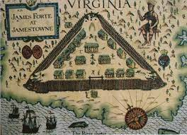
permanence
lasting or remaining unchanged for a long time

