Slide 1
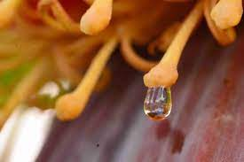
n
the sweet liquid formed by flowers

Slide 2
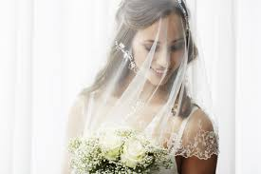
v
a piece of thin, usually transparent material
worn over the head or face

Slide 3
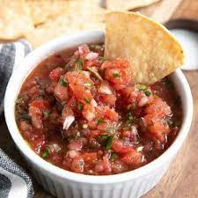
m
weak or gentile

Slide 4
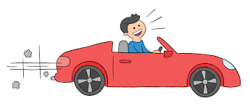
r
to trust; depend

Slide 5
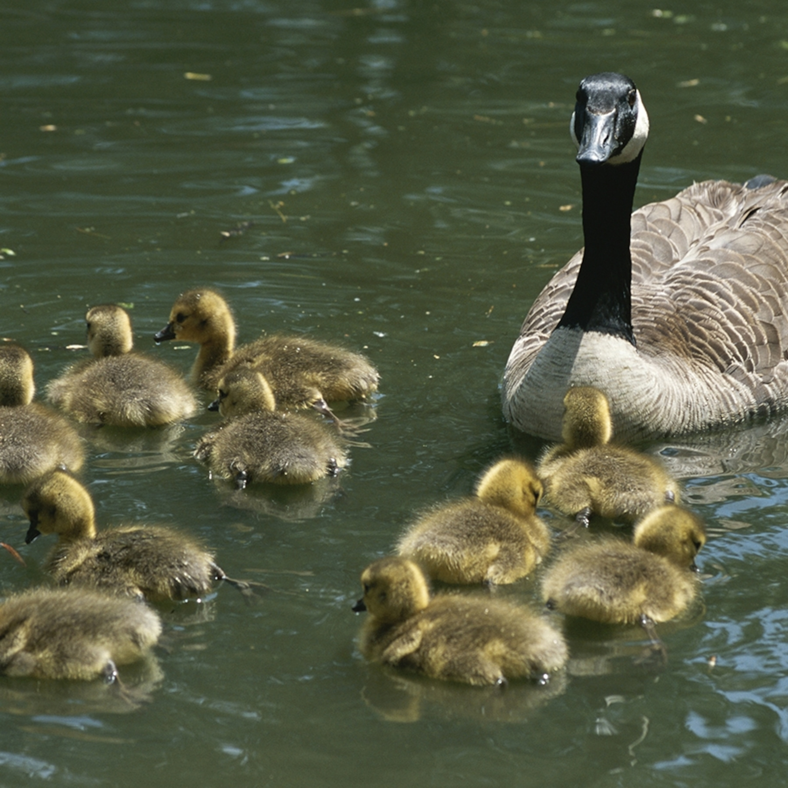
o
the young of a person, animal, or plant

Slide 6
v
rapid movement up and down or back and forth

Slide 7
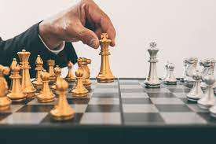
d
with purpose

Slide 8
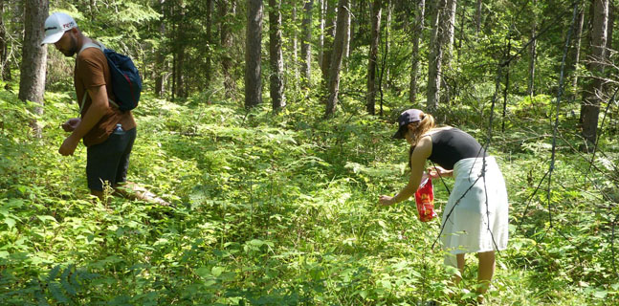
f
to hunt or search for food

Slide 9
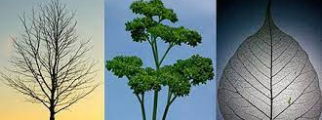
b
having many small parts sticking off a main stem, like a tree’s branch

Slide 10
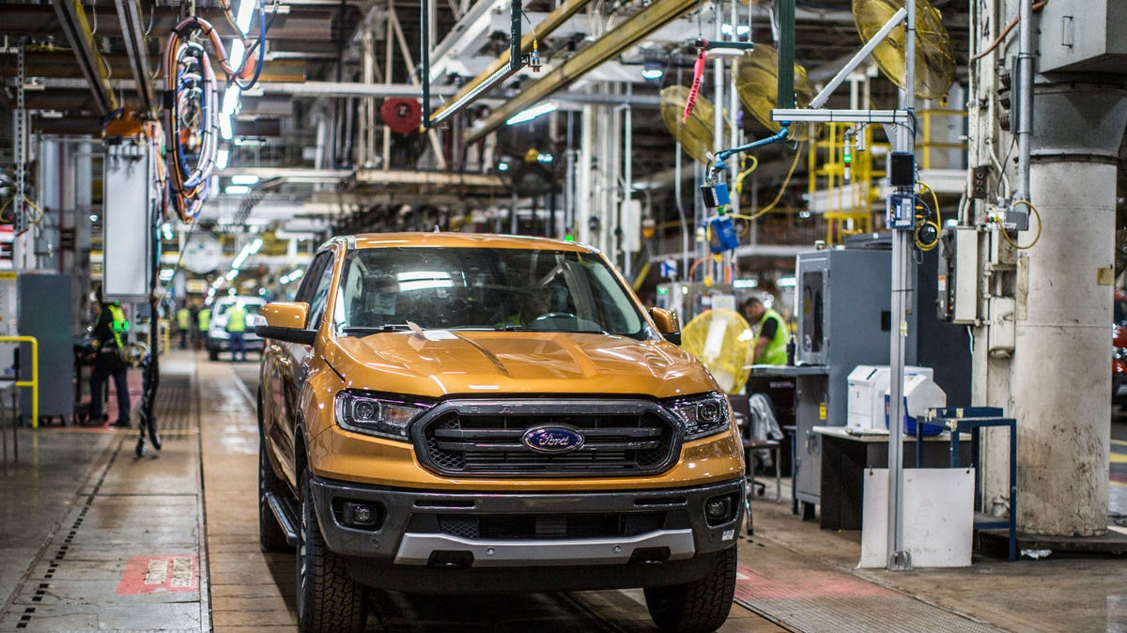
industrial
produced by a company or factory

Slide 11
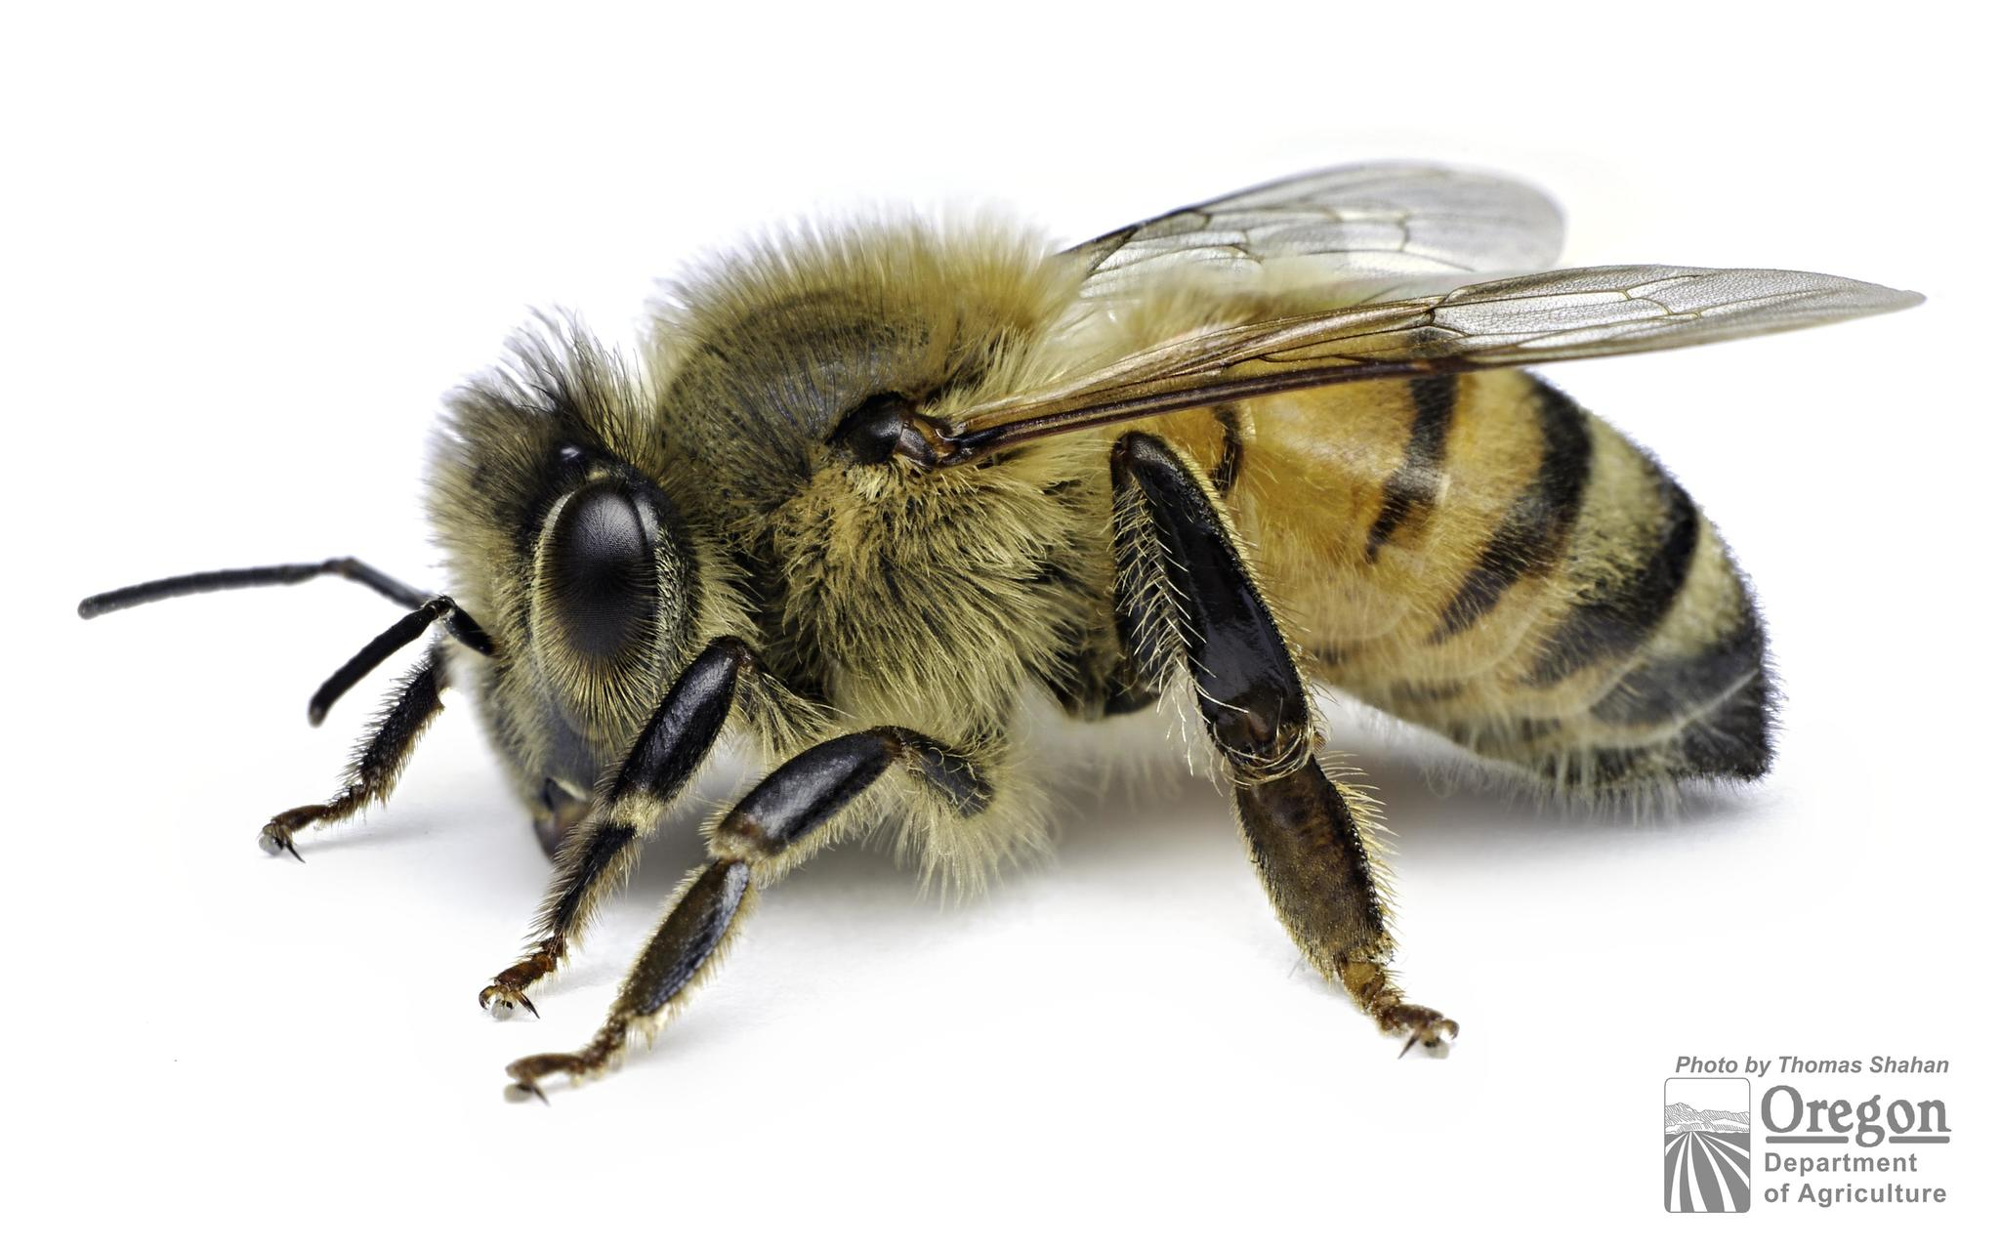
g
a species that can survive in a wide
range of environments

Slide 12
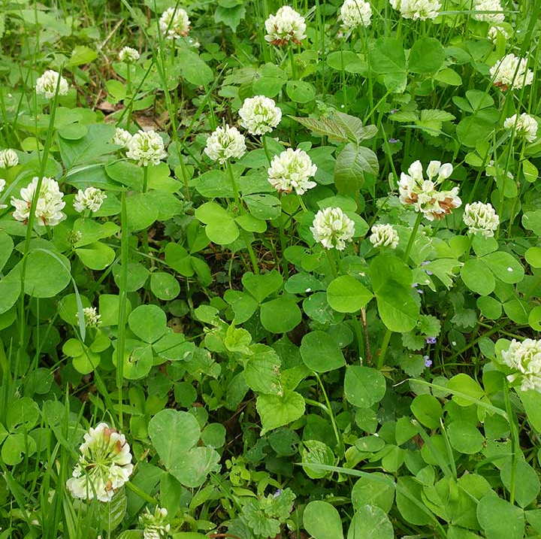
c
a small, flowering plant often eaten by livestock

Slide 13
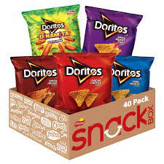
a
made by people, not by nature

Slide 14
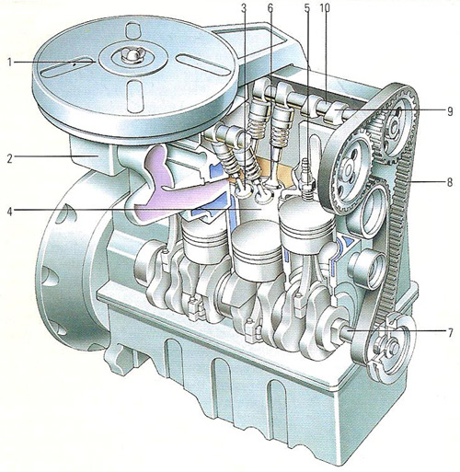
i
very complex or complicate,
or having many parts

