Slide 1
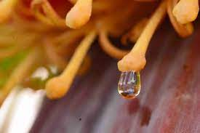
nectar
the sweet liquid formed by flowers

Slide 2
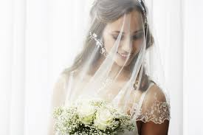
veil
a piece of thin, usually transparent material
worn over the head or face

Slide 3
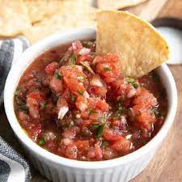
mild
weak or gentile

Slide 4
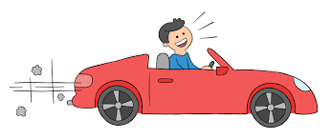
rely
to trust; depend

Slide 5
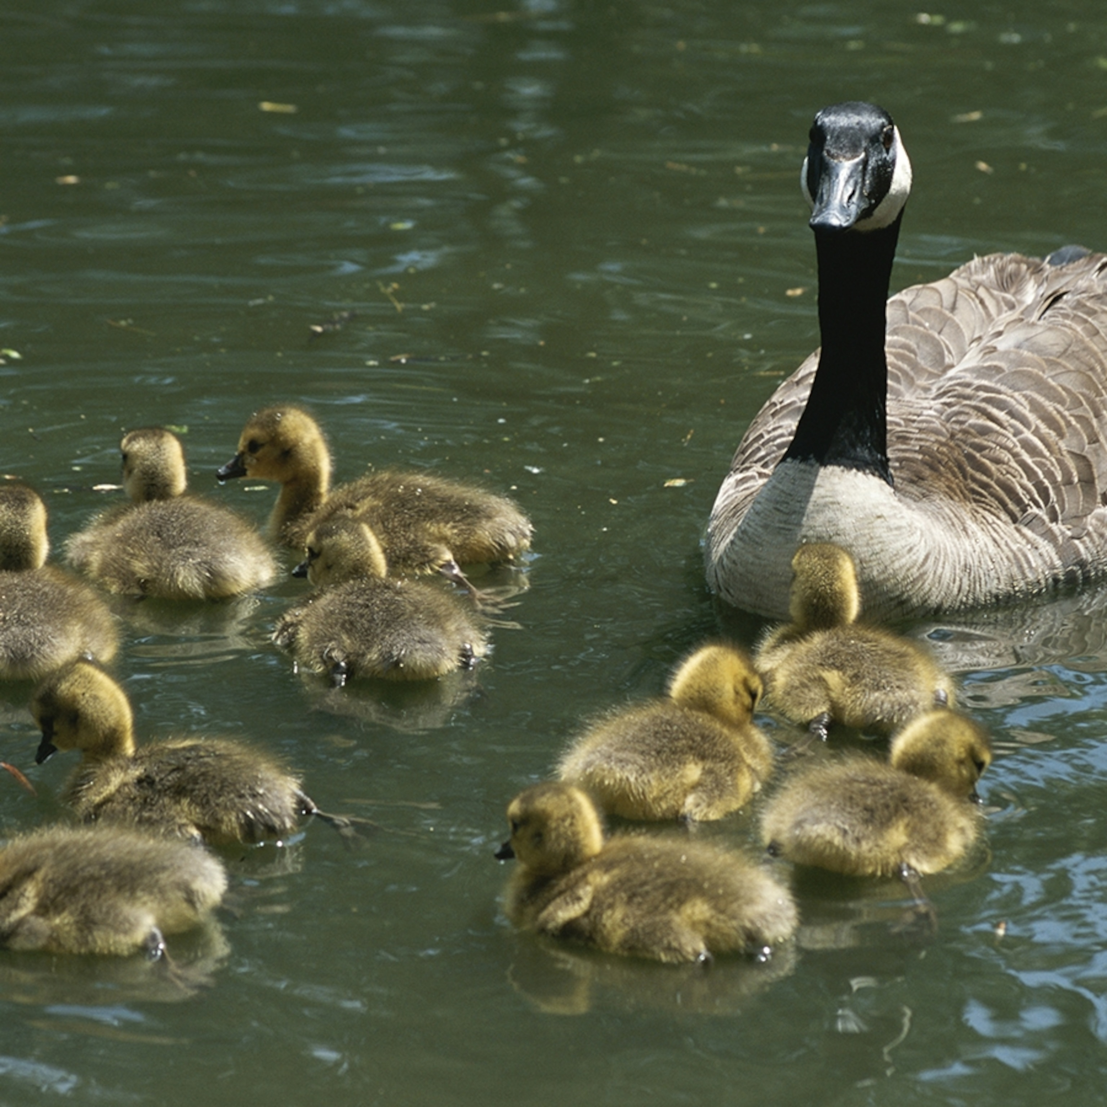
offspring
the young of a person, animal, or plant

Slide 6
vibration
rapid movement up and down or back and forth

Slide 7
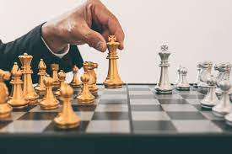
deliberately
with purpose

Slide 8
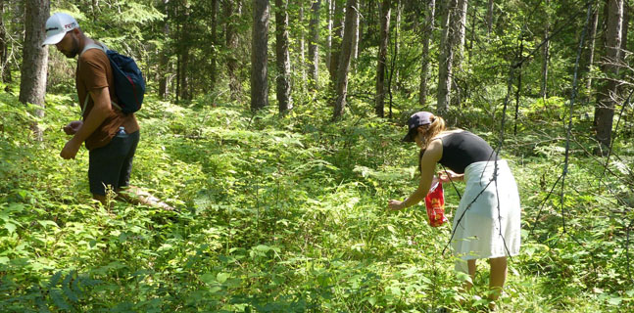
foraging
to hunt or search for food

Slide 9
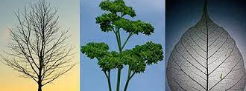
branched
having many small parts sticking off a main stem, like a tree’s branch

Slide 10
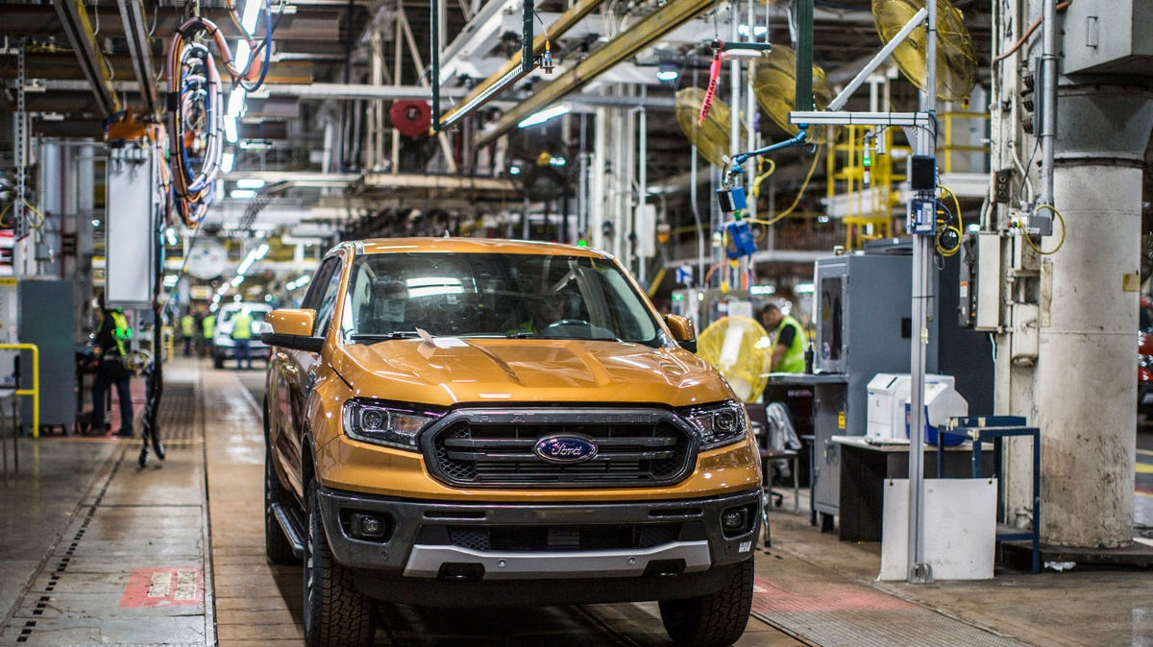
industrial
produced by a company or factory

Slide 11
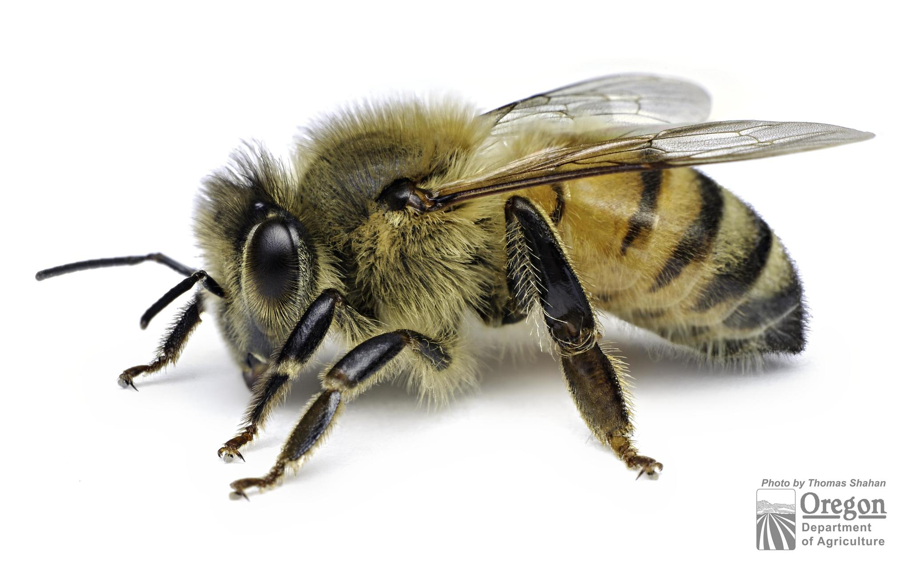
generalists
a species that can survive in a wide
range of environments

Slide 12
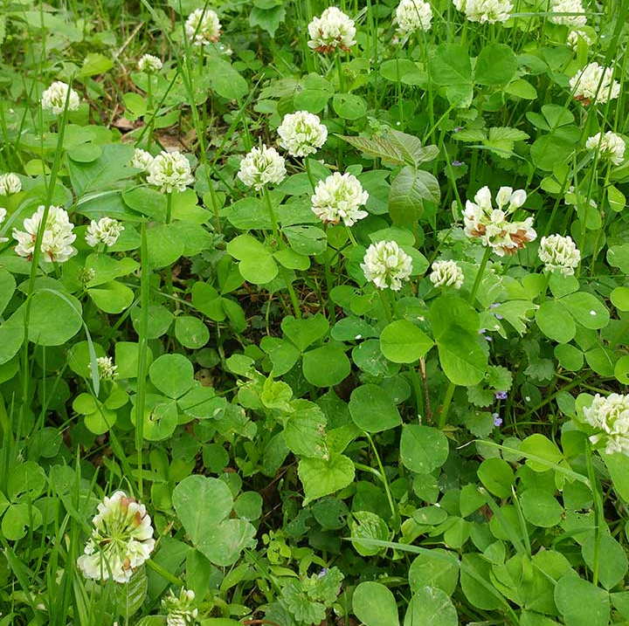
clover
a small, flowering plant often eaten by livestock

Slide 13
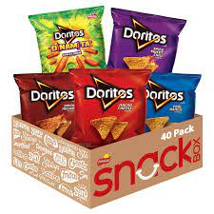
artificial
made by people, not by nature

Slide 14
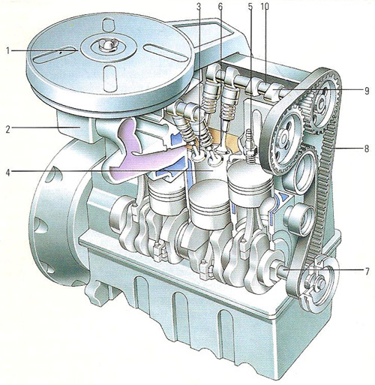
intricate
very complex or complicate,
or having many parts

