Slide 1
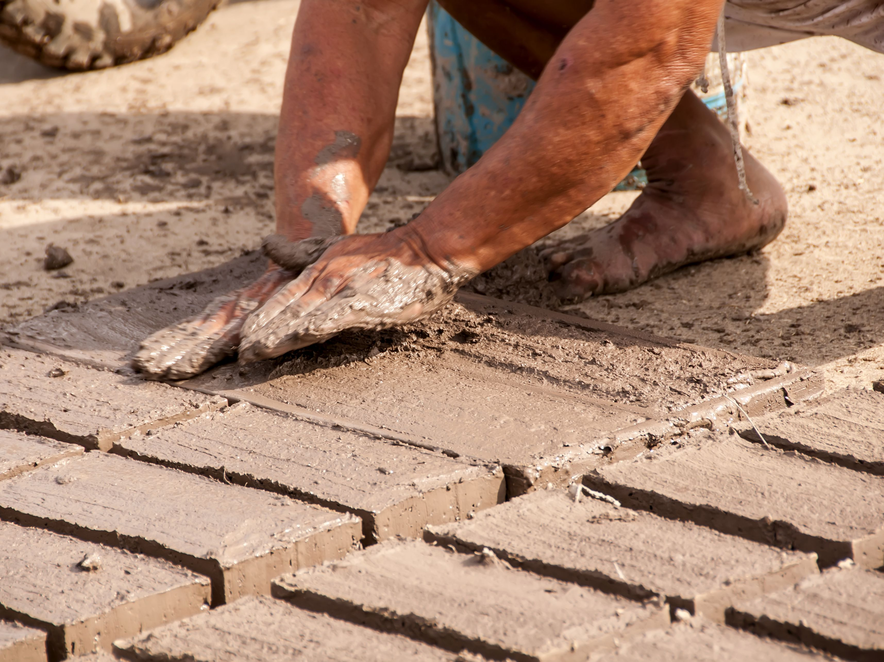
a______
A brick made of clay that is dried in the sun.

Slide 2
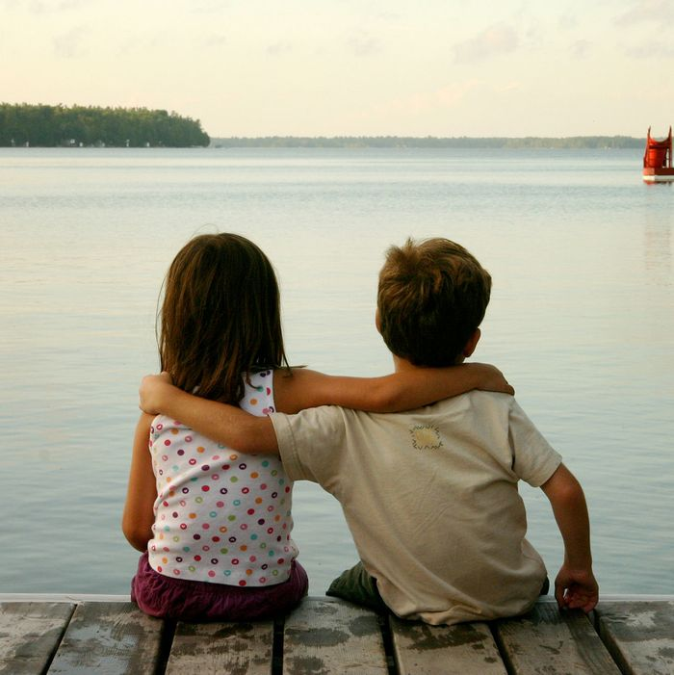
c_______
A friend who is always by your side.

Slide 3
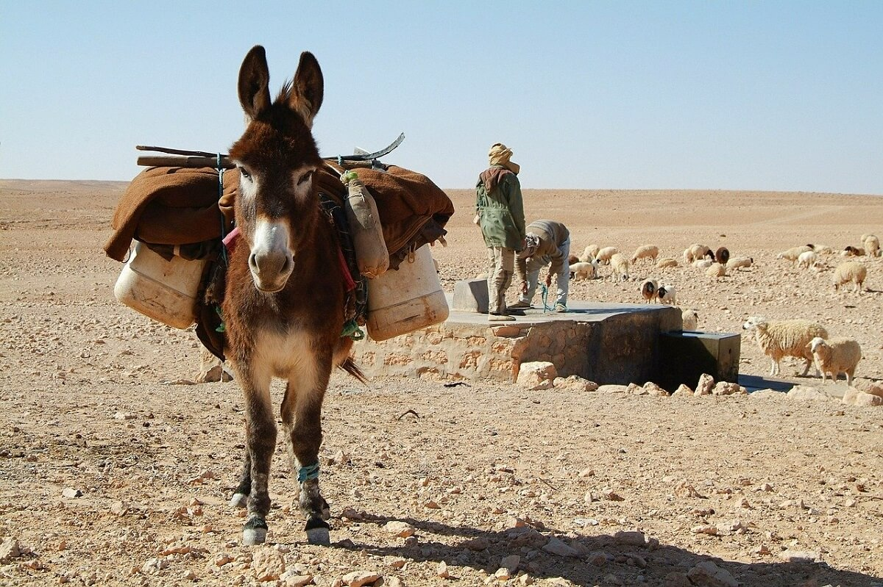
b______
A small donkey used for riding and carrying small loads.

Slide 4
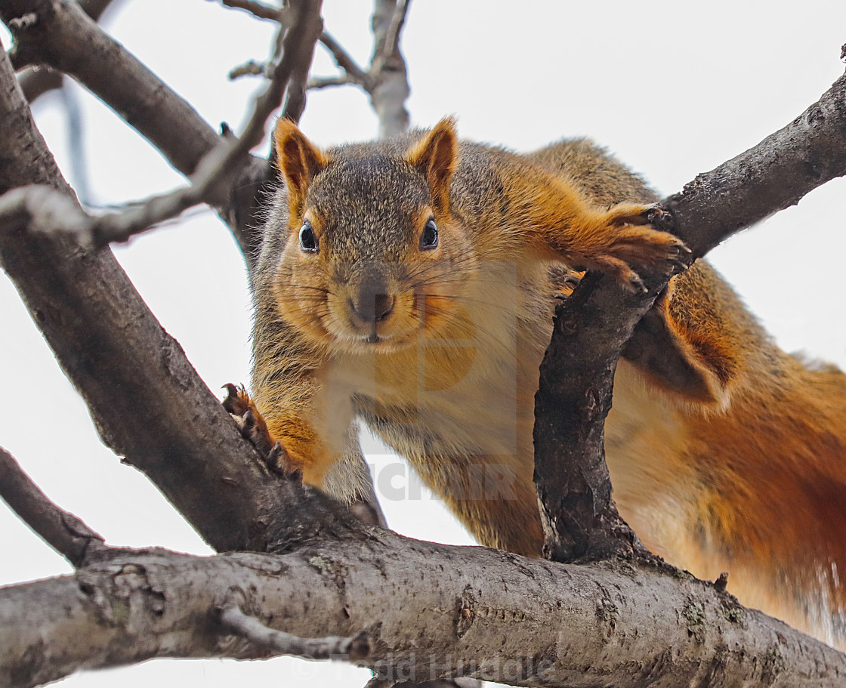
w_____
with great caution; carefully

Slide 5
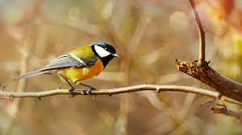
p_____
to sit or rest on something that is raised in the air

Slide 6
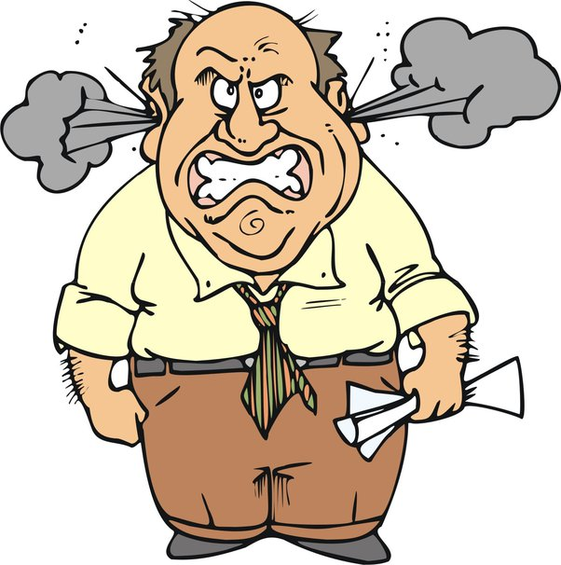
s____-t_____
quickly angered or made upset.

Slide 7
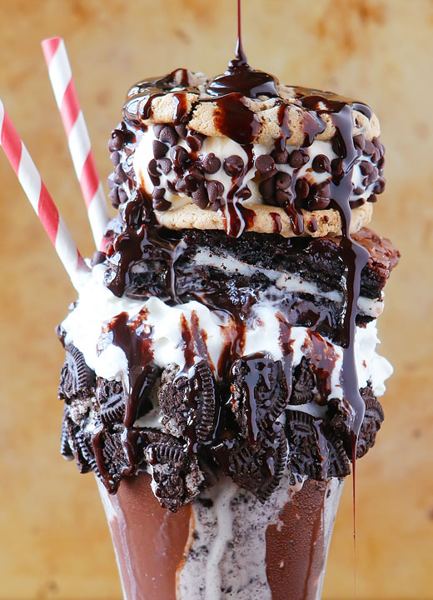
a_____
more than enough

Slide 8
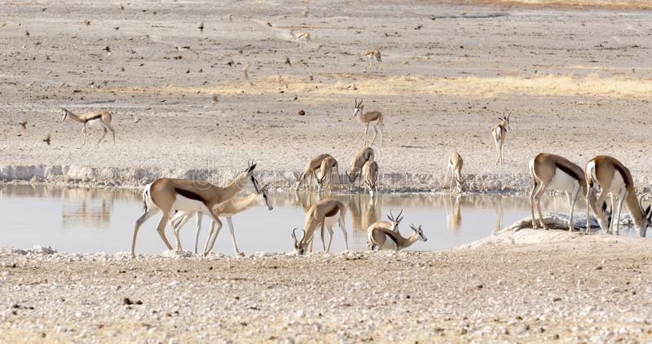
d______
someone or something that makes a home in a place

Slide 9
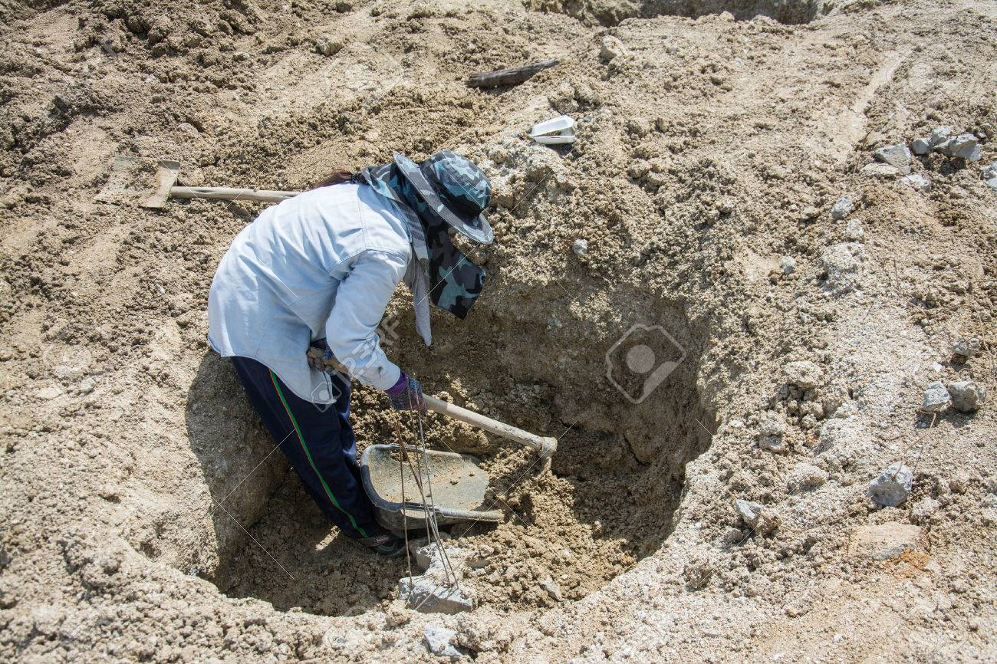
d______
difficult, unpleasant or uninteresting labor

Slide 10
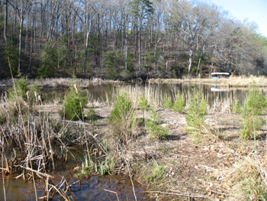
s______
to hide or protect by covering

Slide 11
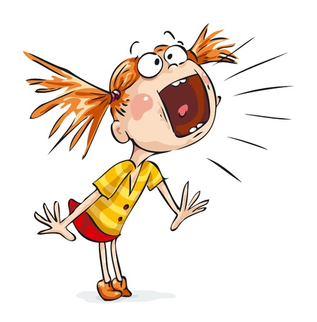
h______
having a rough or sharp sound

Slide 12
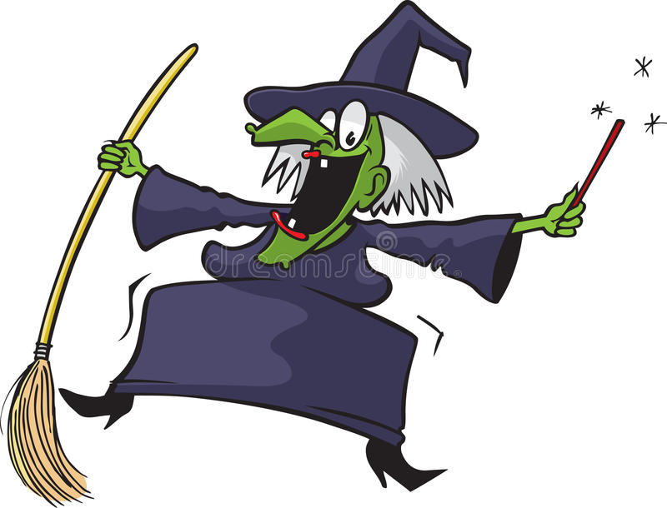
c_______
characterized by a high-pitched, broken sound

Slide 13
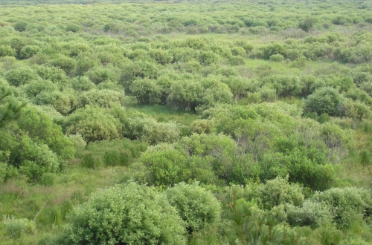
t_______
thick patches of shrubs or bushes

Slide 14
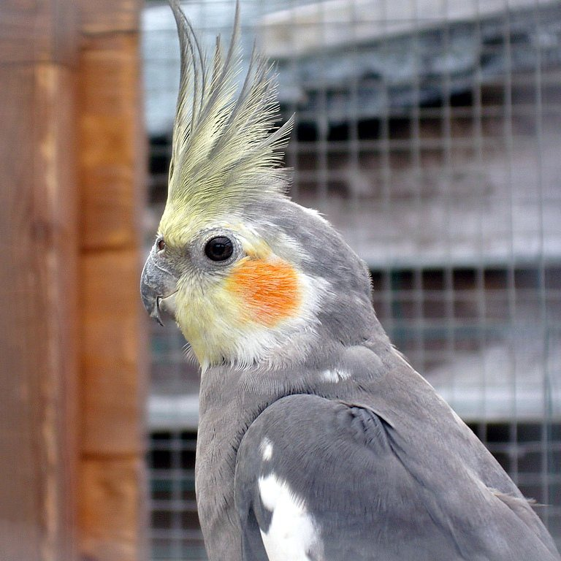
c______
a long tuft of feathers atop a bird’s head

