Slide 1
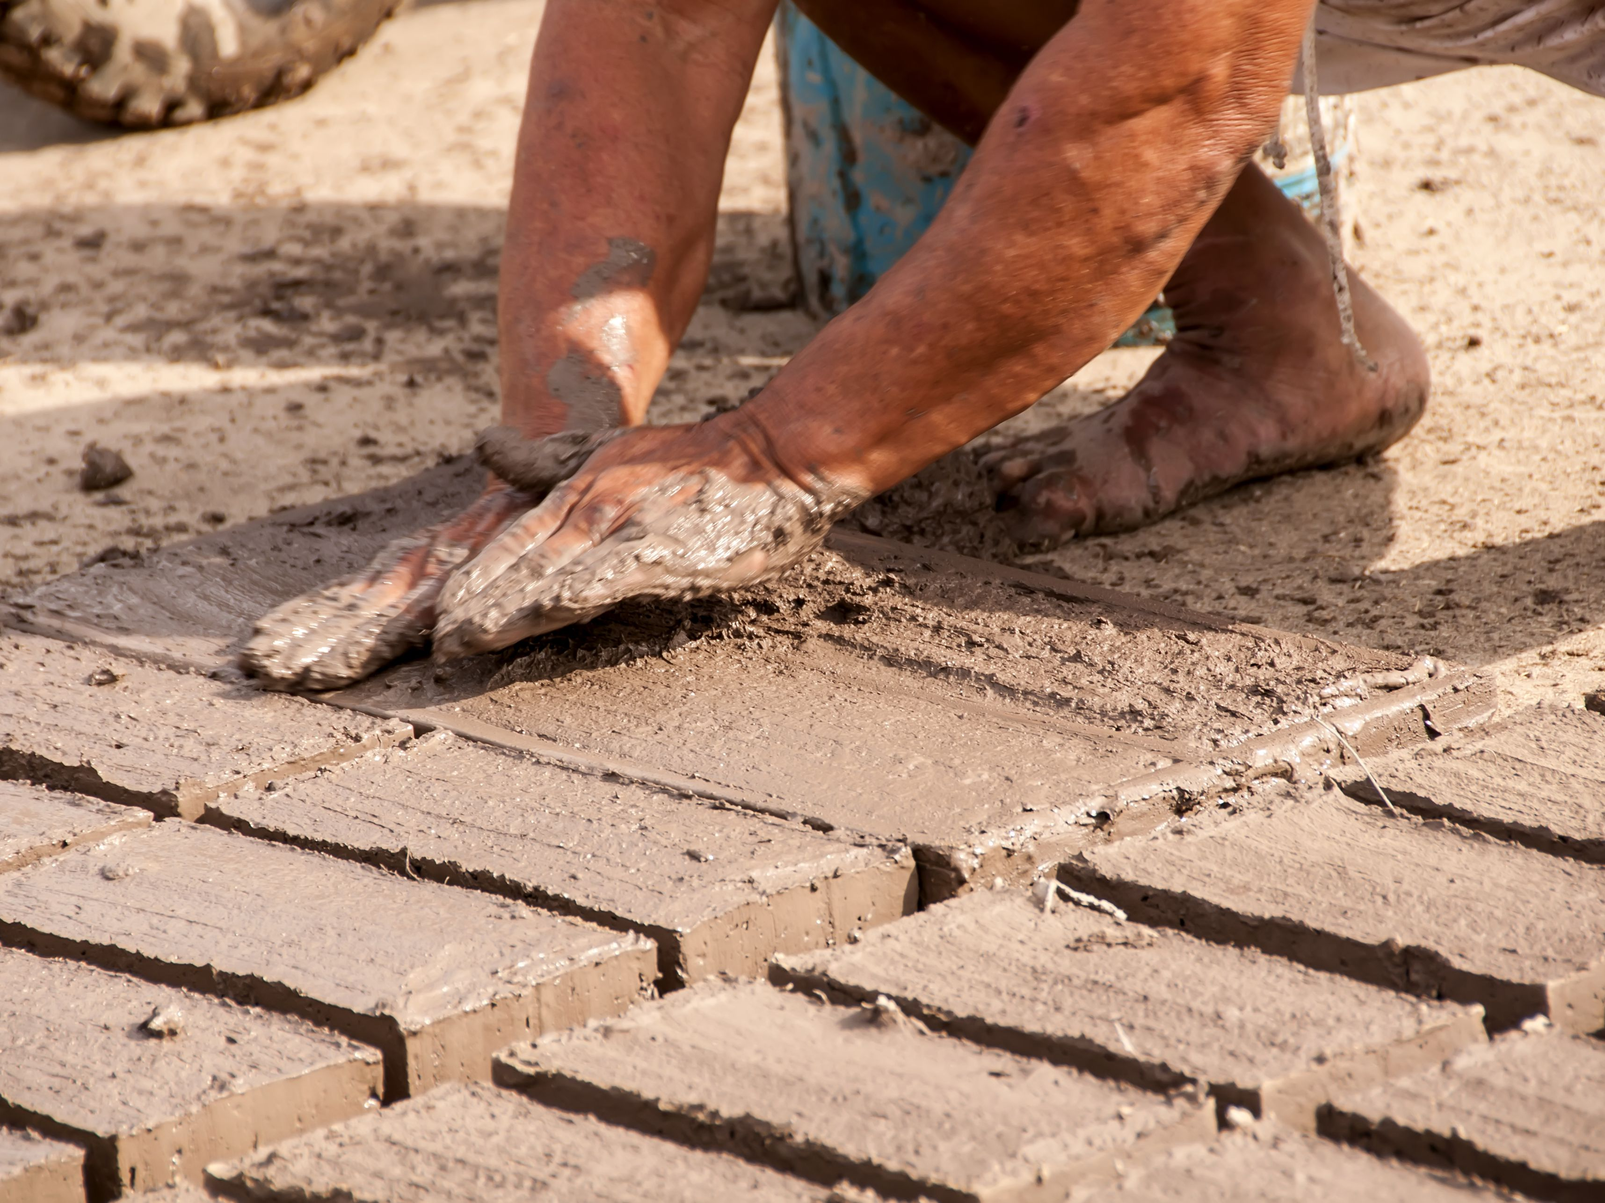
adobe
A brick made of clay that is dried in the sun.

Slide 2
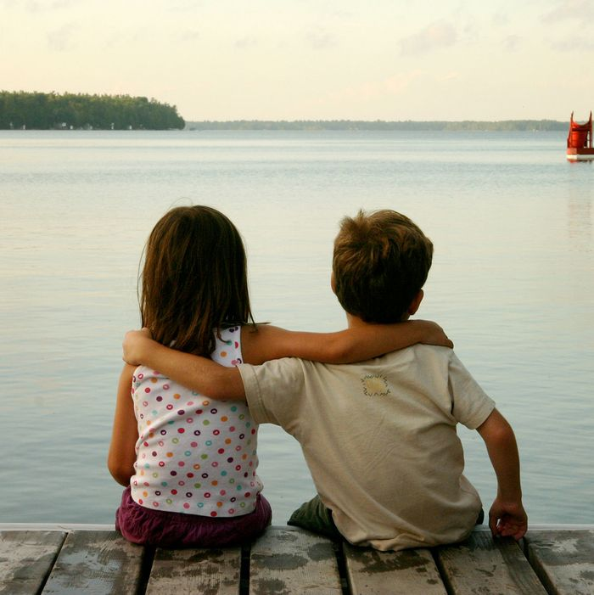
companion
A friend who is always by your side.

Slide 3
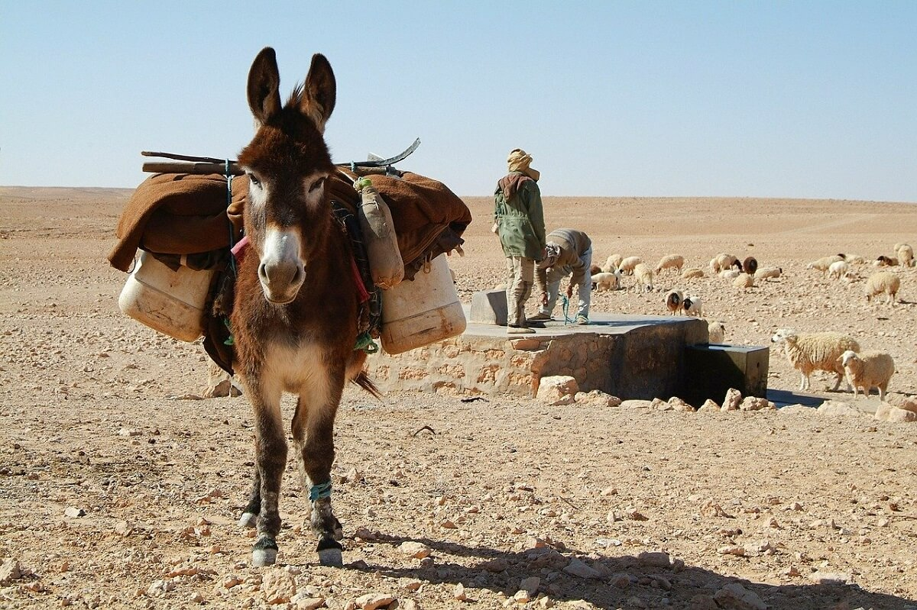
burro
A small donkey used for riding and carrying small loads.

Slide 4
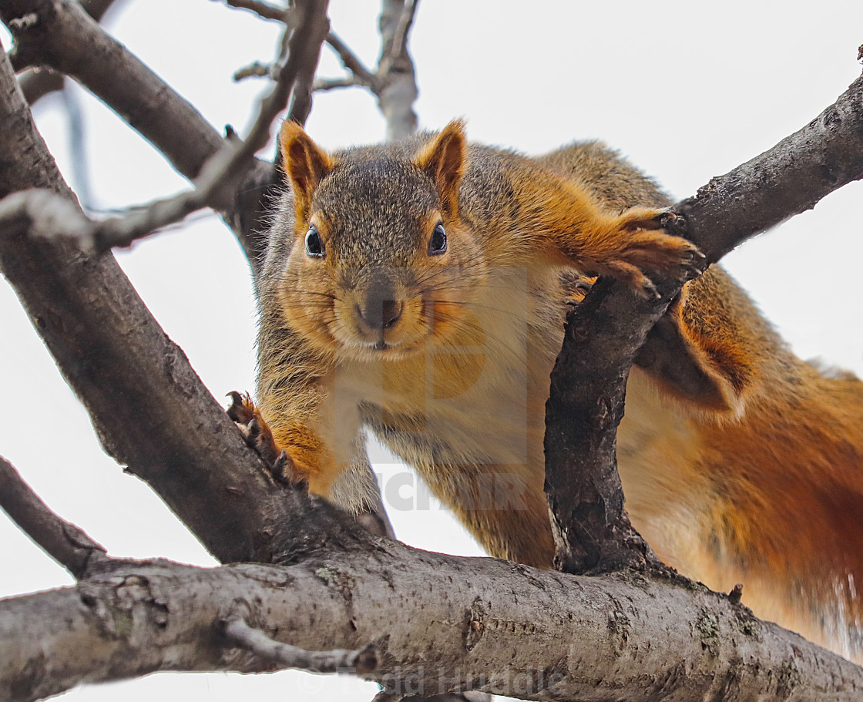
warily
with great caution; carefully

Slide 5
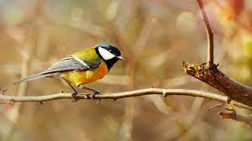
perch
to sit or rest on something that is raised in the air

Slide 6
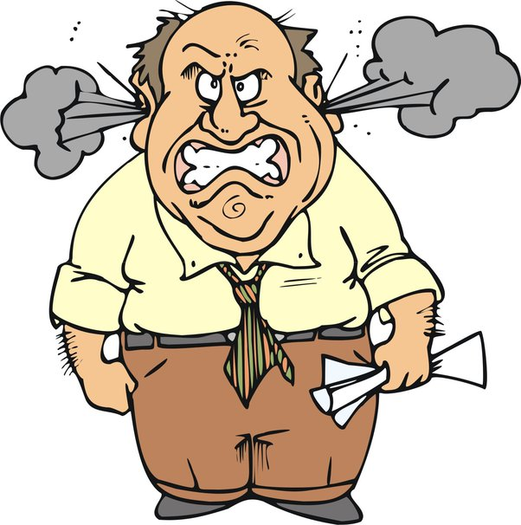
short-tempered
quickly angered or made upset.

Slide 7
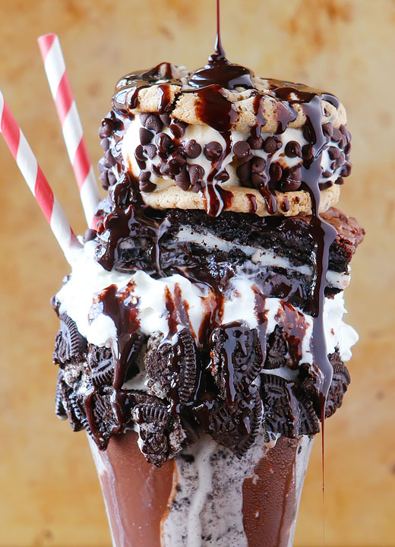
ample
more than enough

Slide 8
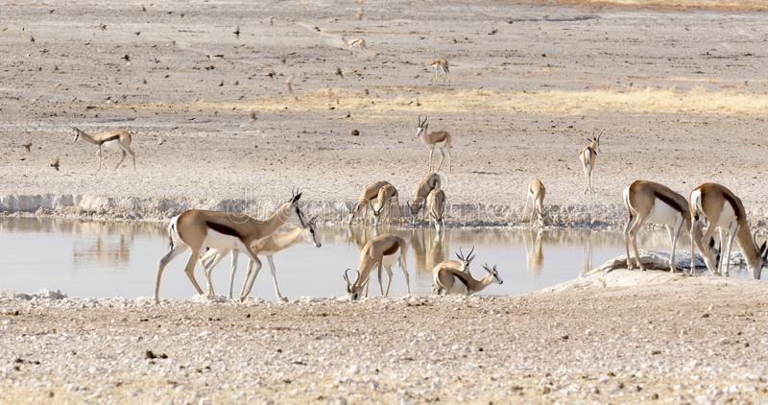
dwellers
someone or something that makes a home in a place

Slide 9
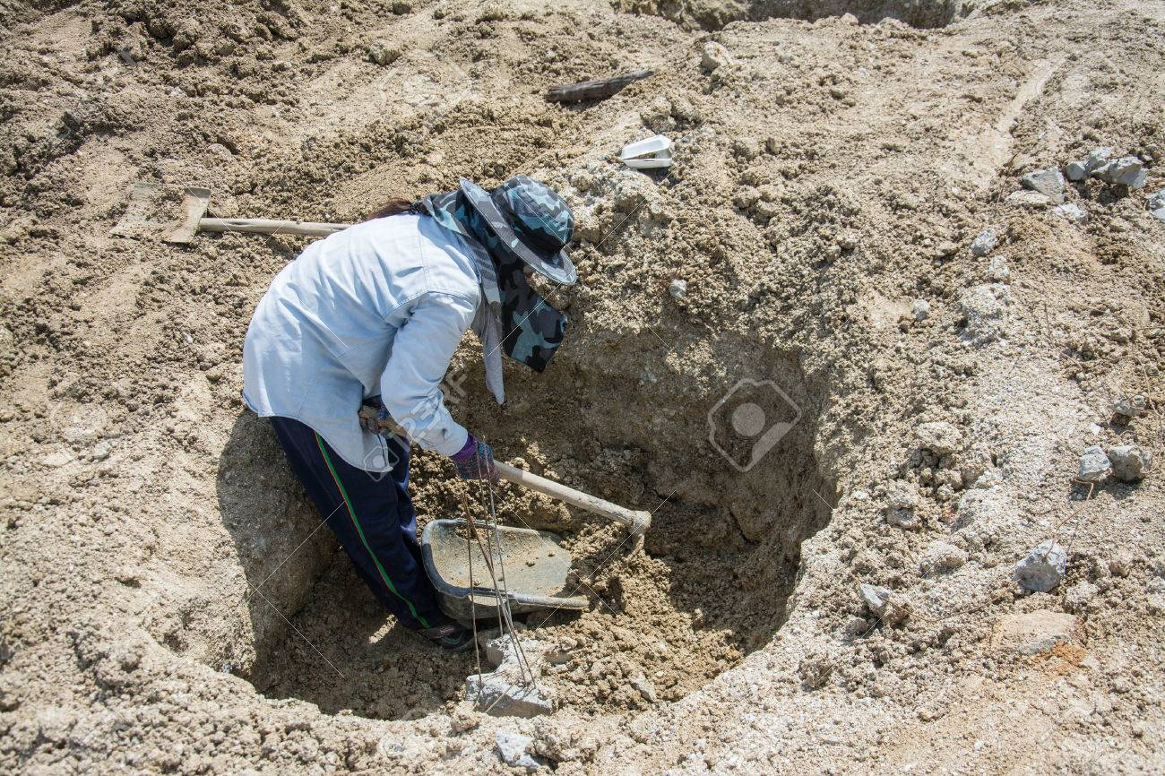
drudgery
difficult, unpleasant or uninteresting labor

Slide 10
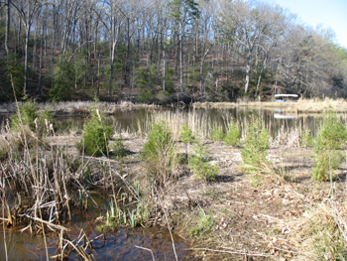
screened
to hide or protect by covering

Slide 11
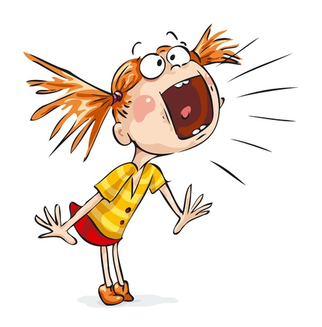
hoarsely
having a rough or sharp sound

Slide 12
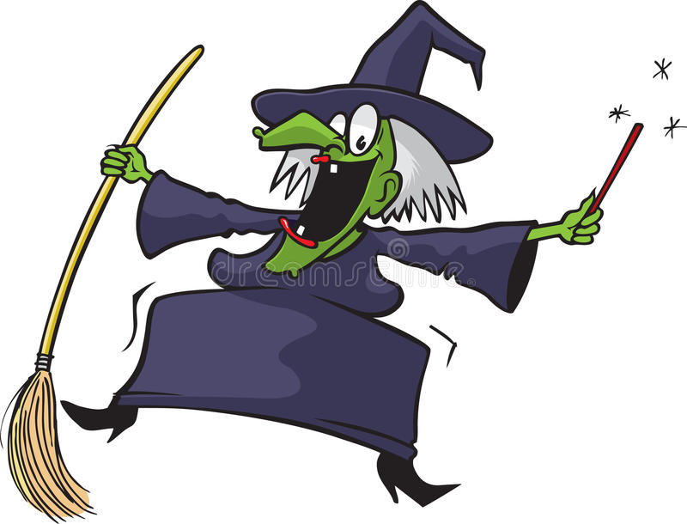
cackling
characterized by a high-pitched, broken sound

Slide 13
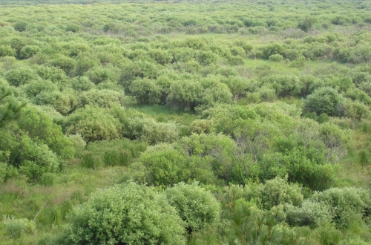
thickets
thick patches of shrubs or bushes

Slide 14
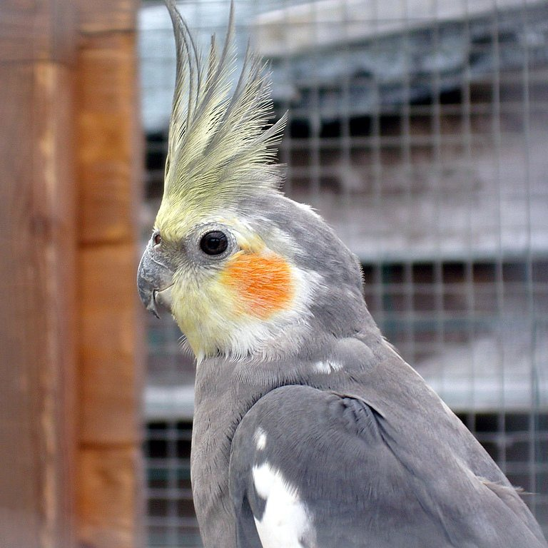
crest
a long tuft of feathers atop a bird’s head

