Slide 1
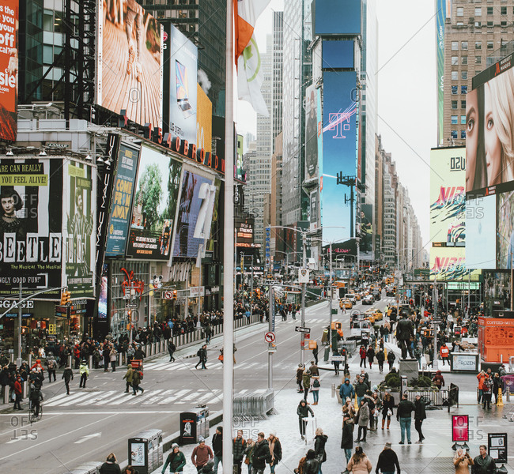
b_______
characterized by hurried, excited movement

Slide 2
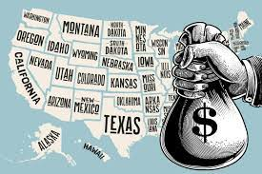
g_____
land or money given as a gift for those who need it

Slide 3
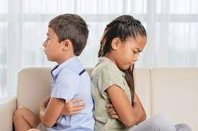
r_______
felt anger or bitterness toward

Slide 4
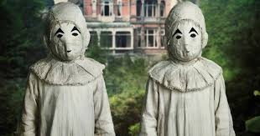
p______
specific or unusual

Slide 5
e_____ w____
filled with a deep love for

Slide 6
c______
gave recognition for an accomplishment

Slide 7
l______
tried to influence someone to think, act, or vote in a certain way

Slide 8
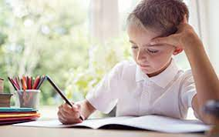
e______
to determine or discover the value of

Slide 9
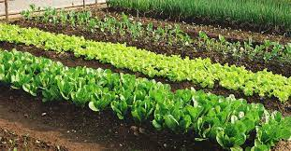
s_____
a group of plants growing in one area

Slide 10
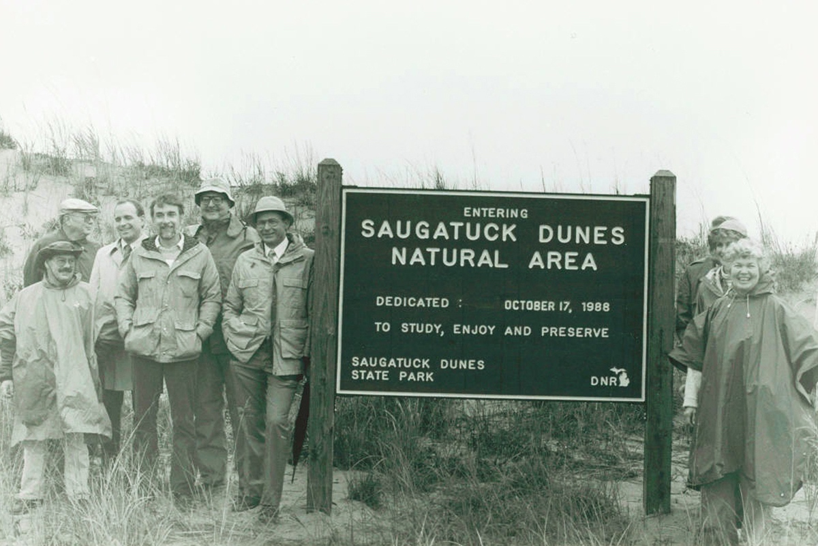
p_______
natural lands set aside by the government for the protection of plants and animals

Slide 11
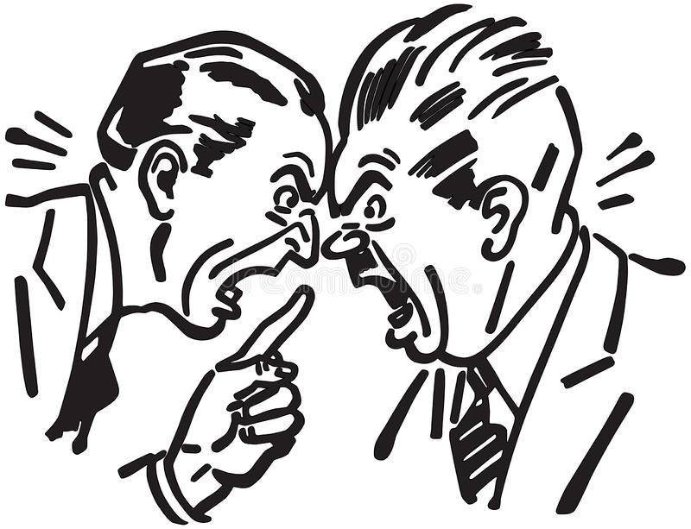
h______
characterized by anger or passion; intense

Slide 12
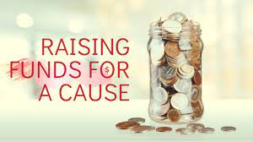
s_______
raises or pays money for

Slide 13
b_____
to carry or wear a mark

