Slide 1
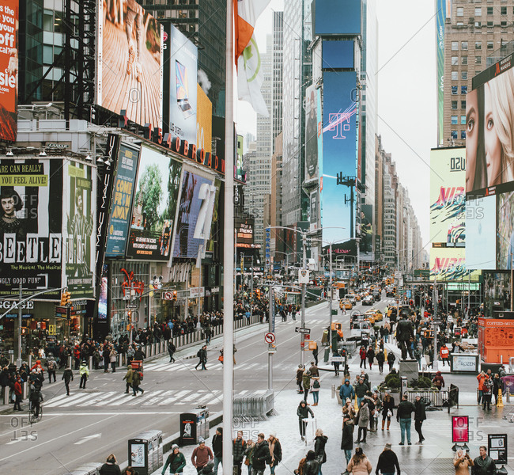
bustling
characterized by hurried, excited movement

Slide 2
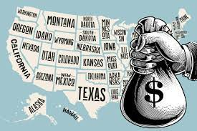
grant
land or money given as a gift for those who need it

Slide 3
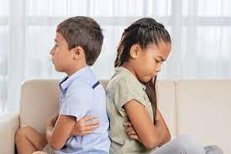
resented
felt anger or bitterness toward

Slide 4
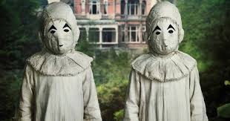
peculiar
specific or unusual

Slide 5
enamored with
filled with a deep love for

Slide 6
credited
gave recognition for an accomplishment

Slide 7
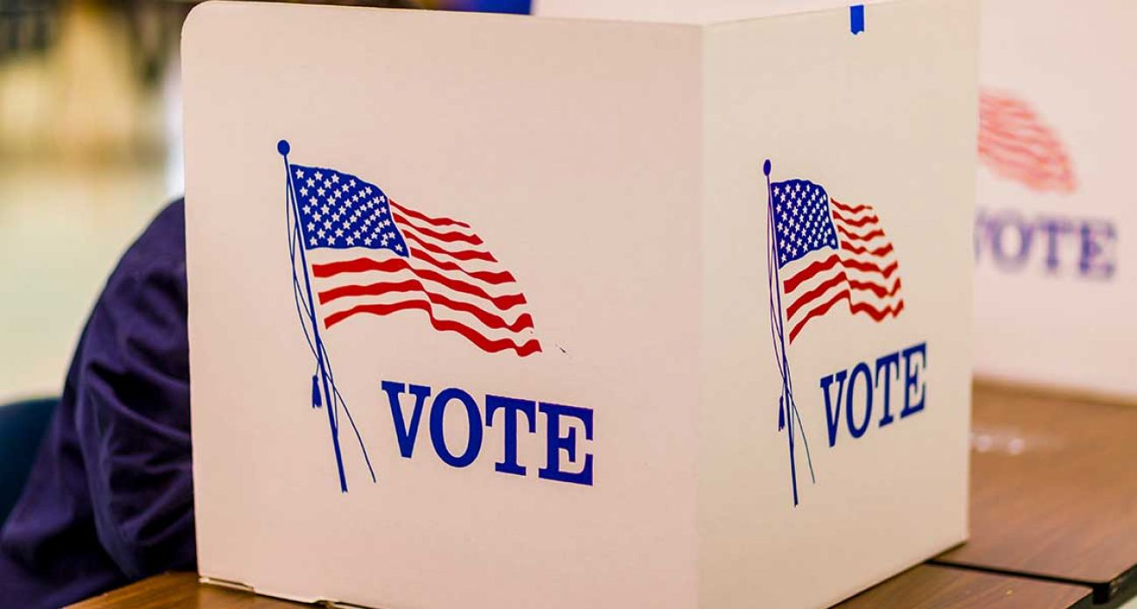
lobbied
tried to influence someone to think, act, or vote in a certain way

Slide 8
evaluate
to determine or discover the value of

Slide 9
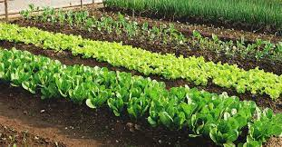
stand
a group of plants growing in one area

Slide 10
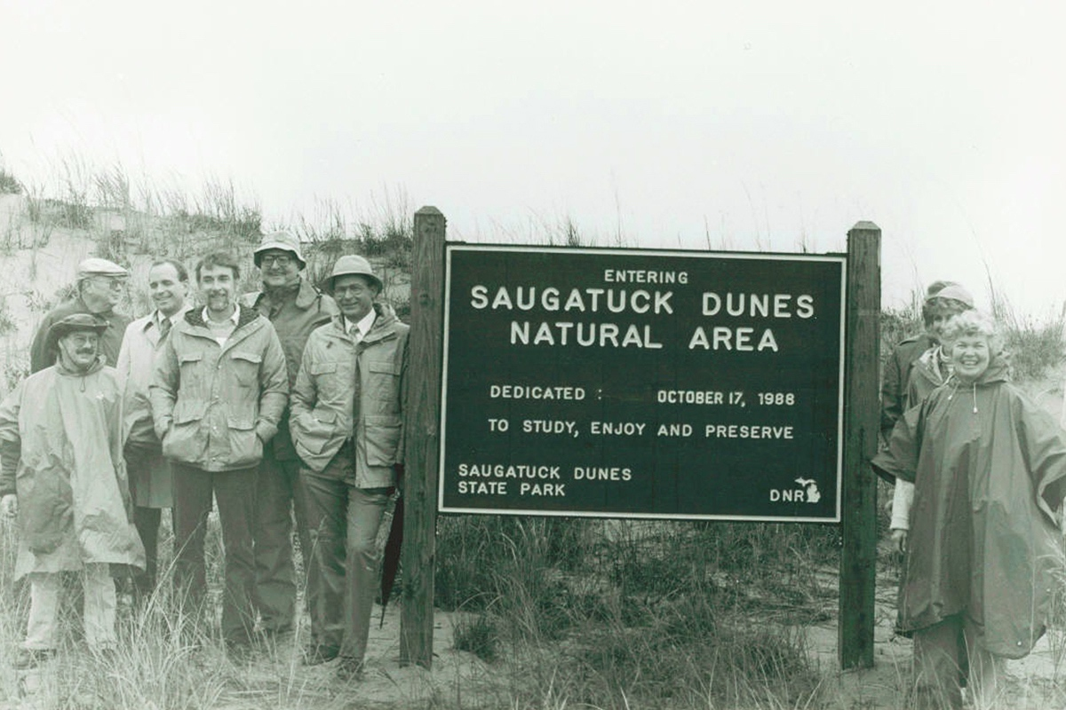
preserves
natural lands set aside by the government for the protection of plants and animals

Slide 11
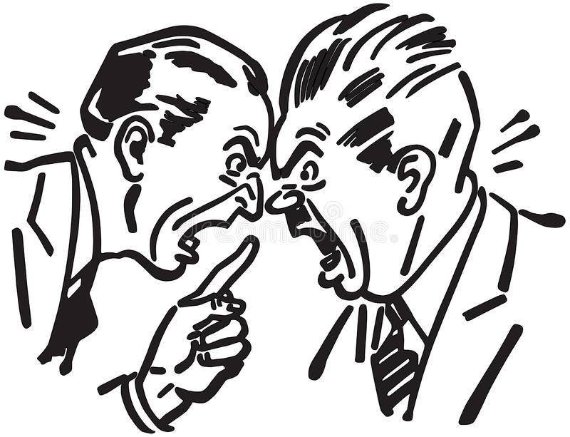
heated
characterized by anger or passion; intense

Slide 12
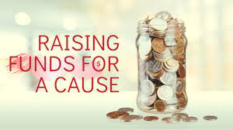
sponsors
raises or pays money for

Slide 13
bear
to carry or wear a mark

