Slide 1
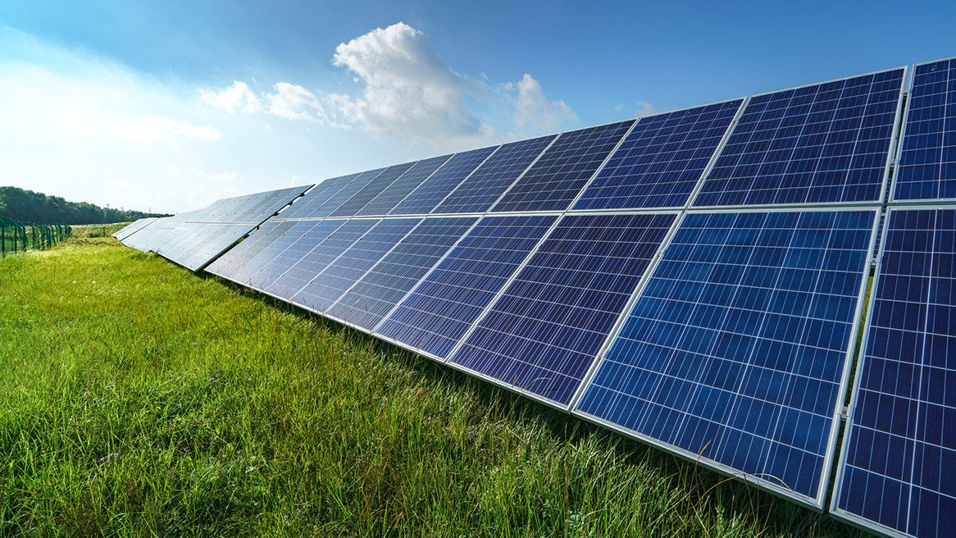
solar
Having to do with or coming from the sun

Slide 2
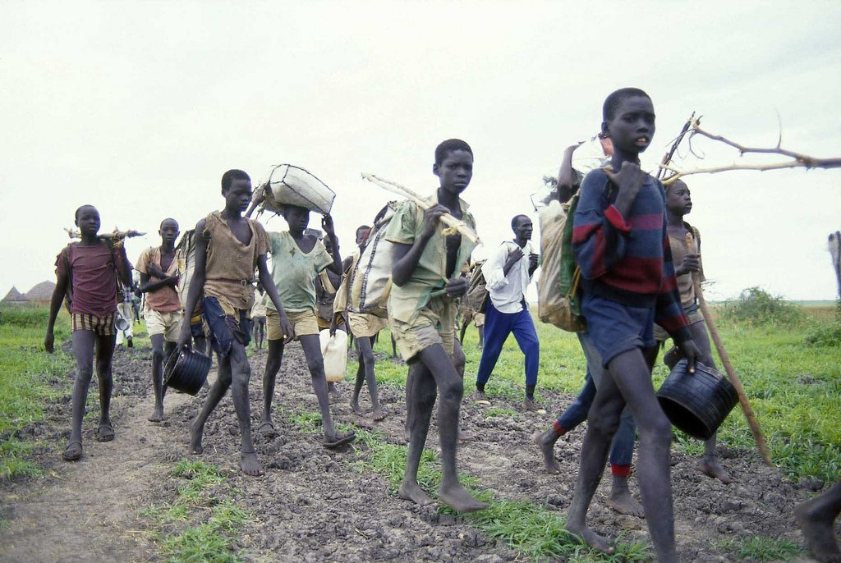
refugee
A person who flees from a place in search of safety or protection.

Slide 3
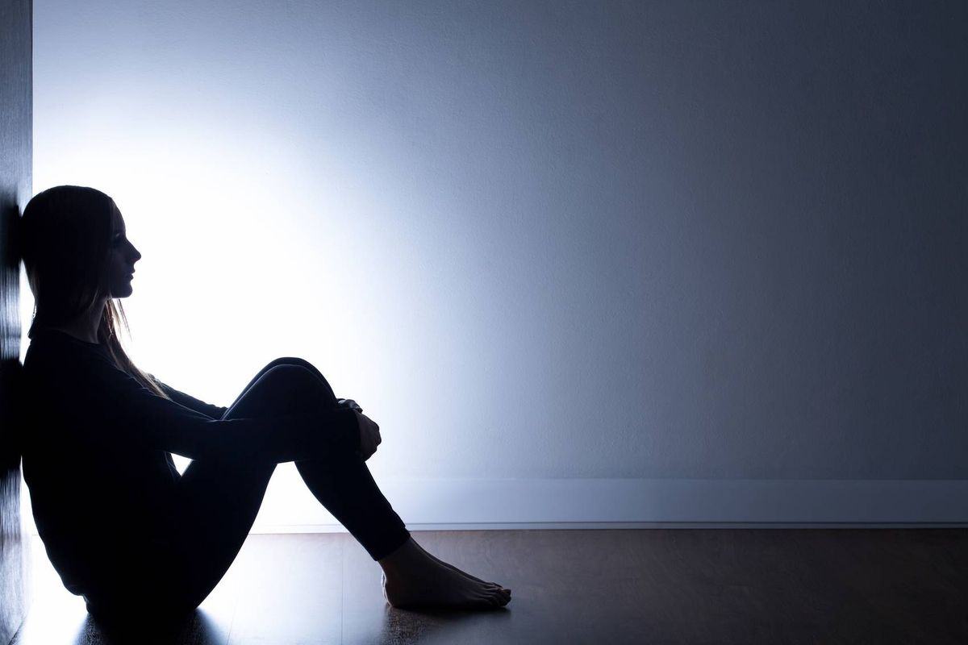
isolated
Apart from other people or communities

Slide 4
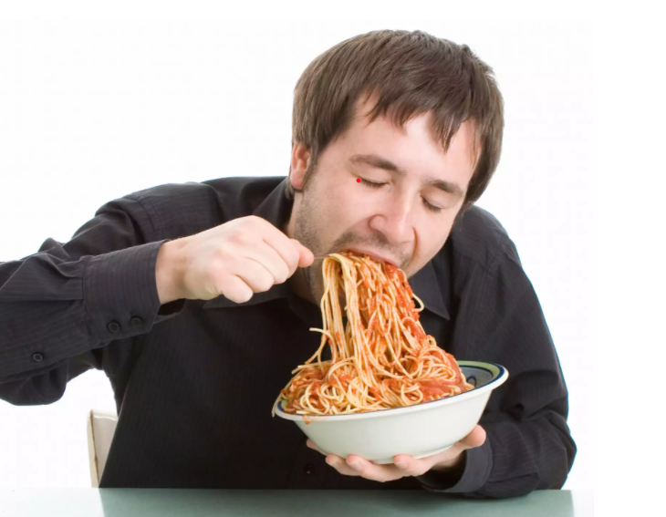
devour
To consume quickly

Slide 5
promote
To contribute to the growth of or endorse

Slide 6
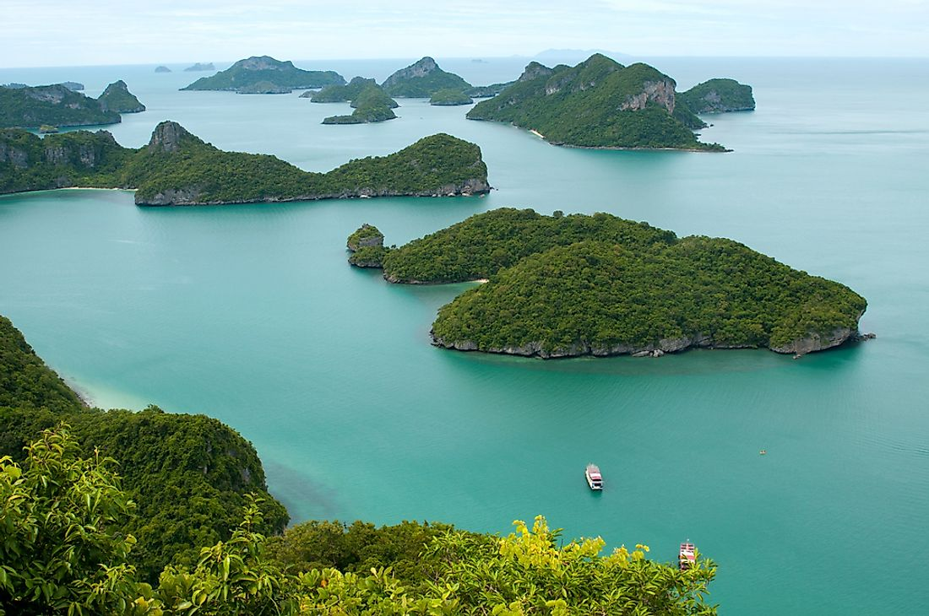
archipelago
A large group of islands, or the body of water in which the islands are located

Slide 7
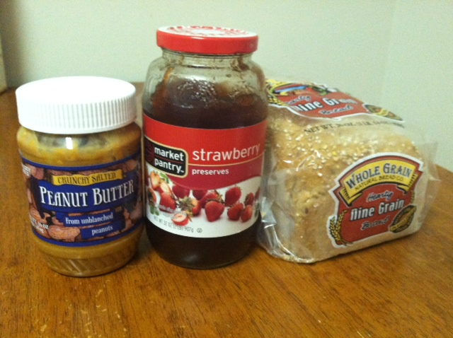
consists
To be made up of

Slide 8
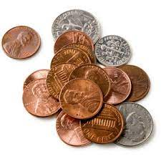
economical
Requiring a relatively small amount of money; cheap; cost-effective

Slide 9
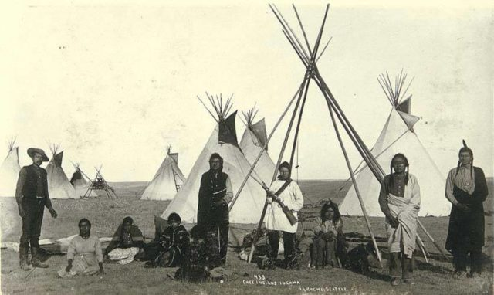
nomadic
Characterized by moving from place to place

Slide 10
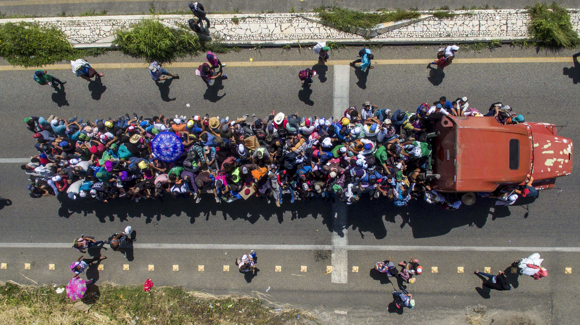
caravan
A group of vehicles traveling together

Slide 11
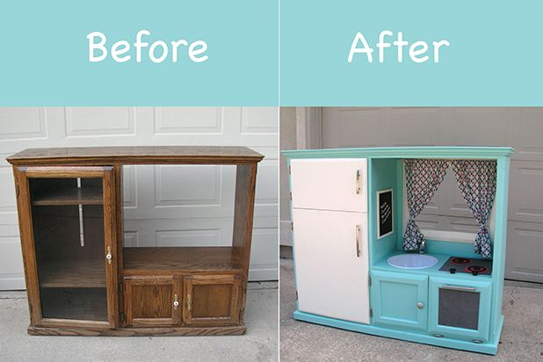
refurbished
Made useful again, renovated

Slide 12
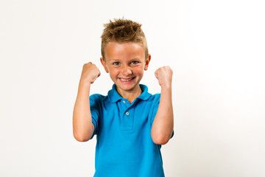
capabilities
Things that are possible, able to be done

