Slide 1
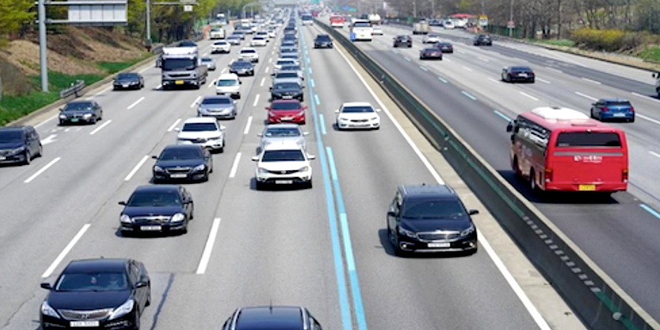
expressway
A wide road with several lanes used for automobile traffic.

Slide 2
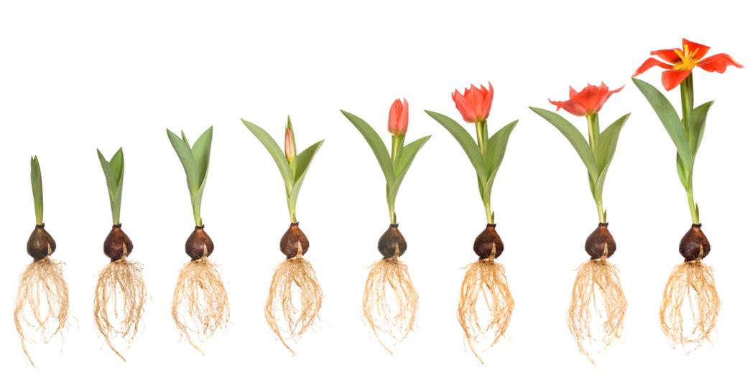
gradually
Happening little by little; slowly

Slide 3
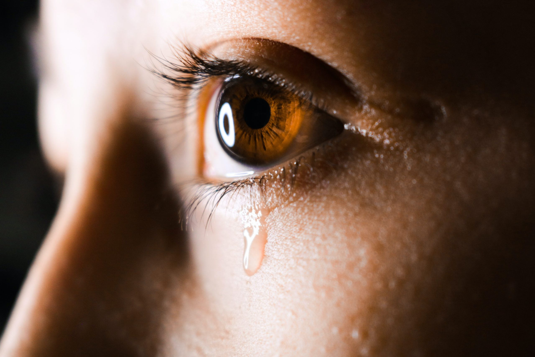
welled
To rise to the surface, usually referring to liquid.

Slide 4
melancholy
A deep sadness

Slide 5
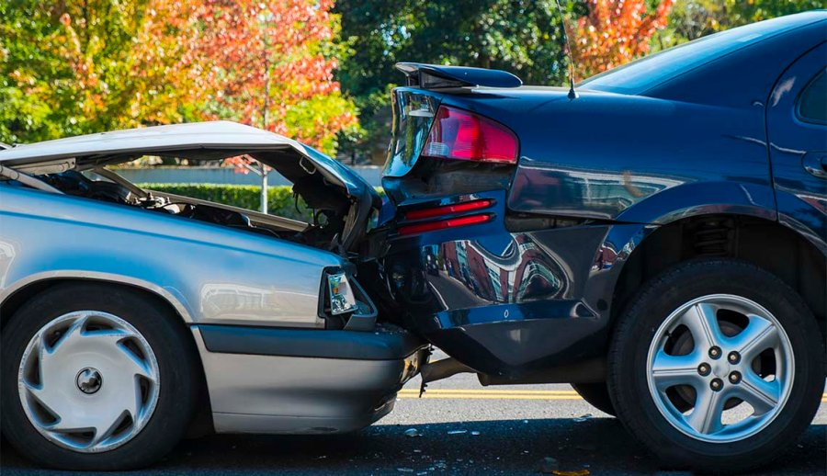
insurance
Protection against loss or damage

Slide 6
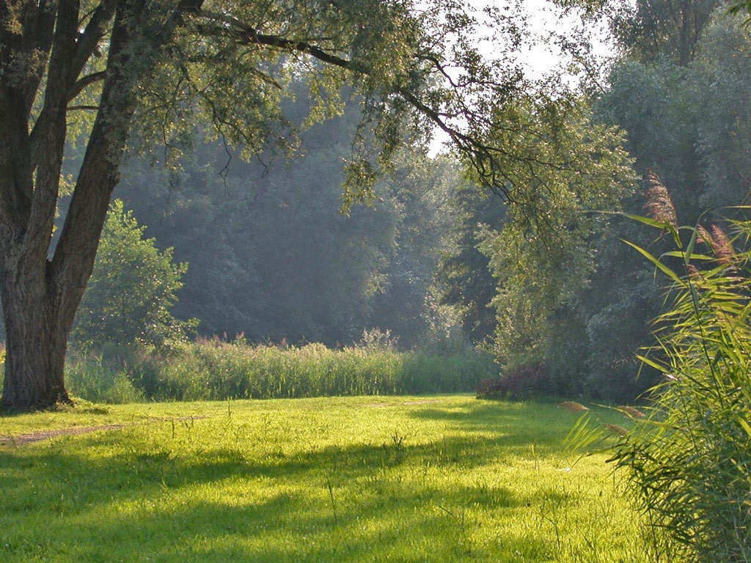
clearing
A piece of land free from trees or large plants

Slide 7
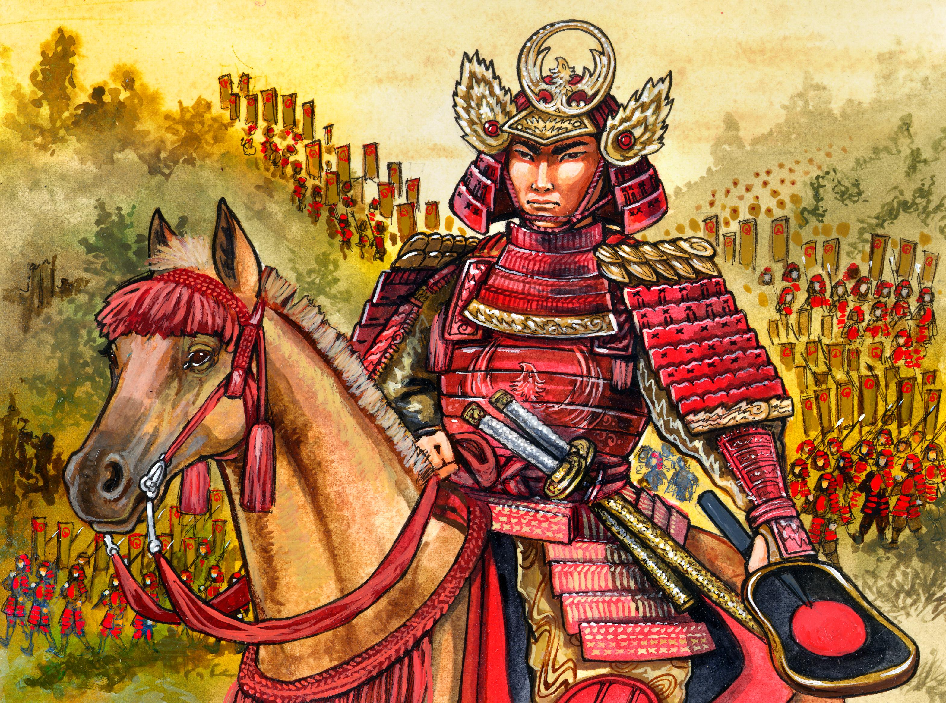
shogun
One of many military rulers of Japan who served before the revolution of 1897-1868

Slide 8
regularly
Done again and again at about the same time; evenly

Slide 9
verse
A section of a poem or song

Slide 10
fiddled
To aimlessly play around with

Slide 11
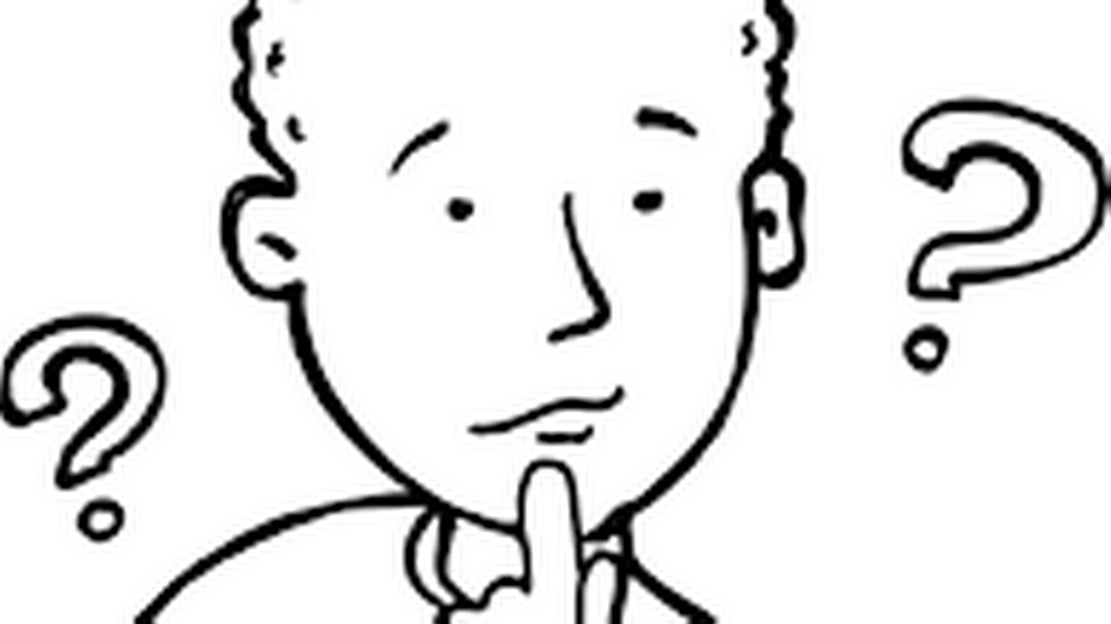
pondered
To think carefully

Slide 12
charming
Attractive or appealing

