Slide 1
scholar
a person with advanced learning experiences

Slide 2
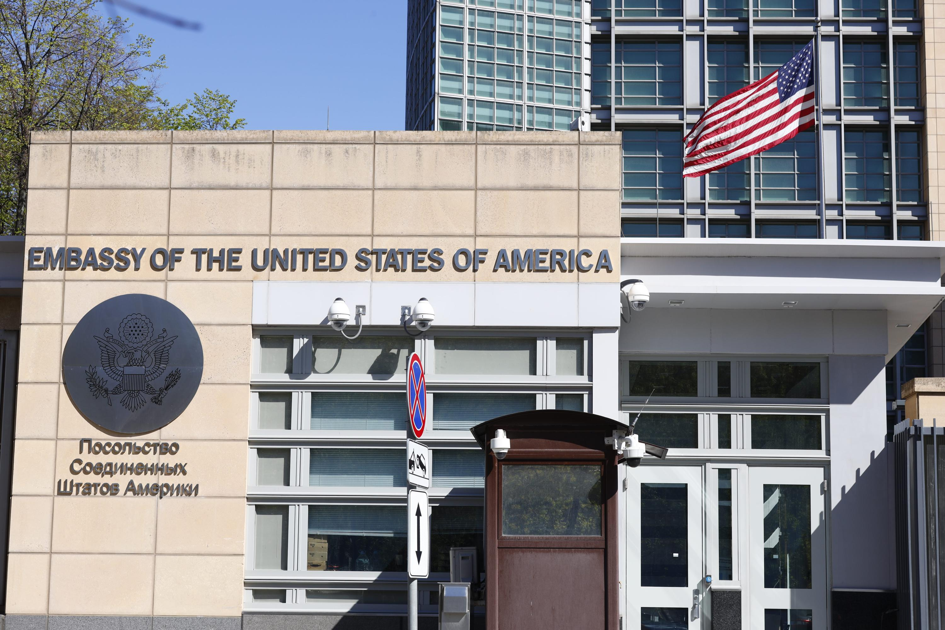
embassies
the home or office of an ambassador
to a foreign country

Slide 3
engineer
a person who designs or builds structures or machines, such as roads, bridges, or planes

Slide 4
abroad
outside of one’s home country

Slide 5
stoic
unwilling to show emotions; expressionless

Slide 6
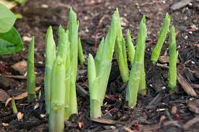
shoots
the stem and leaves of a young plant

Slide 7
reprimanded
to express disapproval or punish

Slide 8
betrayal
an unfaithful act that often violates expectations

Slide 9
inseparable
unable to be taken apart

Slide 10
luscious
rich in detail, attractive or fancy

Slide 11
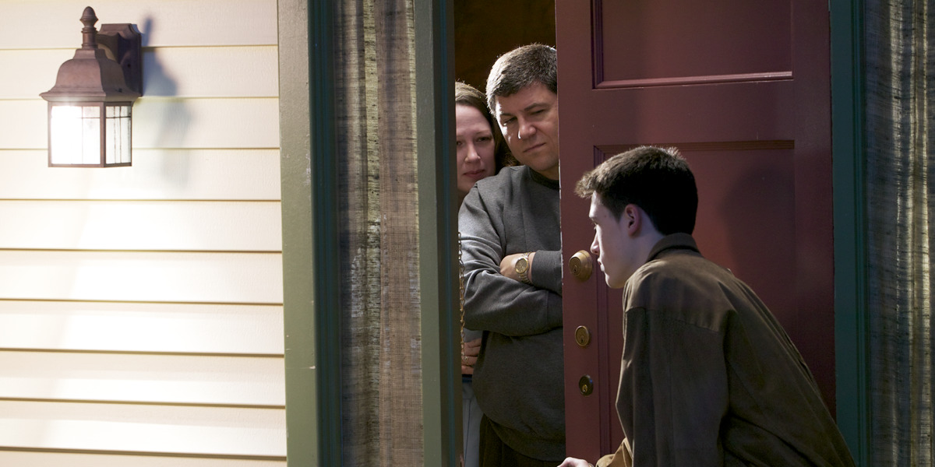
curfew
a set time by which people are expected or demanded to be home

Slide 12
shrill
characterized by a high-pitched shrieking sound

Slide 13
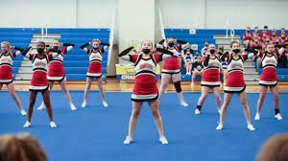
unison
happening at the same time, together

Slide 14
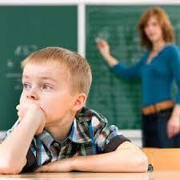
trance
a condition where a person is conscious but seems unaware of what is going on

Slide 15
lolled
to stand, sit, or lay in a casual, relaxed way

