Slide 1
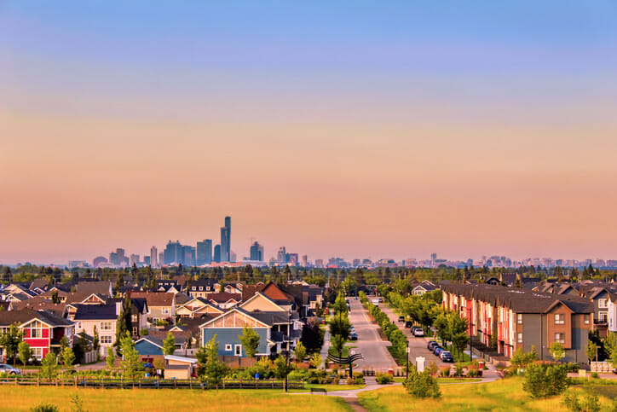
suburbs
a residential are just outside of a big city

Slide 2
croissaint
a flaky pastry shaped like a crescent moon

Slide 3
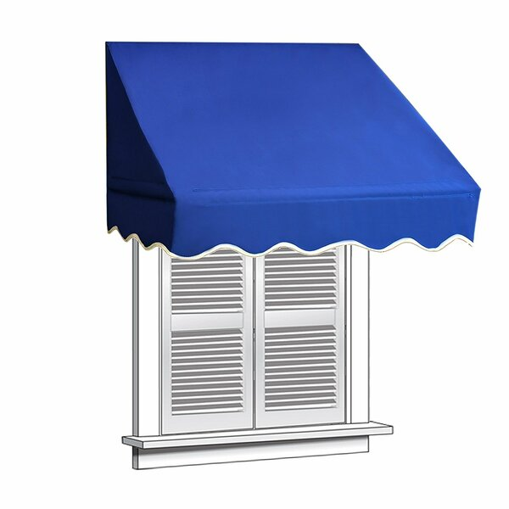
awnings
a piece of canvas or other material used as a
small roof for a doorway or patio

Slide 4
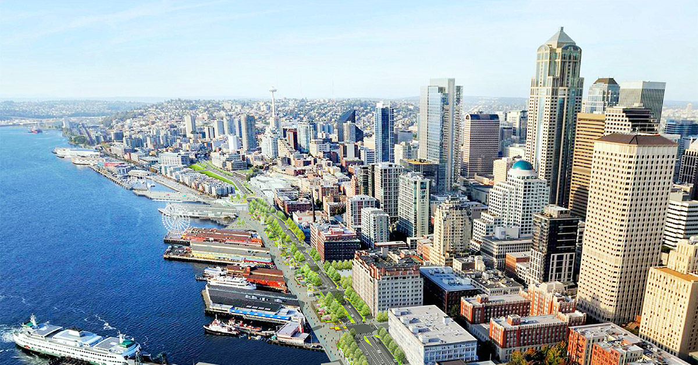
waterfront
a section of a city that borders a body of water

Slide 5
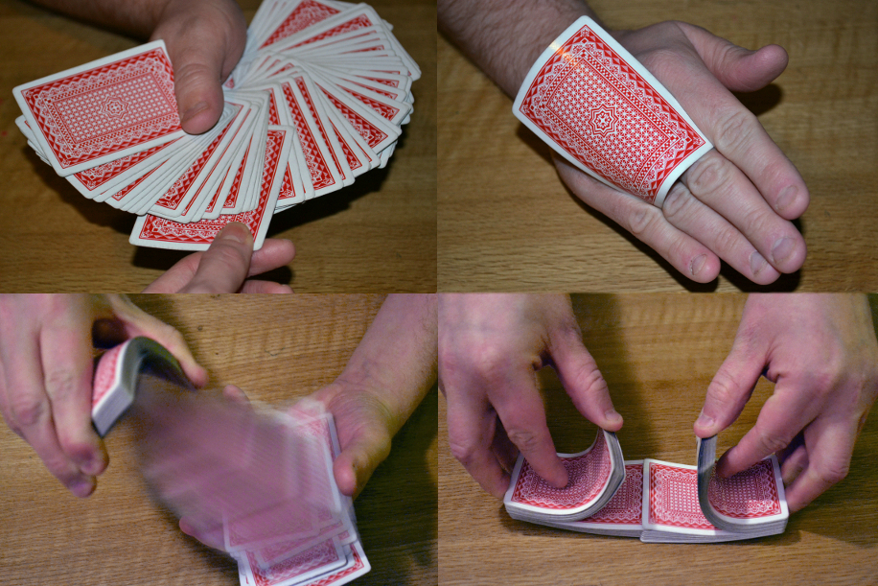
subtle
difficult to see; stealthy

Slide 6
attendant
a person whose job is to provide
people with assistance

Slide 7
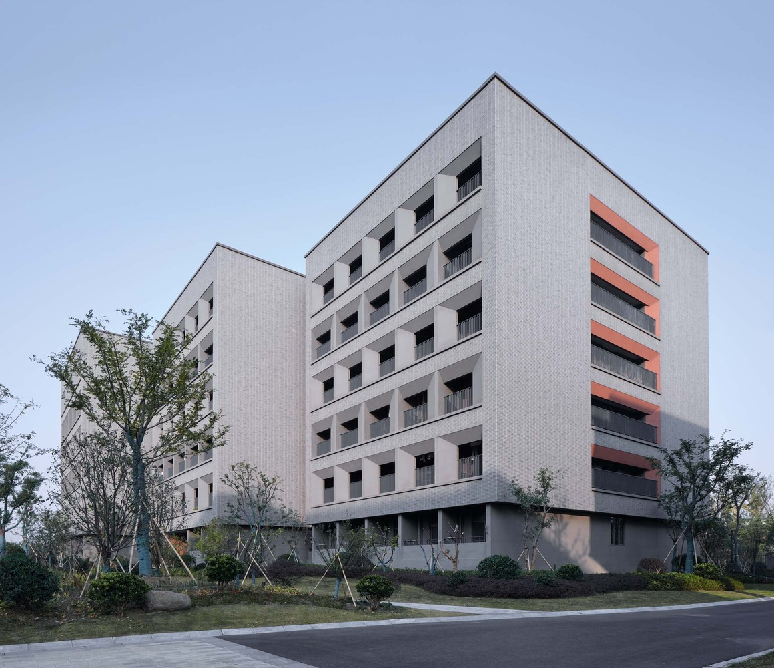
dormitory
a building at a school that contains bedrooms used for housing a group of people

Slide 8
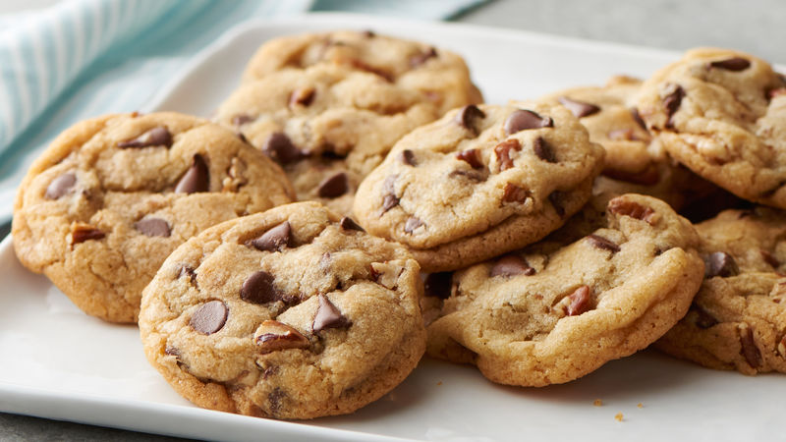
authentic
true to reality, genuine

Slide 9
candlelight
the mild light provided only by candles

Slide 10
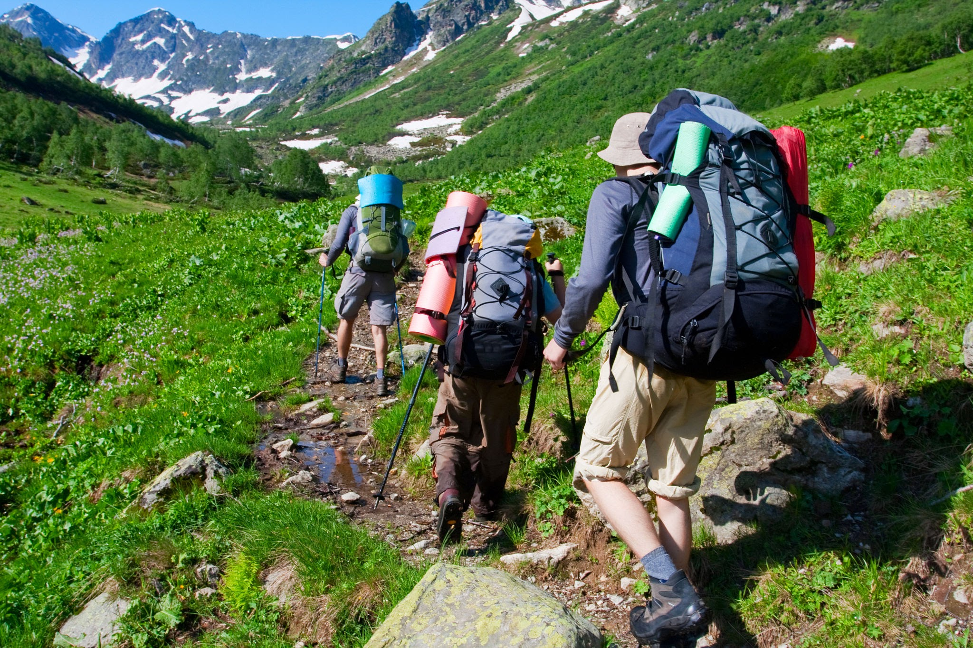
trekked
to make a long journey on foot

Slide 11
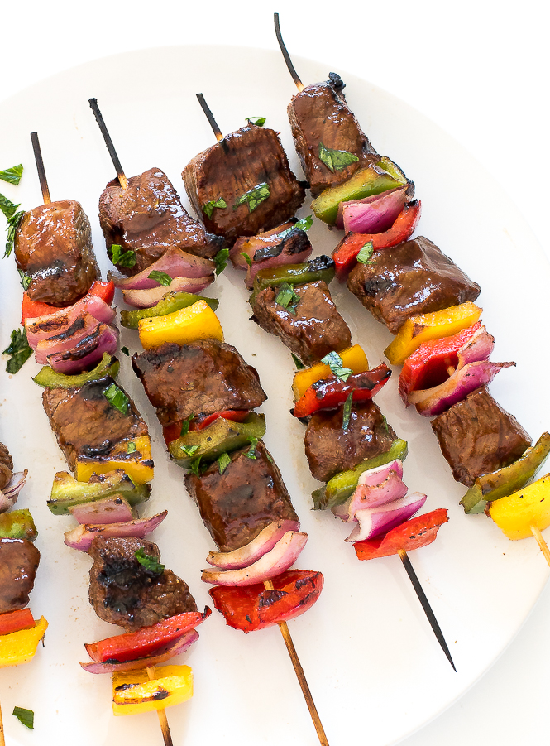
kabob
roasted meat or vegetables on a stick

Slide 12
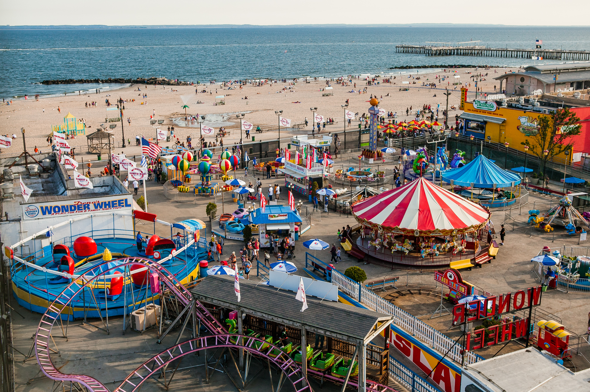
excursion
a short trip taken for fun

