Slide 1
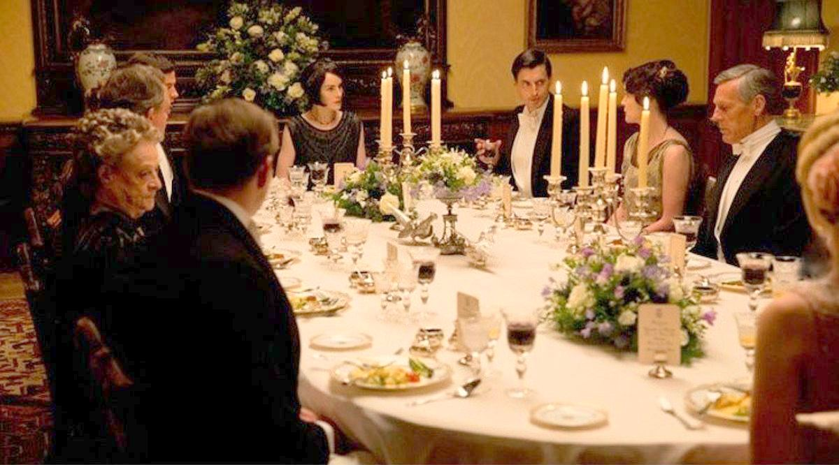
formal
very proper, official

Slide 2
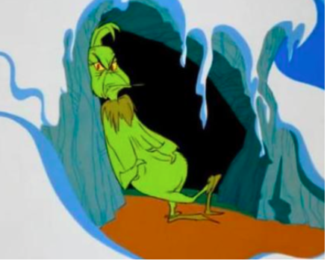
remote
not near, distant

Slide 3
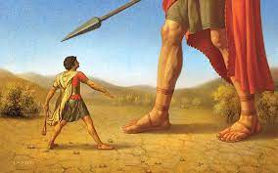
formidable
causing fear, intimidating

Slide 4
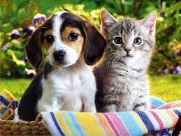
prevalent
common, widely acknowledge

Slide 5
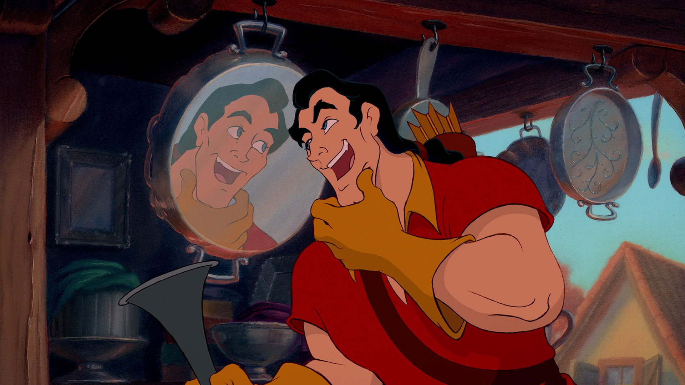
arrogant
showing to much pride and confidence
Video: Start at 2 minutes

Slide 6
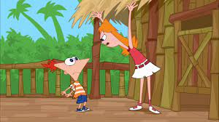
authoritarian
controlling or bossy

Slide 7
manufacturer
a person or company that produces a product

Slide 8
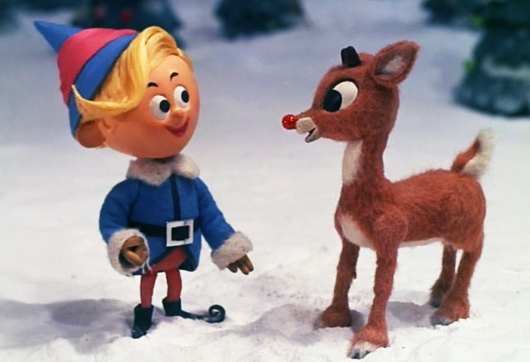
nostalgia
happiness caused by good memories

Slide 9
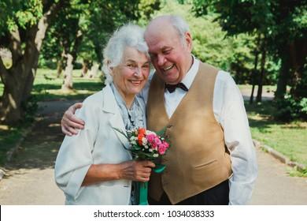
steadfast
dedicated and devoted to a person or cause for a long period of time

