Slide 1
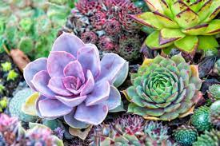
succulents
A type of plant characterized by its ability to store water

Slide 2
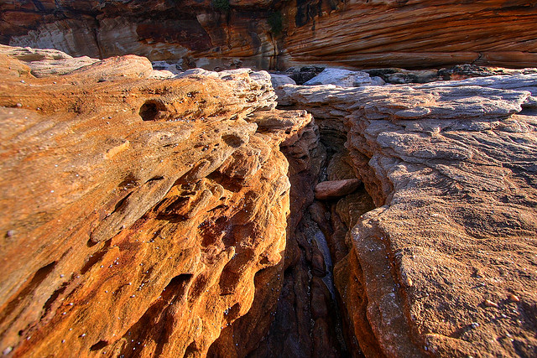
crevices
A crack in the earth

Slide 3
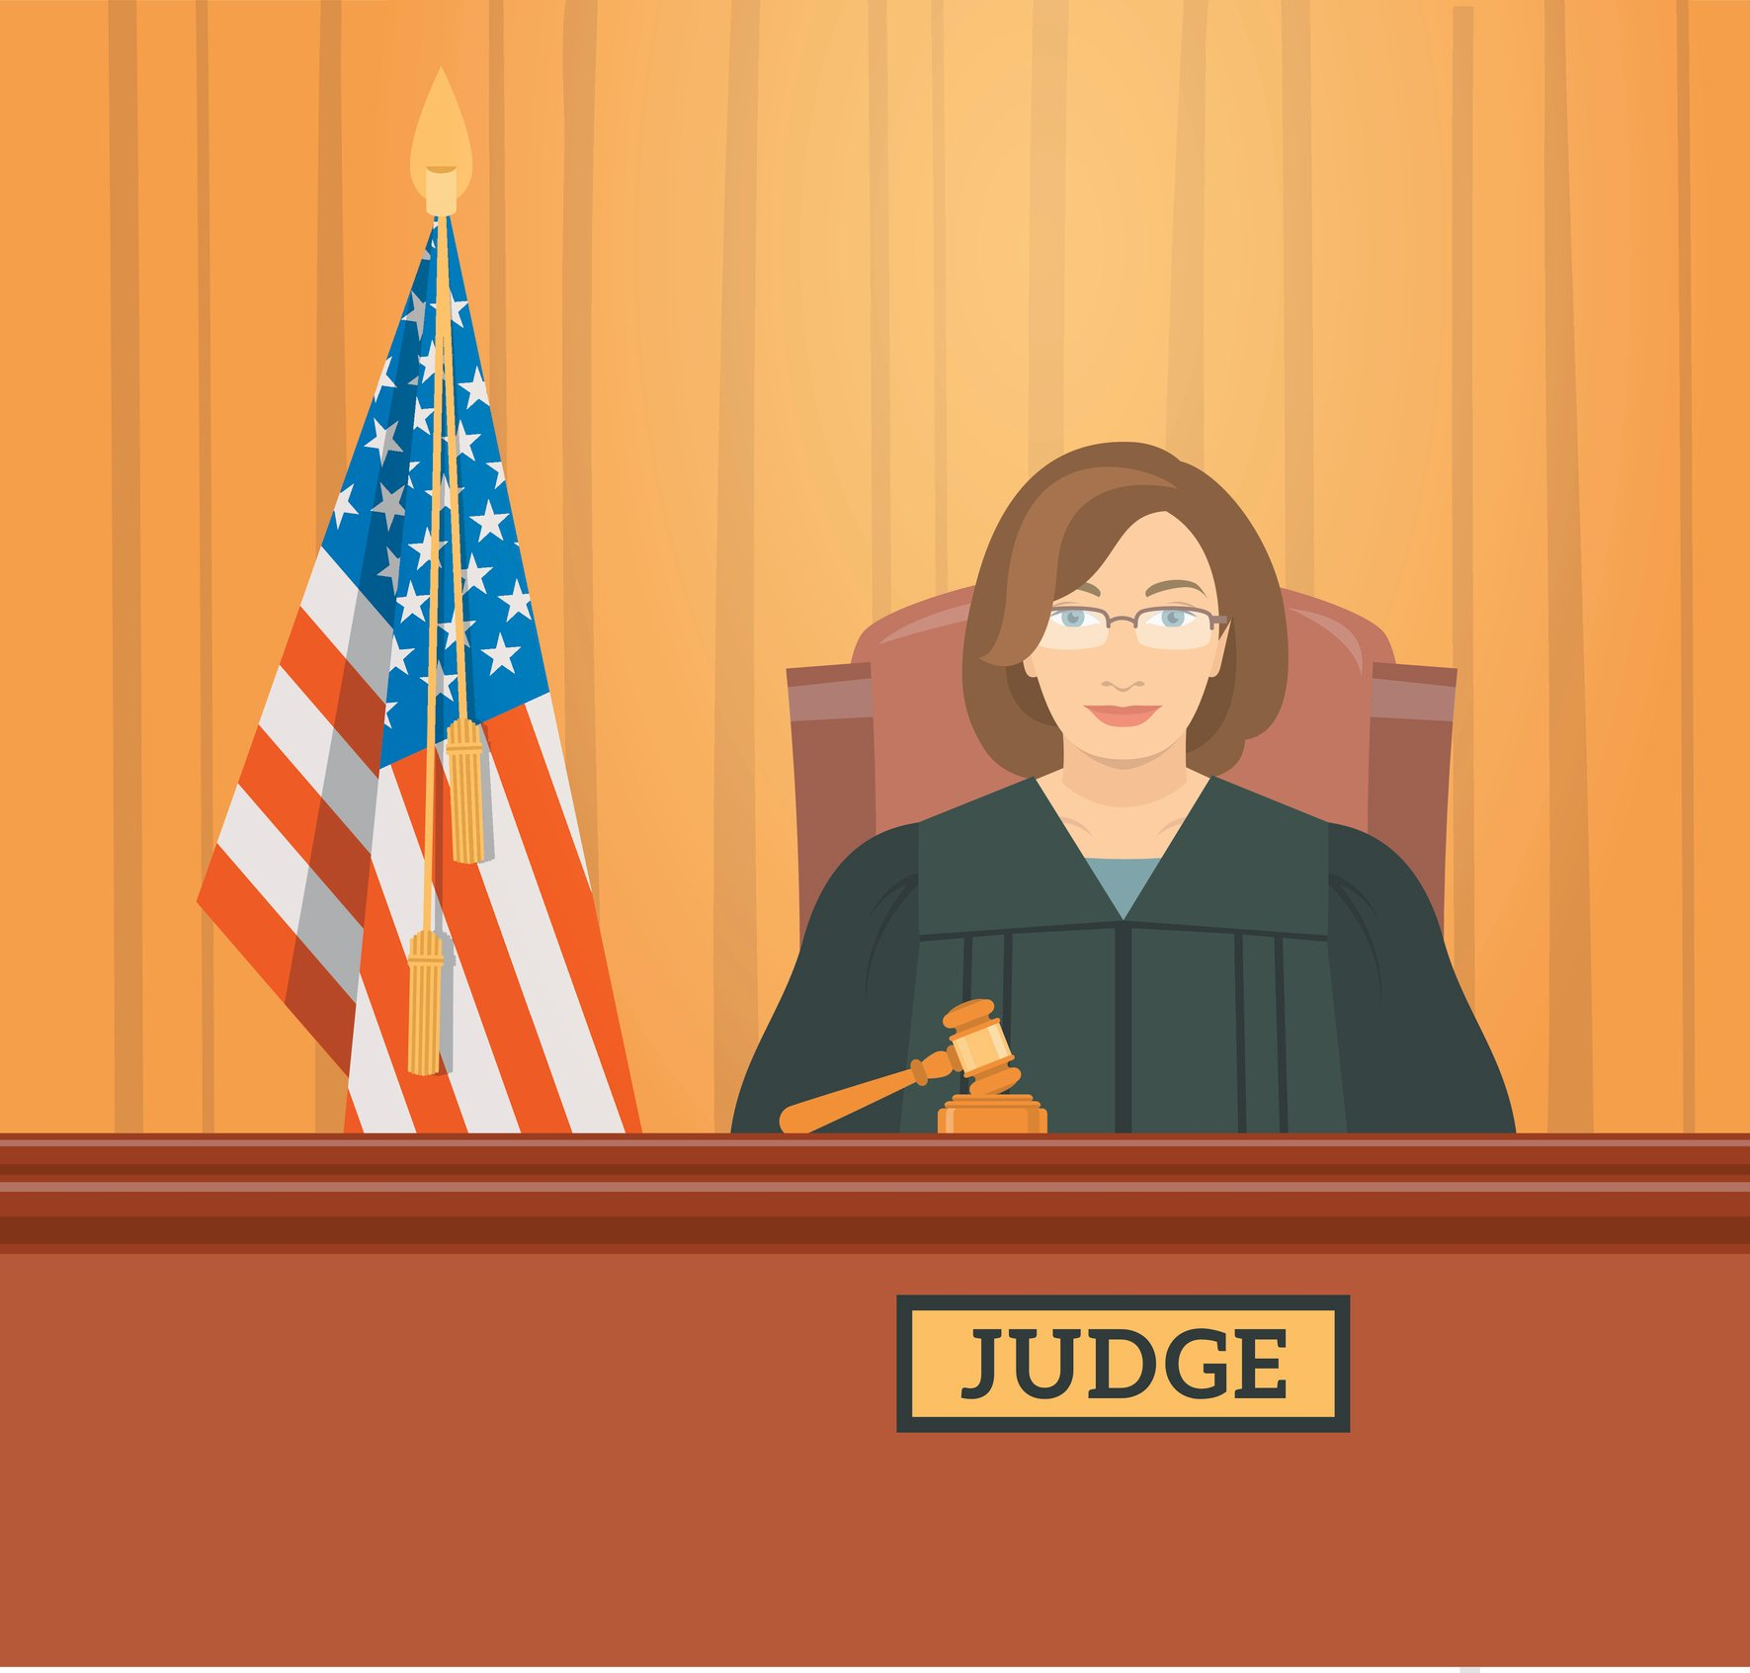
supremacy
The state of authority; to be in a position of power.

Slide 4
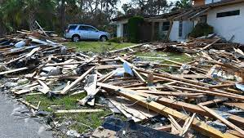
debris
the scattered remains of something, usually broken or discarded

Slide 5
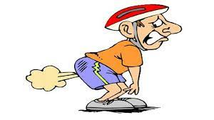
emit
To give off; send out

Slide 6
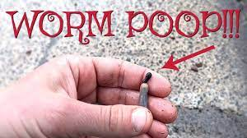
excrete
To release waste from the body

Slide 7
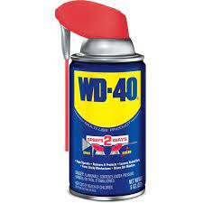
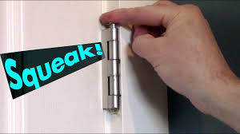
lubricated
Covered in a liquid to allow for easier movement and less friction

Slide 8
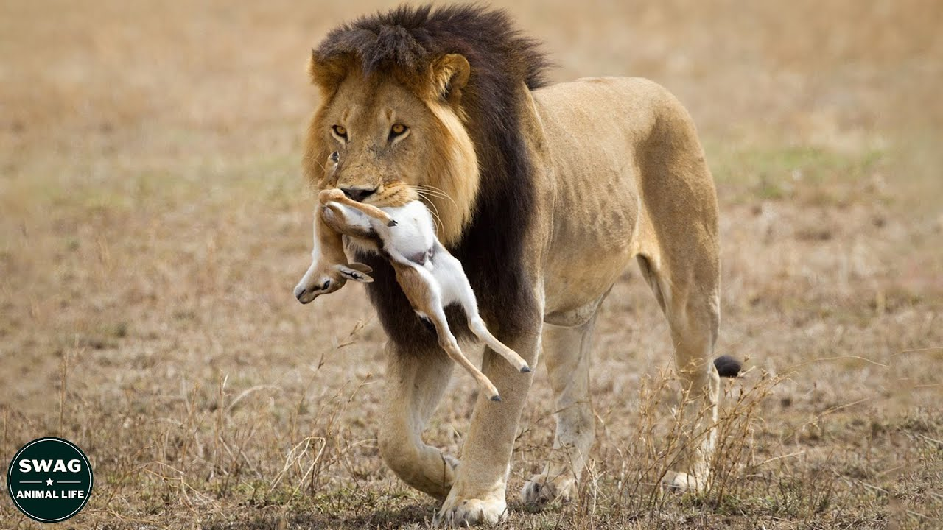
ruthless
Without pity or mercy

Slide 9
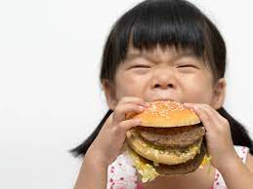
ravenous
Very hungry, often characterized by an impatient need for food.

Slide 10
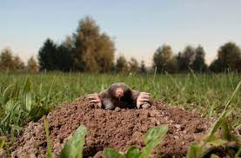
churning
To stir or turn up with force

Slide 11
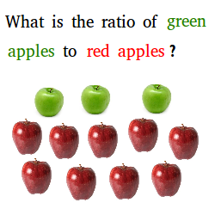
ratio
A comparison in number or quantity between two things

Slide 12
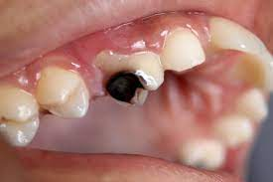
decay
The slow, natural breaking down of plant or animal matter

