Slide 1
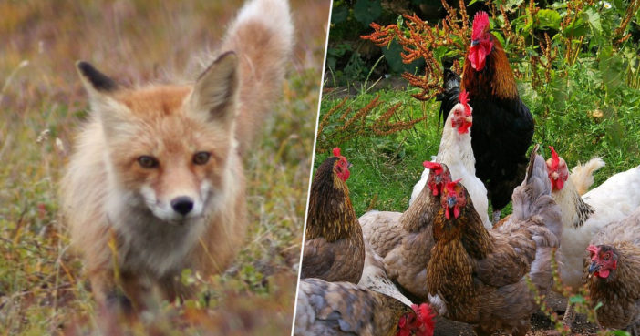
scrabbling
to run frantically or without direction

Slide 2
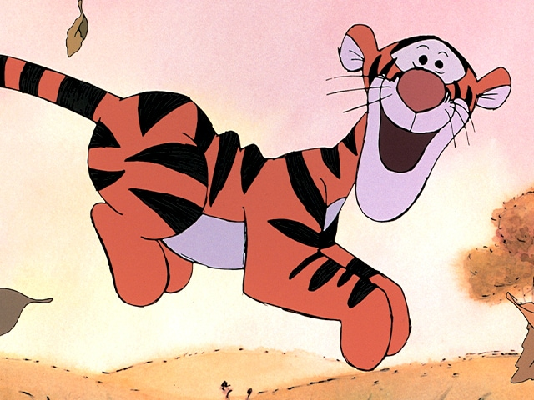
romp
to play or jump with excitement

Slide 3
retractable
able to be pulled back, sometimes by pushing a button

Slide 4
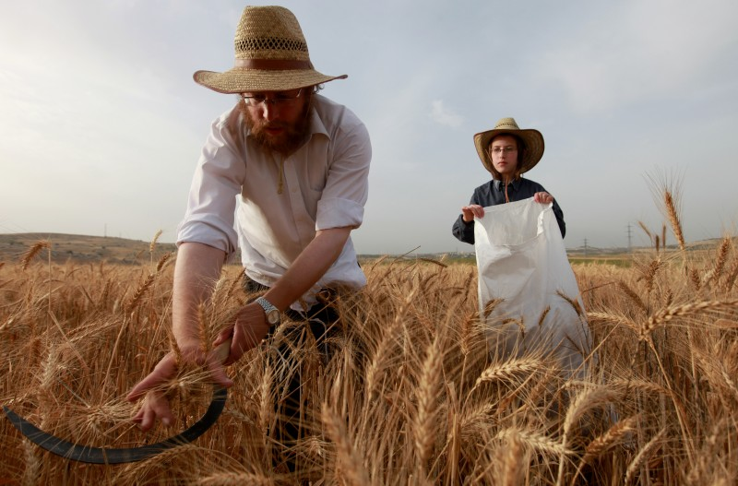
reap
to cut down and gather; harvest a crop

Slide 5
intercept
to stop something from continuing in a direction

Slide 6
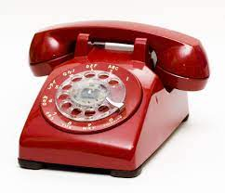
operation
the act or way of working

Slide 7
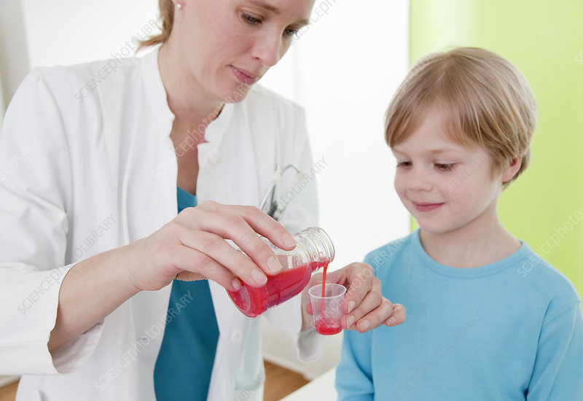
administered
to give or provide

Slide 8
lush
thick, full

Slide 9
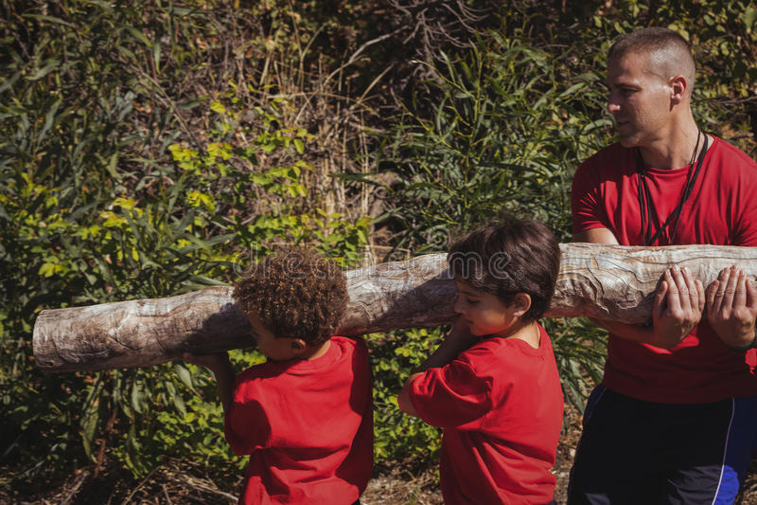
hefted
to struggle to lift something heavy

Slide 10
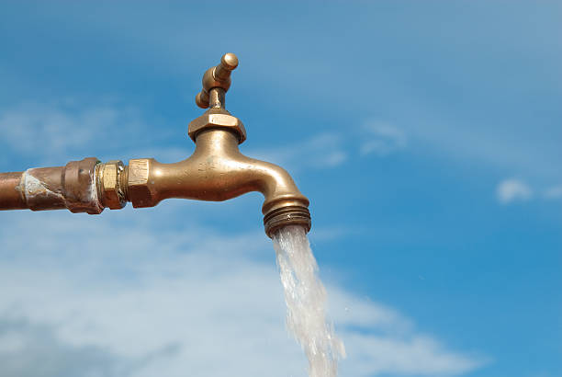
spigot
a faucet from which water flows

Slide 11
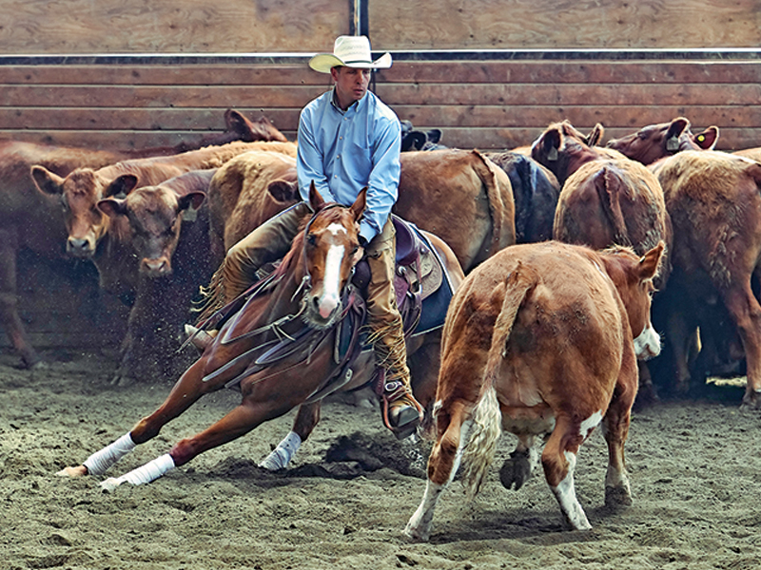
cull
to remove, reduce

Slide 12
rolling
a rising and falling pattern like a wave

