Slide 1
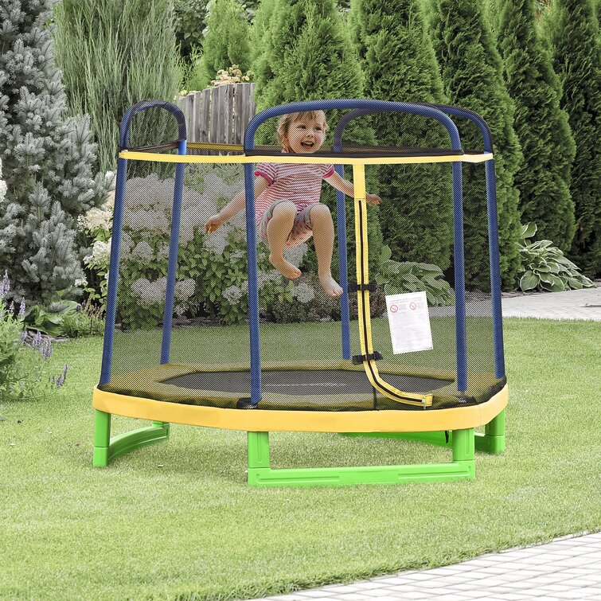
enclosing
to surround on all sides

Slide 2
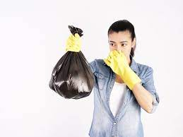
lingered
to remain

Slide 3
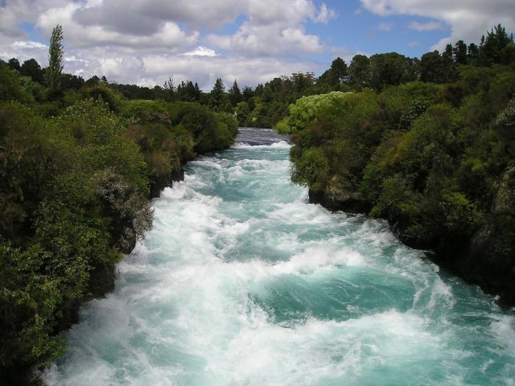
torrent
a fast, heavy stream

Slide 4
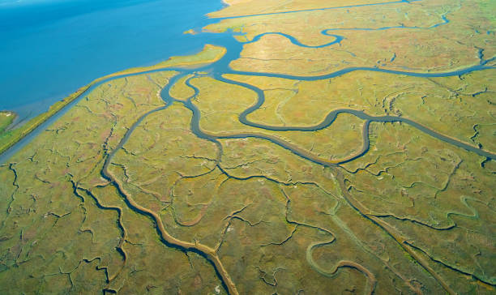
estuary
the mouth of a river, where its stream meets a larger body of water

Slide 5
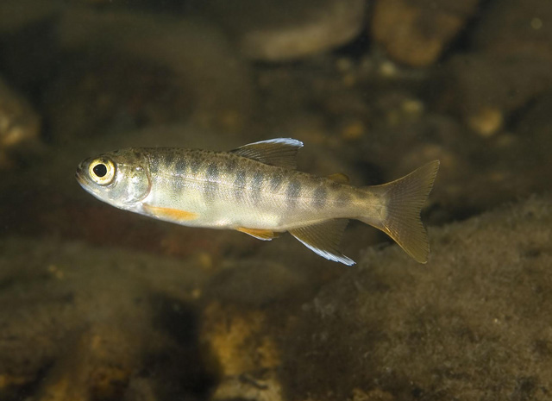
smolt
a young salmon

Slide 6
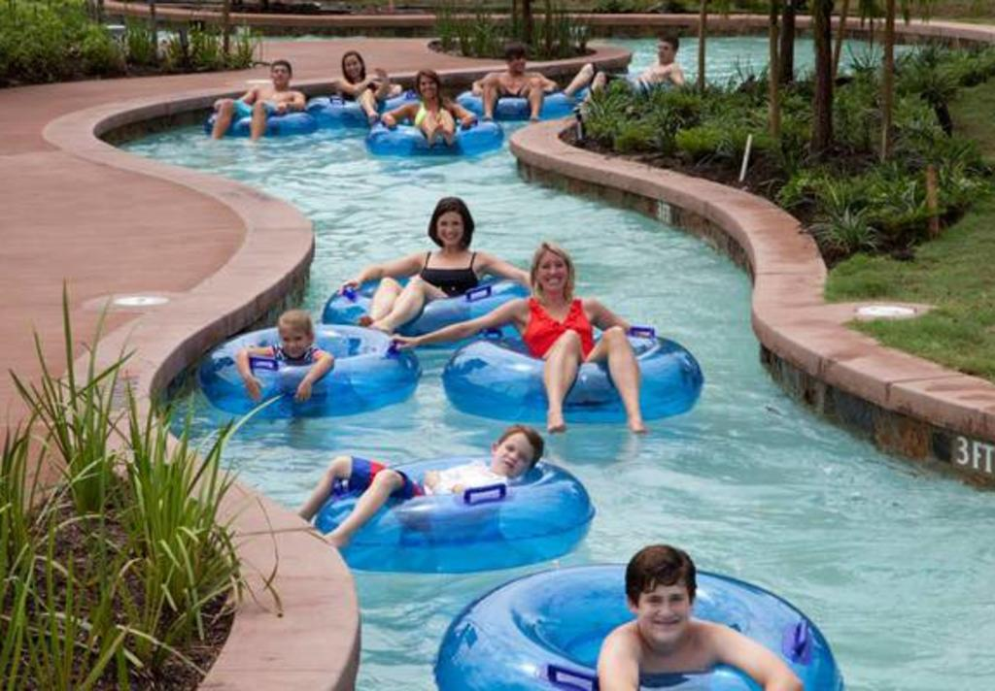
lazed
to relax or rest without much activity

Slide 7
quickening
to animate

Slide 8
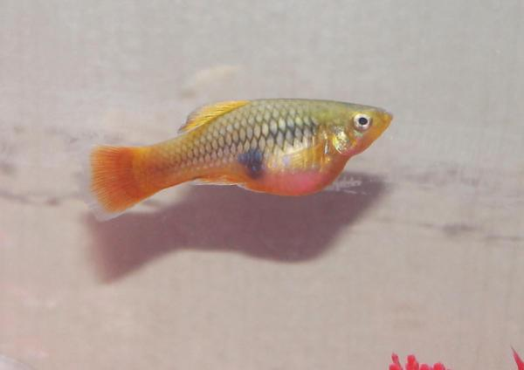
swelling
to grow in size

