Slide 1
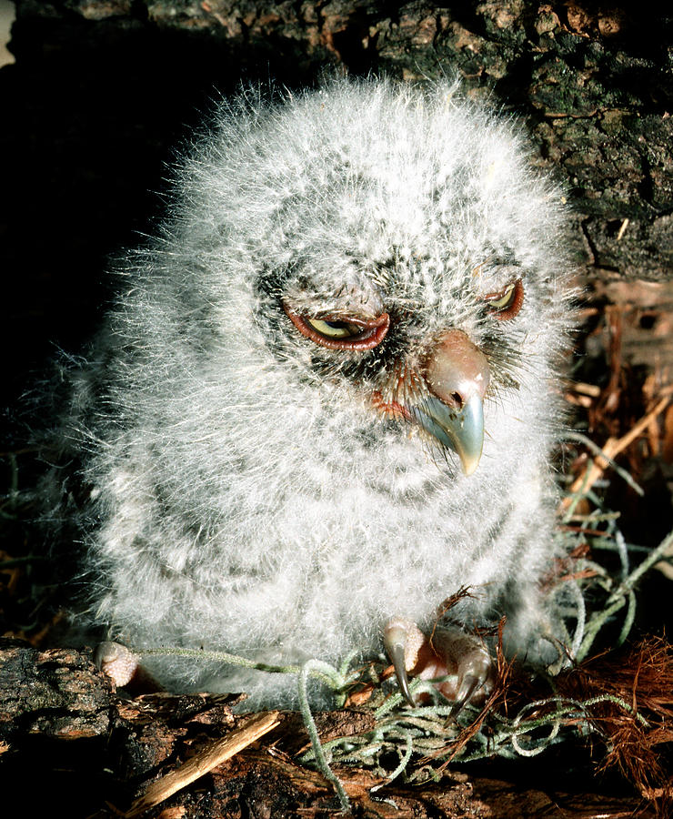
downy
covered with fuzzy hair or soft feathers

Slide 2
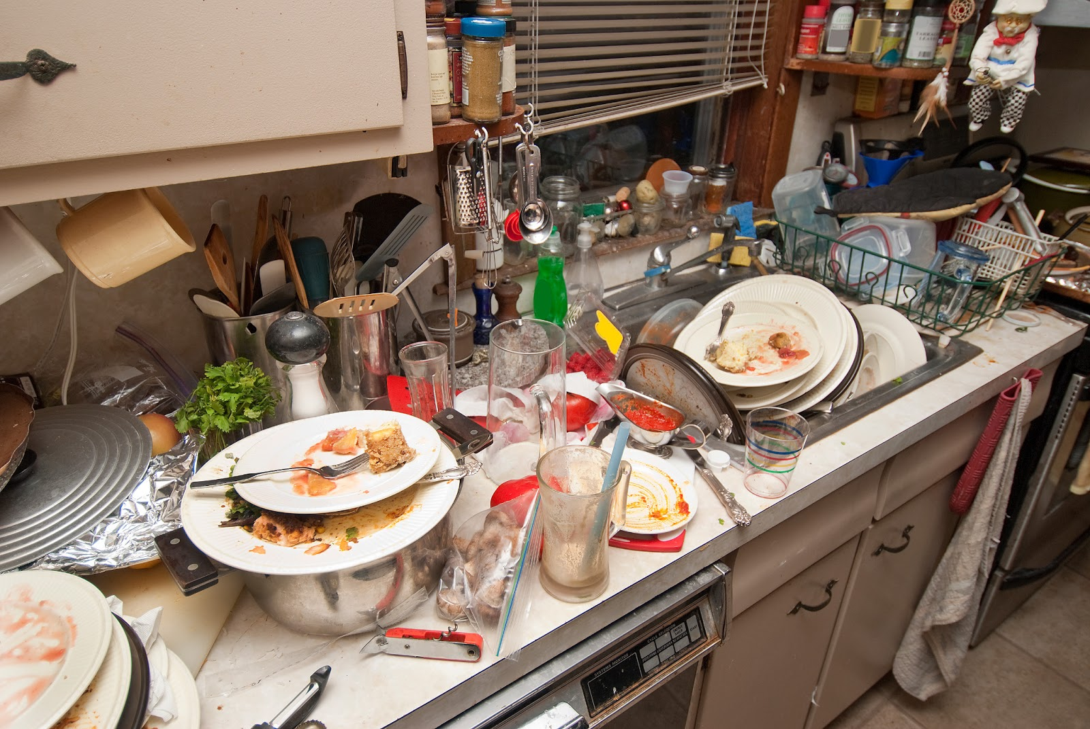
seldom
not often

Slide 3
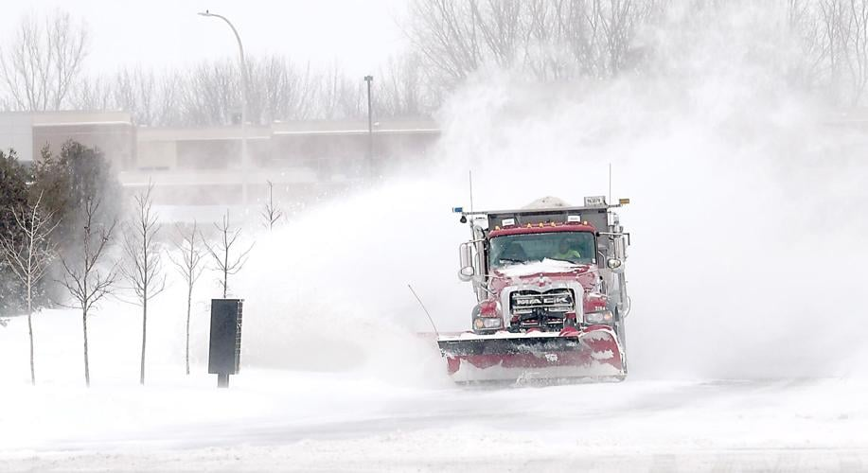
blustery
characterized by violent winds

Slide 4
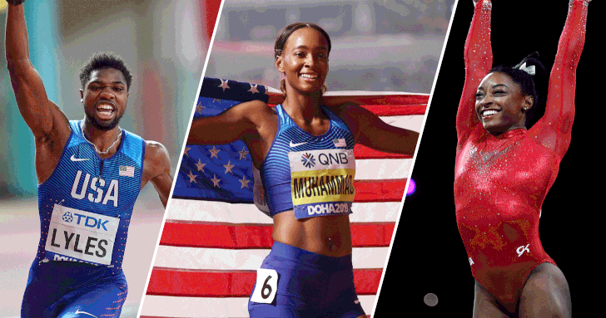
exceptionally
more than is normal or expected

Slide 5
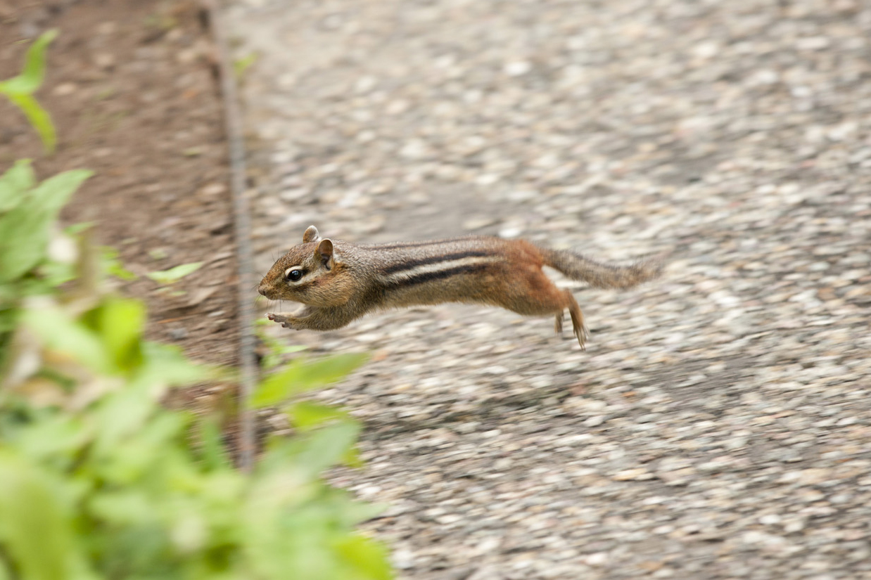
scurrying
to move quickly with small steps

Slide 6
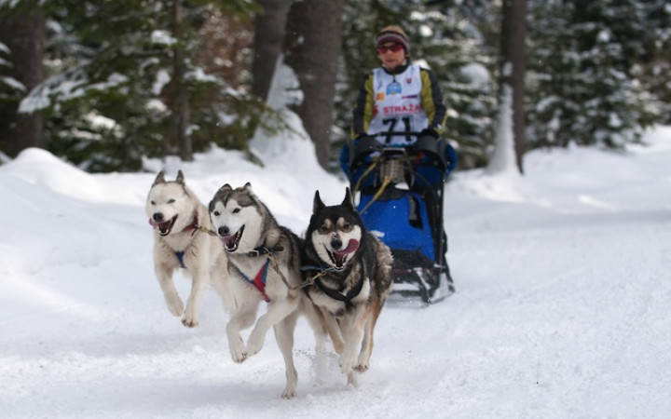
lurched
to move forward in a sudden and unsteady manner

Slide 7
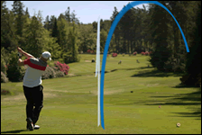
veered
to change direction

Slide 8
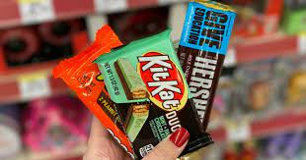
indifferent
characterized by a lack of concern or interest

