Slide 1
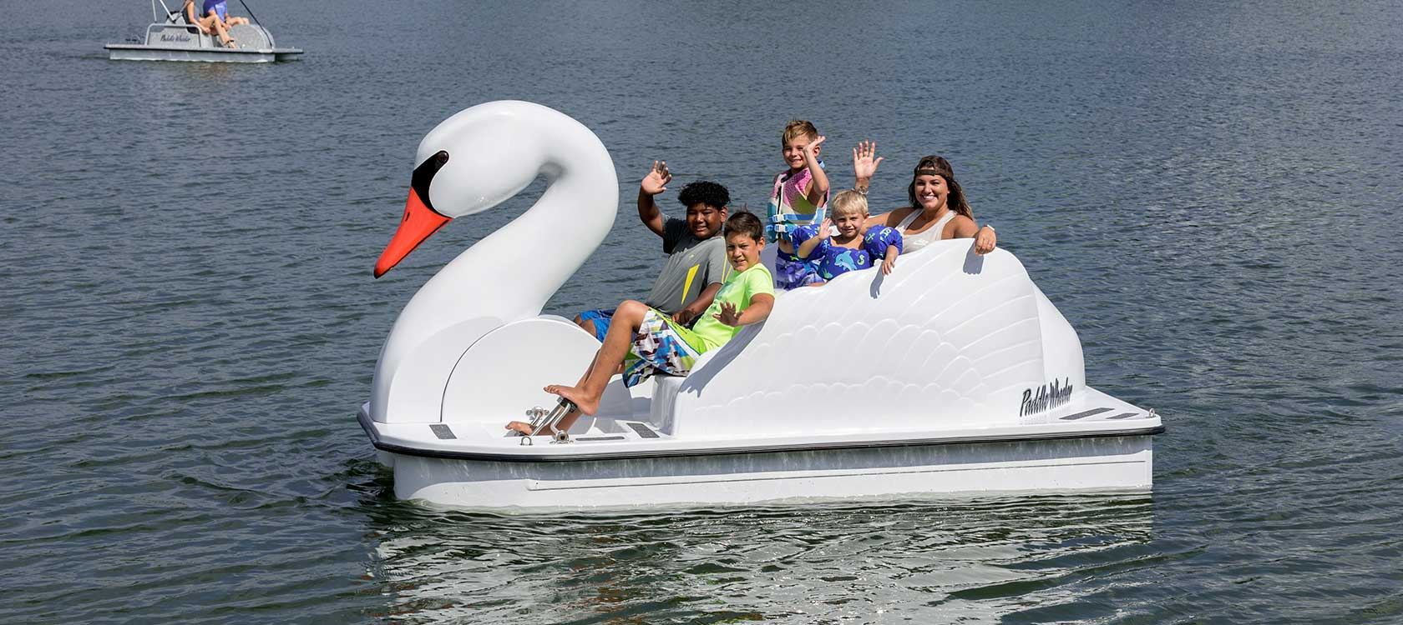
functions
an action that must occur for something to work

Slide 2
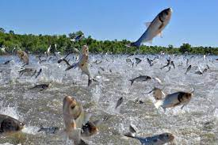
emerging
rising to prominence, becoming known

Slide 3
specialized
made for a specific purpose

Slide 4
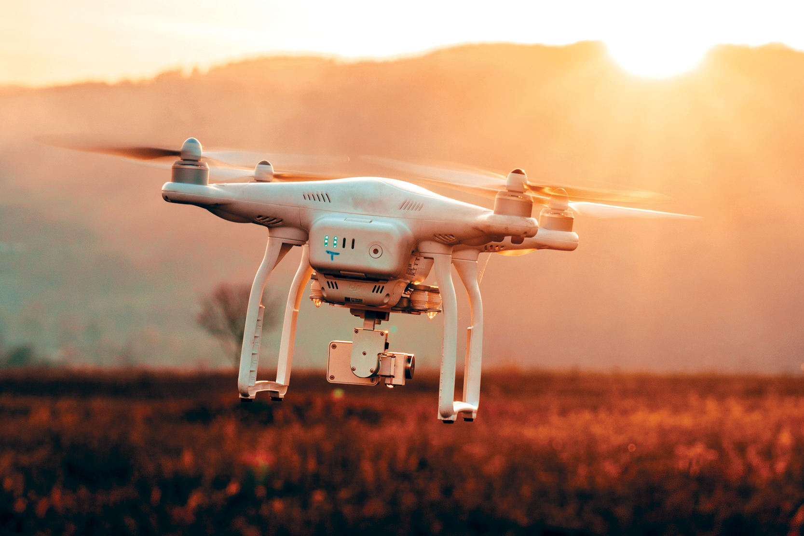
aerial
above the ground

Slide 5
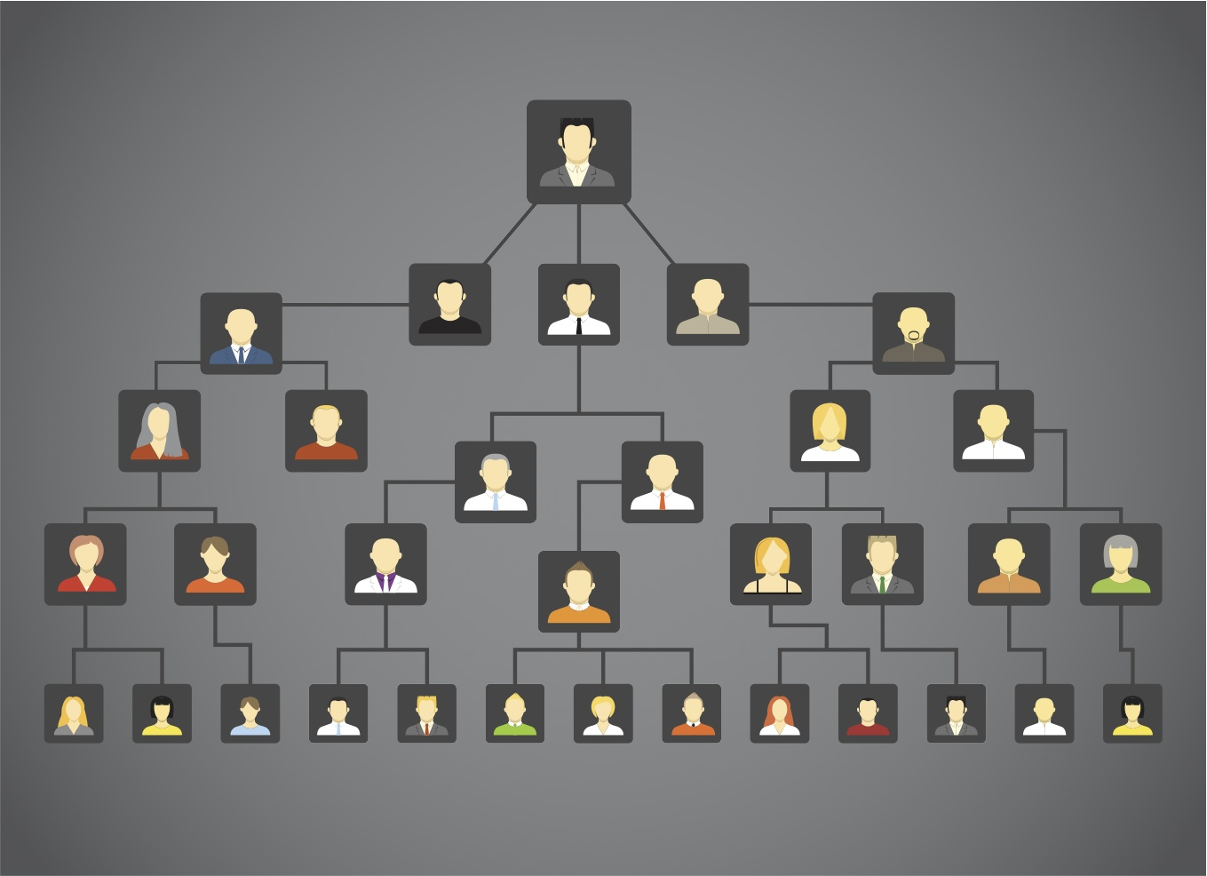
ancestry
family from which a living things came from

Slide 6
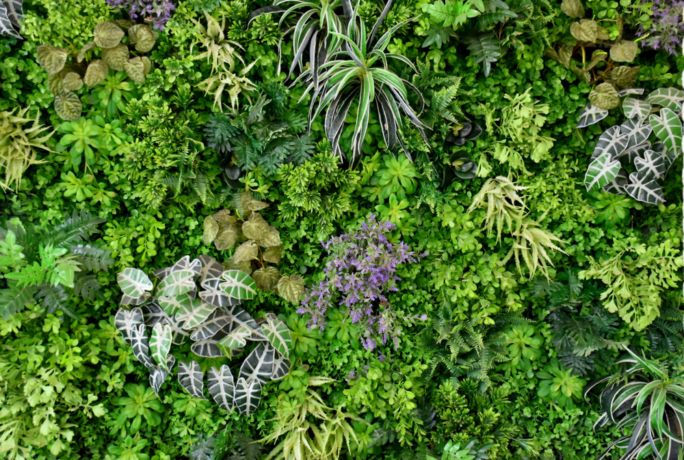
vegetation
plants

