Slide 1
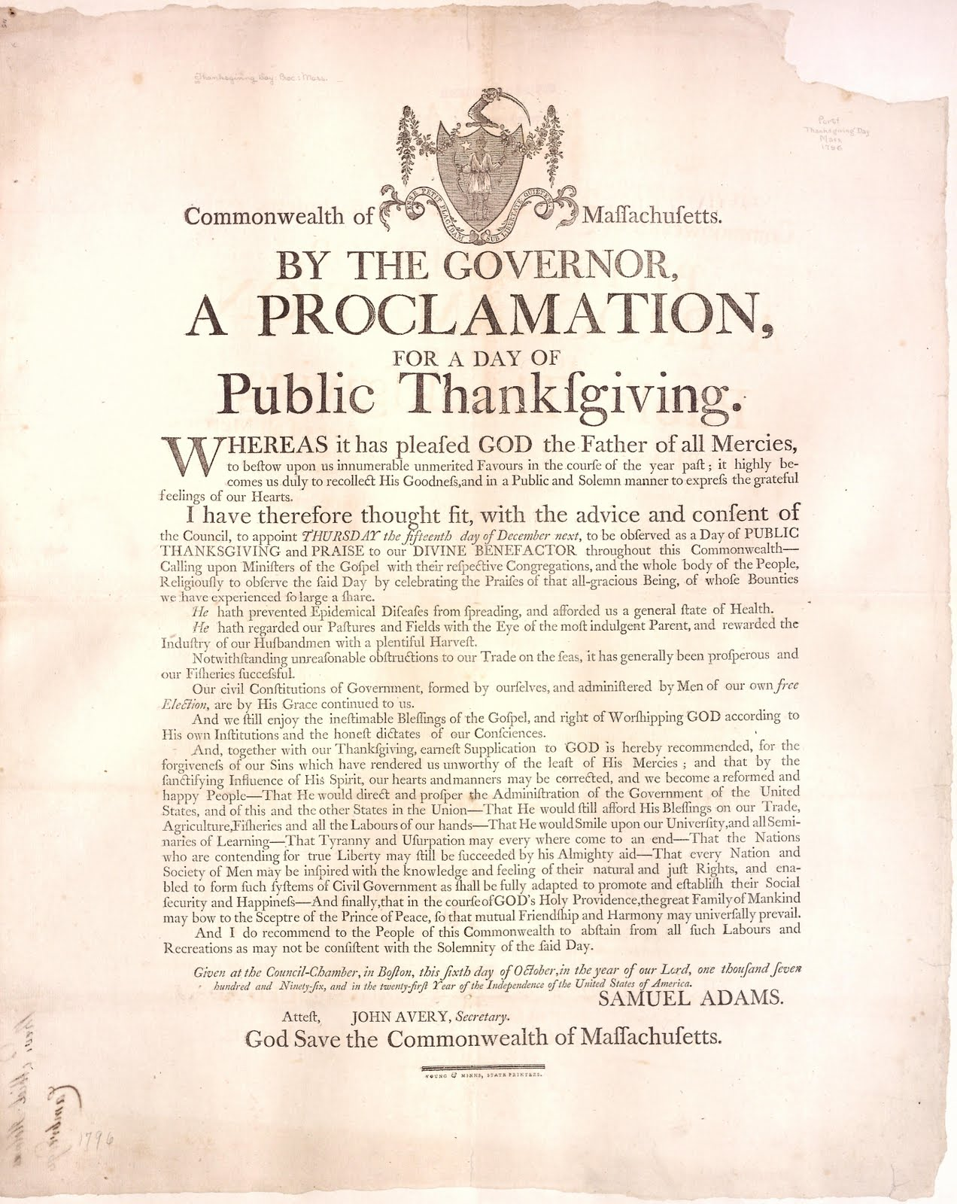
proclamation
This Photo by Unknown author is licensed under CC BY-SA-NC.
an official announcement of something

Slide 2
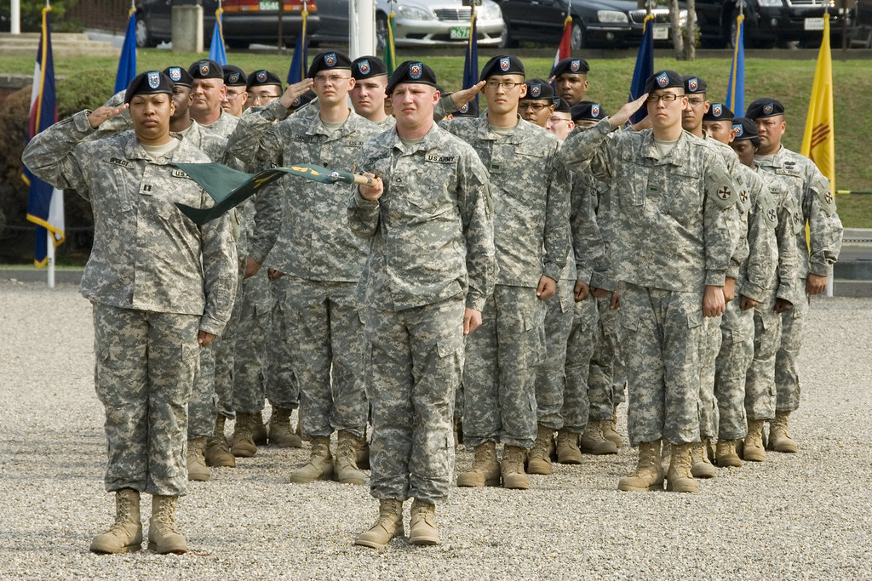
commanded
This Photo by Unknown author is licensed under CC BY.
to give an order

Slide 3
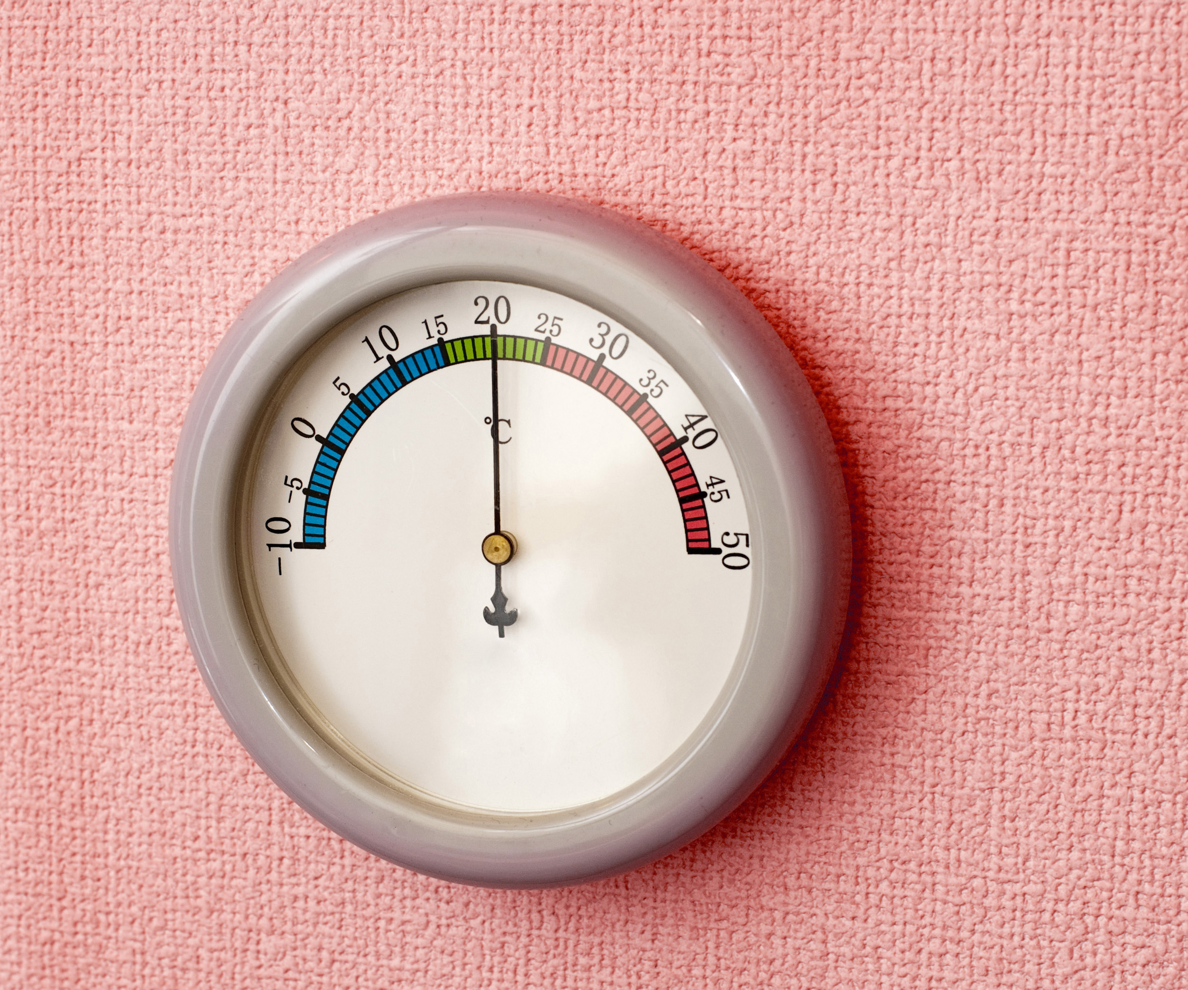
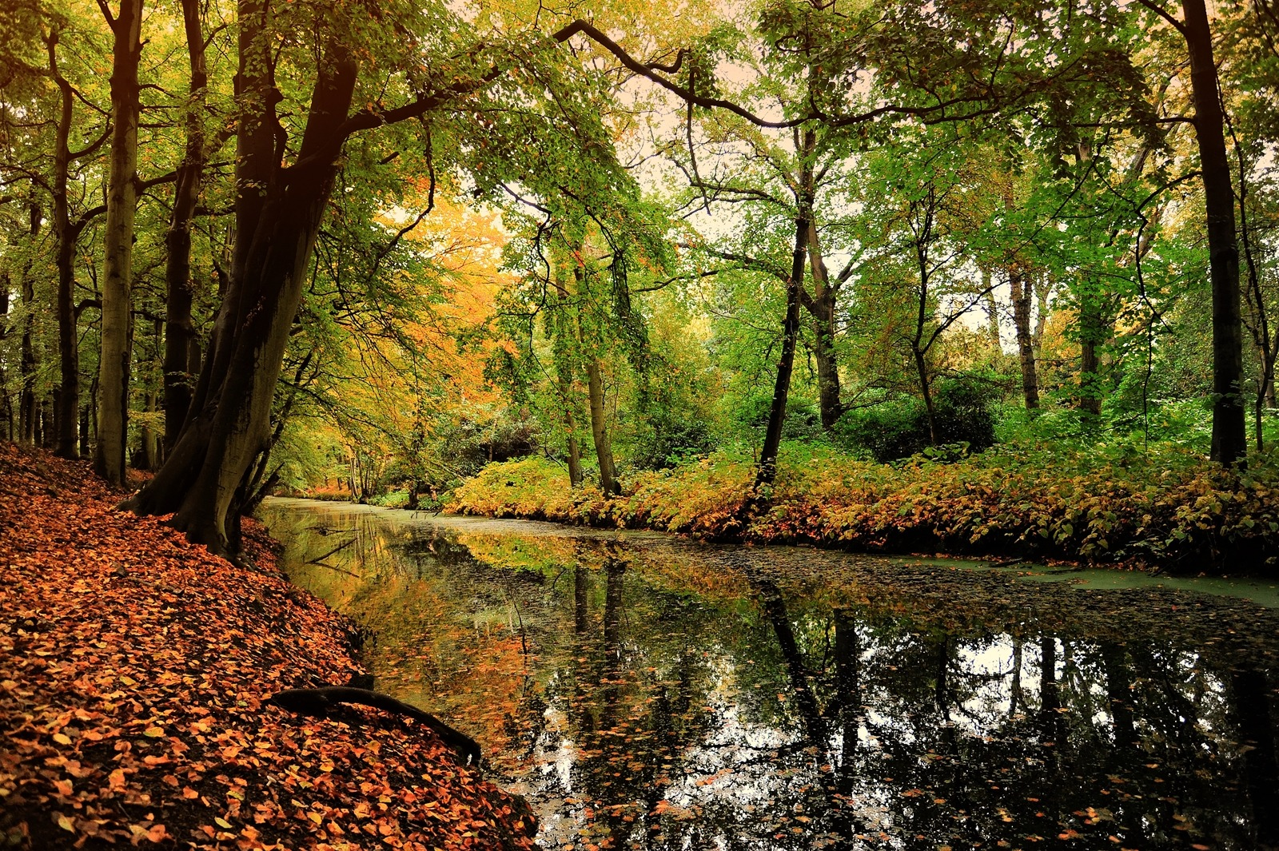
temperate
This Photo by Unknown author is licensed under CC BY.
not too hot and not too cold

Slide 4
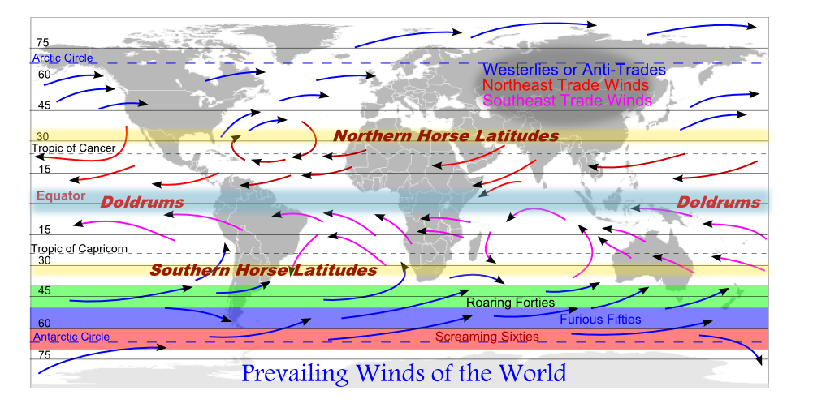
prevailing
This Photo by Unknown author is licensed under CC BY-SA.
currently existing

Slide 5
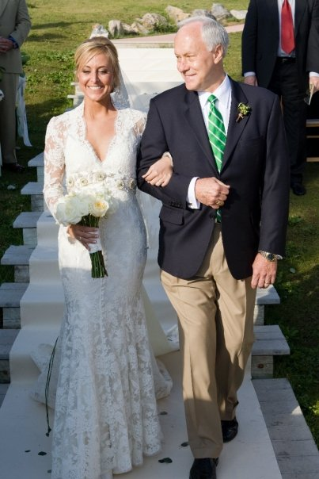
usher
This Photo by Unknown author is licensed under CC BY.
to lead somewhere

Slide 6
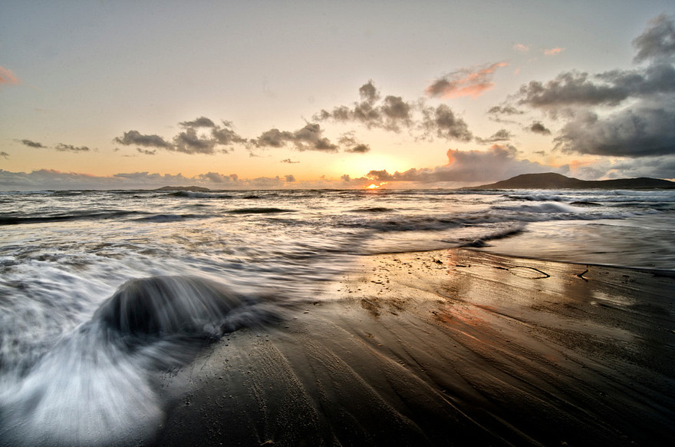
ebb
This Photo by Unknown author is licensed under CC BY-SA.
withdraw or move back

Slide 7
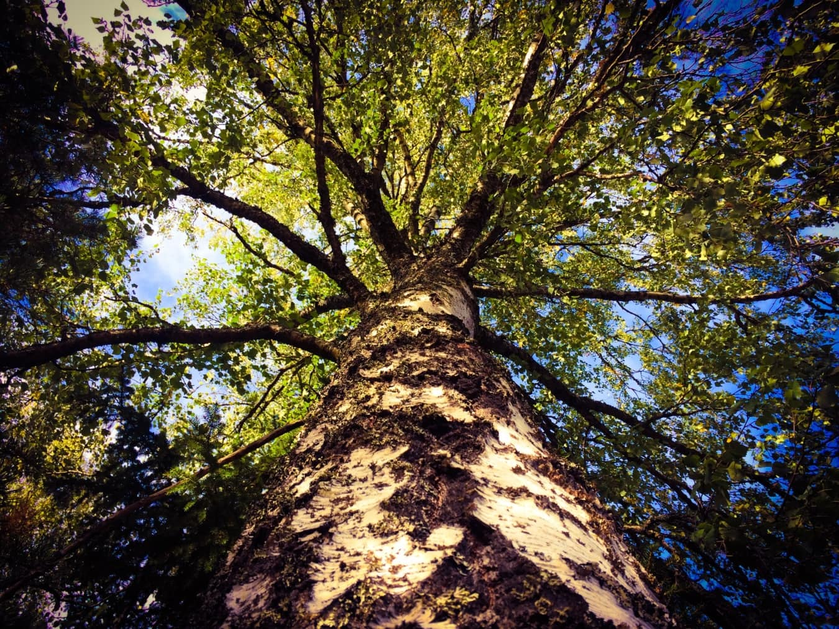
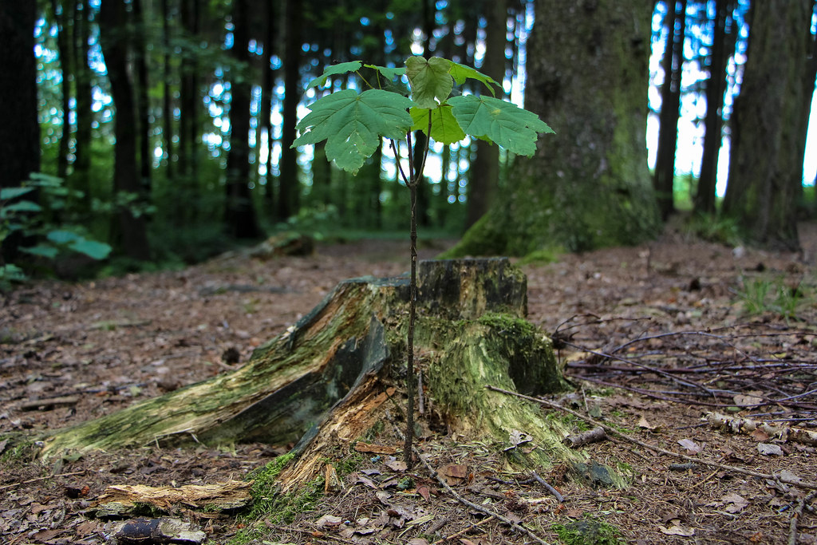
mature
to fully develop

Slide 8
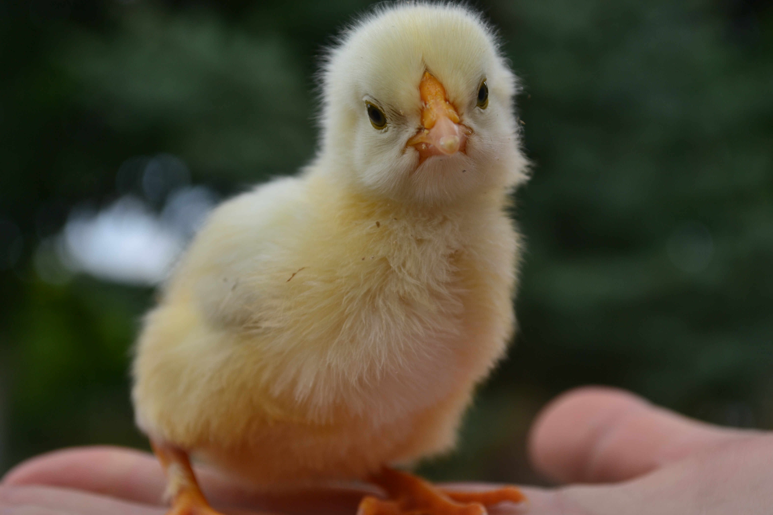
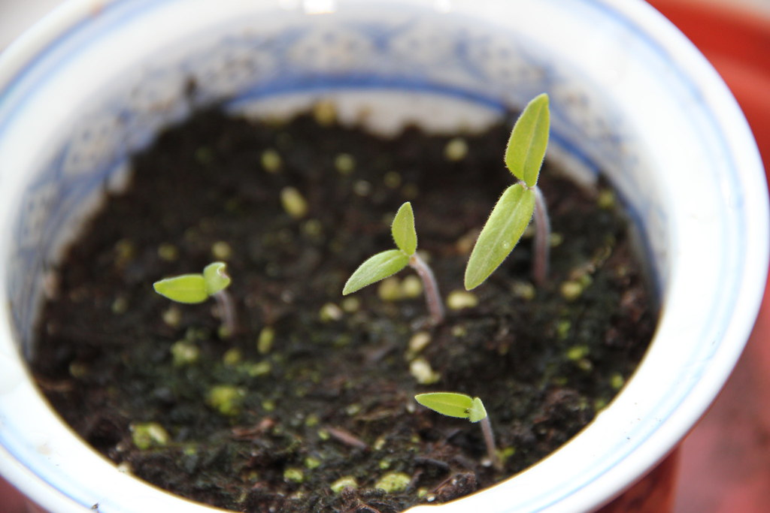
tender
This Photo by Unknown author is licensed under CC BY-SA.
easy to break or damage; sensitive

Slide 9
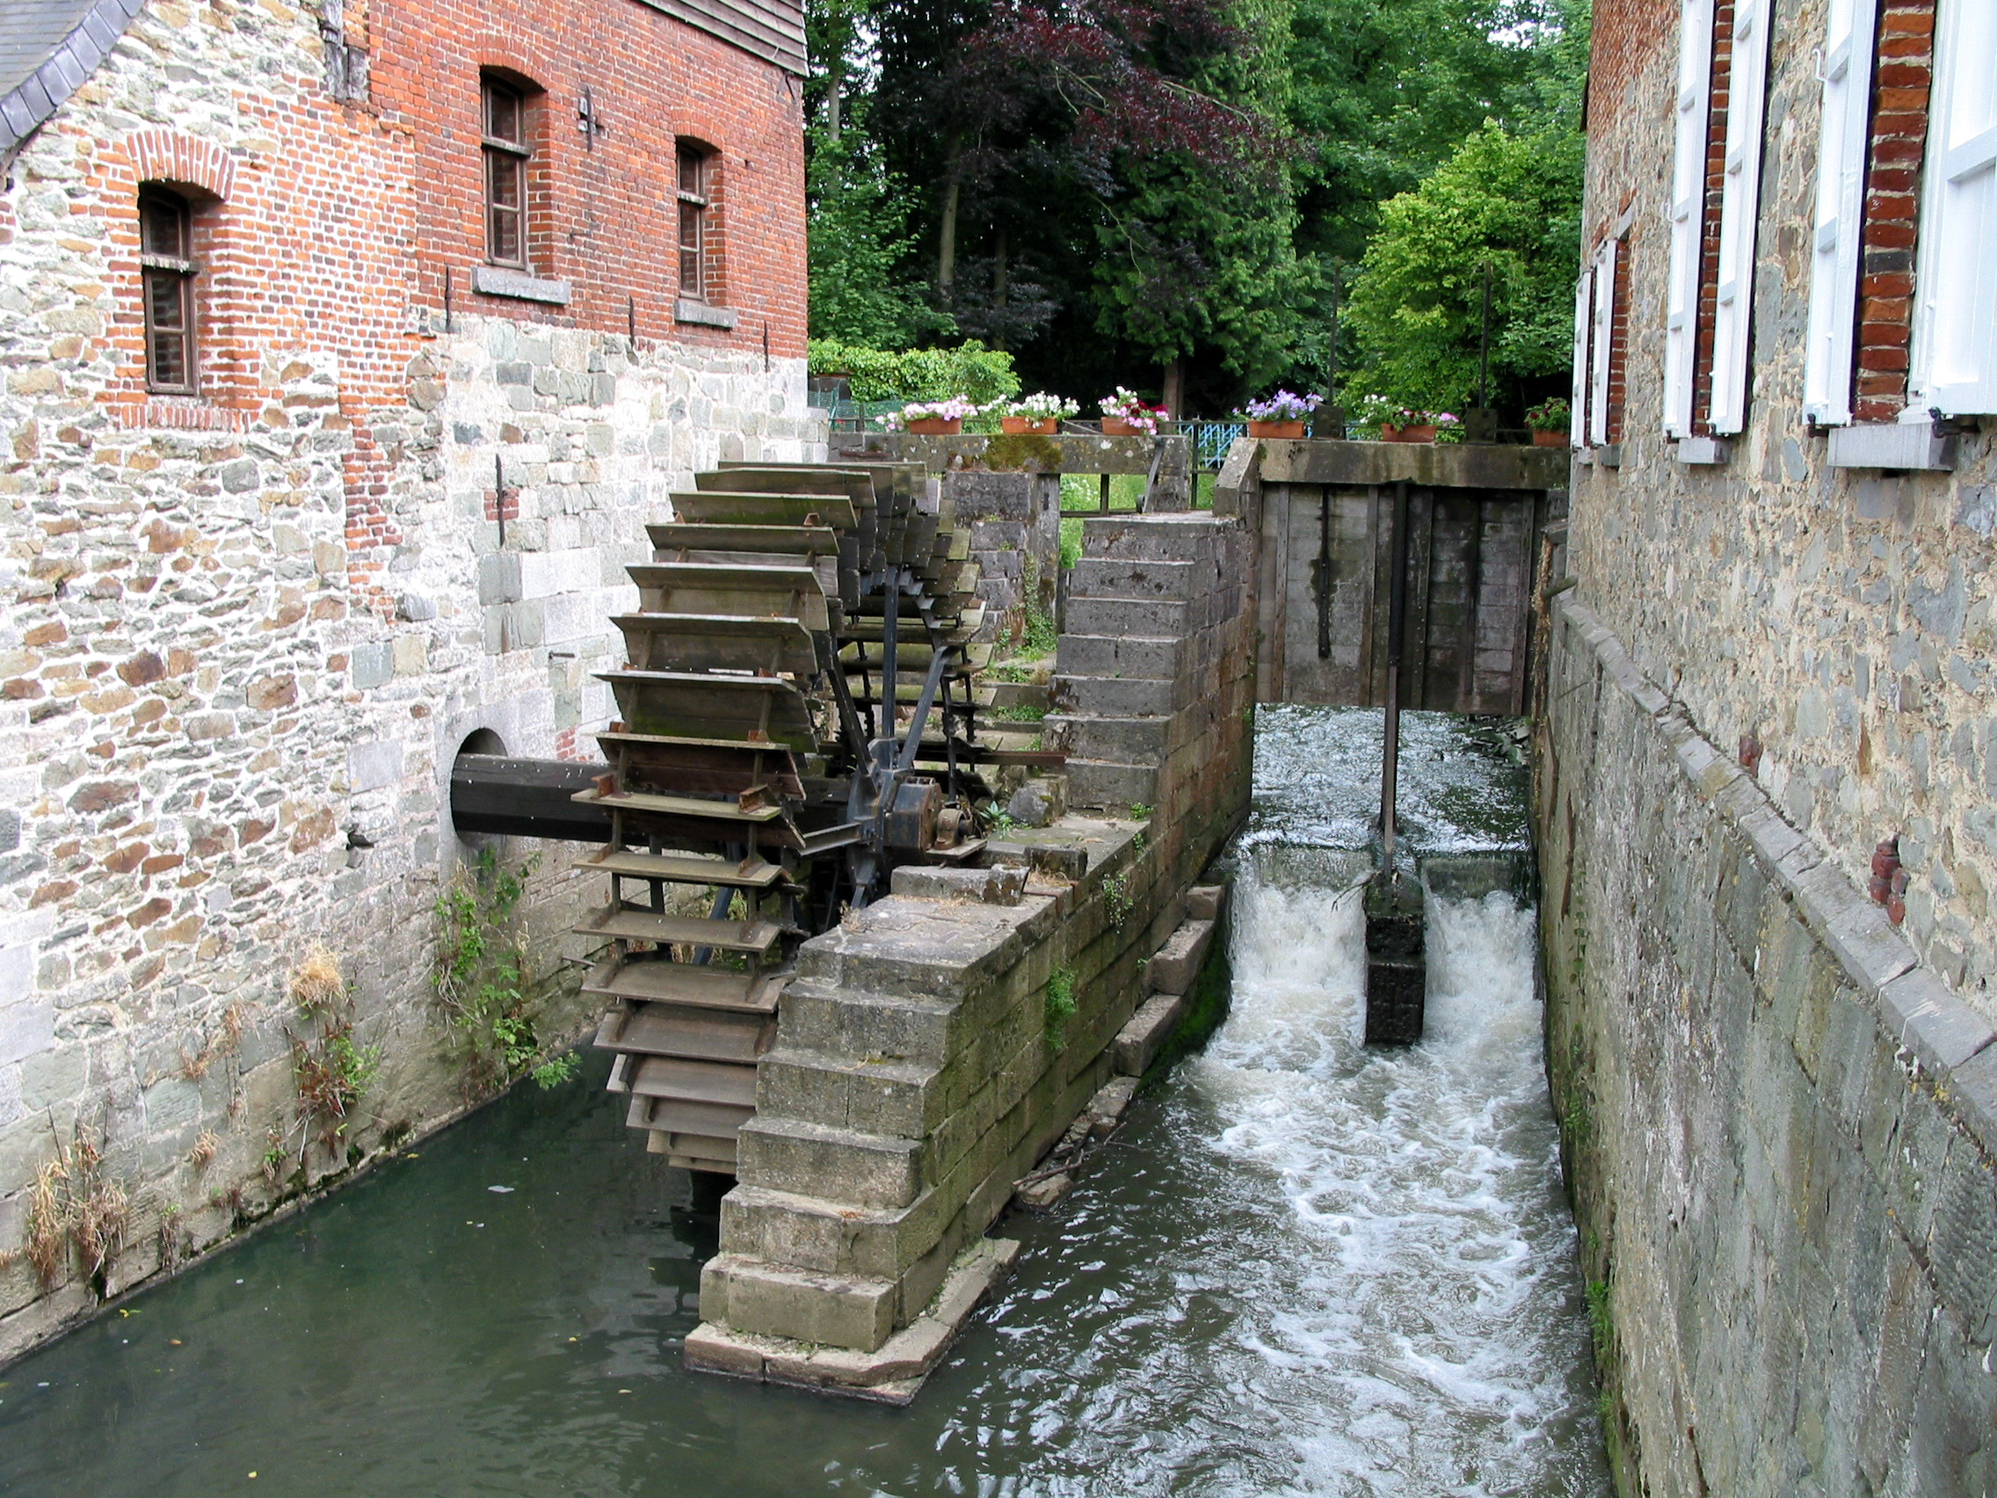
hydroelectric
Relating to the generation of electricity by moving water

Slide 10
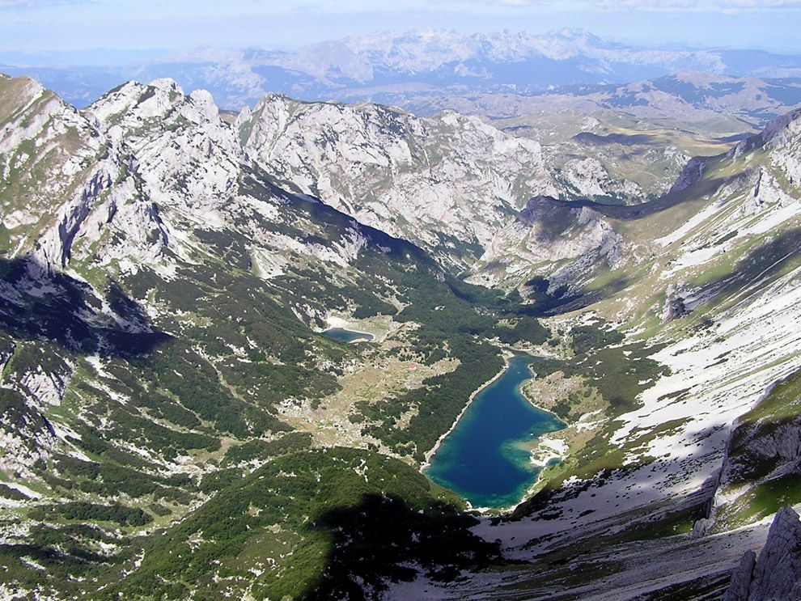
basins
A depression in the Earth’s surface that holds water

Slide 11
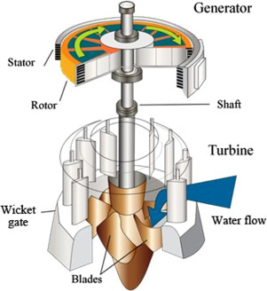
turbines
a machine that is activated by the movement of water, steam or air

Slide 12
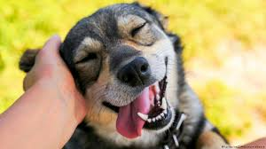
reliable
characterized by regularity; consistent

