Slide 1
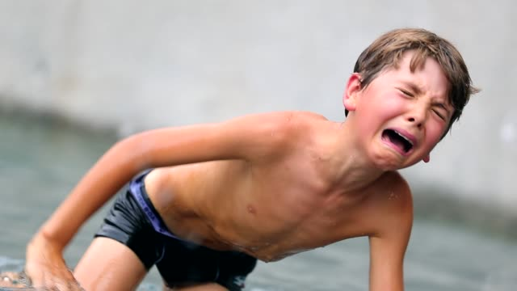
s_______
to move in a quick and shaky way

Slide 2
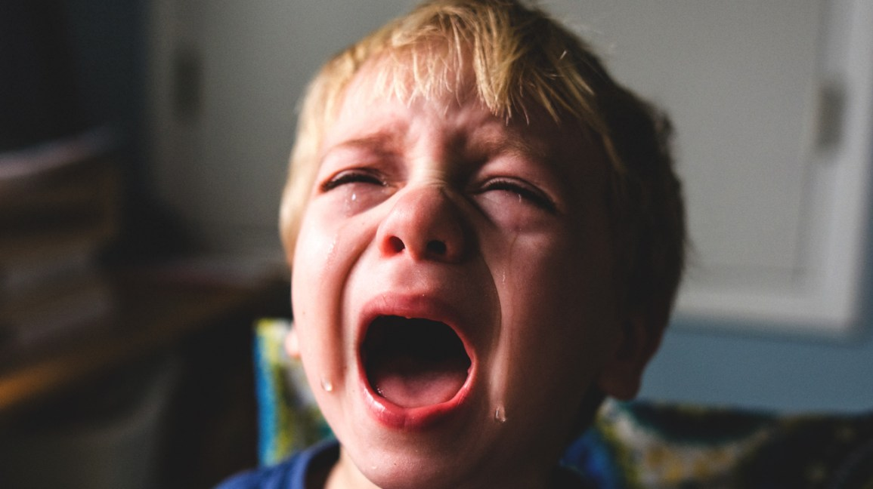
r______
rough; screeching

Slide 3
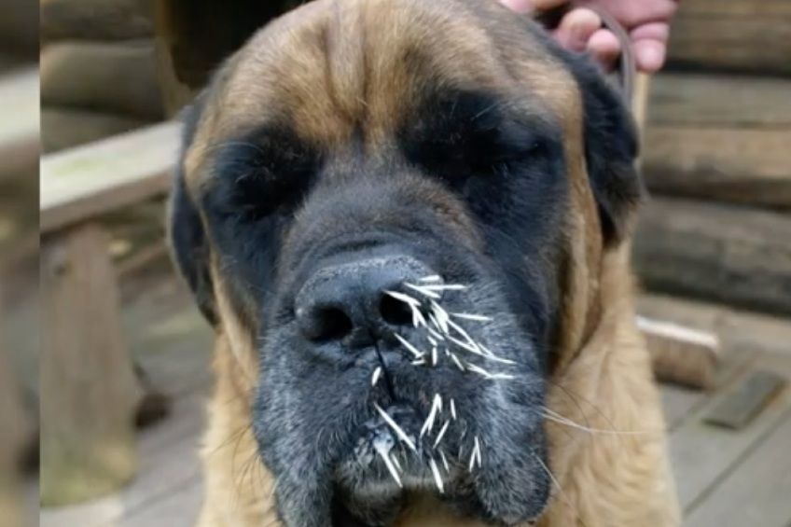
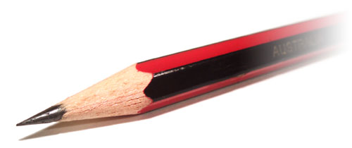
p______
characterized as being sharp and specific

Slide 4
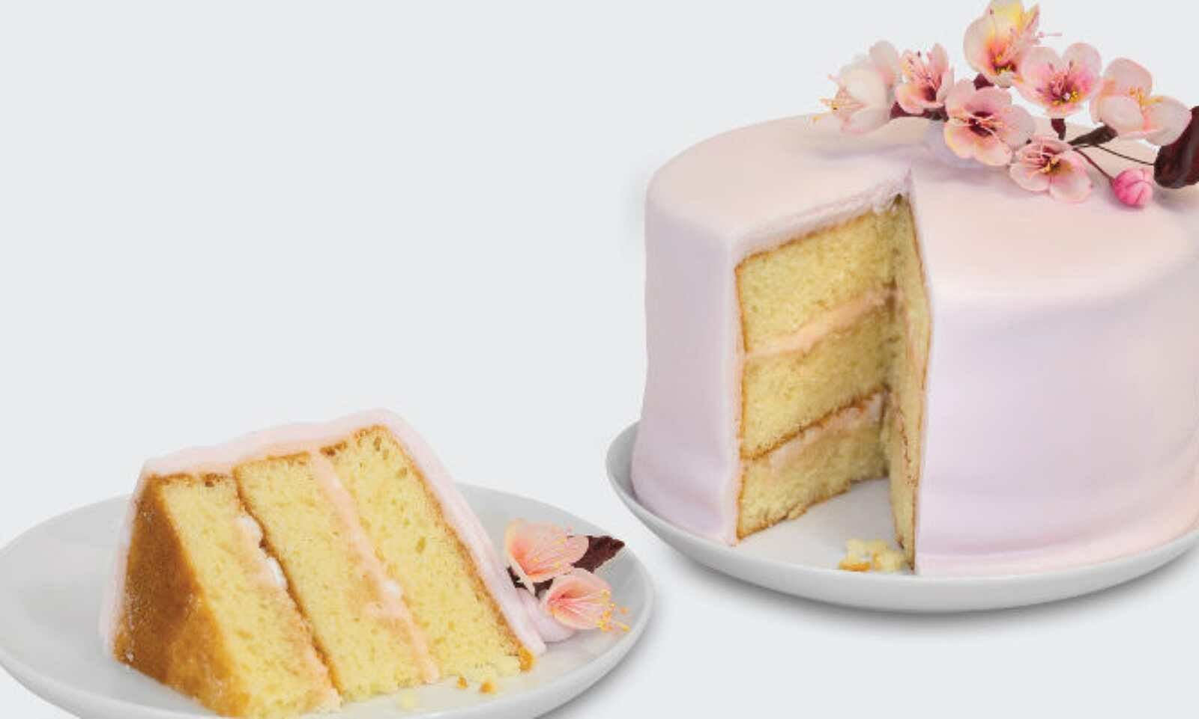
s______
a part of something

Slide 5
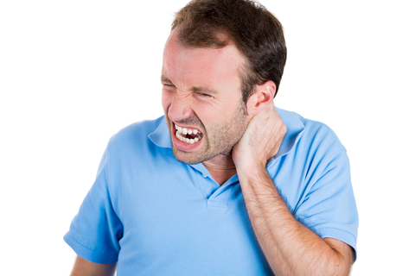
w_____
to make a pained expression

Slide 6
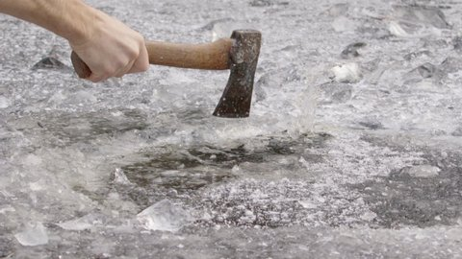
g_______
hitting or striking at an angle instead of directly

Slide 7
r________
to recognize something or someone

Slide 8
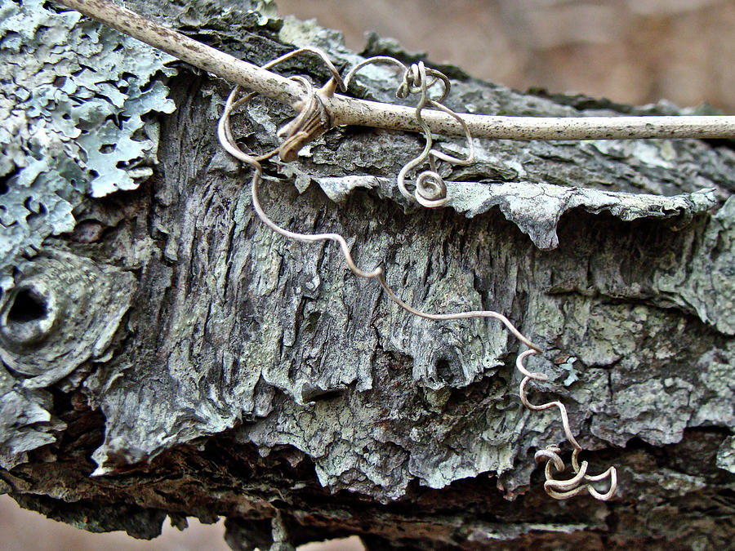
t______
a thin, curly piece of material

Slide 9
p______
careful and thorough

Slide 10
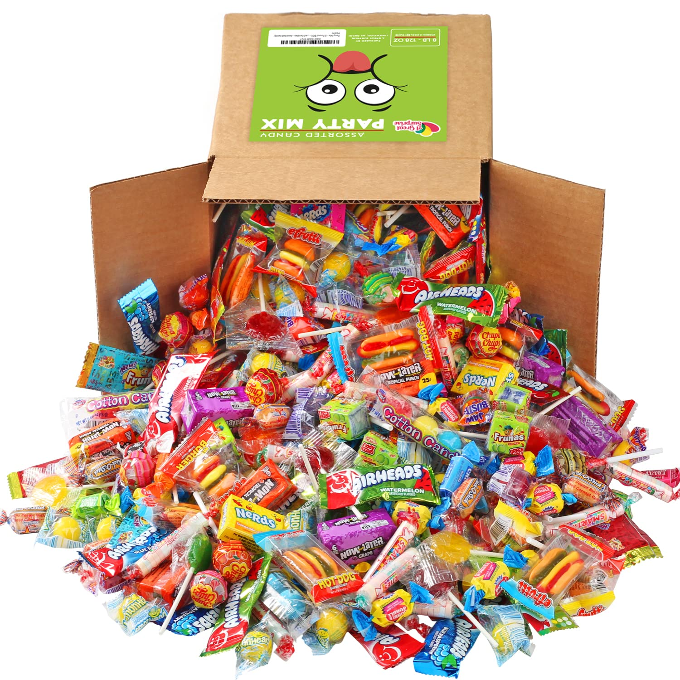
q______
the number or amount

Slide 11
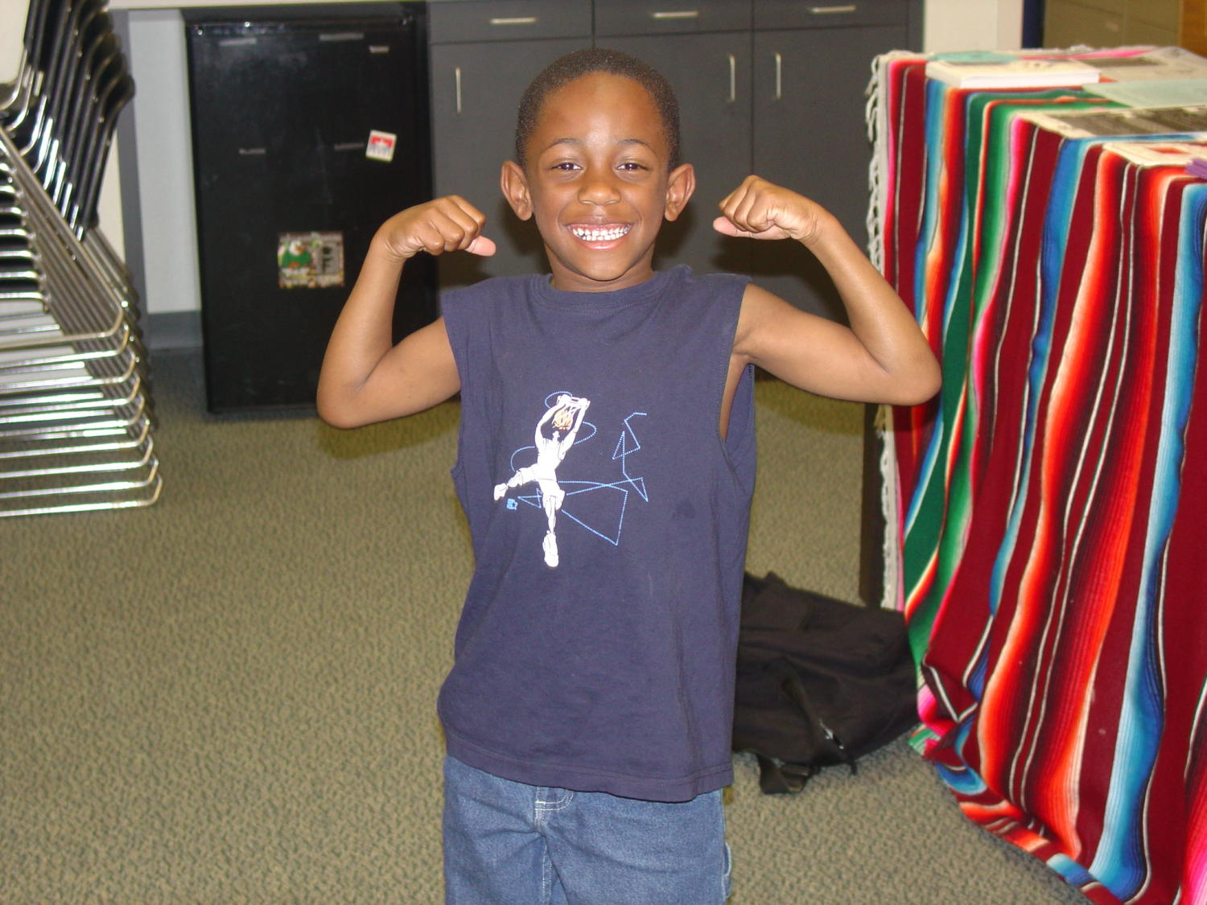
t______
to make one’s muscles tight

Slide 12
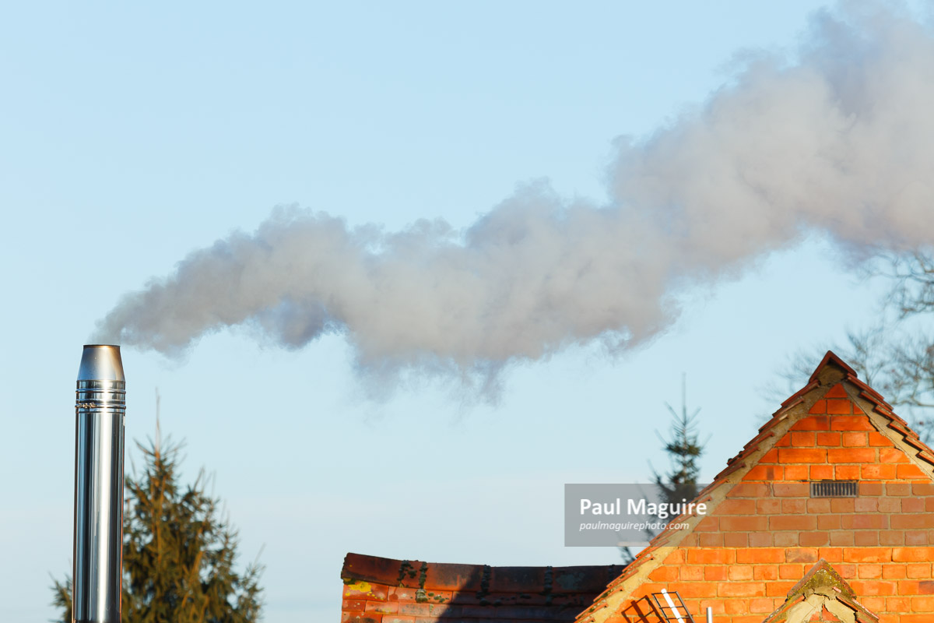
f____
a passage through which smoke flows

