Slide 1
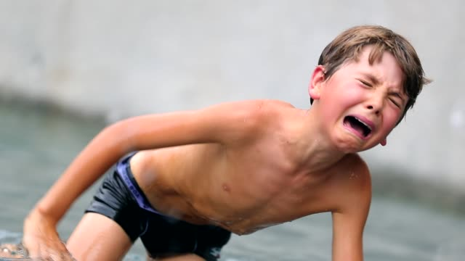
skittered
to move in a quick and shaky way

Slide 2
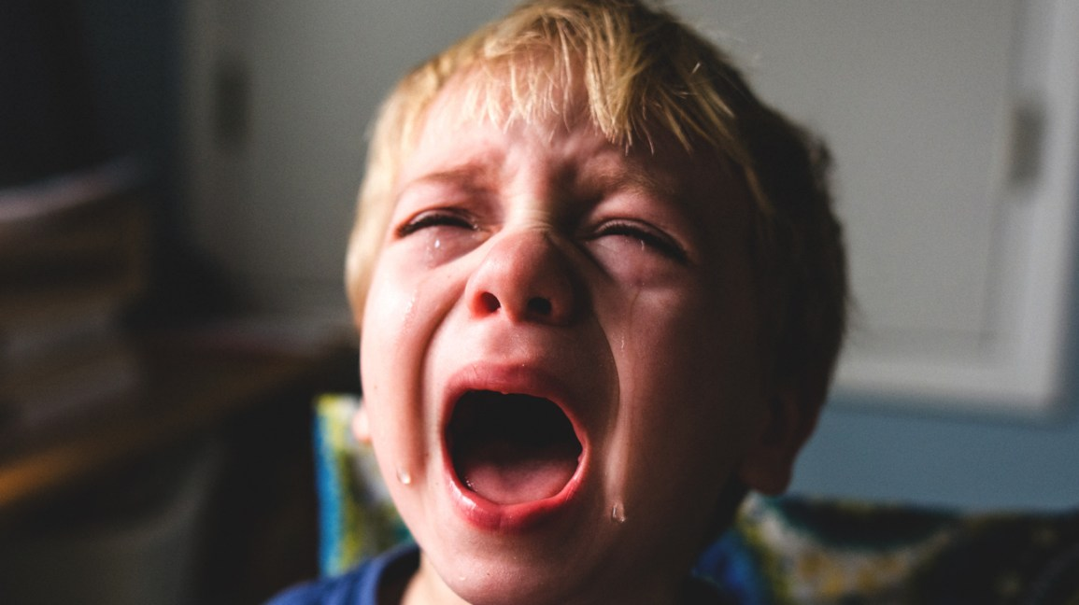
rasping
rough; screeching

Slide 3
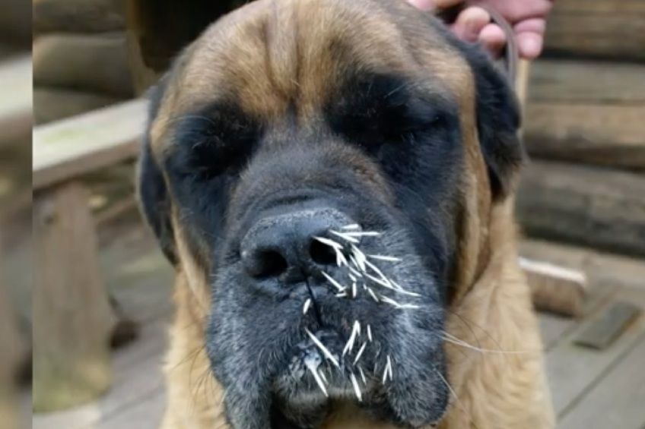
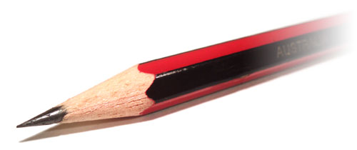
pointed
characterized as being sharp and specific

Slide 4
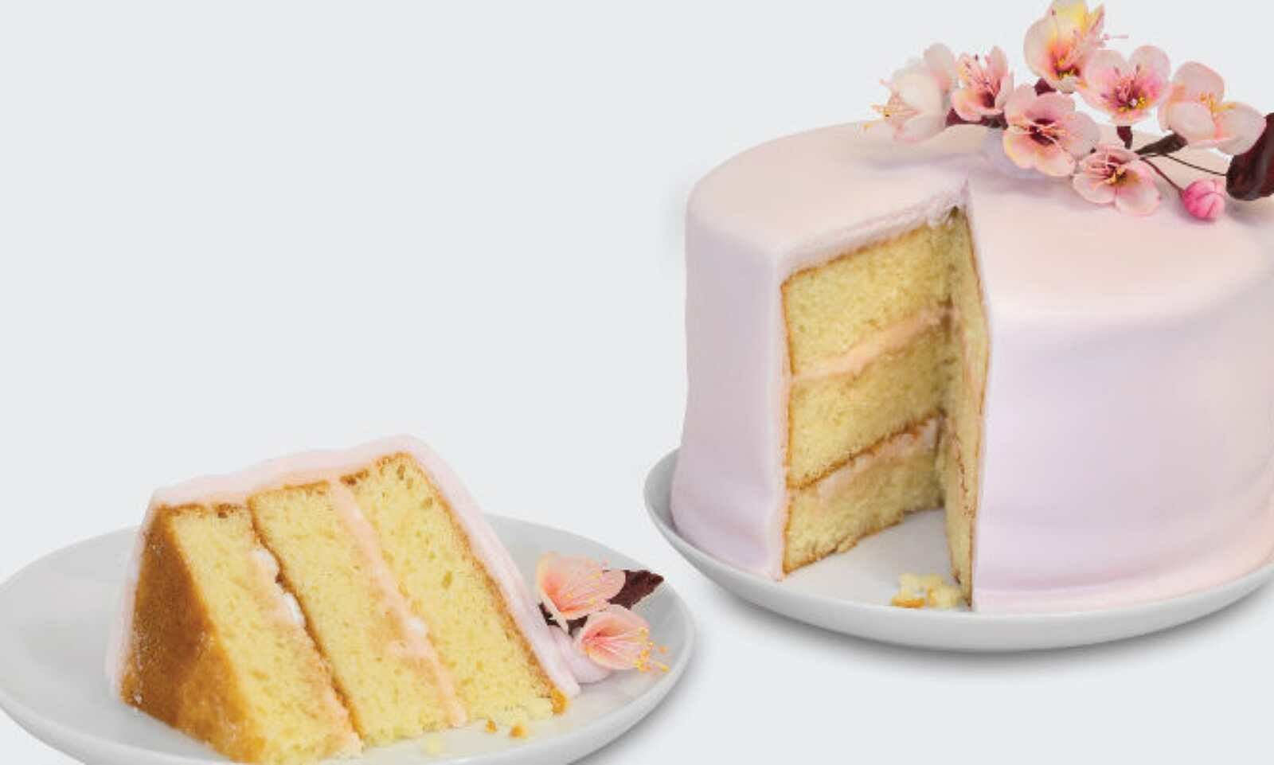
segment
a part of something

Slide 5
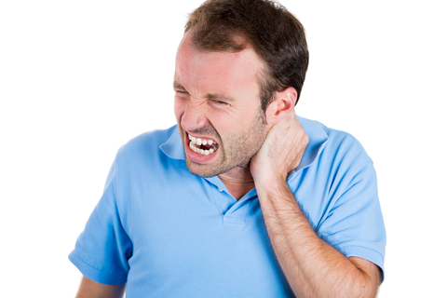
wincing
to make a pained expression

Slide 6
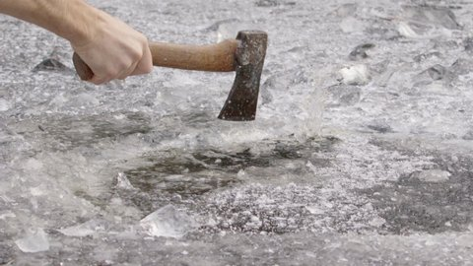
glancing
hitting or striking at an angle instead of directly

Slide 7
registered
to recognize something or someone

Slide 8
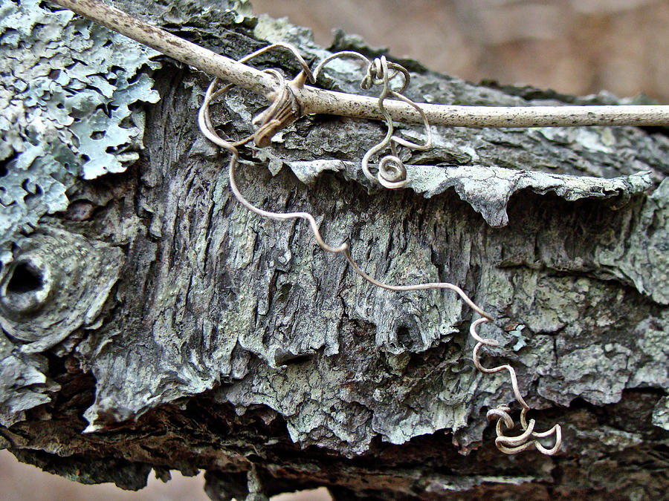
tendrils
a thin, curly piece of material

Slide 9
painstaking
careful and thorough

Slide 10
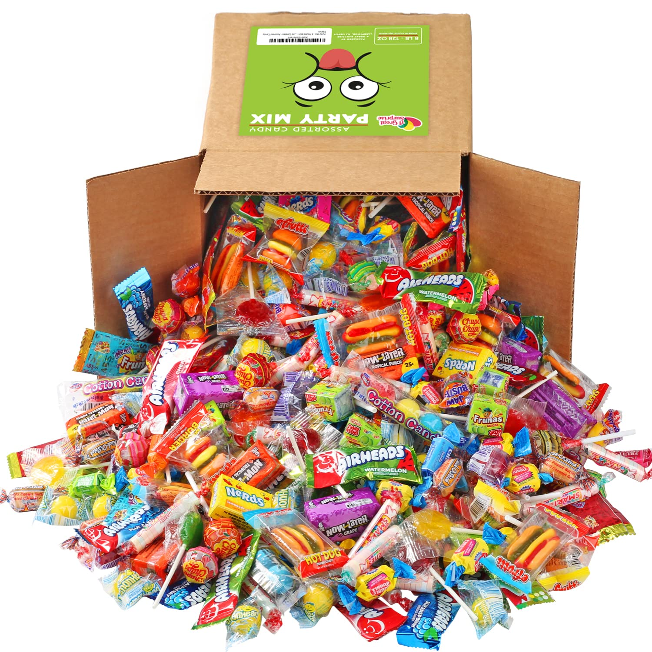
quantity
the number or amount

Slide 11
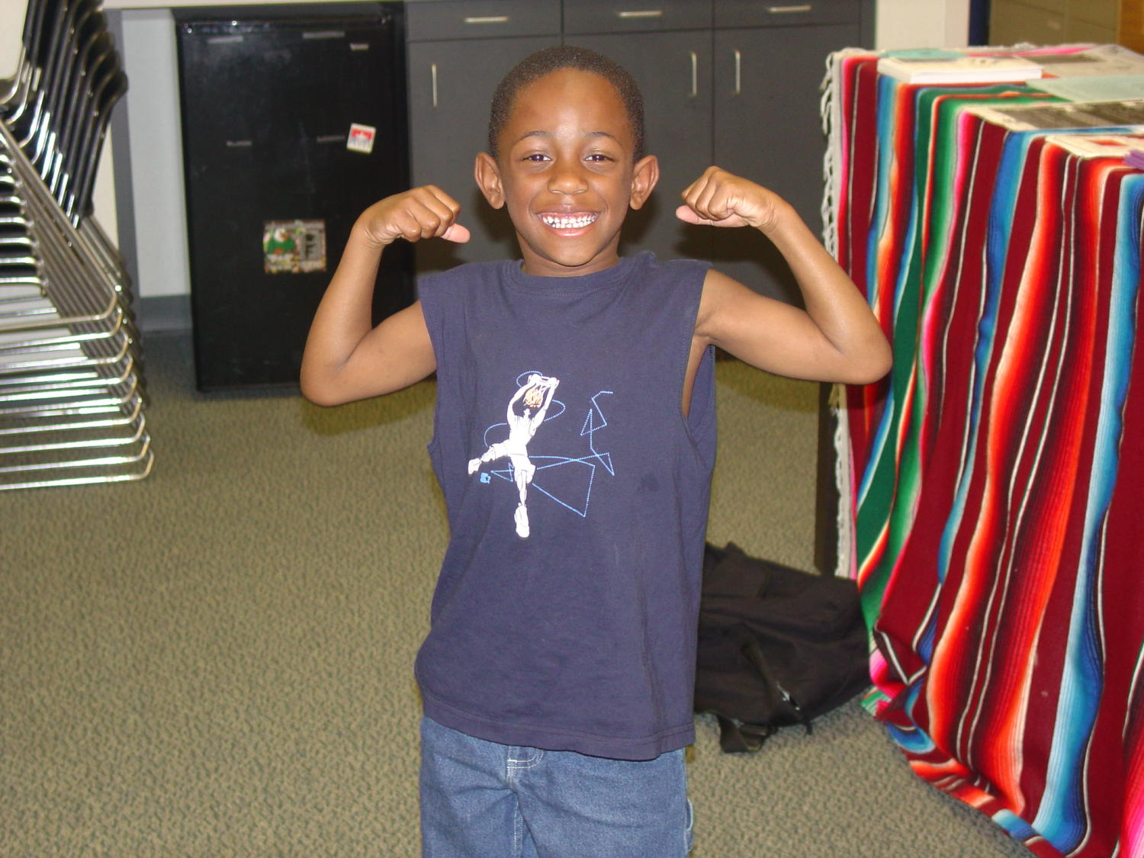
tensed
to make one’s muscles tight

Slide 12
flue
a passage through which smoke flows

