Slide 1
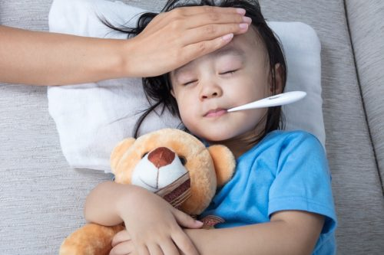
s_______
a sign of illness or disease.

Slide 2
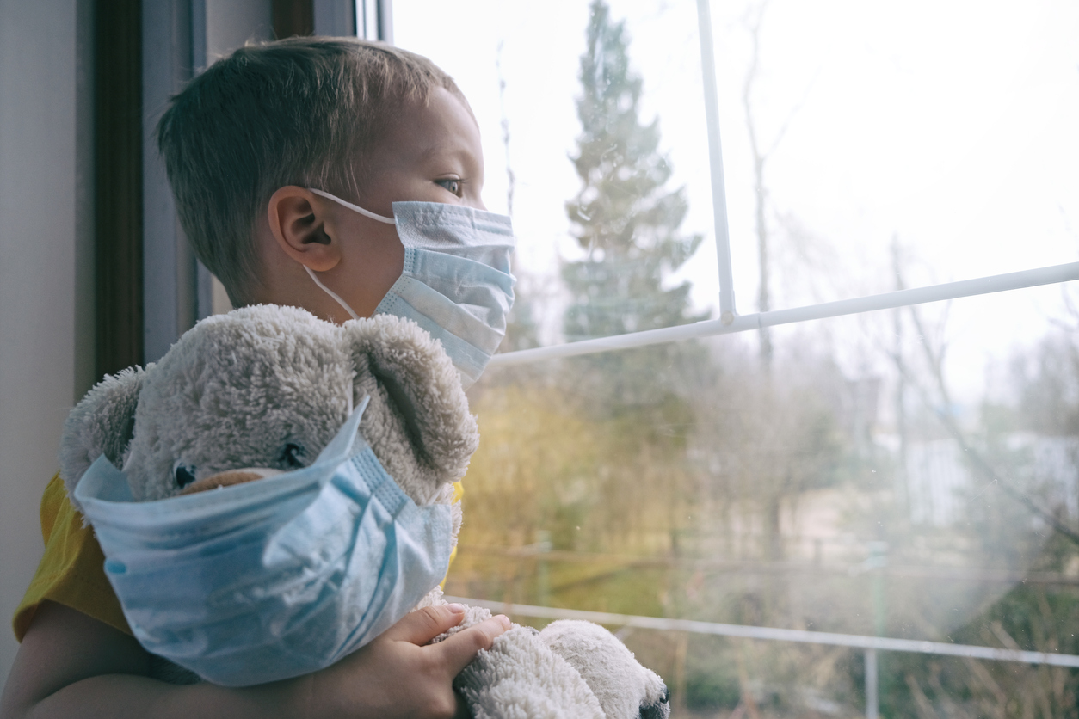
q________
the act of separating people who have a contagious disease from people who are healthy

Slide 3
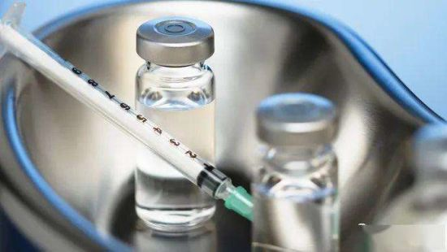
s_____
a medicinal liquid used to battle an illness

Slide 4
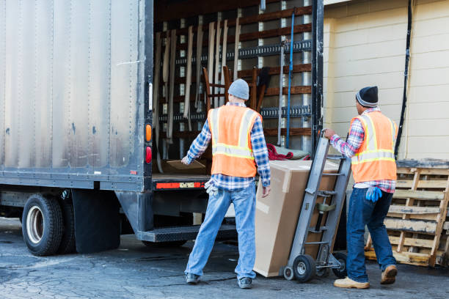
f______
materials transported in a train or vehicle

Slide 5
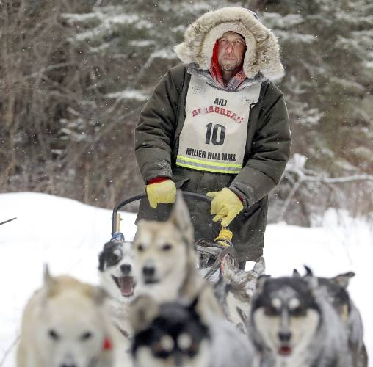
m______
a person in charge of a dog sled

Slide 6
w______
to walk through water

Slide 7
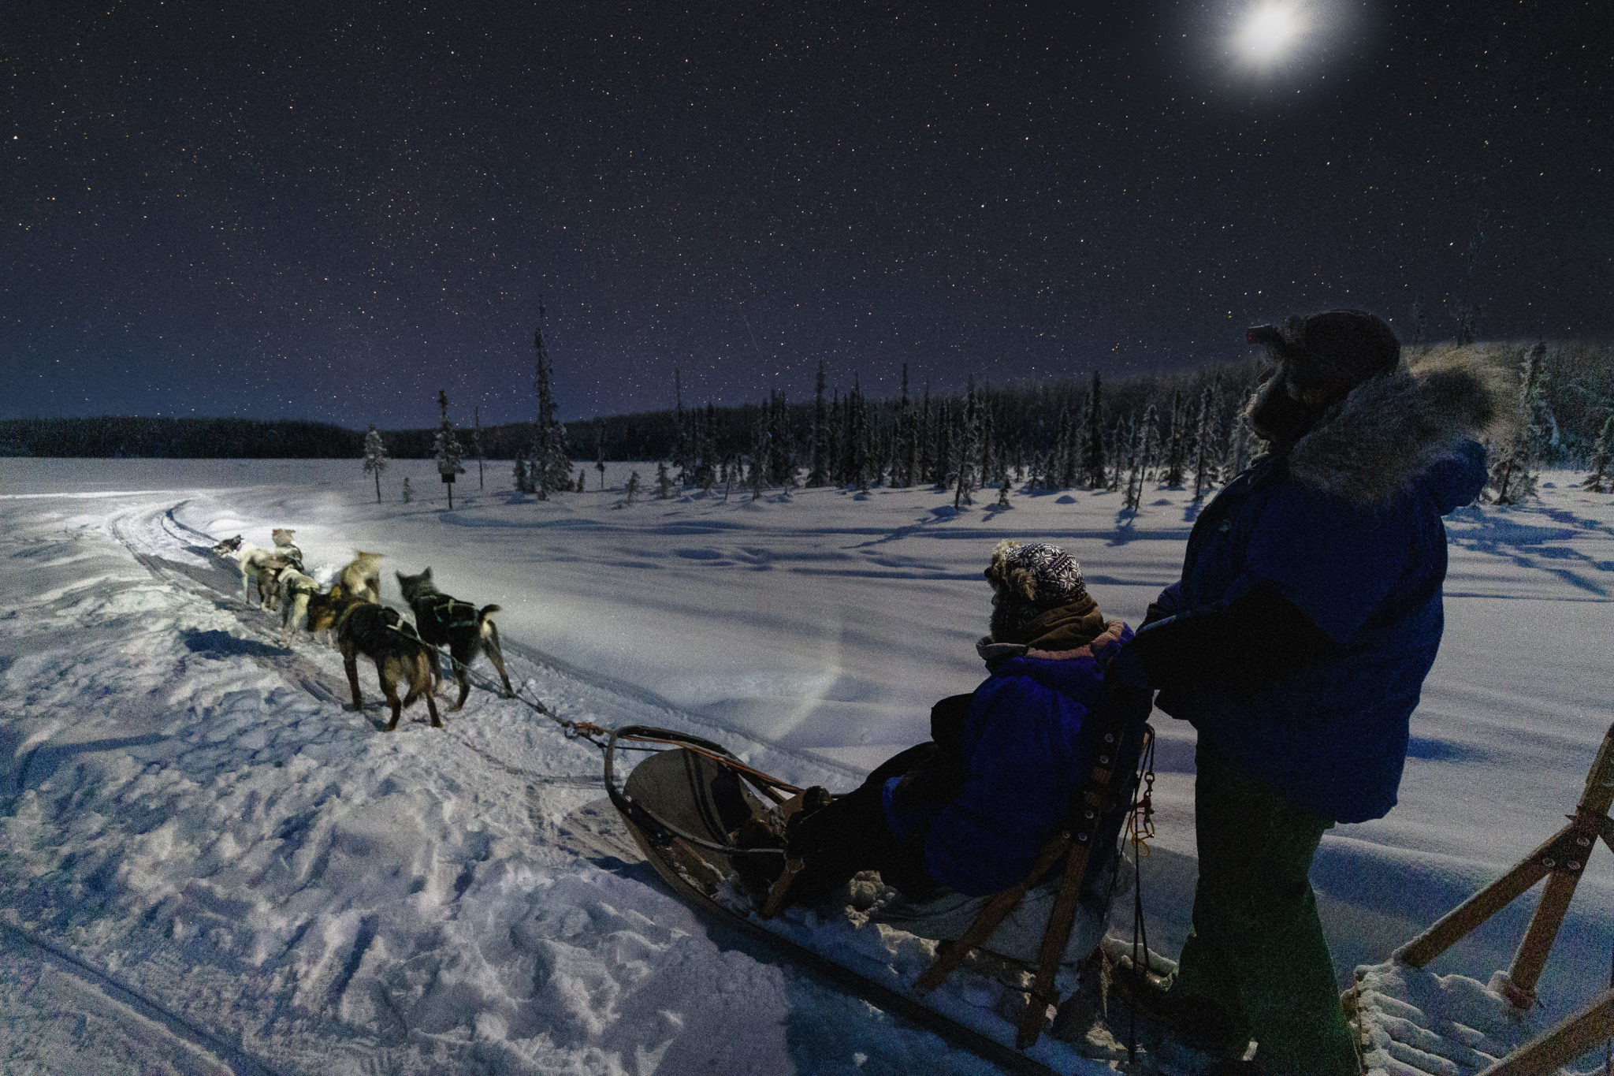
t_______
the time when the sun is beyond the horizon, but its light is still visible; often after sunset

Slide 8
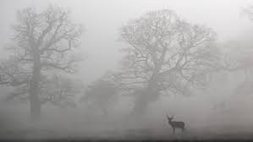
e_____
mysterious; scary

Slide 9
p______
a struggle; a dangerous and difficult situation

Slide 10
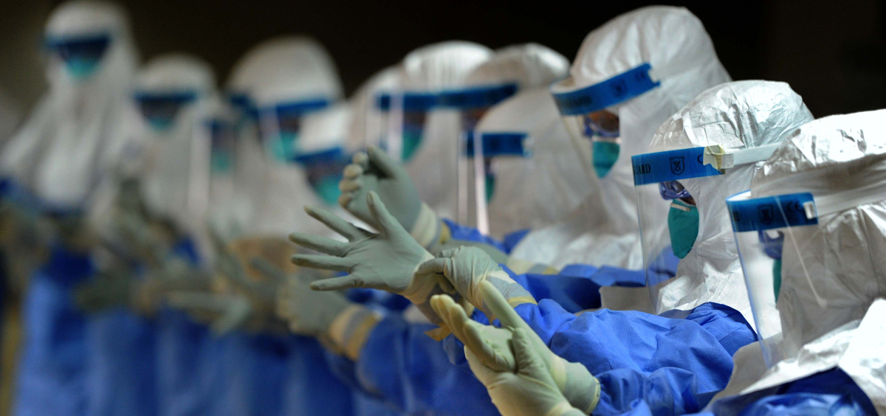
e_______
an illness that spreads and
affects a lot of people

Slide 11
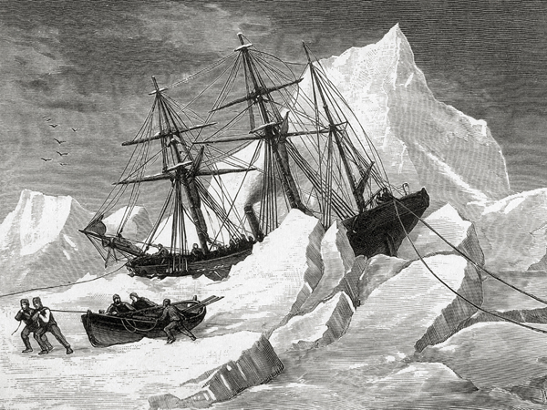
t_______
difficult; dangerous

Slide 12
p_______
to die

