Slide 1
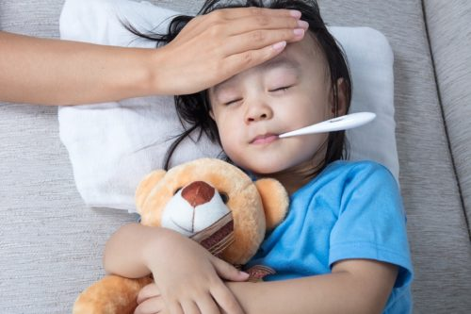
symptoms
a sign of illness or disease.

Slide 2
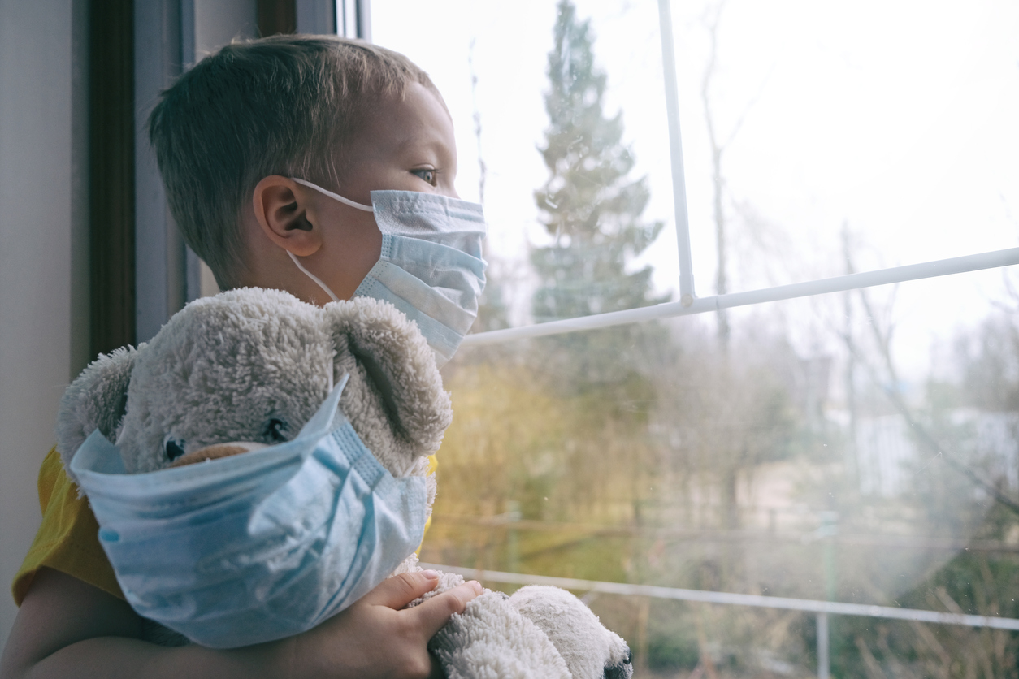
quarantine
the act of separating people who have a contagious disease from people who are healthy

Slide 3
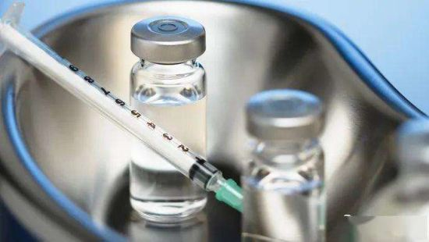
serum
a medicinal liquid used to battle an illness

Slide 4
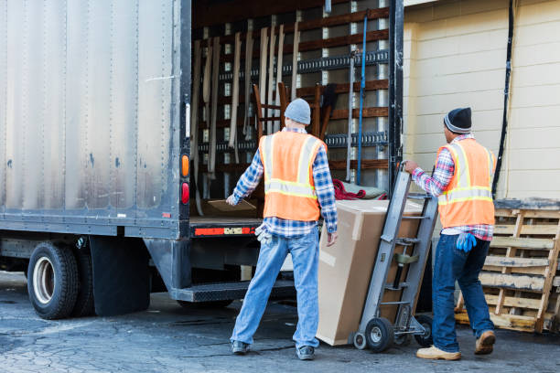
freight
materials transported in a train or vehicle

Slide 5
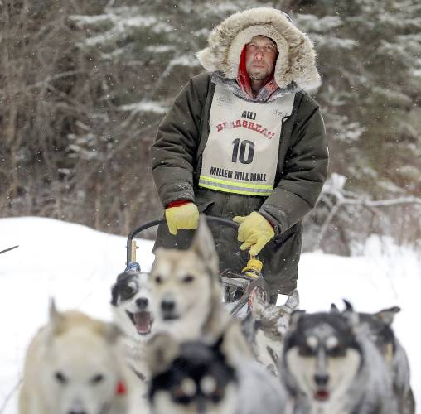
mushers
a person who is in charge of a dog sled

Slide 6
wade
to walk through water

Slide 7
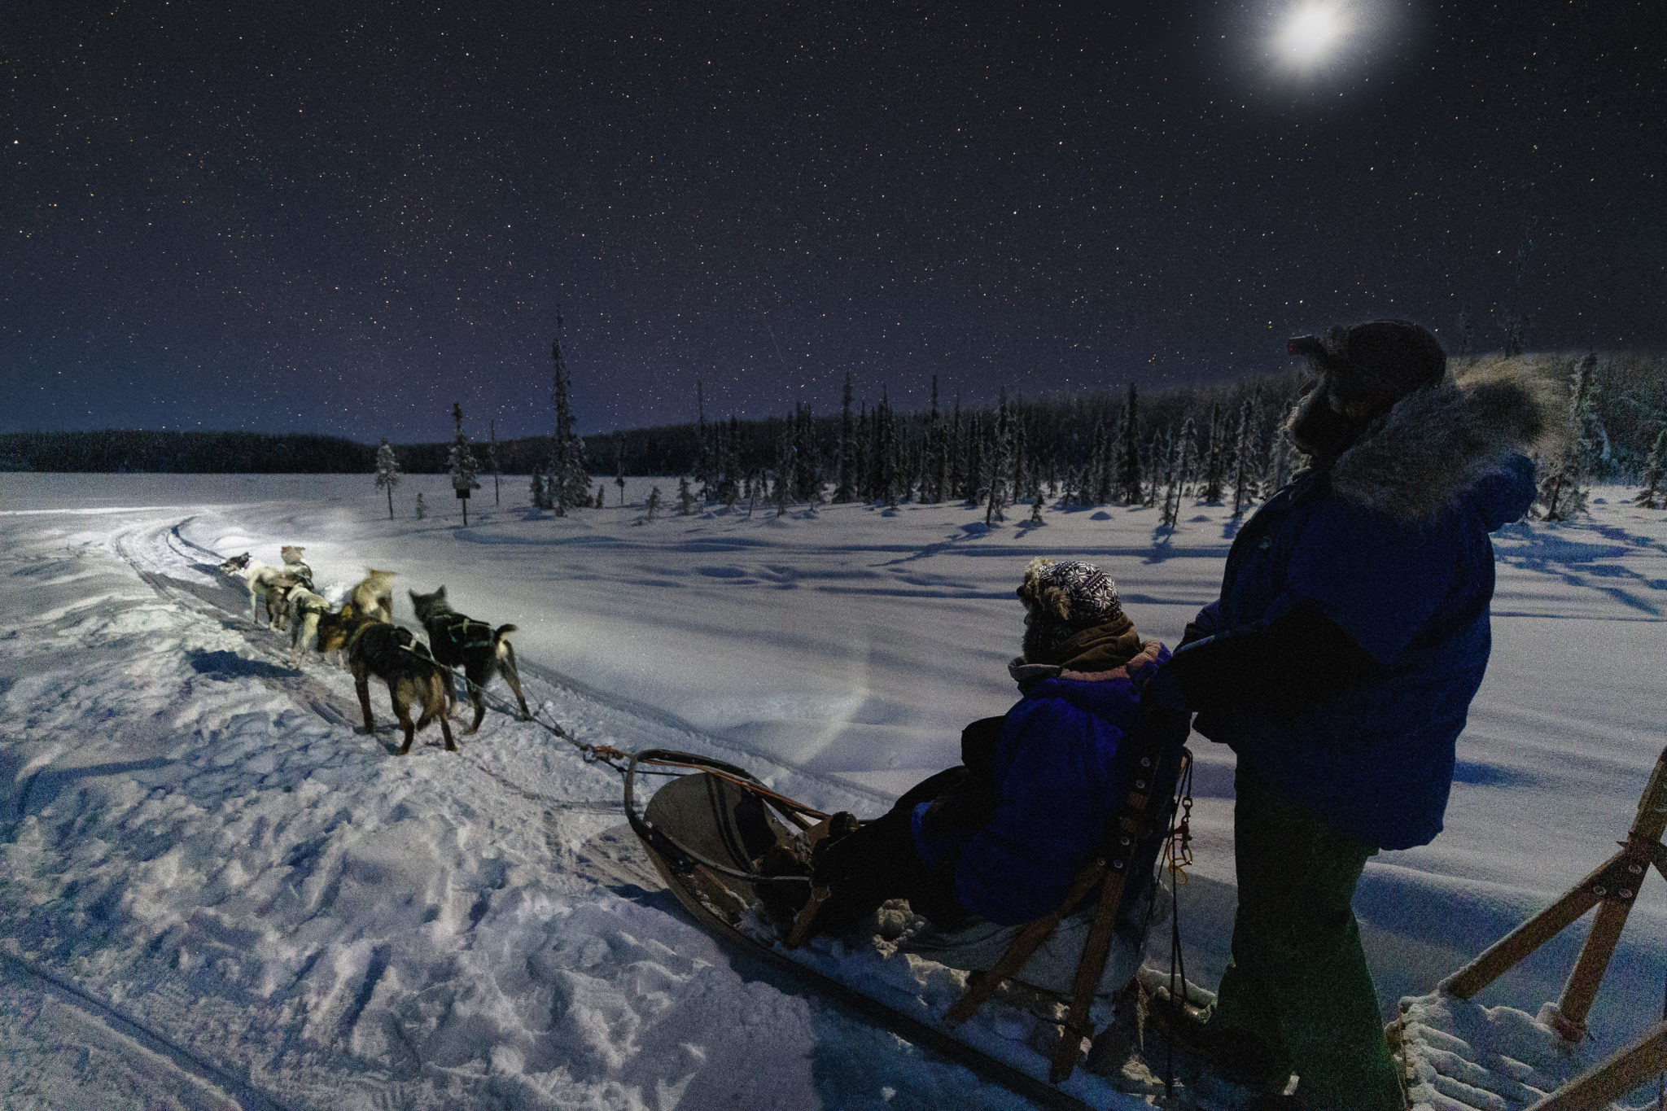
twilight
the time when the sun is beyond the horizon, but its light is still visible; often after sunset

Slide 8
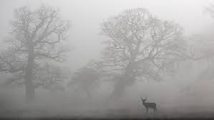
eerie
mysterious; scary

Slide 9
plight
a struggle; a dangerous and difficult situation

Slide 10
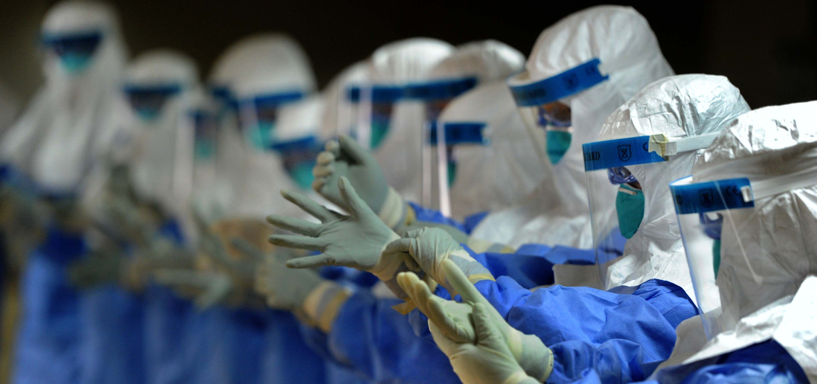
epidemic
an illness that spreads and affects a lot of people

Slide 11
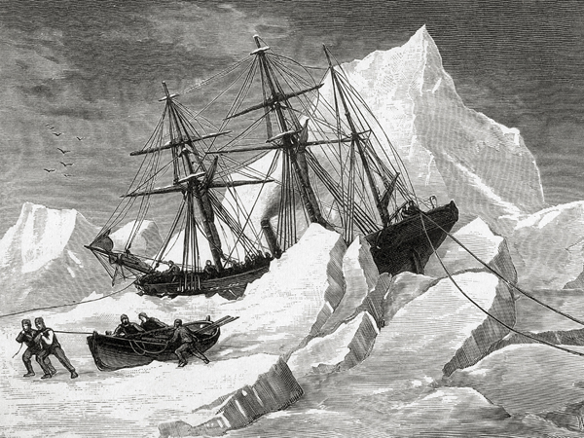
treacherous
difficult; dangerous

Slide 12
perished
to die

