Slide 1
v_______
to leap over something

Slide 2
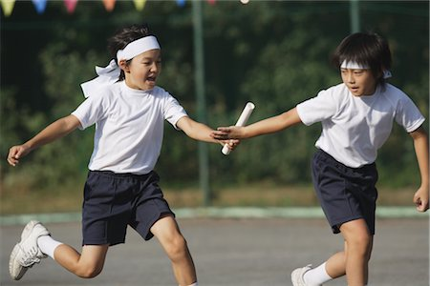
r________
A race between two or more groups of people. One person from each group races at a time.

Slide 3
r_____ w______
a person who assists after a
disaster has occurred

Slide 4
a_________
physical games or sports

Slide 5
t_________
the cost of attending a school or institution

Slide 6
c_________
the property of a university or college

Slide 7
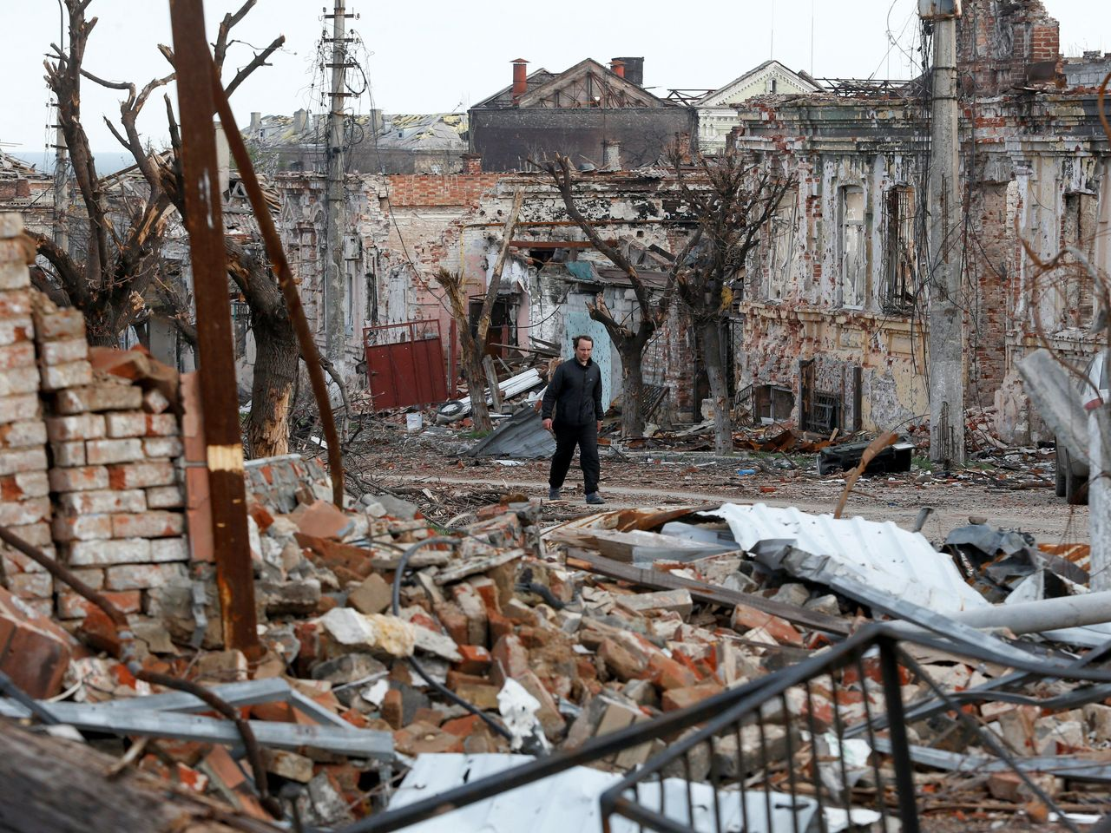
t_________
a cost associated with an event

Slide 8
h________
a challenging obstacle

Slide 9
p__________
to officially announce

Slide 10
c________
to get over or beyond something

Slide 11
d__________
characterized by a delicate disposition and an attention to good manners

Slide 12
s_________
the separation of people based on race

Slide 13
anon_______
something done for you or given to you
by an unknown person

