Slide 1
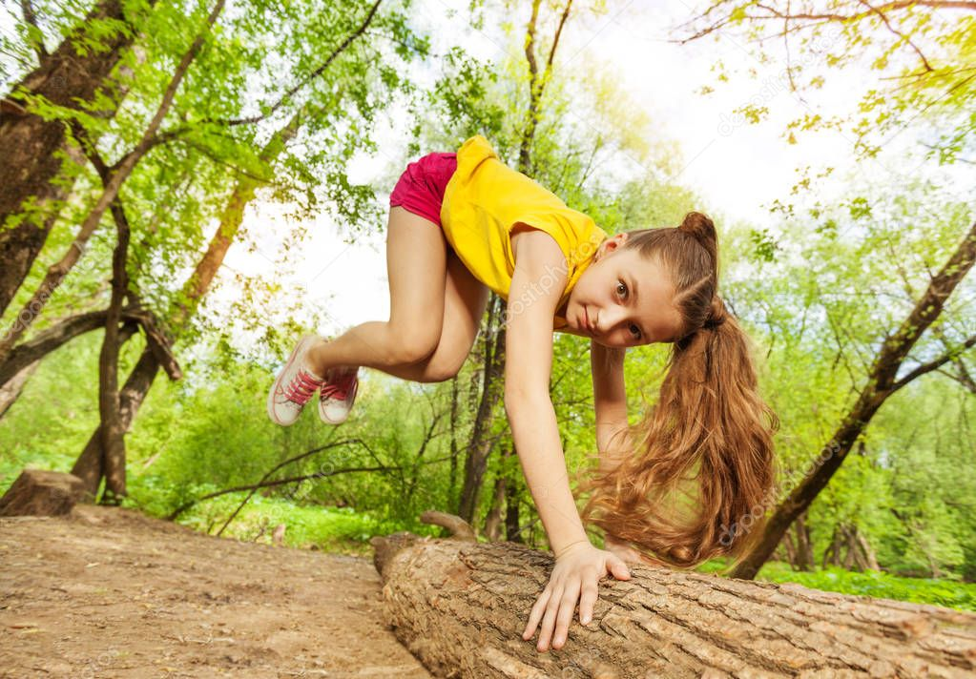
vaulted
to leap over something with the aid of one’s hands

Slide 2
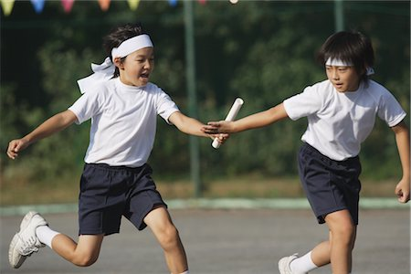
relays
A race between two or more groups of people. One person from each group races at a time.

Slide 3
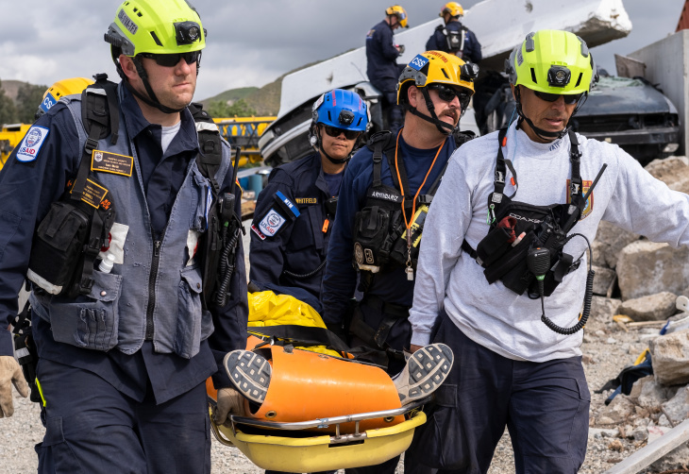
rescue worker
a person who assists after a disaster has occurred, often by attending to injuries or serving food

Slide 4
athletics
physical games or sports

Slide 5
tuition
the cost of attending a school or institution

Slide 6
campus
the property of a university or college

Slide 7
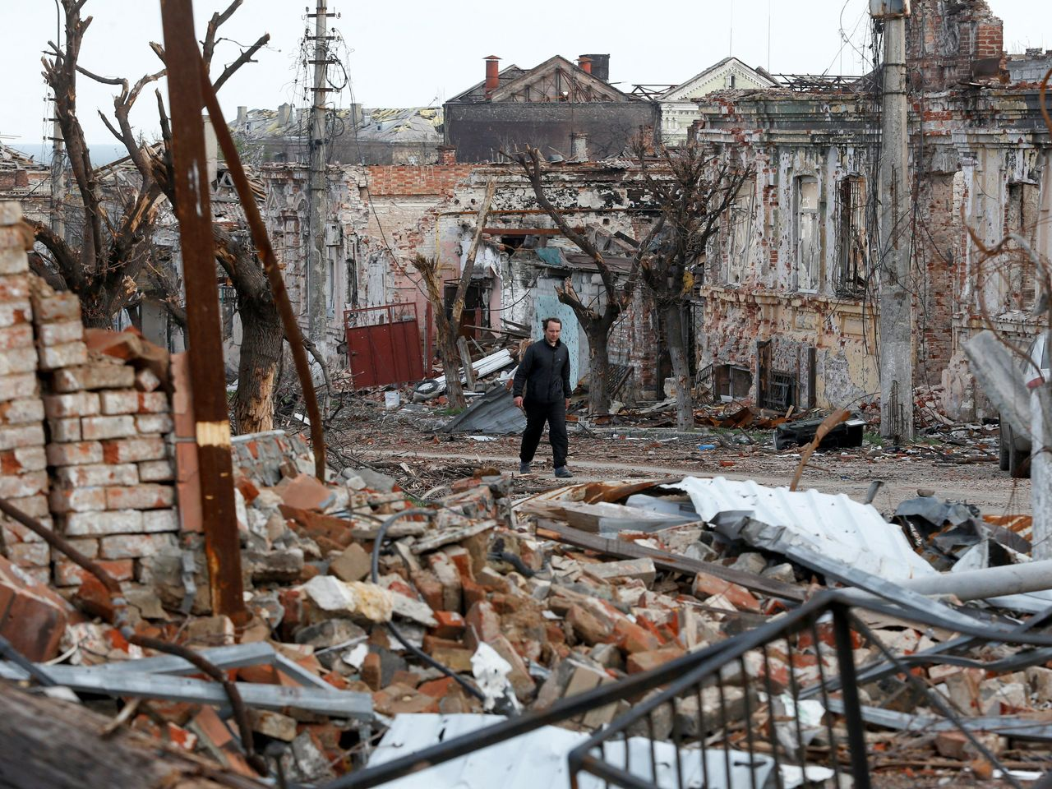
toll
a cost associated with an event

Slide 8
hardships
a challenging obstacle

Slide 9
proclaimed
to officially announce

Slide 10
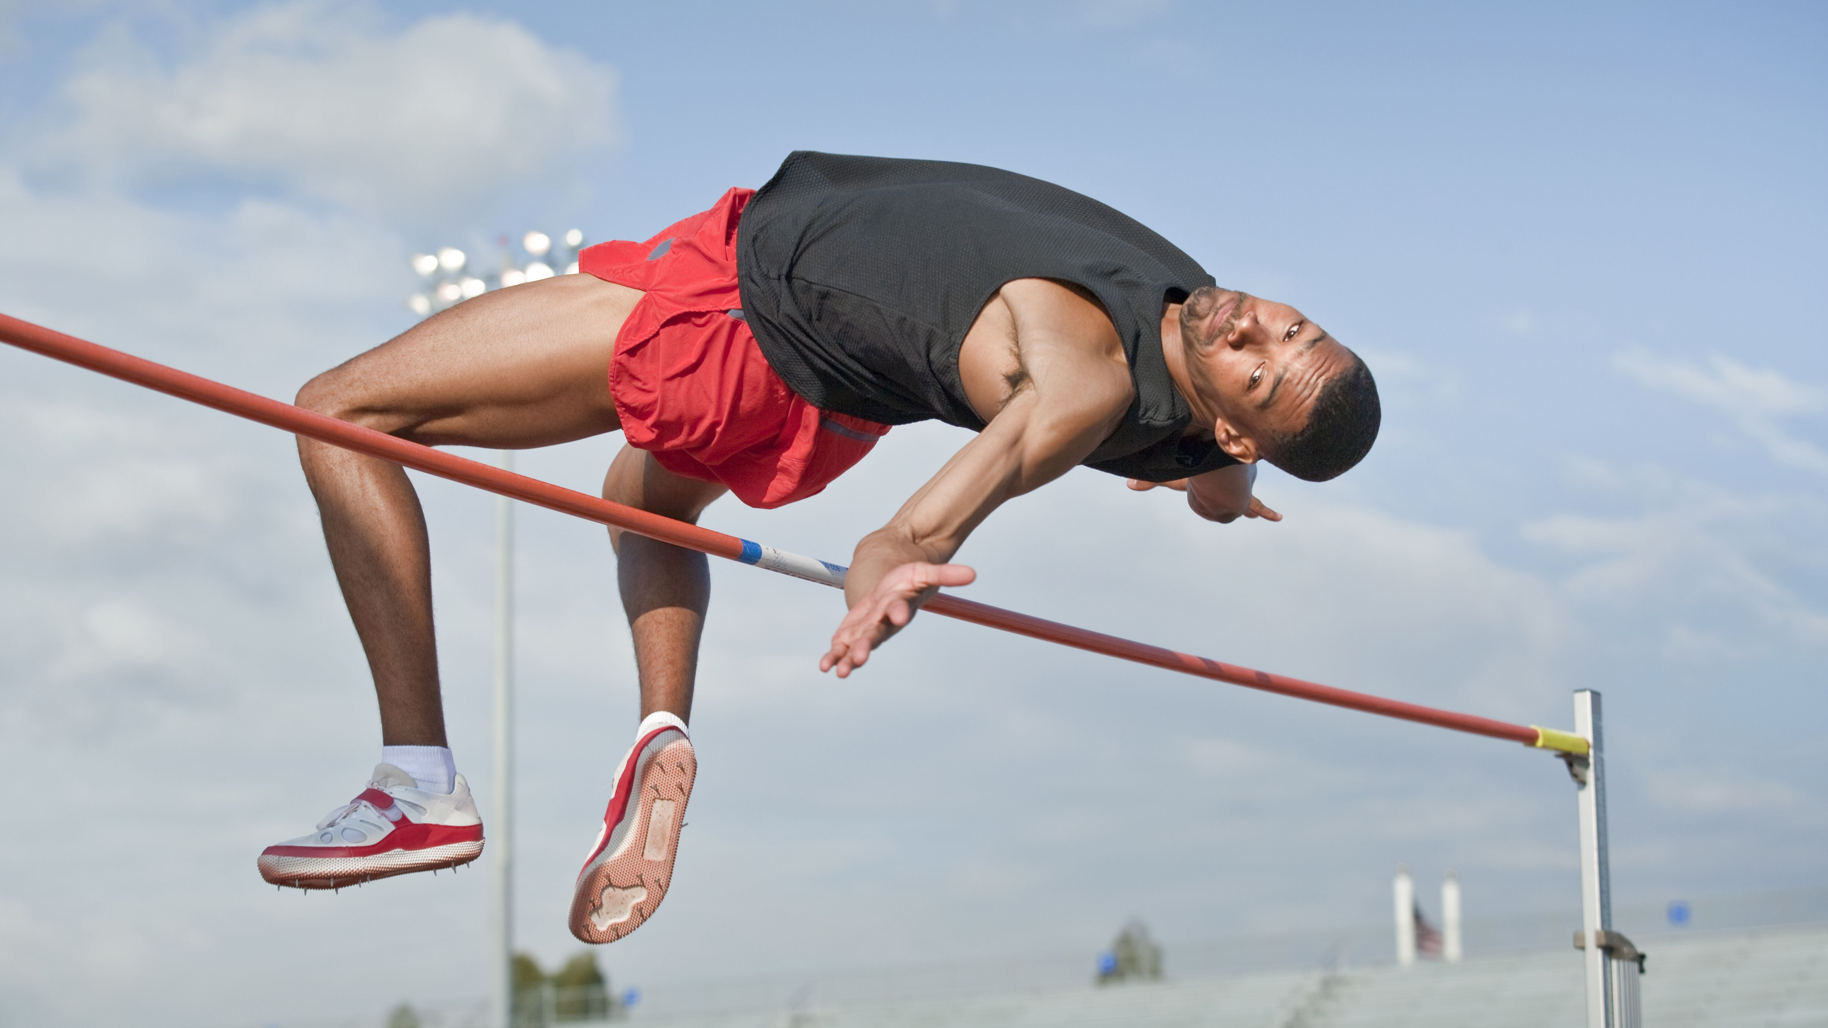
clear
to get over or beyond something

Slide 11
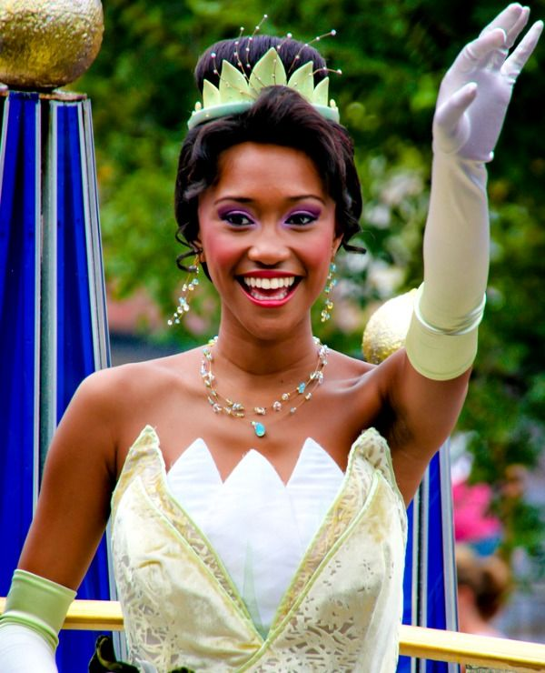
dainty
characterized by a delicate disposition and an attention to good manners

Slide 12
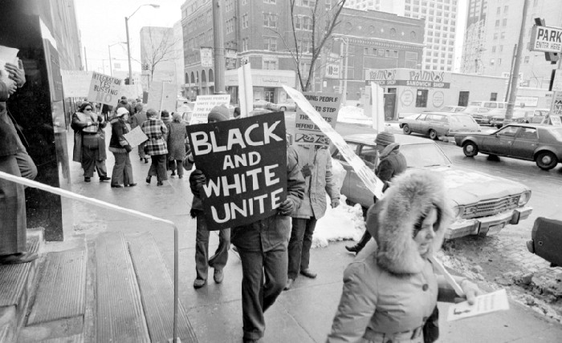
segregation
the separation of people based on race

Slide 13
anonymous
not identified as coming from a specific person

