Slide 1
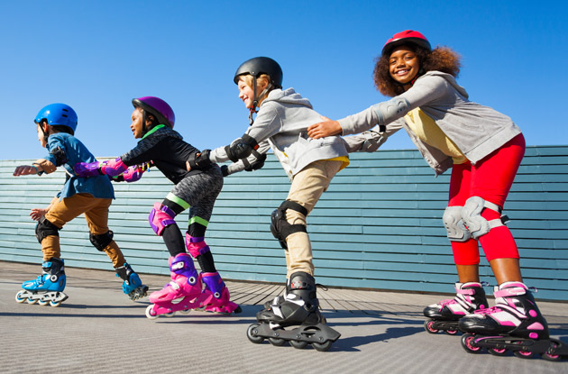
chanced
to risk

Slide 2
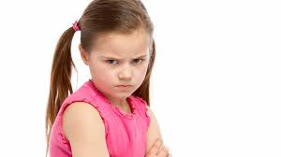
fumed
to express irritation or anger

Slide 3
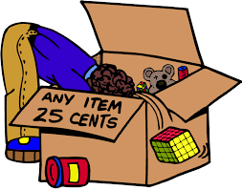
rummaged
to search by moving things around

Slide 4
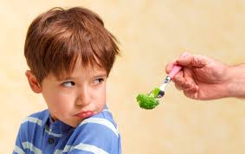
reluctantly
not wanting to act; unwilling

Slide 5
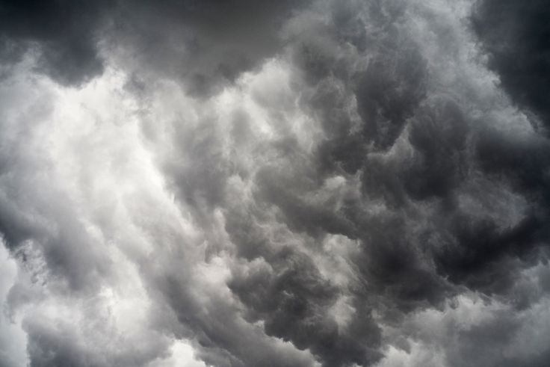
slate
dark gray color

Slide 6
nerves
a state of mind characterized by nervousness or anticipation

Slide 7
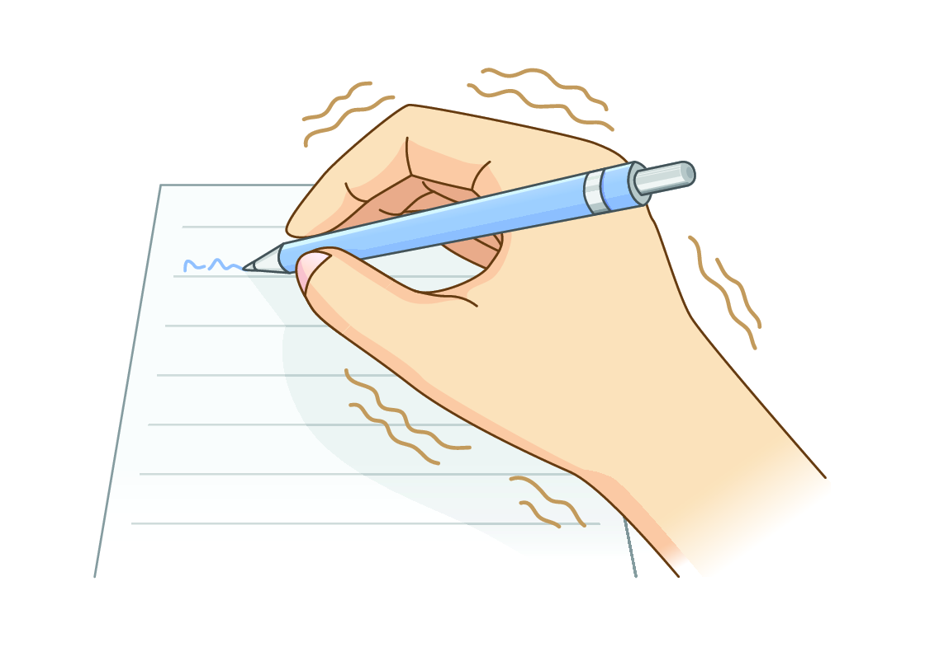
quivering
to shake slightly; shiver

Slide 8
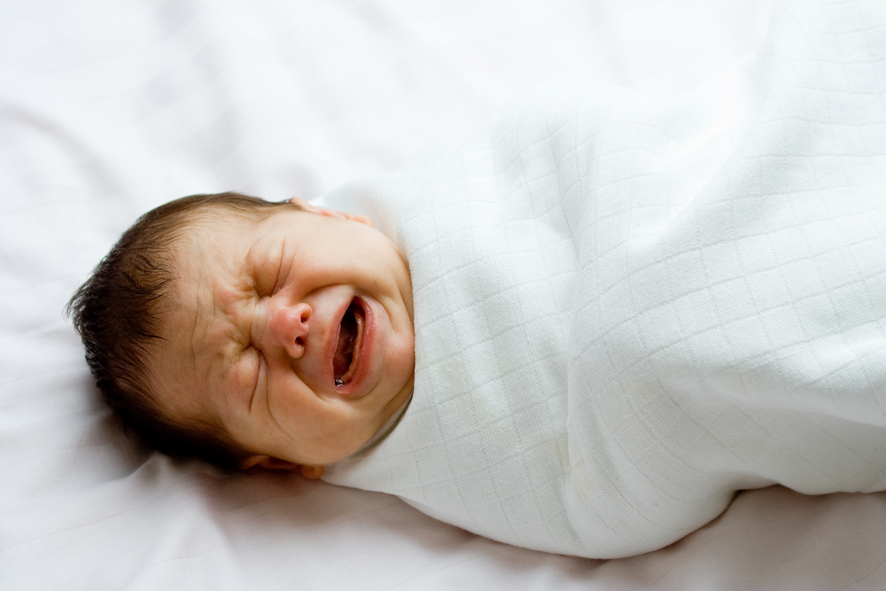
instinct
a way of acting without thinking that one is born with or has practiced

Slide 9
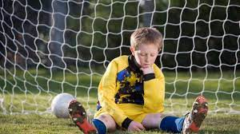
glumly
with disappointment or unhappiness

Slide 10
association
a group of people organized for a common purpose

Slide 11
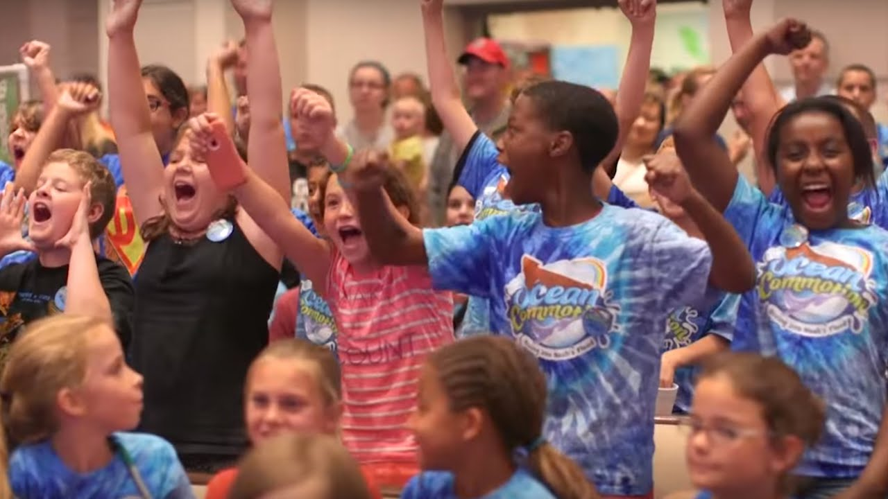
commotion
disorderly noise; disturbance

Slide 12
privacy
a condition of being alone or not shared with others

