Slide 1
cryptic
seeming to have a secret meaning; mysteriously

Slide 2
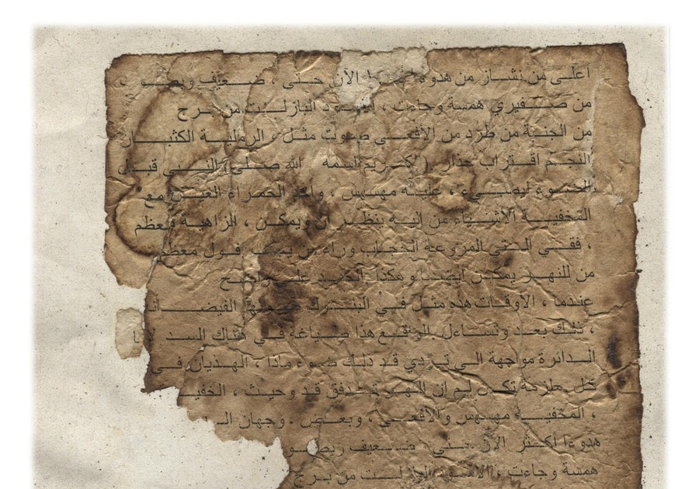
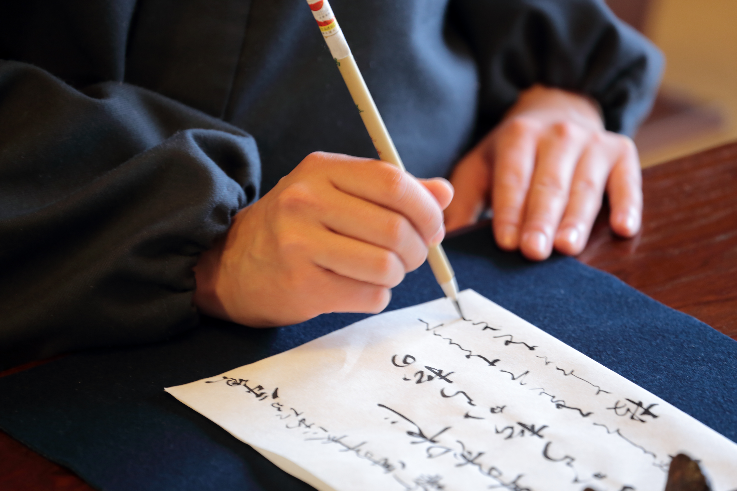
manuscript
This Photo by Unknown author is licensed under CC BY-SA-NC.
an unfinished or unpublished writing, usually done by hand

Slide 3
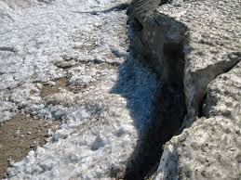
distortions
an unexpected and unwanted change caused by heat, movement, or another outside force

Slide 4
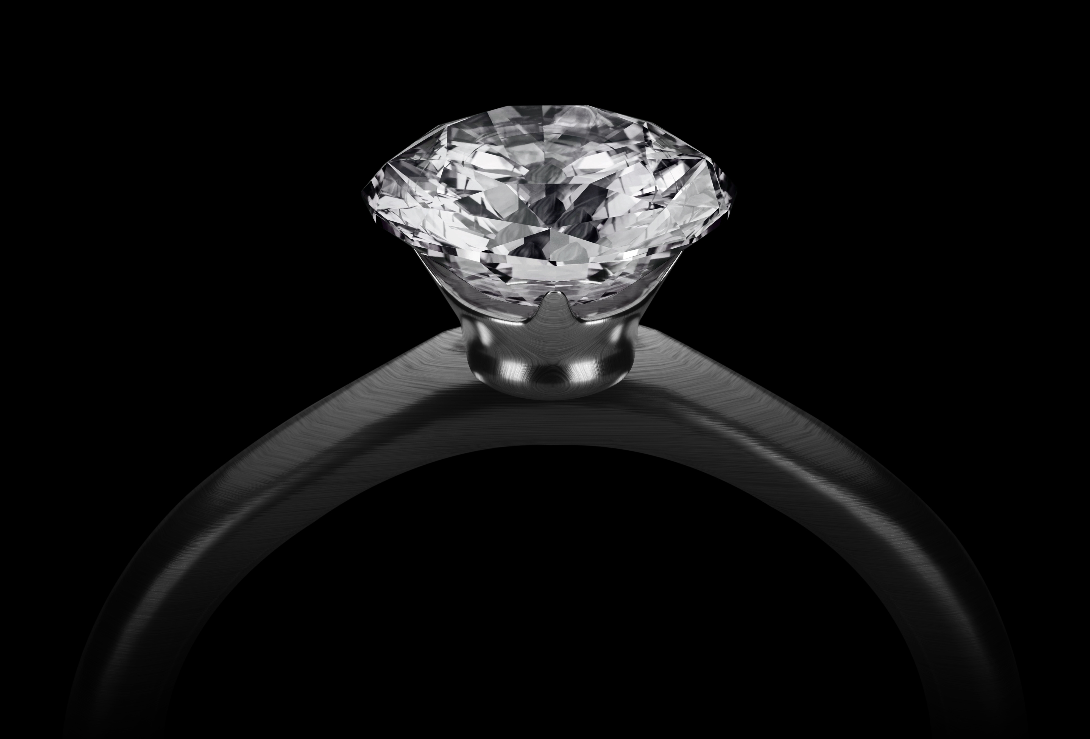
facets
one of the flat surfaces of a gemstone or other rock.

Slide 5
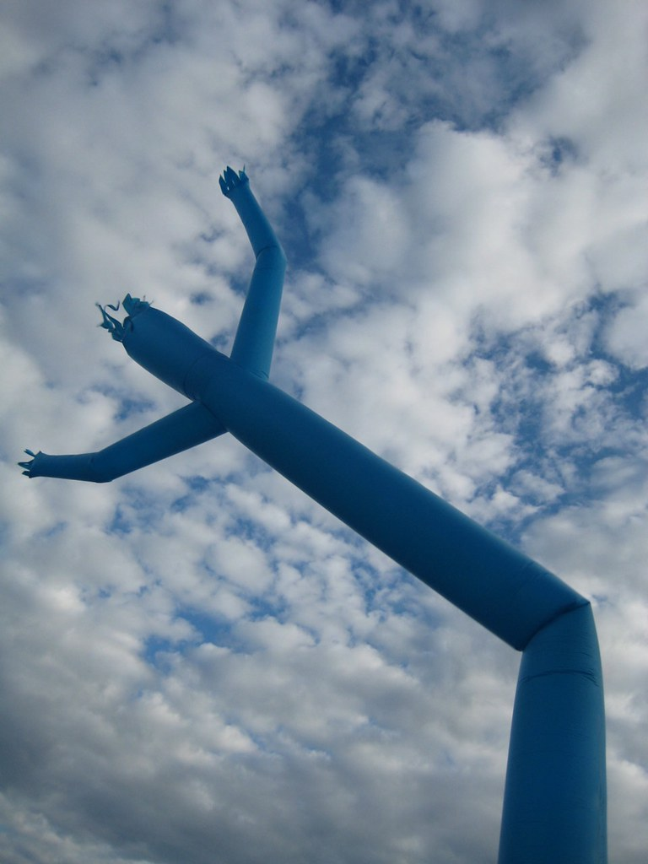
flailing
This Photo by Unknown author is licensed under CC BY-NC.
to swing your arms or legs violently as if out of control

Slide 6
dared
to have the courage for
This Photo by Unknown author is licensed under CC BY-SA-NC.

Slide 7
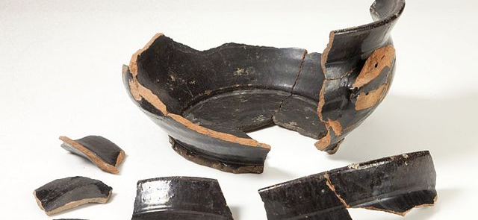
fragments
small pieces of something, usually broken off of something larger
This Photo by Unknown author is licensed under CC BY-SA.

Slide 8
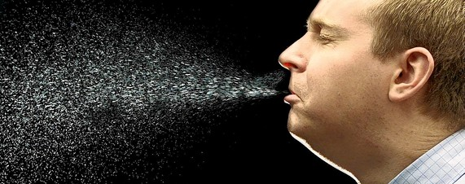
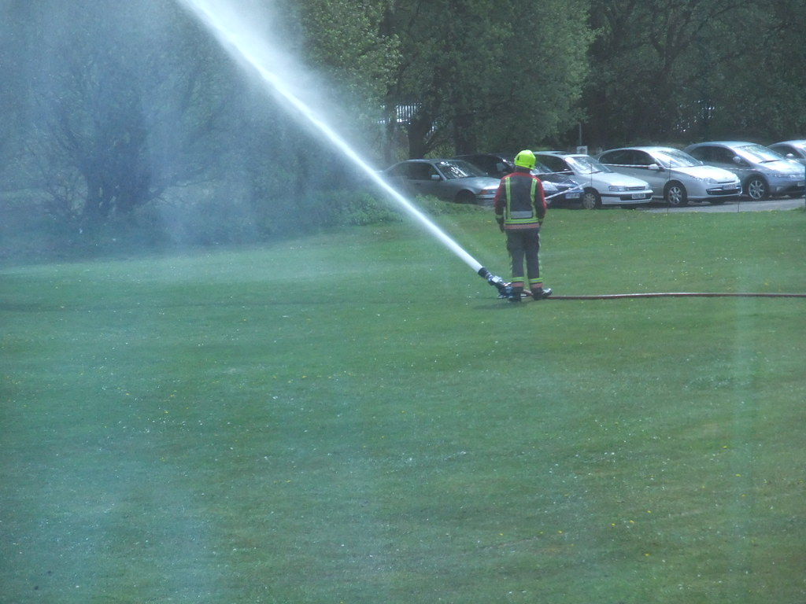
spurted
This Photo by Unknown author is licensed under CC BY-SA.
To burst out suddenly

Slide 9
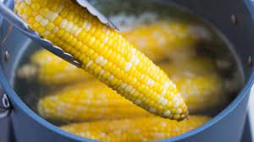
plunged
to put in suddenly

Slide 10
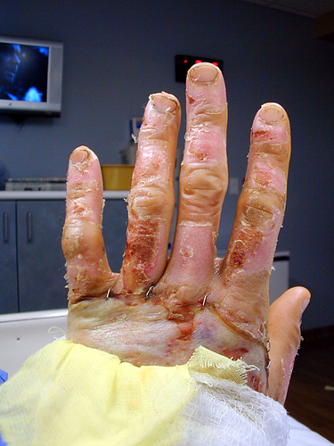
scalded
This Phoo by Unknown author is licensed under CC BY.
to burn with hot water or steam

Slide 11
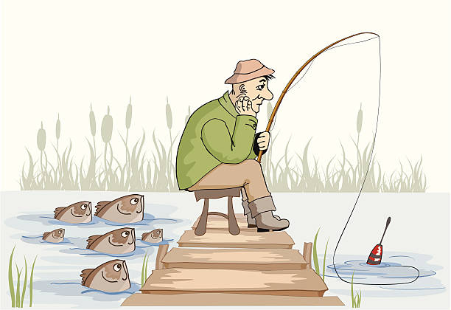
fruitless
Not having the intended or hoped for outcome; unsuccessful

Slide 12
heartily
This Photo by Unknown author is licensed under CC BY-NC.
In a way that indicates friendliness or enthusiasm

