Slide 1
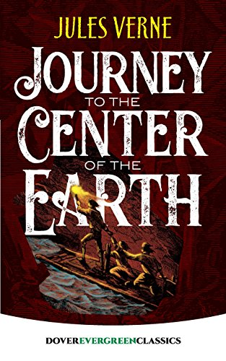
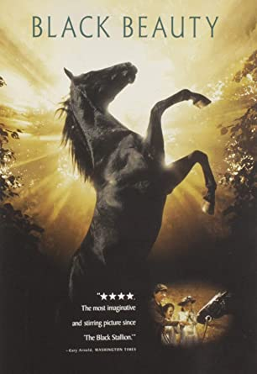
OPEN COURT
Unit 1
Getting Started

Slide 2
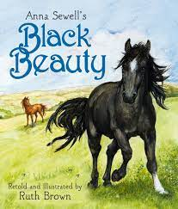
GETTING STARTED BLACK BEAUTY

Slide 4
Is it an Adventure Tale?

Slide 5
Is it an Adventure Tale?

Slide 6
Is it an Adventure Tale?

Slide 7
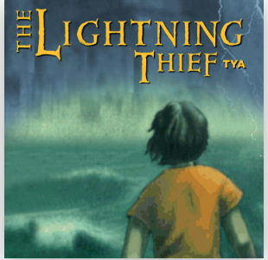
Is it an Adventure Tale?

Slide 8
Is it an Adventure Tale?

Slide 9
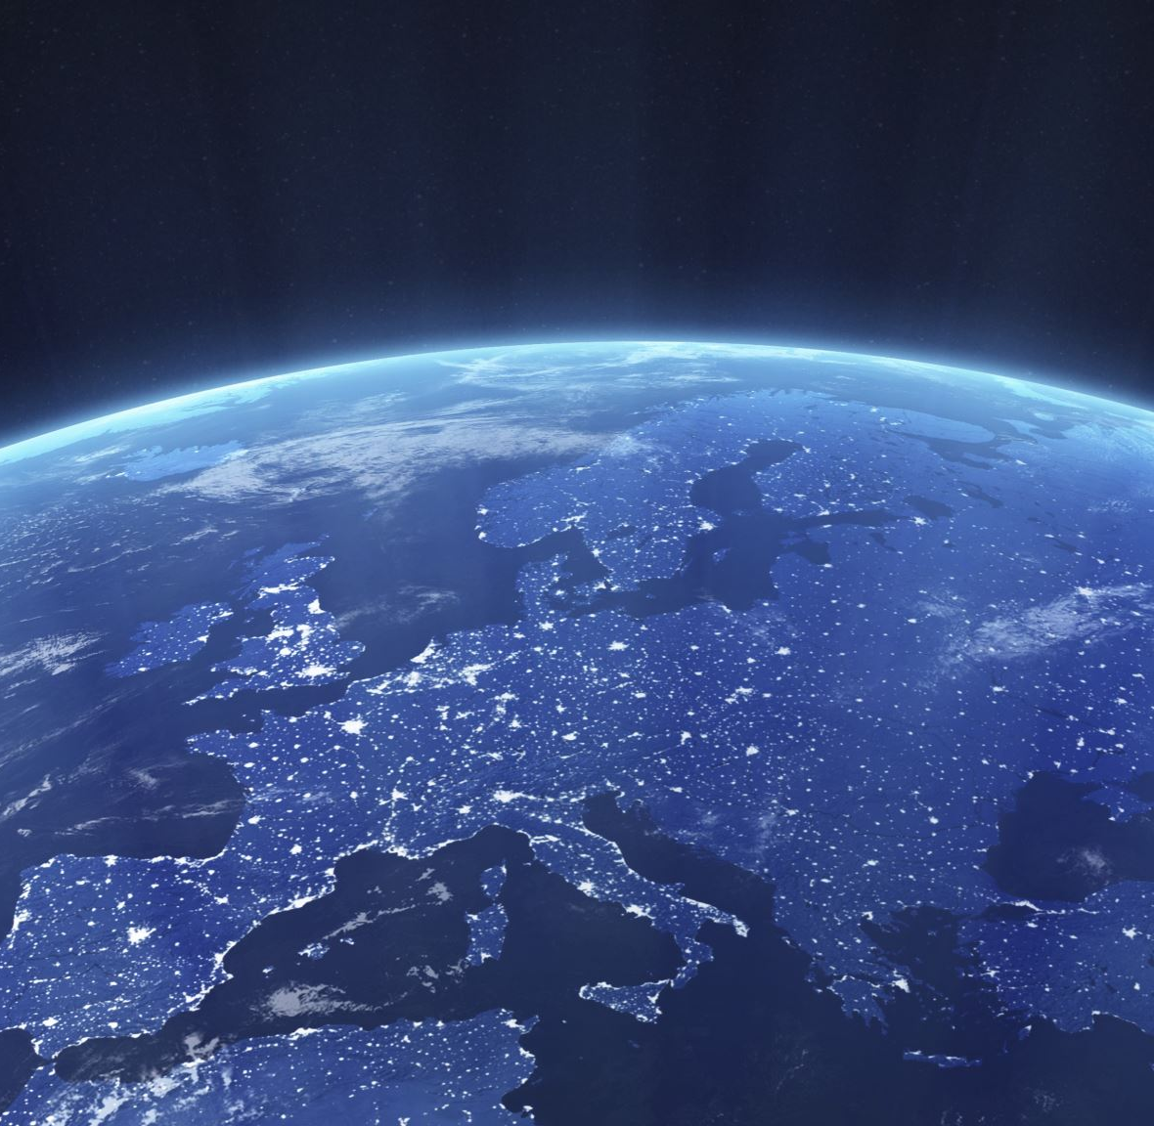
Journey to the Center of the Earth https://www.youtube.com/watch?v=iJkspWwwZLM

Slide 10
Journey to the Center of the Earth Science Fiction Genre

Slide 12
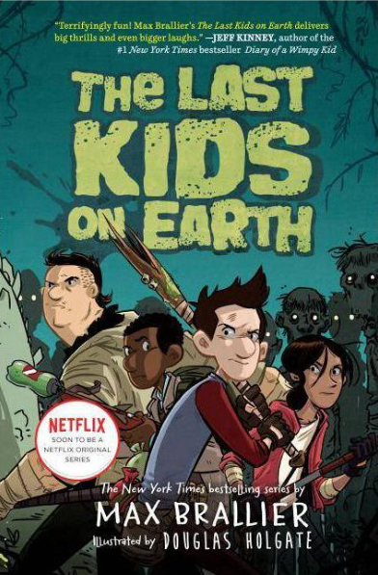
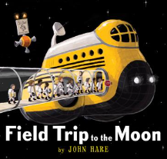
Examples of Science Fiction Genre

