Slide 1
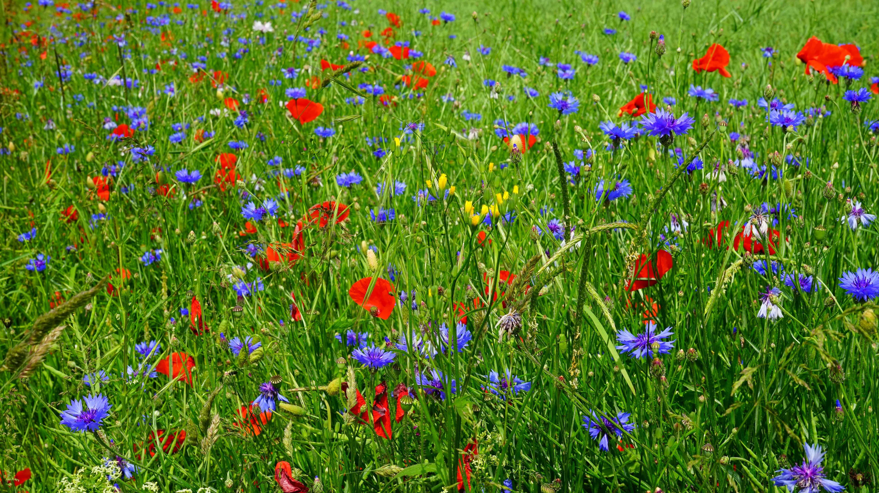
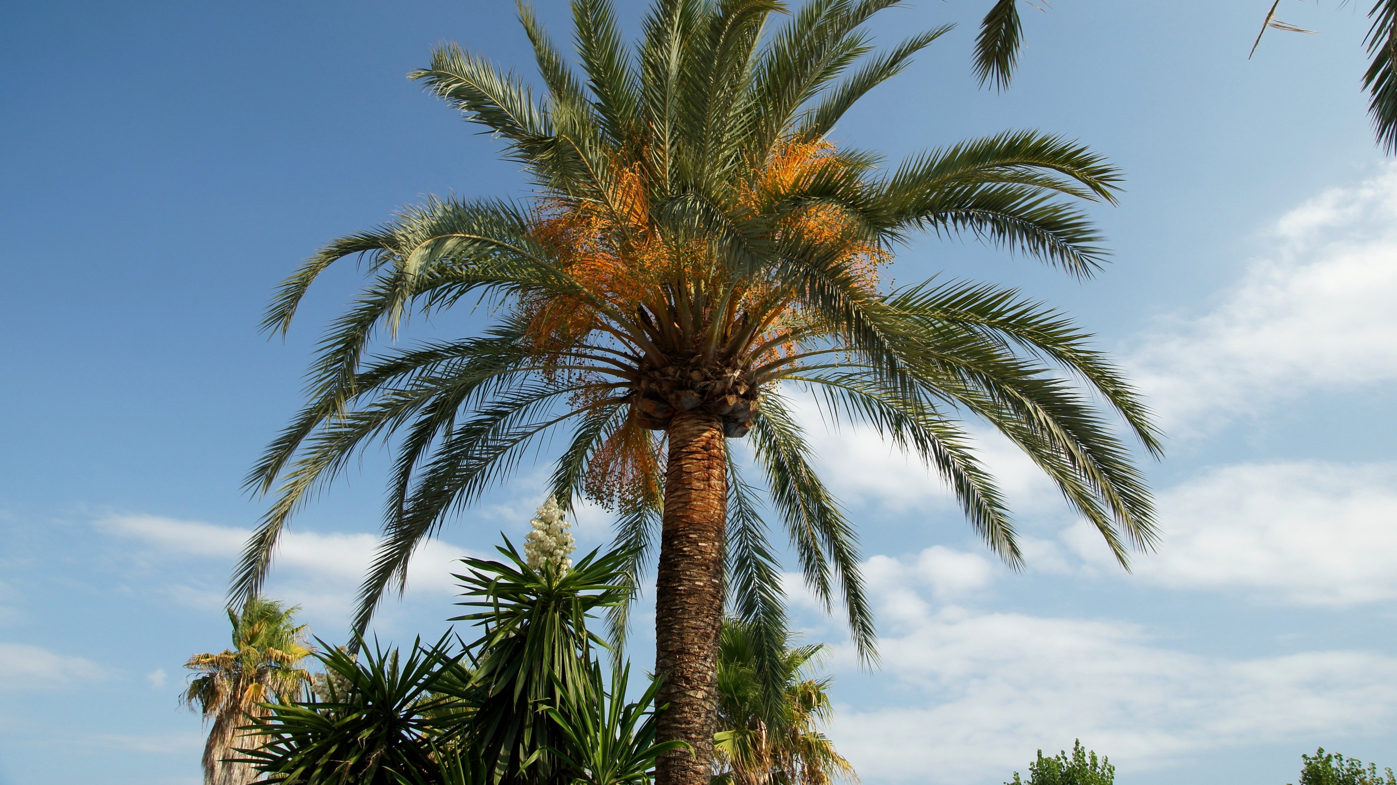
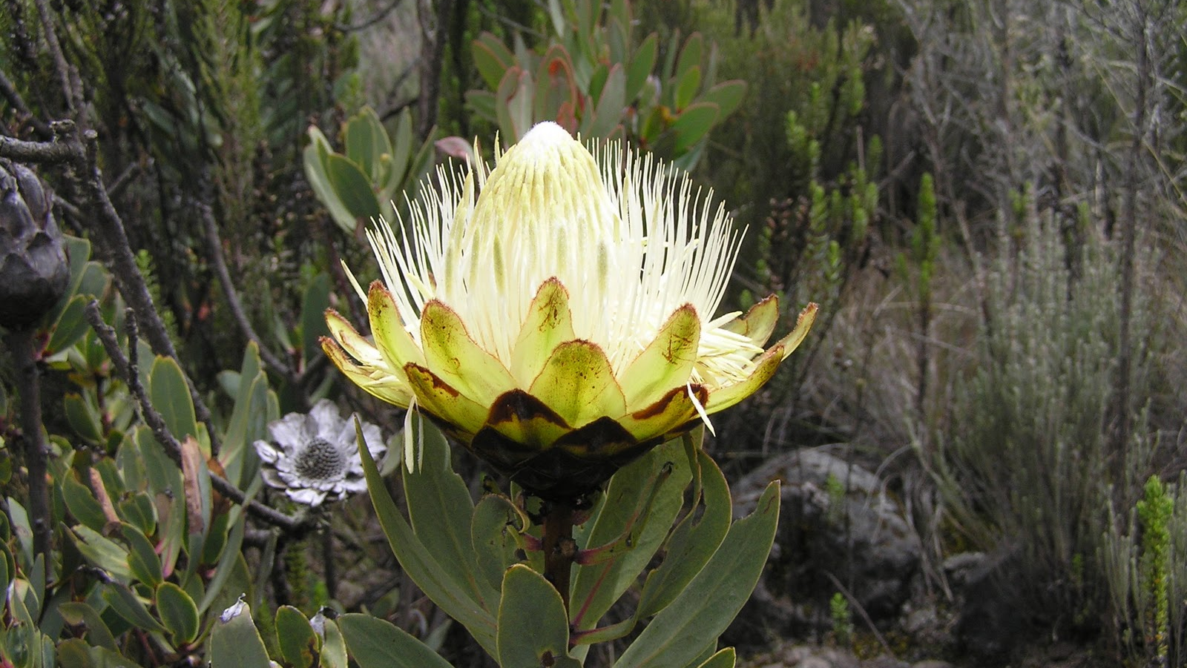
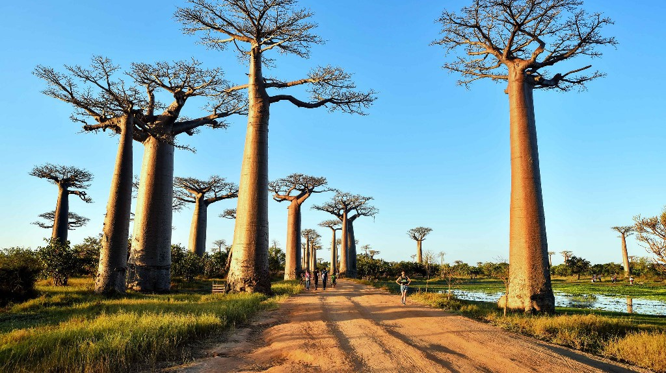
F_____
the plant life of a particular region

Slide 2
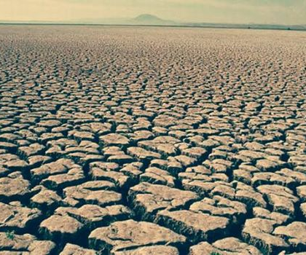
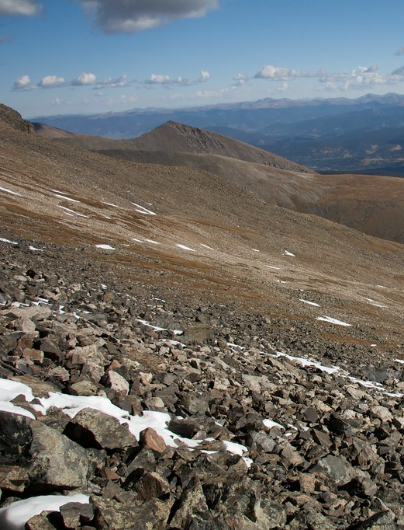
b_______
not able to produce anything

Slide 3
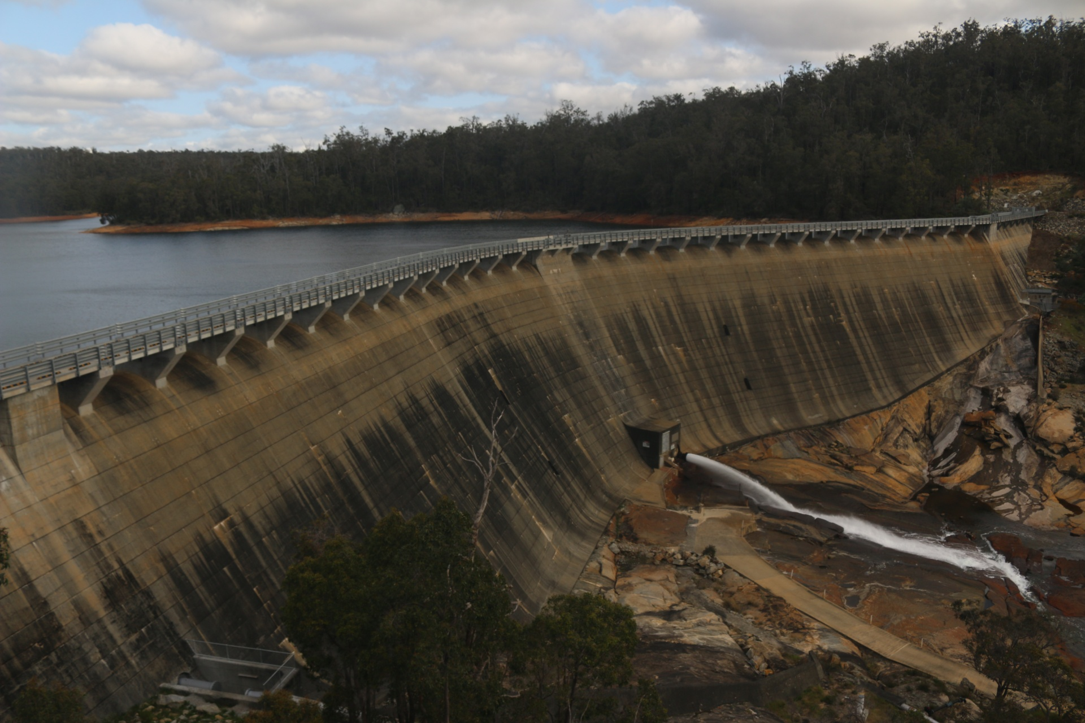
o____________
to be in the way of

Slide 4
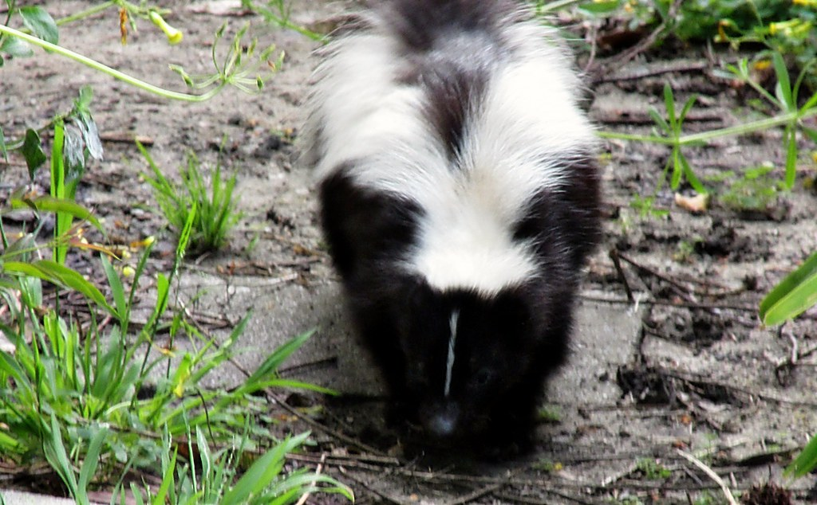
r_________
to wander about, roam
This Photo by Unknown Author is licensed under CC BY-NC-ND

Slide 5
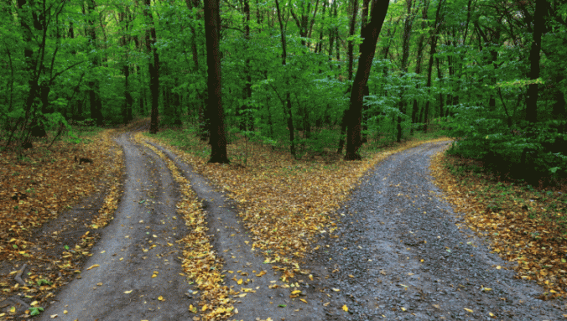
d________
to decide something after looking at and studying things
This Photo by Unknown Author is licensed under CC BY
This Photo by Unknown Author is licensed under CC BY

Slide 6
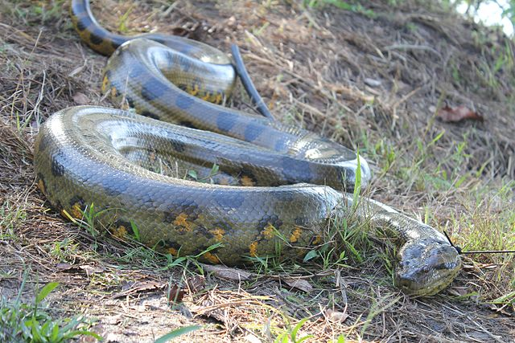
s_______
to glide like a snake

Slide 7
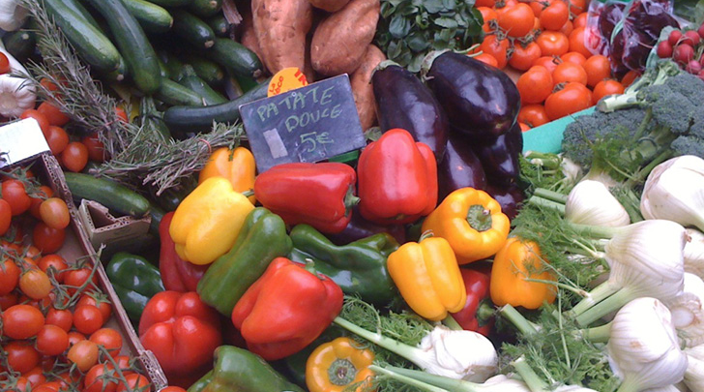
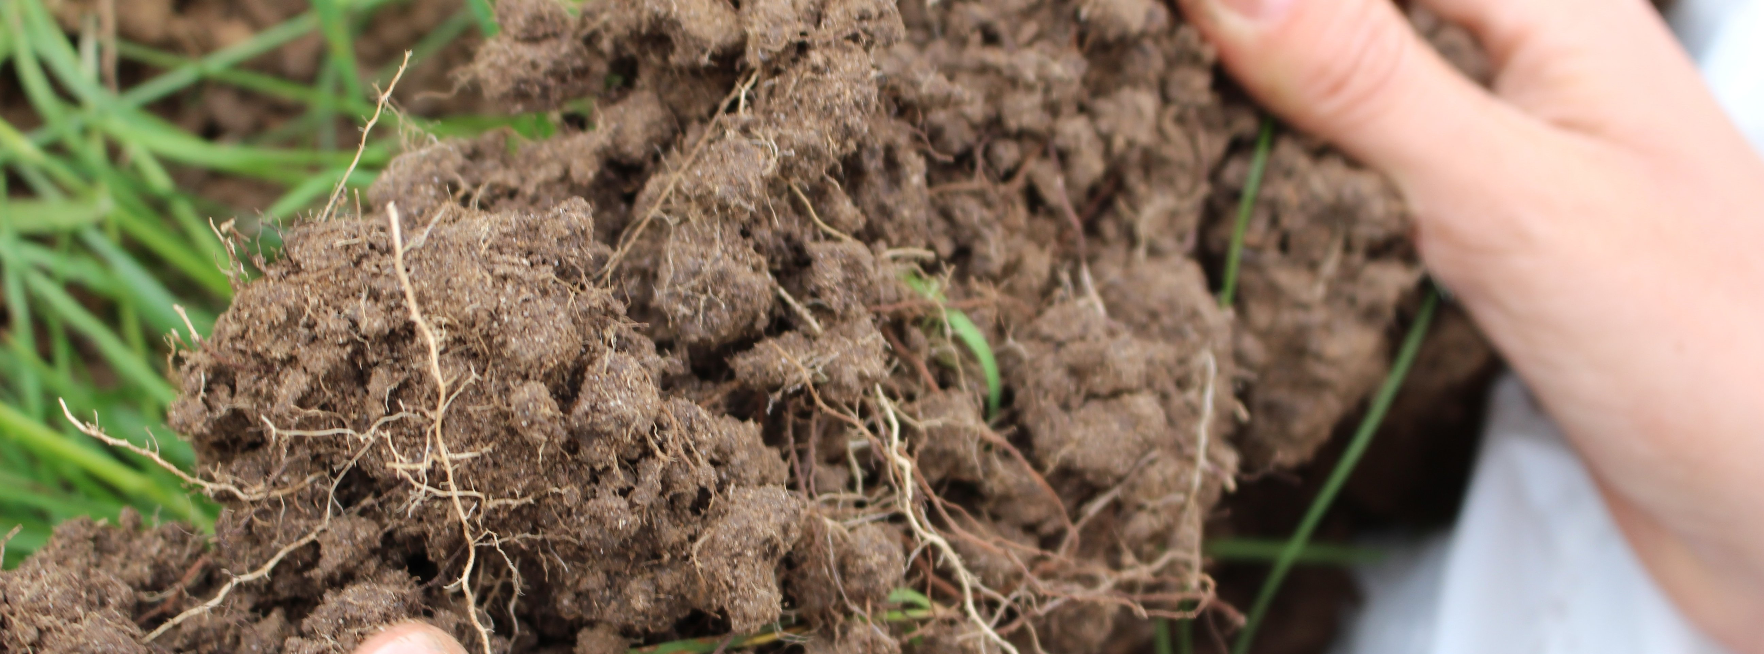
o__________
related to living matter

Slide 8
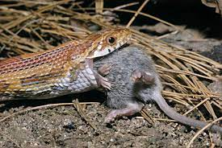
c___________
to eat

Slide 9
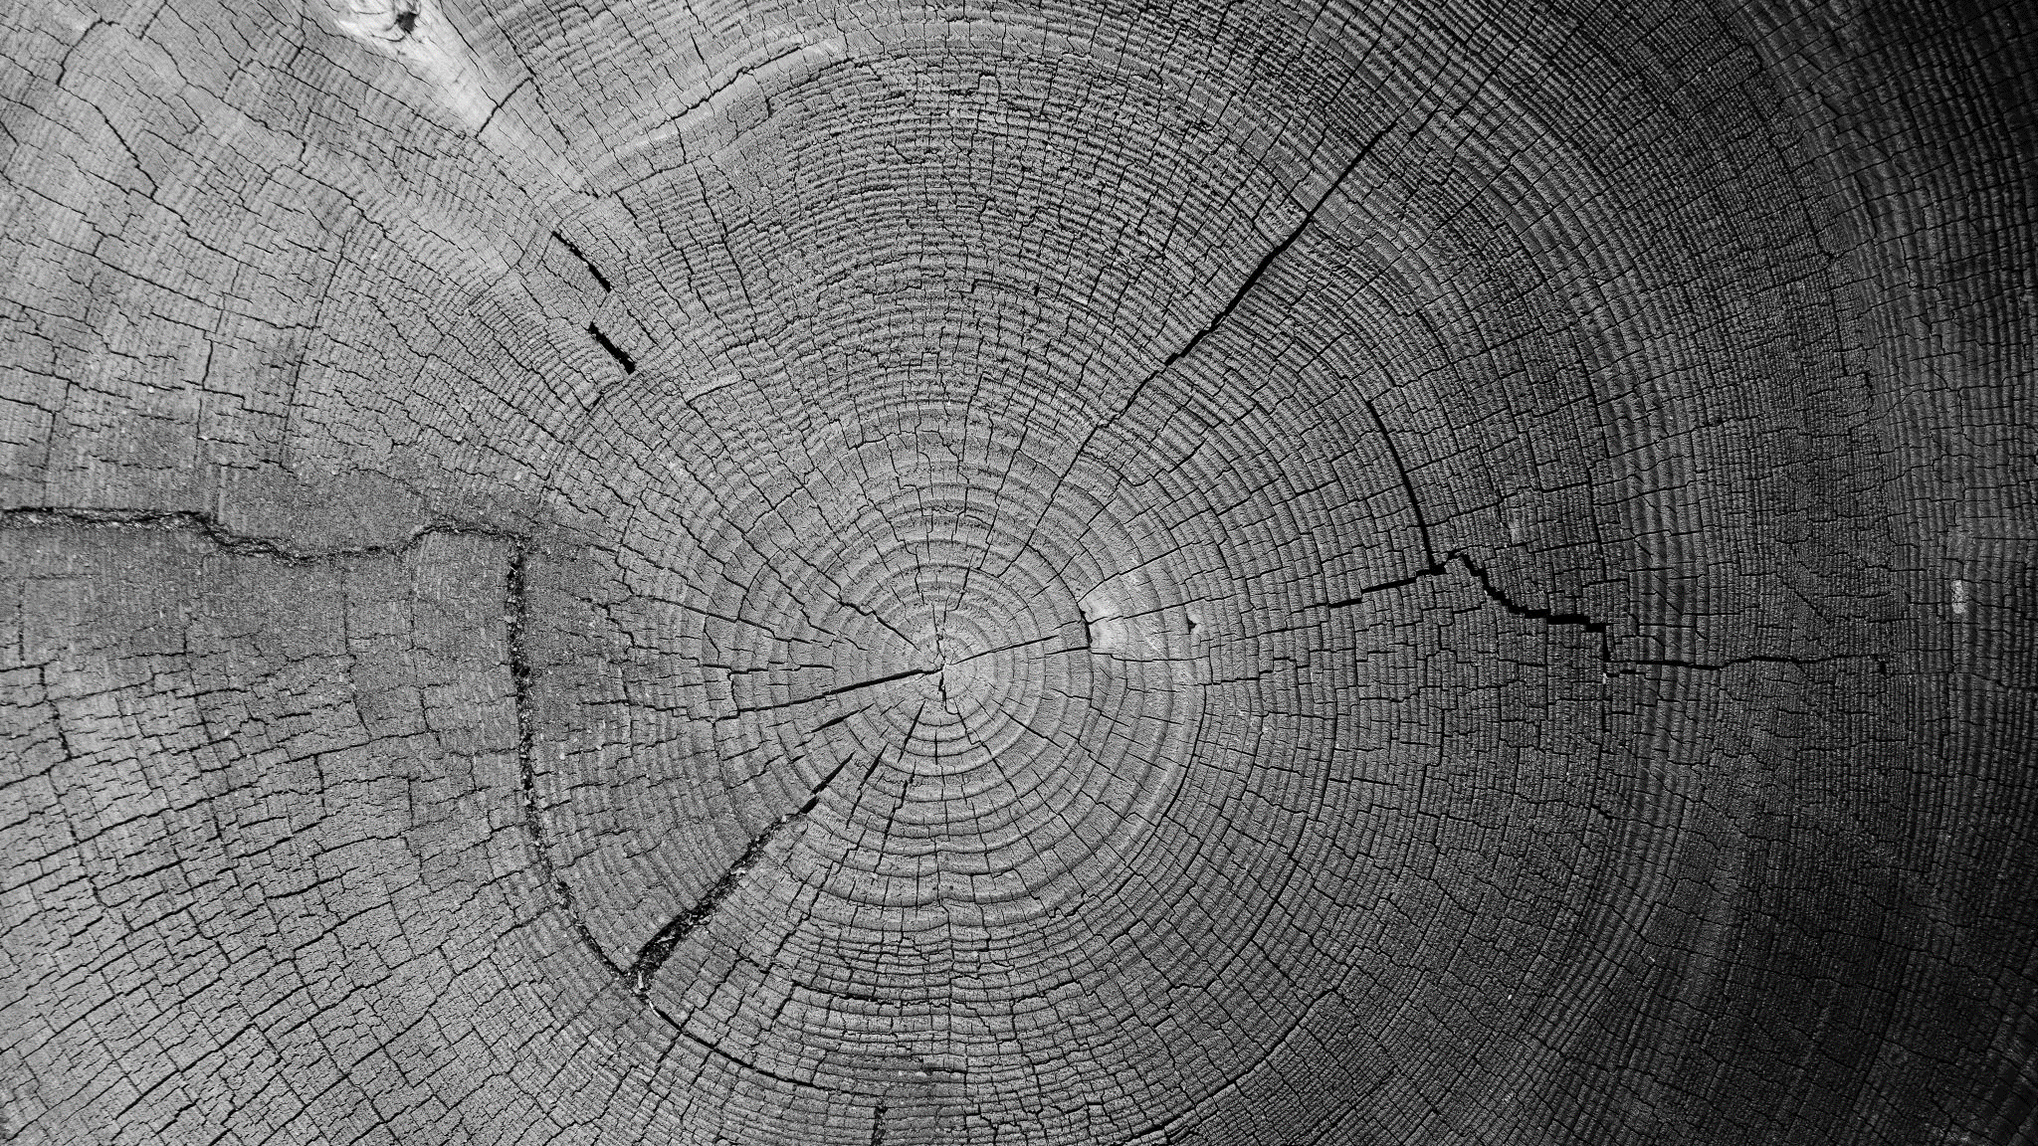
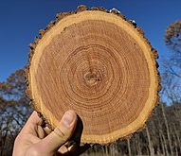
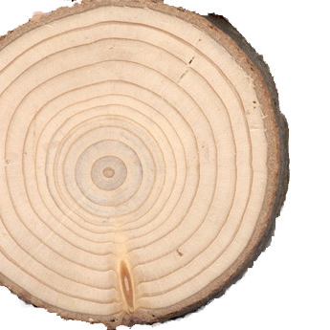
g_____ r______
A layer in a tree that develops after a regular period of growth, and which is often used to measure the tree’s age.

Slide 10
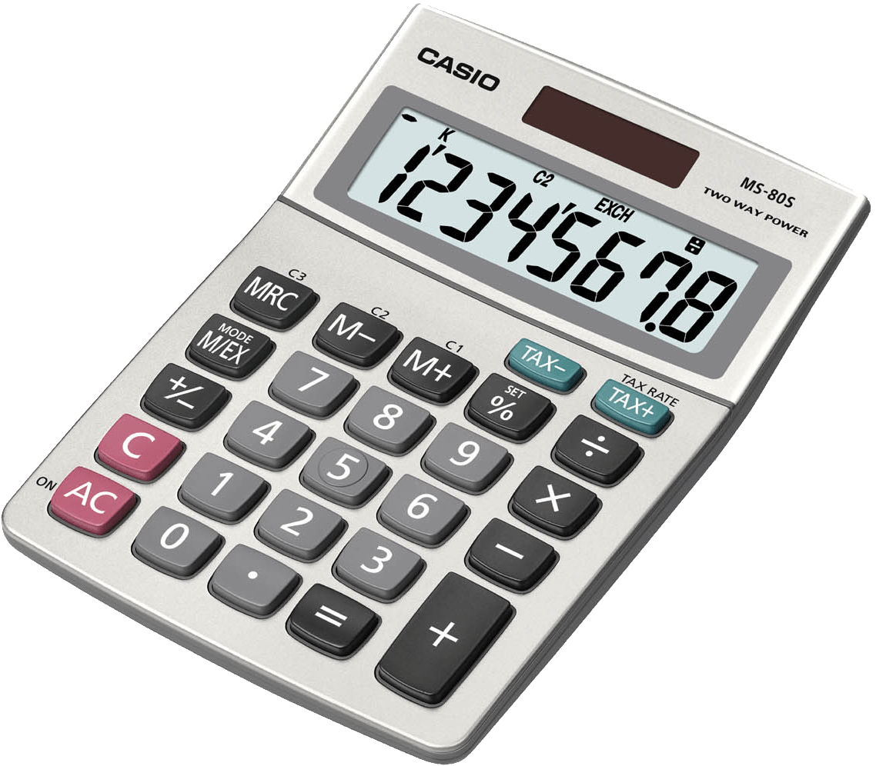
c__________
to find out something using numbers or quantities

Slide 11
a__________
to judge the importance or value of

Slide 12
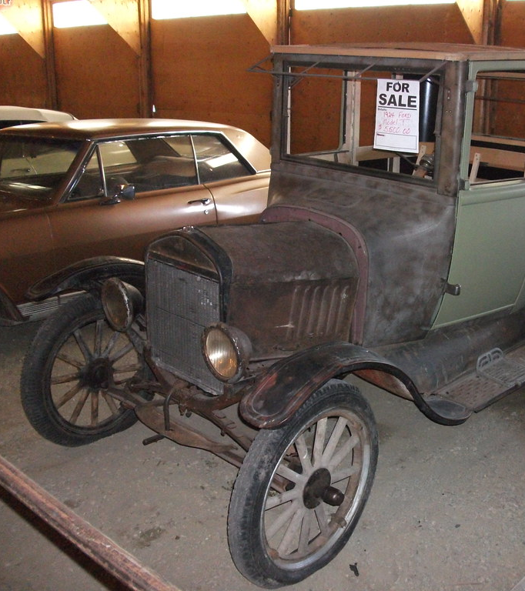
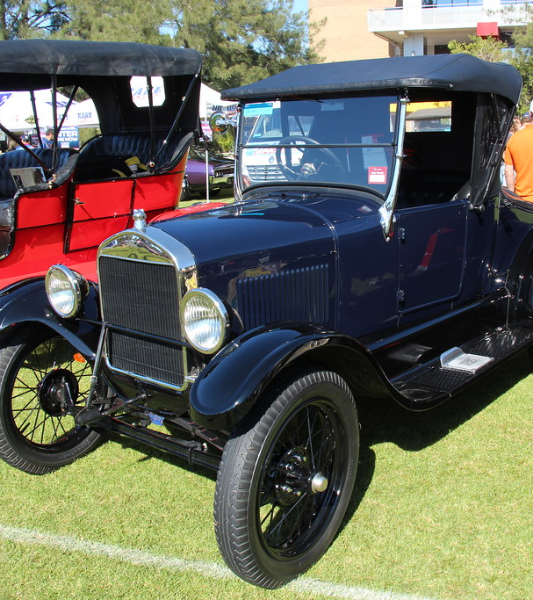
r________
to bring back or re-establish

Slide 13
c_________
very important

