Slide 1
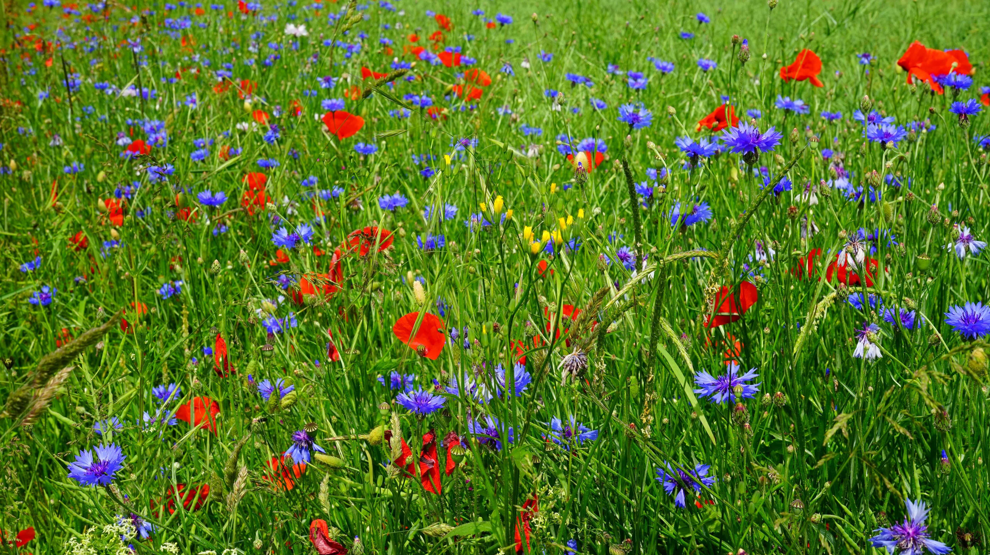
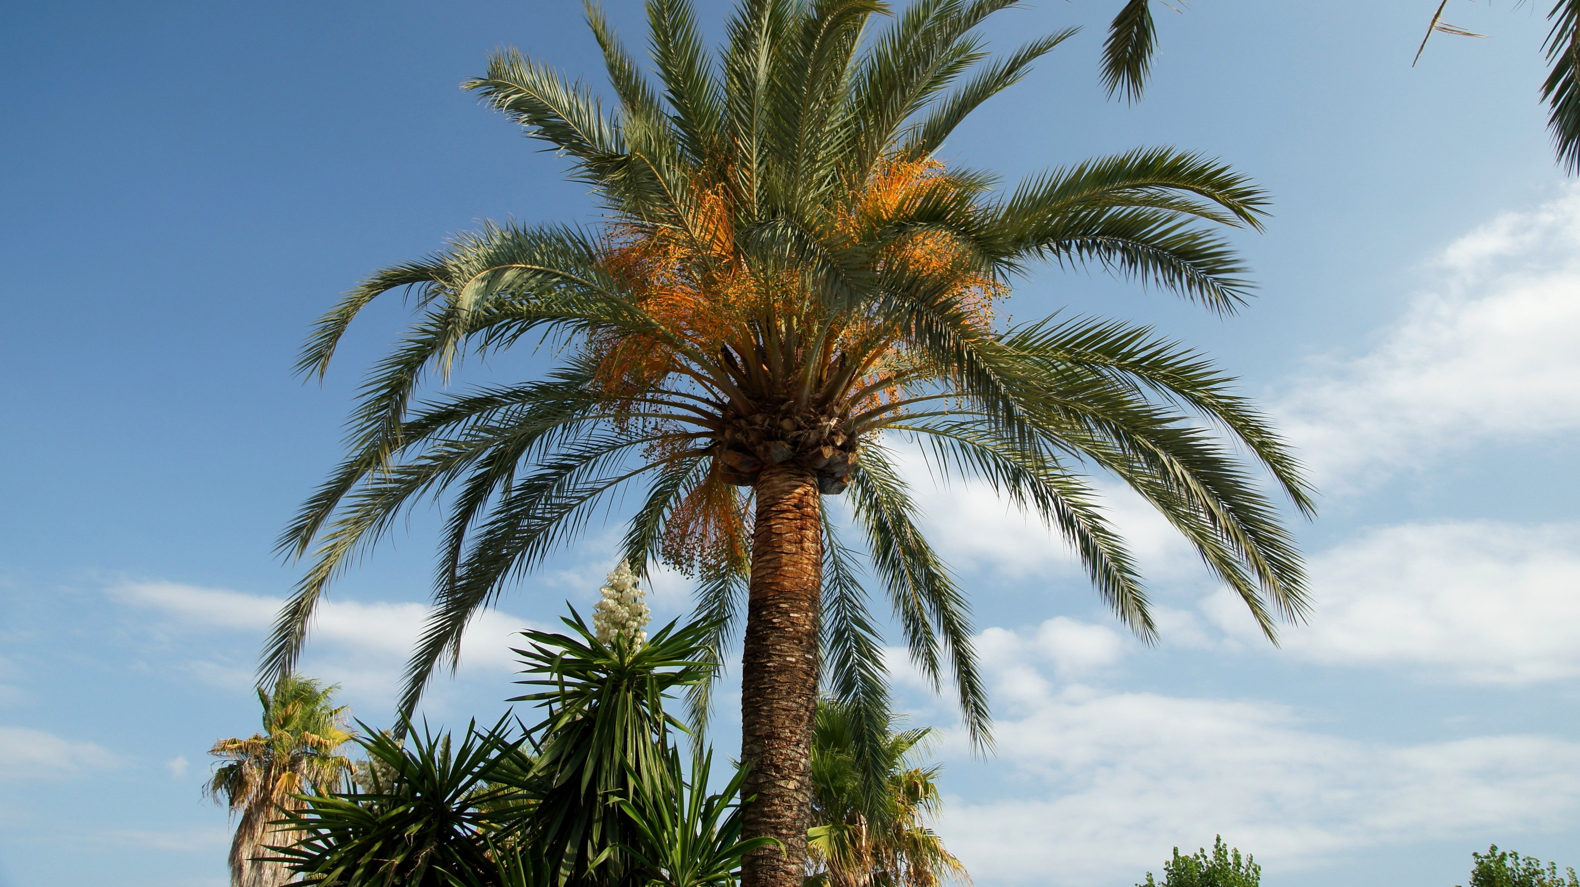
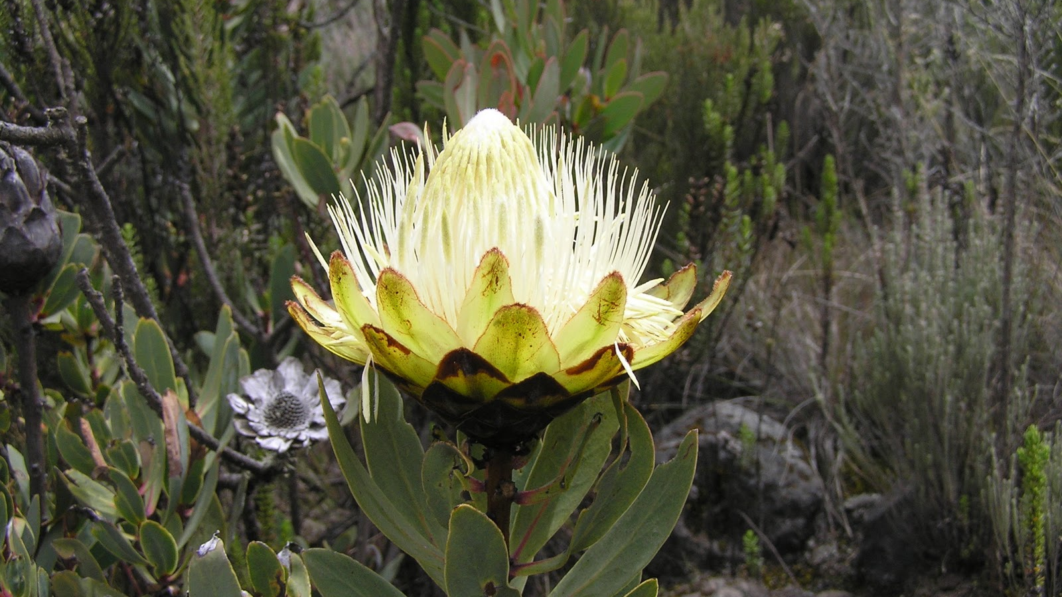
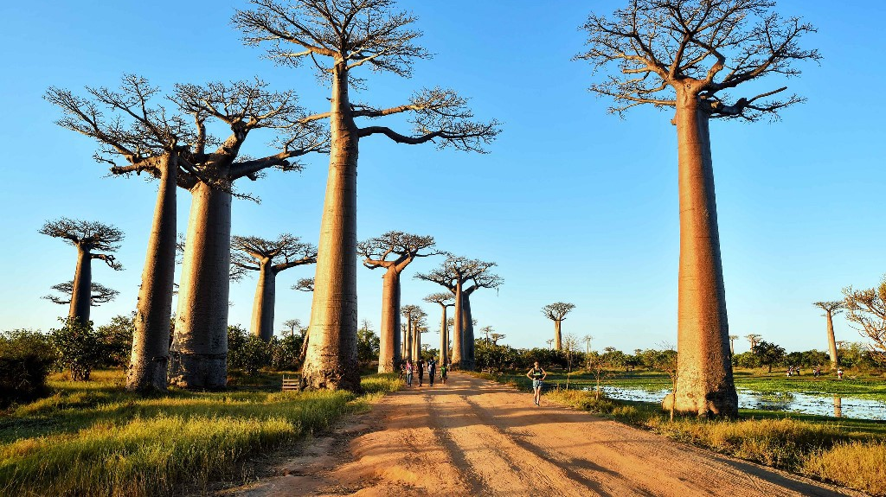
flora
the plant life of a particular region

Slide 2
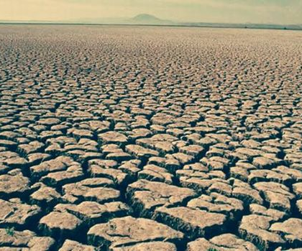
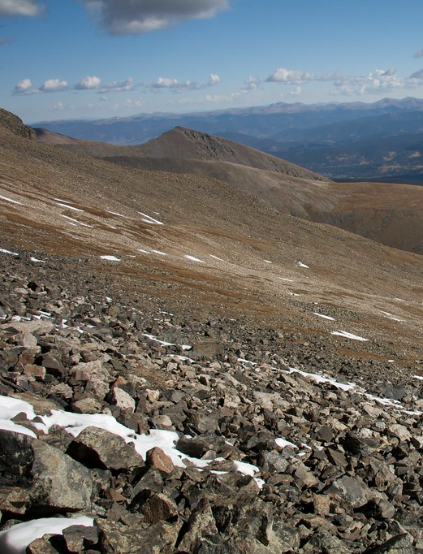
barren
not able to produce anything

Slide 3
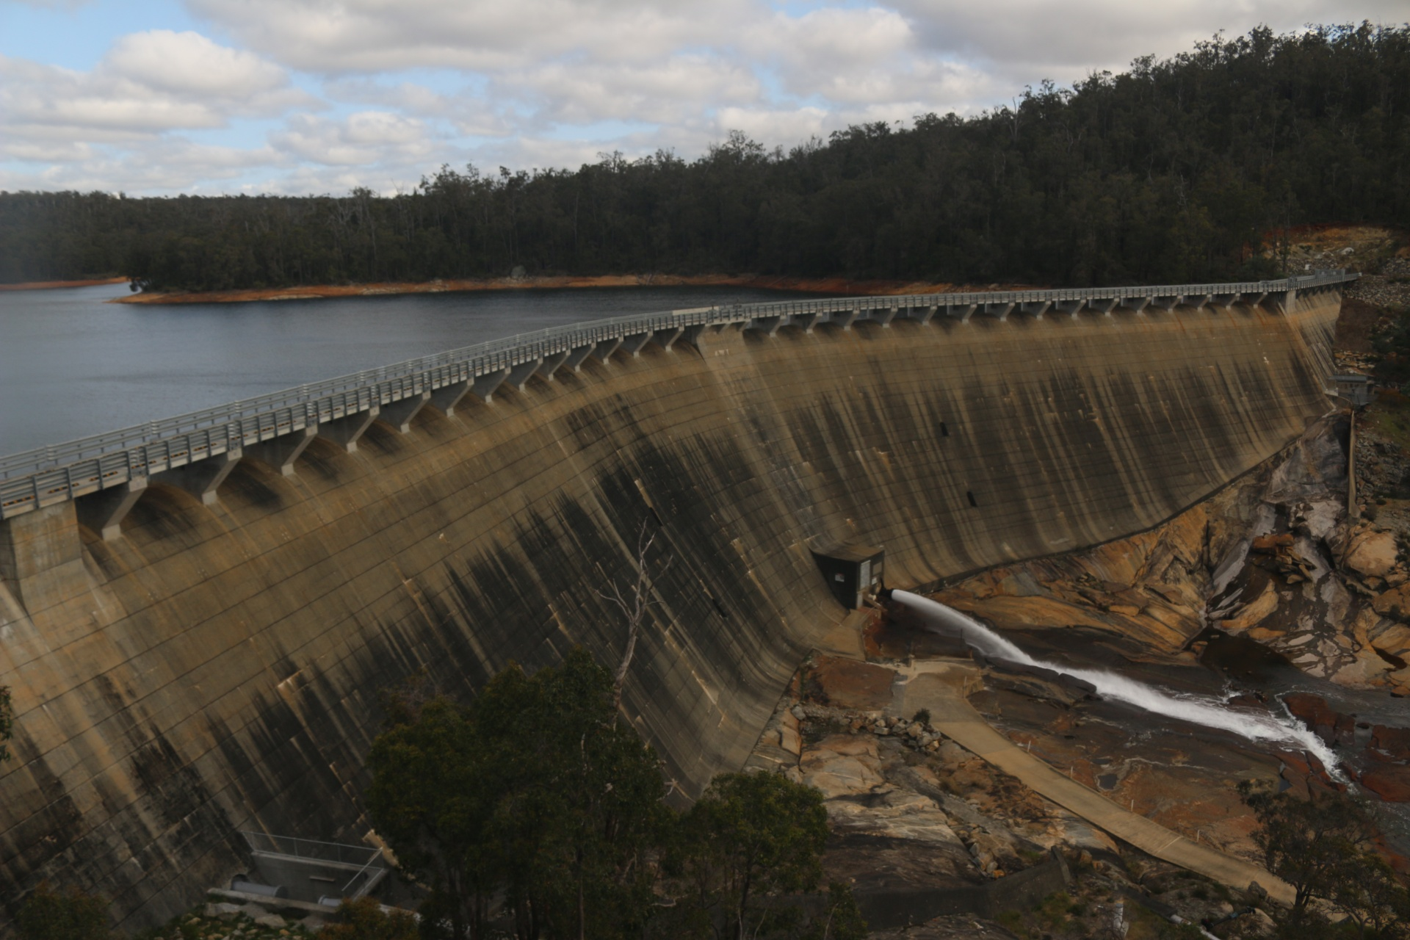
obstructed
to be in the way of

Slide 4
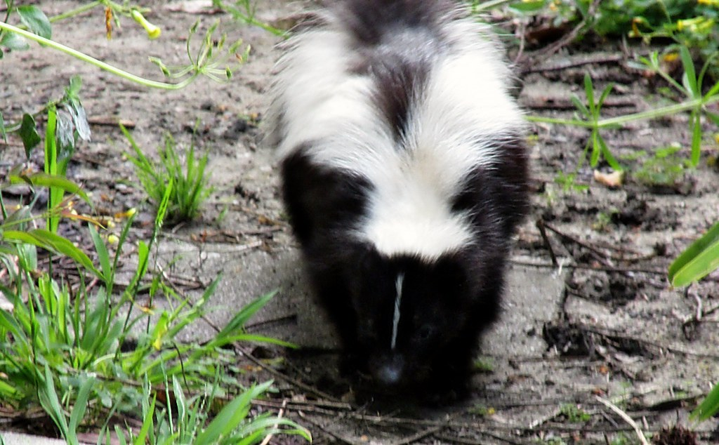
ramble
to wander about, roam
This Photo by Unknown Author is licensed under CC BY-NC-ND

Slide 5
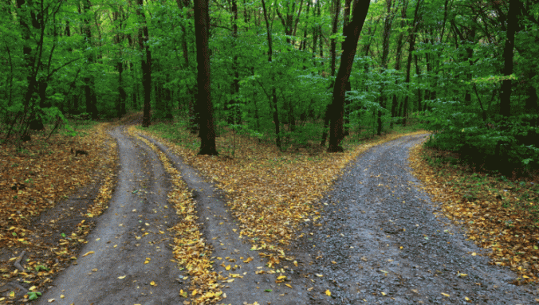
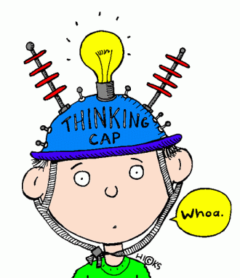
discern
to decide something after looking at and studying things
This Photo by Unknown Author is licensed under CC BY
This Photo by Unknown Author is licensed under CC BY

Slide 6
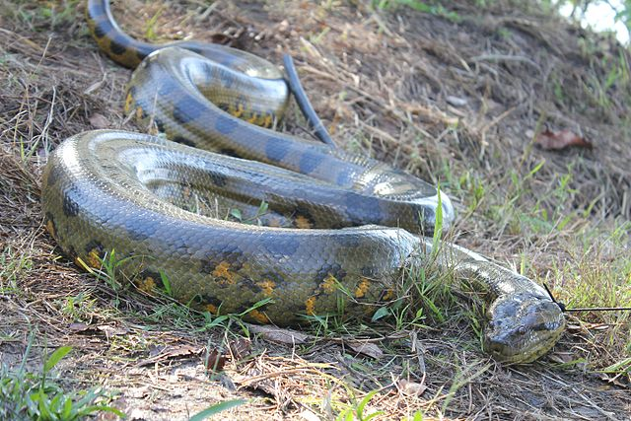
slither
to glide like a snake

Slide 7
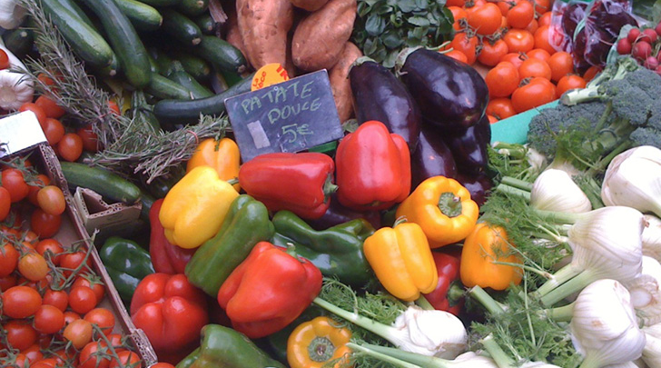
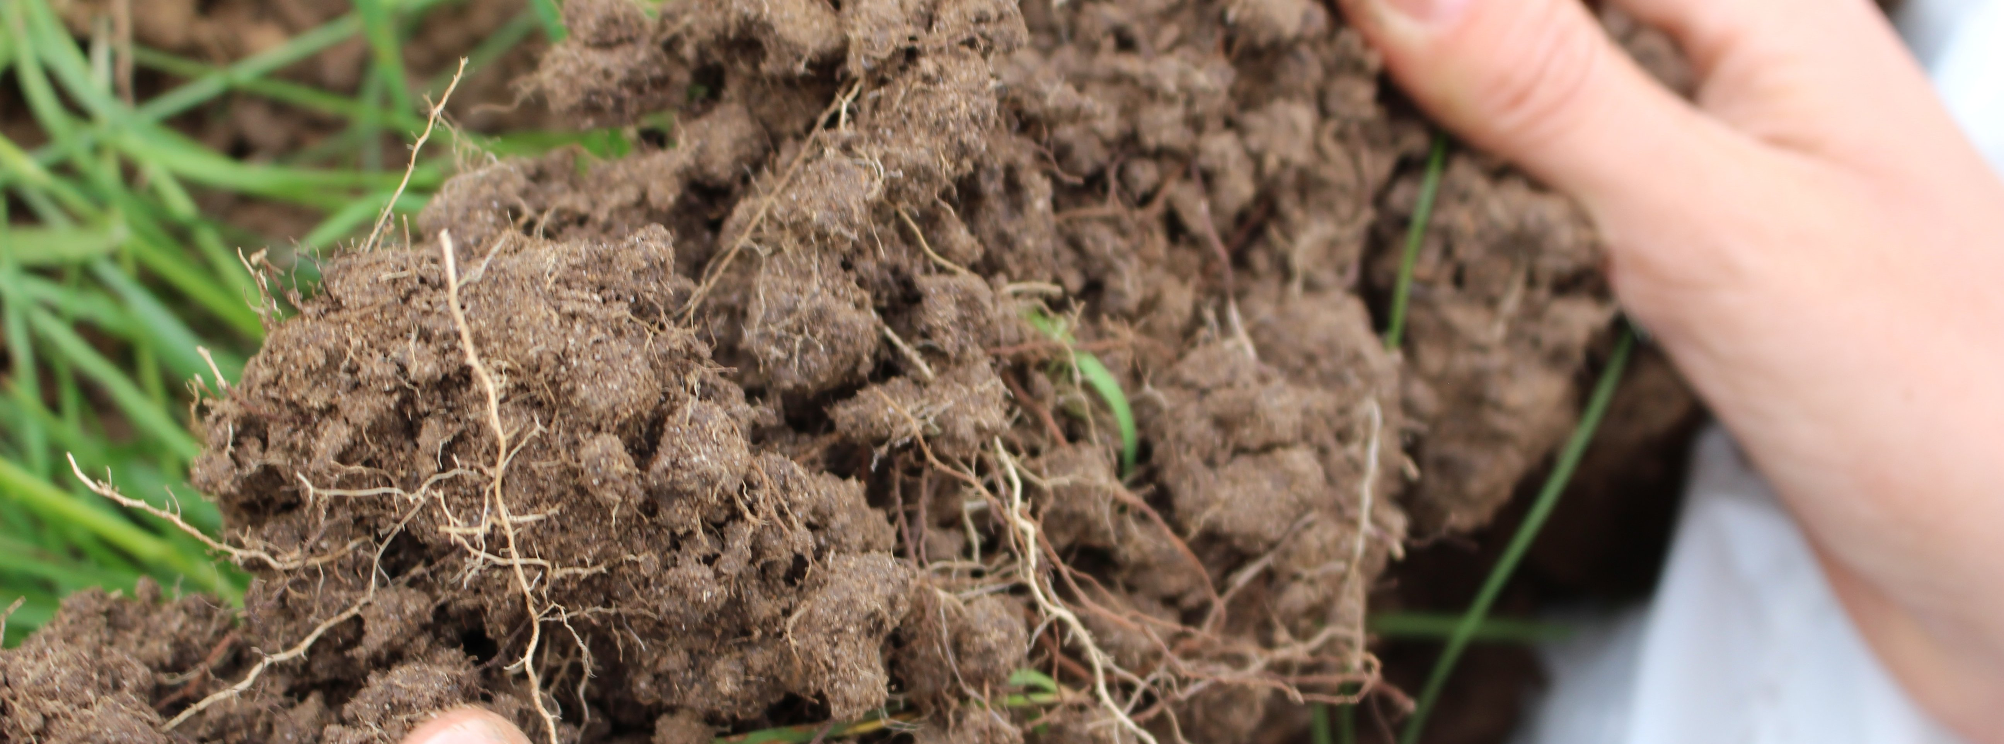
organic
related to living matter

Slide 8
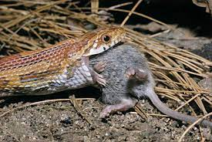
consumed
to eat

Slide 9
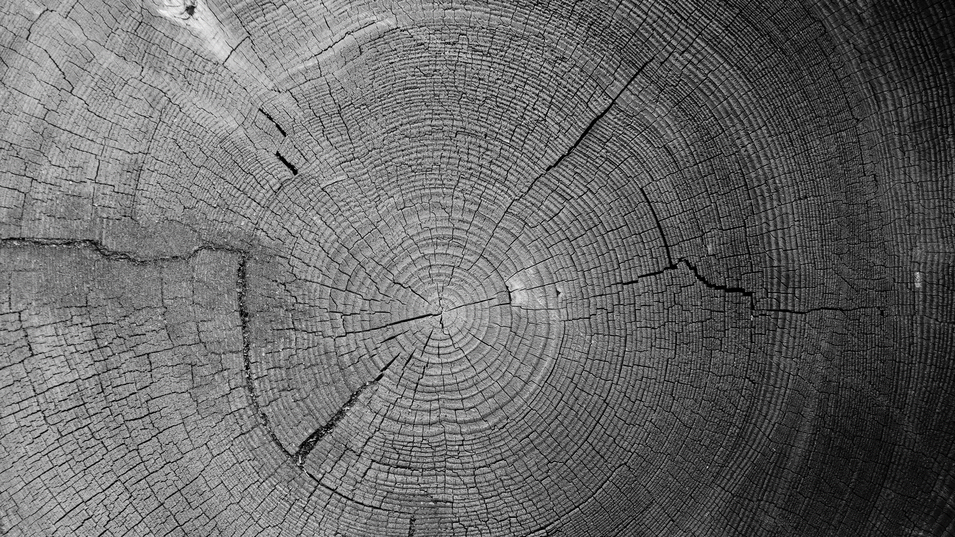
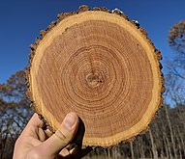
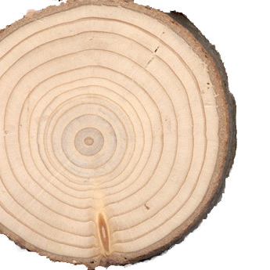
growth rings
A layer in a tree that develops after a regular period of growth, and which is often used to measure the tree’s age.

Slide 10
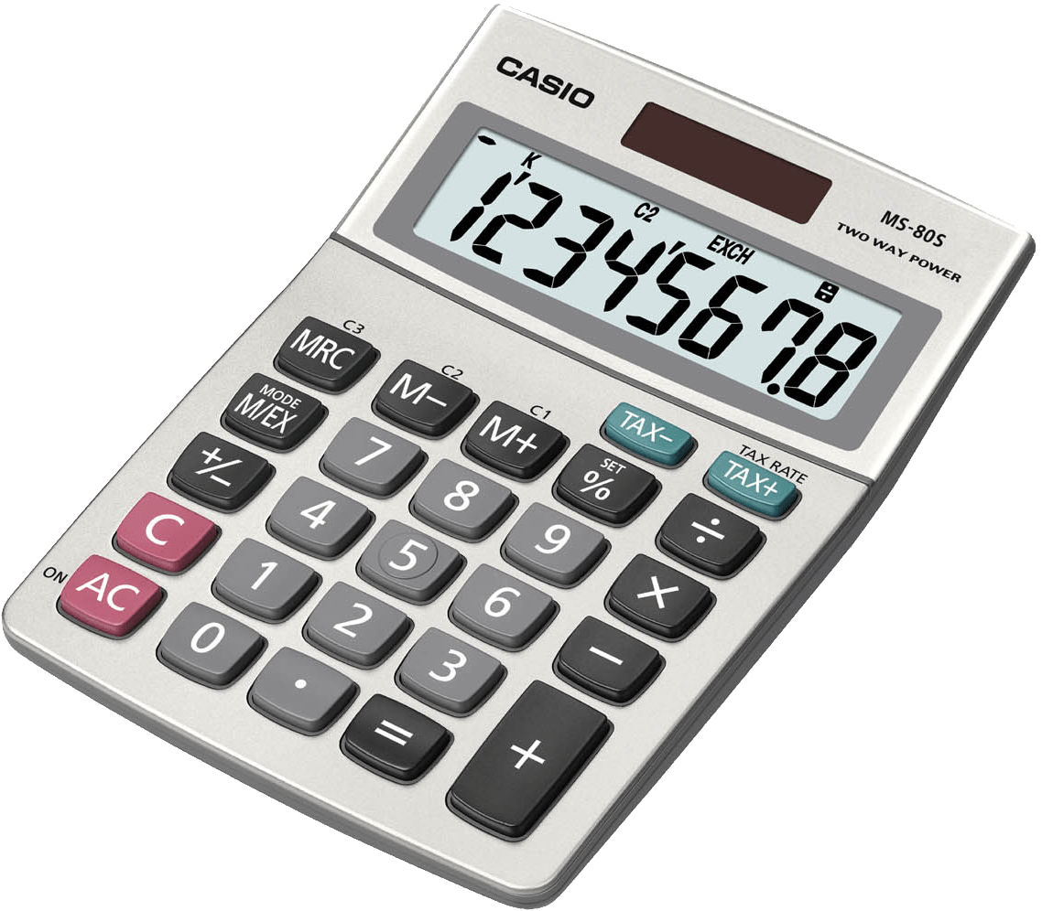
calculated
to find out something using numbers or quantities

Slide 11
assessed
to judge the importance or value of

Slide 12
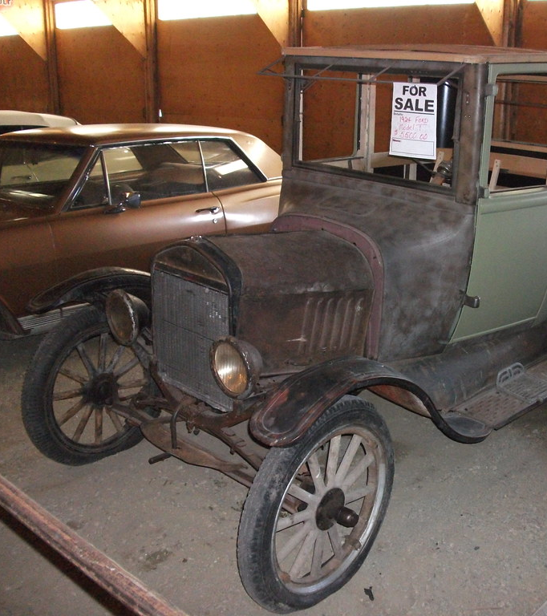
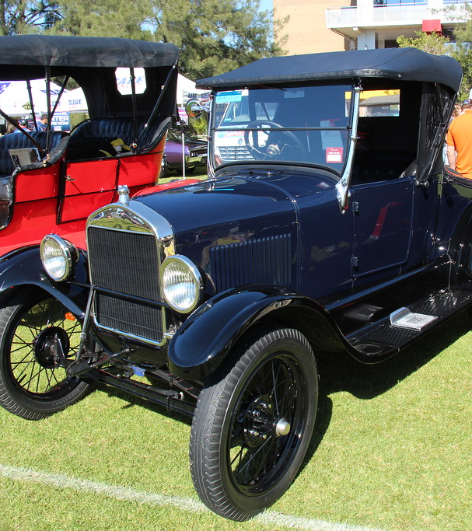
restored
to bring back or re-establish

Slide 13
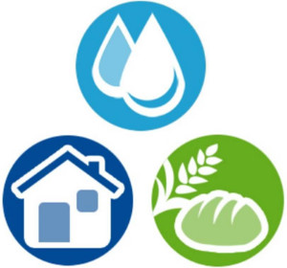
crucial
very important

