Slide 1
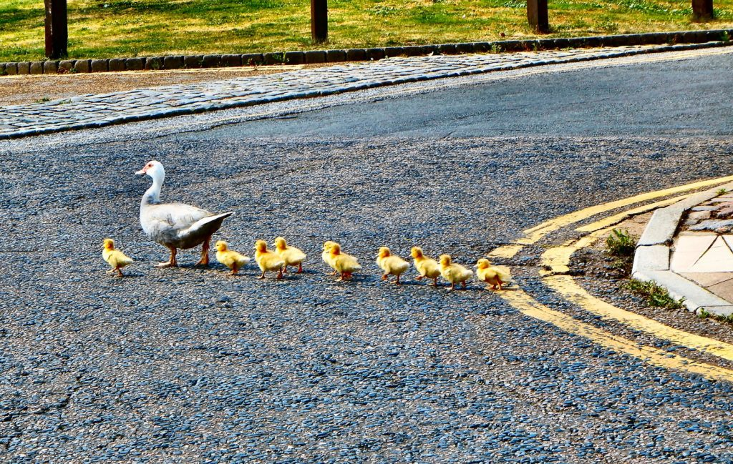
tagging along
This Photo by Unknown Author is licensed under CC BY-SA-NC
to dutifully follow someone from one place to another

Slide 2
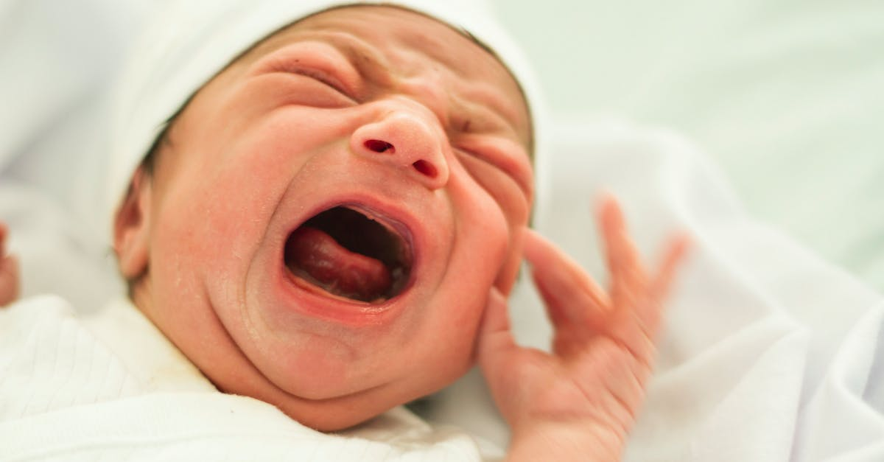
shrieks
to utter a loud, sharp cry or scream

Slide 3
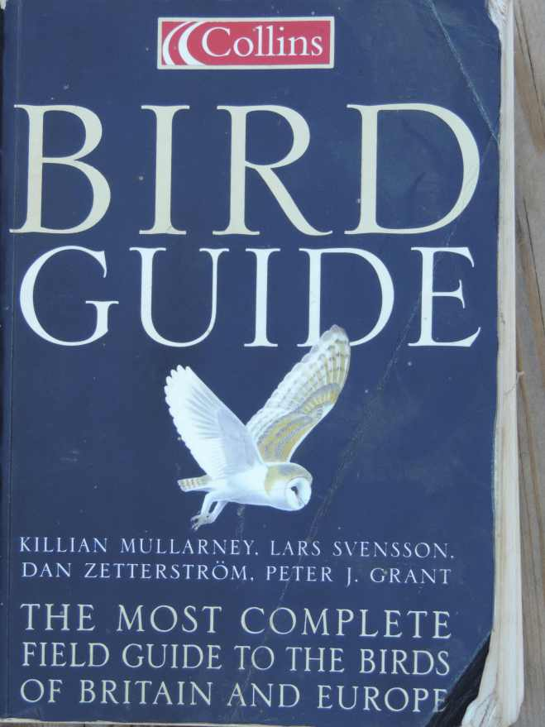
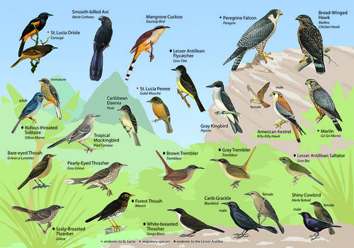
guidebook
a book of information about a place, usually intended to be read by tourists or visitors.

Slide 4
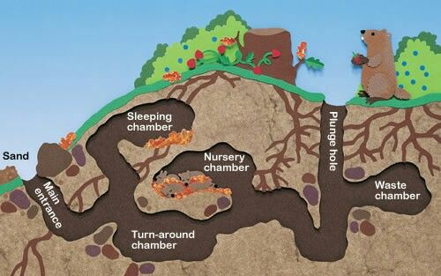
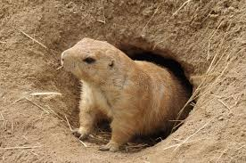
den
a place where animals sleep or rest

Slide 5
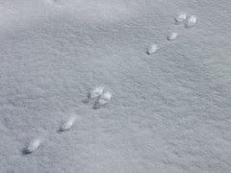
tracking
to follow the markings, path, or course of

Slide 6
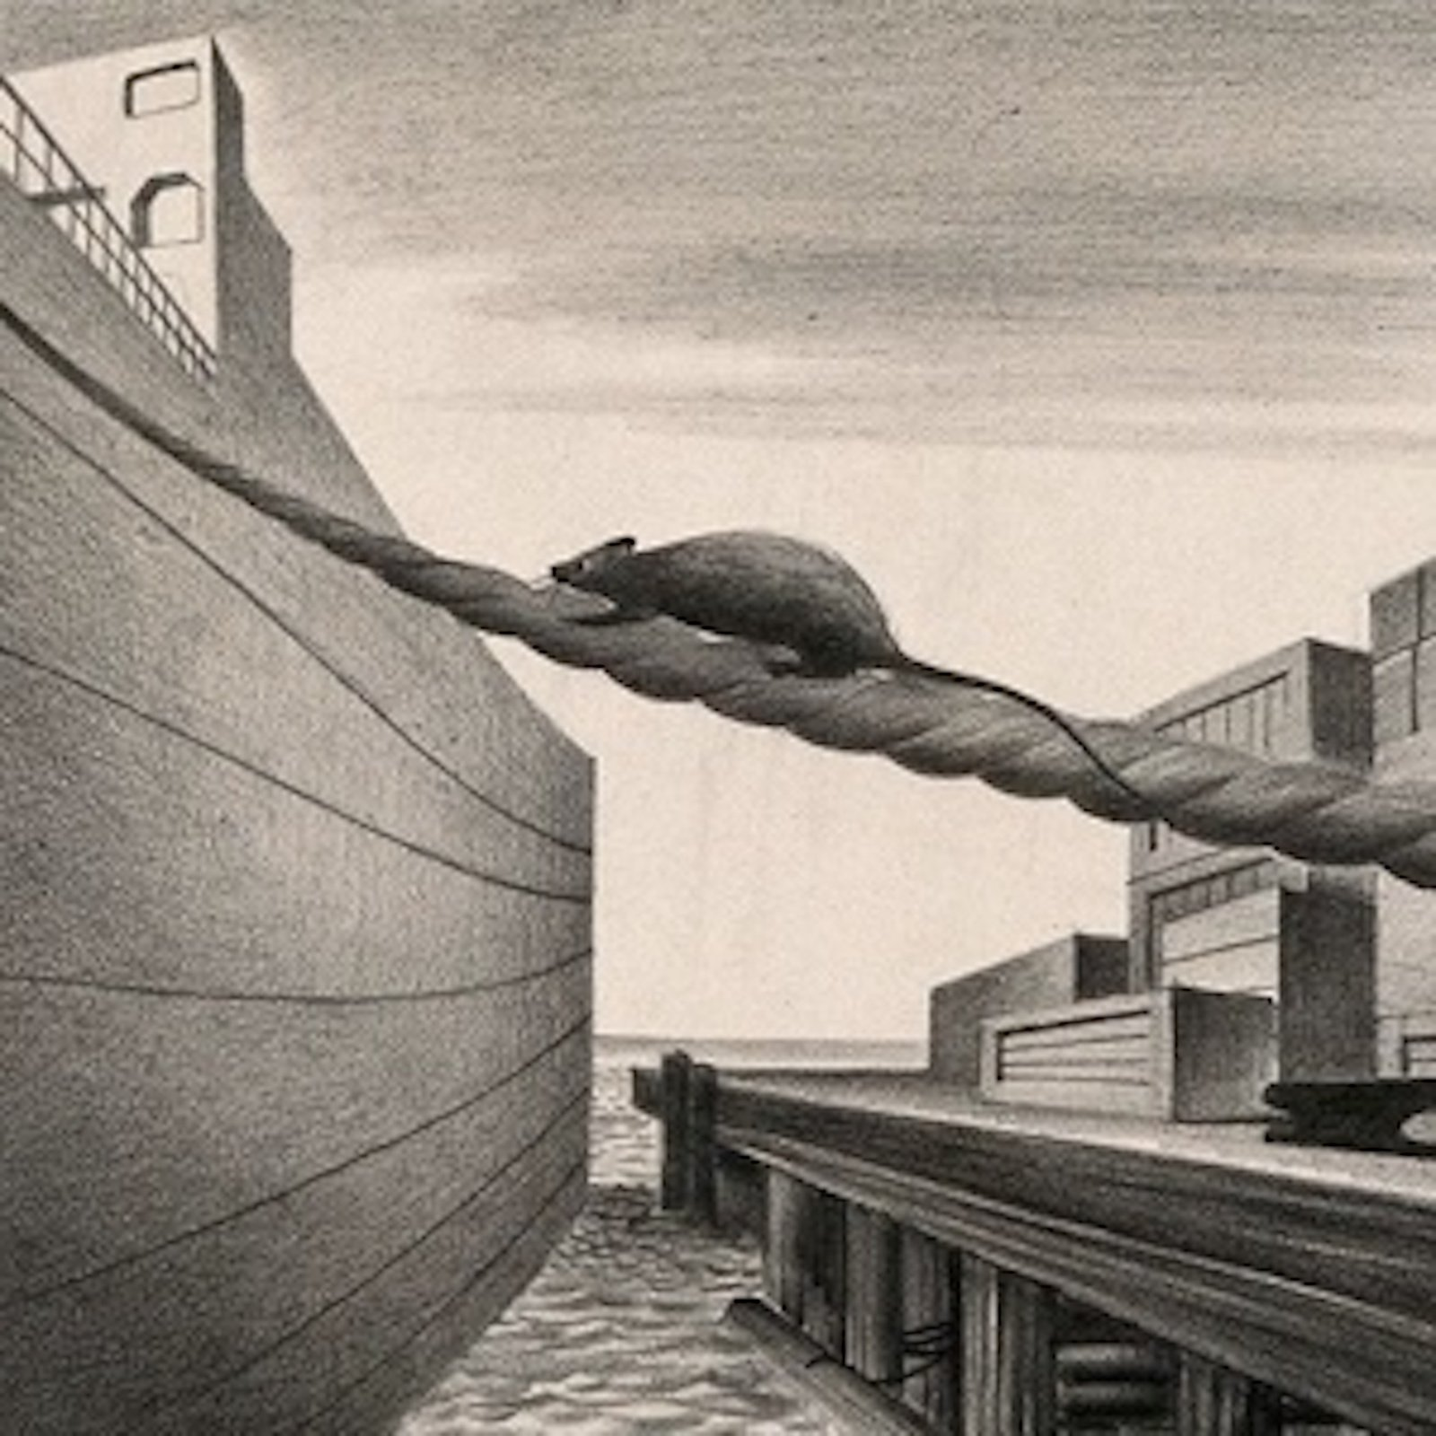
stowaways
someone or something that secretly boards a vehicle and is taken to another place

Slide 7
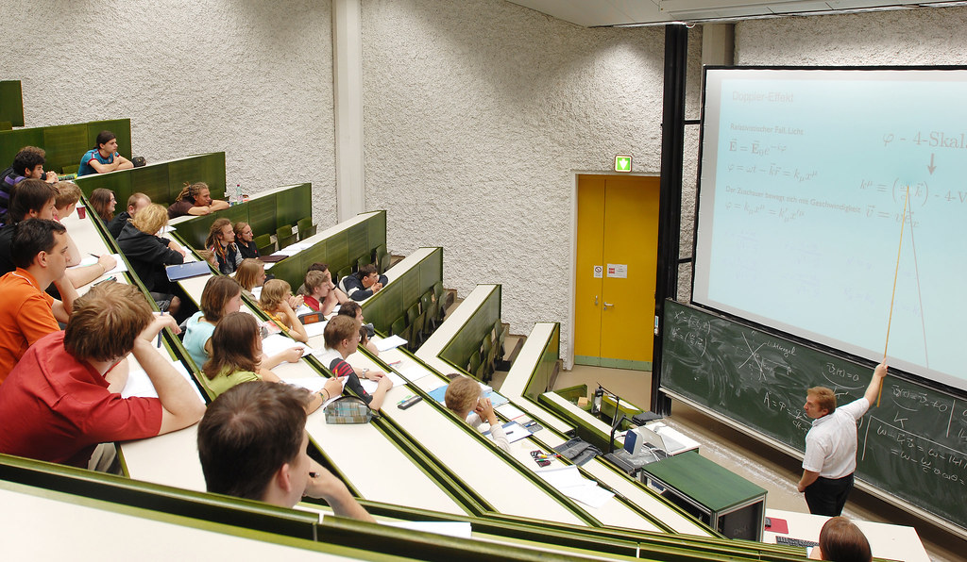
lecture
an informational talk given to an audience

Slide 8
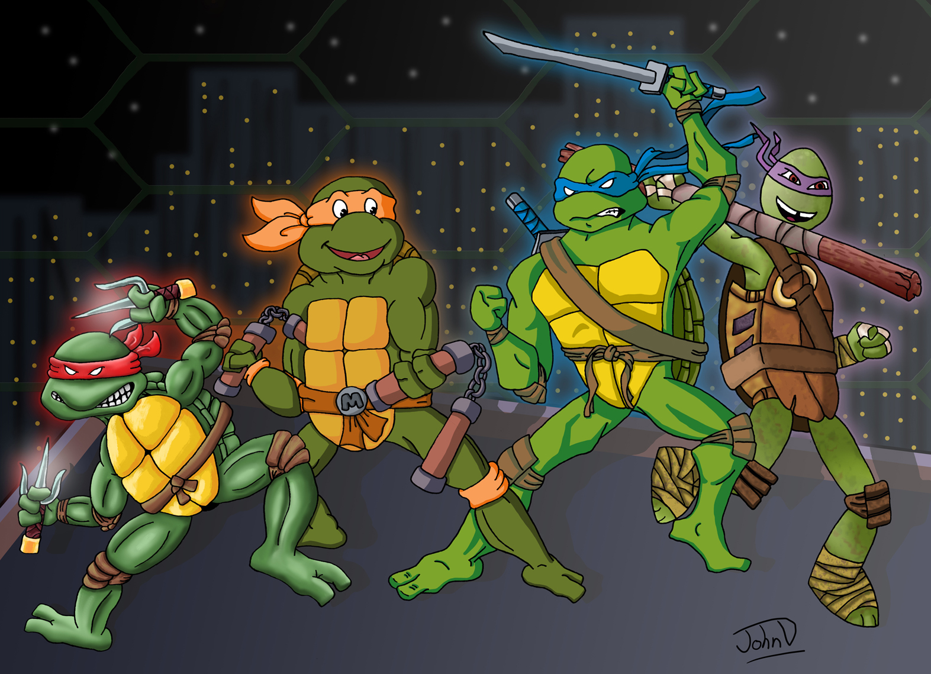
mutant
an organism created from an unexpected change in genetics
This Photo by Unknown Author is licensed under CC BY-NC

Slide 9
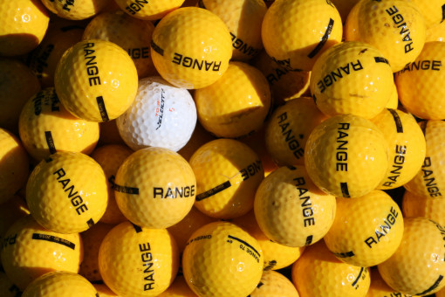
distinctive
easy to recognize as being different

Slide 10
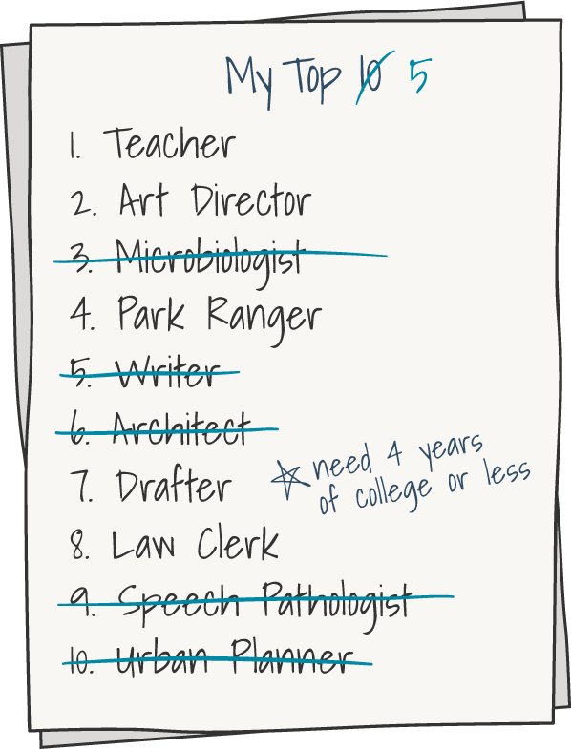
eliminate
to get rid of, remove

Slide 11
candidates
someone or something put forward as a possible option to choose from

Slide 12
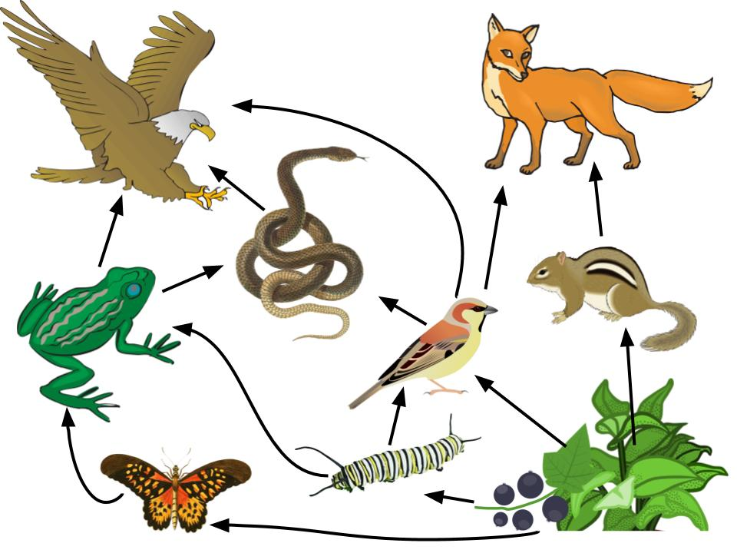
omnivorous
describing an animal or human that eats both meat and plants
This Photo by Unknown Author is licensed under CC BY-SA-NC

Slide 13
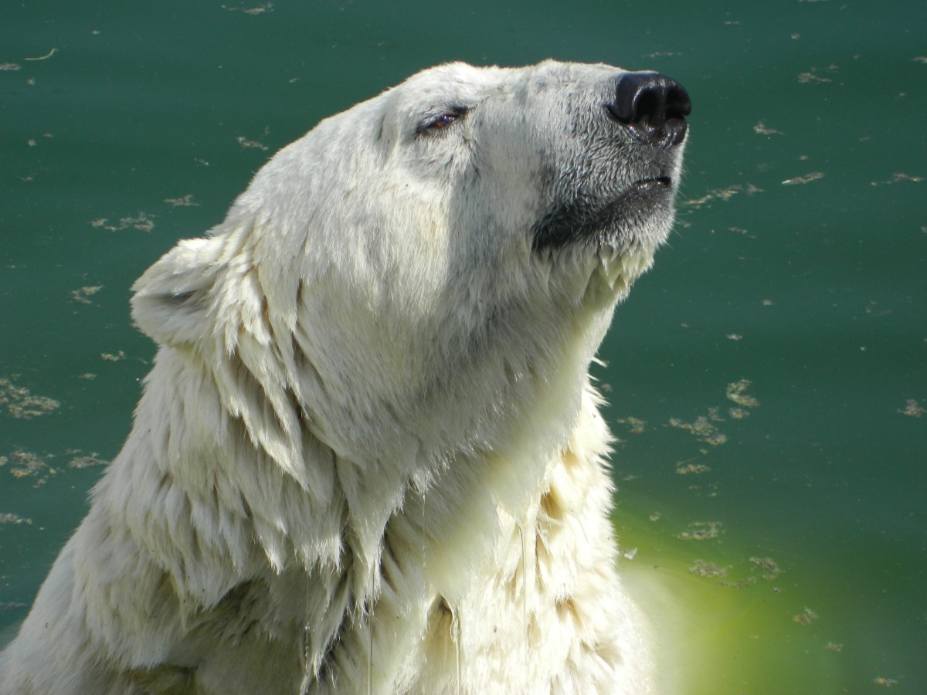
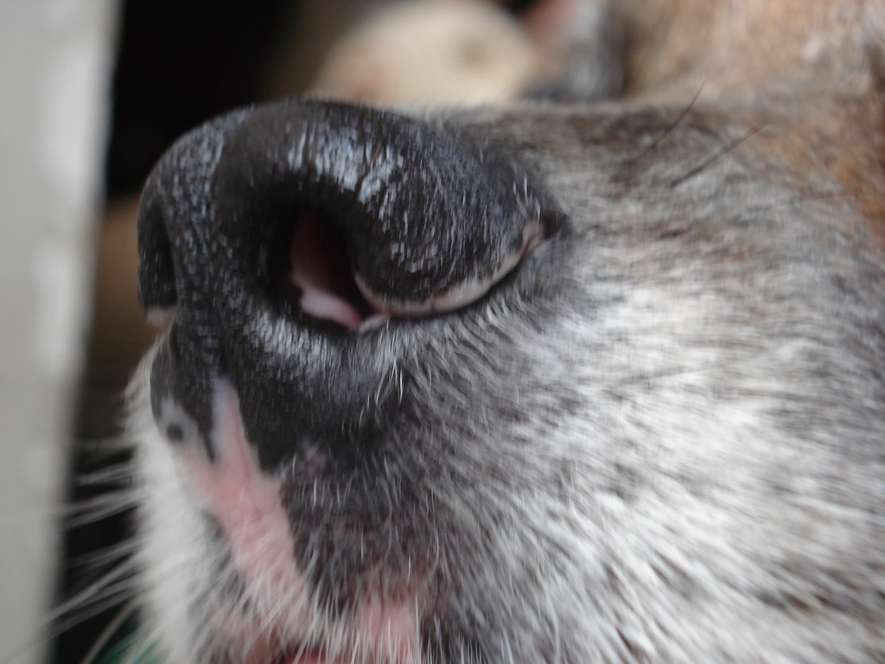
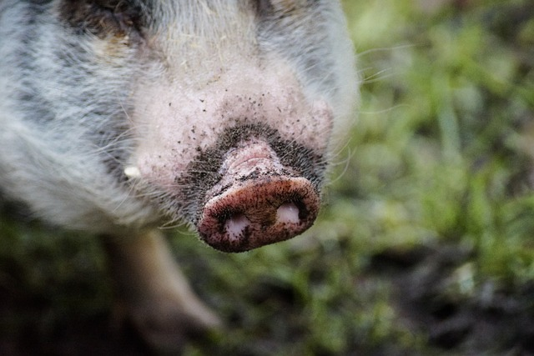
snout
the front part of an animal’s head,
including the nose and mouth
This Photo by Unknown Author is licensed under CC BY-SA

Slide 14
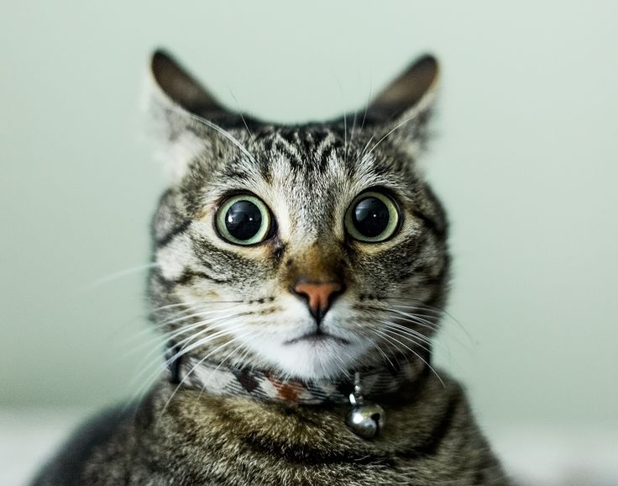
alarmed
feeling a sense of danger; suddenly frightened

