Slide 1
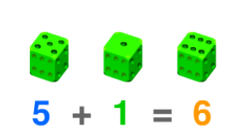
a______
to combine 2 or more numbers or objects

Slide 2
a_______
the number of objects in a group

Slide 3
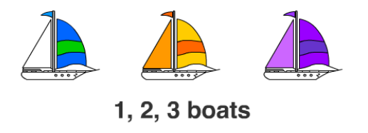
c_____
to say the number names in order

Slide 4
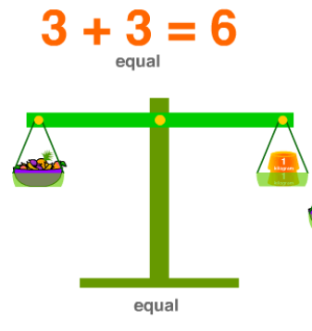
e______
having the same amount or value

Slide 5
e_______
a number sentence that shows the same
value on each side

Slide 6
l_____
a value that is smaller than another

Slide 7
m______
a larger number or amount

Slide 8
l______
the smallest amount or value

