Slide 1
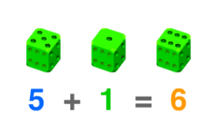
add
to combine 2 or more numbers or objects

Slide 2
amount
the number of objects in a group

Slide 3
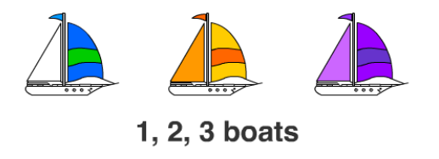
count
to say the number names in order

Slide 4
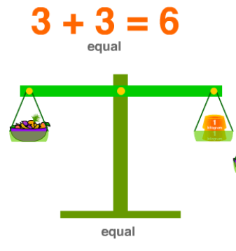
equal
having the same amount or value

Slide 5
equation
a number sentence that shows the same
value on each side

Slide 6
less
a value that is smaller than another

Slide 7
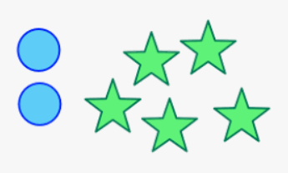
more
a larger number or amount

Slide 8
least
the smallest amount or value

