Slide 1
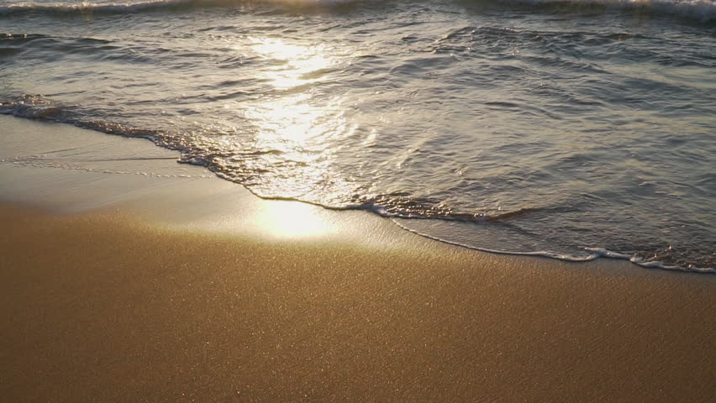
lap
to wash gently against

Slide 2
integral
an important and necessary part of

Slide 3
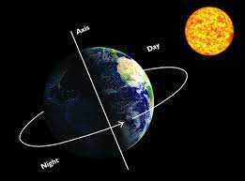
axis
a real or imaginary line through the center of an object around which the object turns

Slide 4
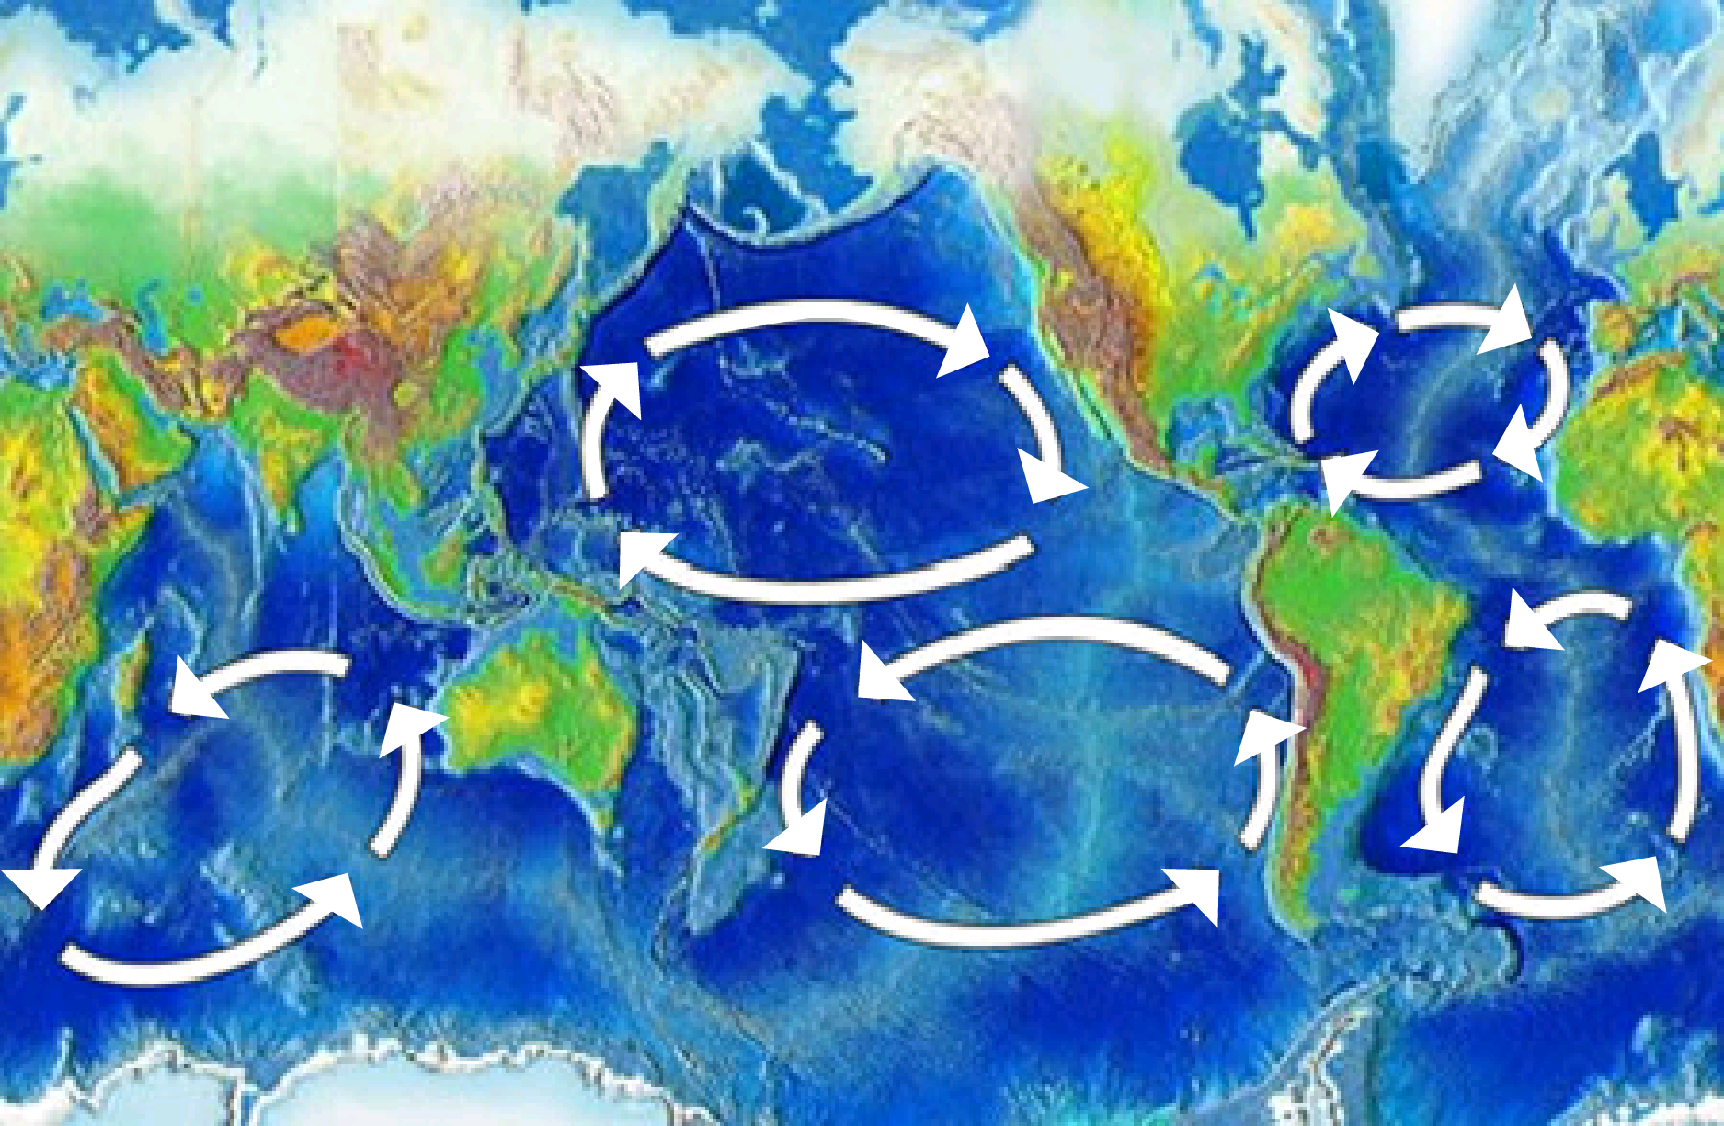
gyre
a moving spiral

Slide 5
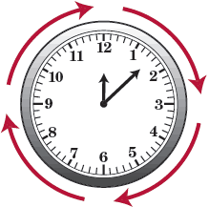
clockwise
a circular motion that moves in the same direction as the hands of a clock

Slide 6
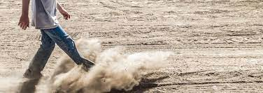
kicks up
to cause a disturbance

Slide 7
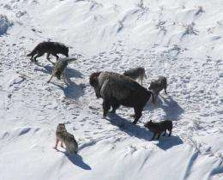
fences
to enclose

Slide 8
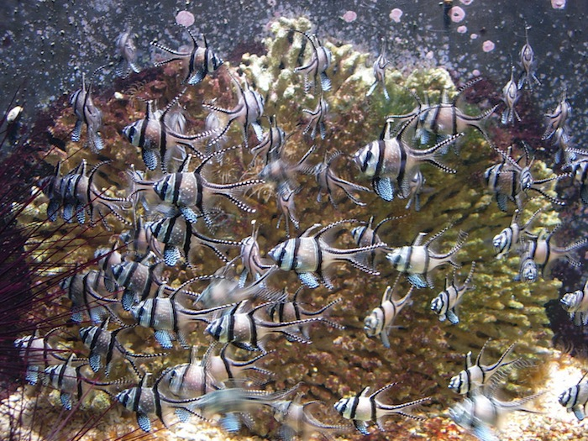
teeming
to be filled with

Slide 9
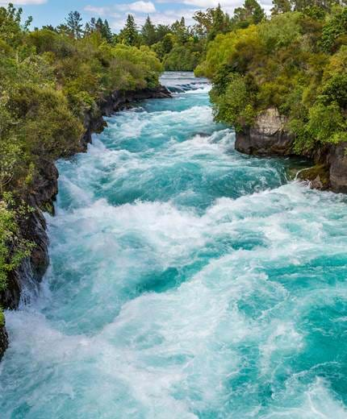
velocity
the speed at which something moves

Slide 10
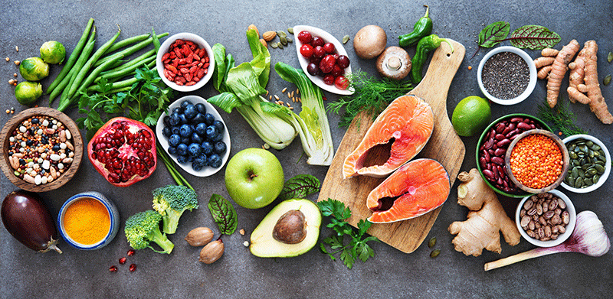
sustain
to support

Slide 11
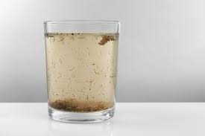
sediment
small pieces of matter that have been carried into place by moving water

Slide 12
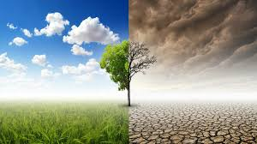
conversely
in opposition to a previous statement

