Slide 1
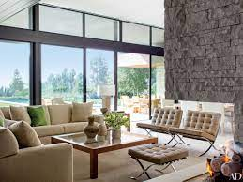
i_________
the inside of a room, vehicle, or building

Slide 2
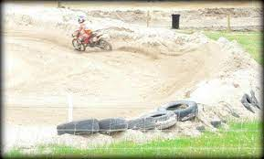
b________
to pile into a heap

Slide 3
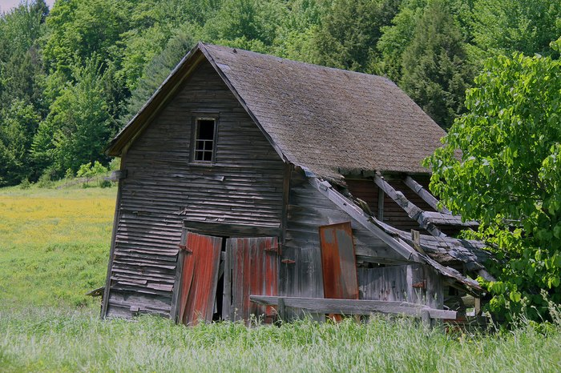
w_________
worn out from being in the weather

Slide 4
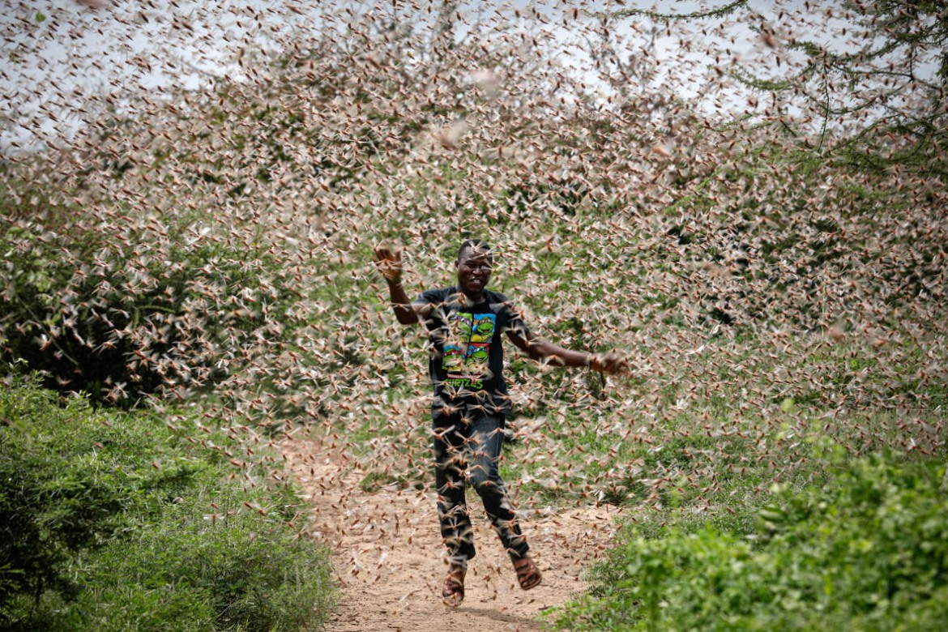
s_________
to surround with great numbers

Slide 5
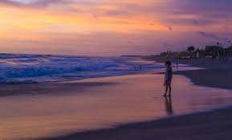
d______
the time of day it begins to get dark

Slide 6
h________
having a control over a difficult situation

Slide 7
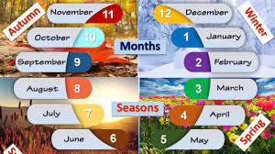
i_________
periods of time

Slide 8
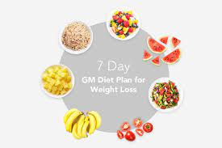
r_________
to adjust or control

Slide 9
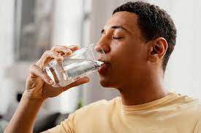
f_________
water that comes from lakes or the ground and is drinkable

Slide 10
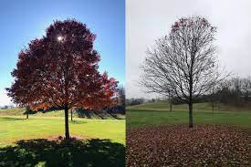
d________
inactive; as if sleeping

Slide 11
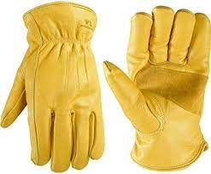
l_________
having a tough bendable surface like leather

Slide 12
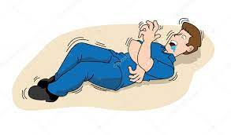
c_________
to shake in an uncontrolled manner

