Slide 1
Black Beauty
Vocabulary

Slide 2
substantial adj. of considerable quality or material

Slide 3
scarcely adv. only just; barely

Slide 4
fresh adj. not tired, alert

Slide 5
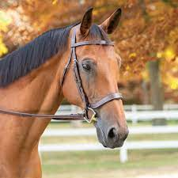
bridle n. a section of the harness that goes over the head and is used to control the animal

Slide 6
chaise n. a light carriage that is pulled by a horse

Slide 7
dreadful adj. very bad, terrible

Slide 8
fancying adj. picturing something in one’s mind; imagining

Slide 9
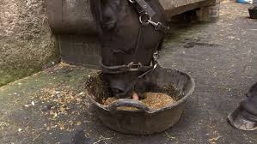
mash n. a soft mixture of grains fed to an animal

